Slide 1
UniBoard2 Production
Sjouke Zwier
Gijs Schoonderbeek
6-5-2015
Notes:
CSP consortium led by NRC Herzberg Institute of Astrophysics in Canada, large consortium
Since last year our (Astron’s) effort has been increased in order to basically push UniBoard^2 technology in CSP.
The work involved to do the same for LFAA decreased.
Just recently held the PDR
“Bureaucracy is the art of making the possible impossible”
Held December last year. External people in panel and internal people.
Panel report not available yet.
Calibration
Not all doc’s where in the same state: 140
Inconsistency between ADD and requirements.
Some L1 req’s were not there and consortium should have made assumptions. But they were not always traceable.
Reliability of cost estimation. There is still some pretty margin in it.
Delta PDR will be held to: include the re-baselining and the proposed changes, amongst one of them is a SKA-LOW beamformer

Slide 2
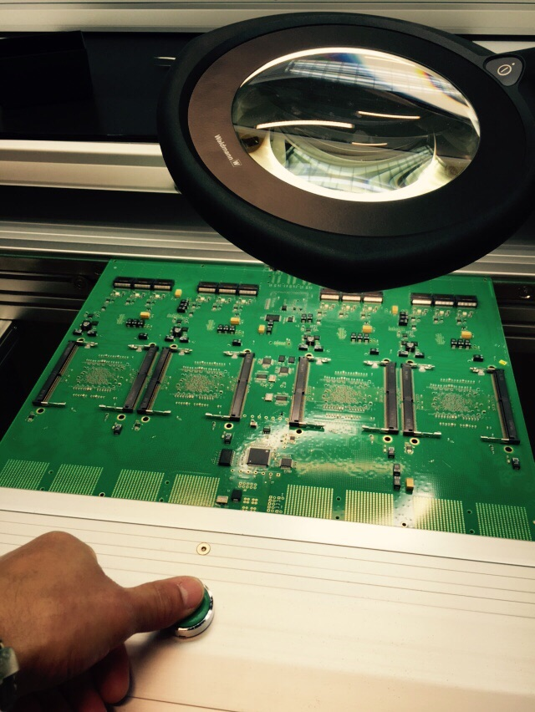
Bottom side in Oven

Slide 3
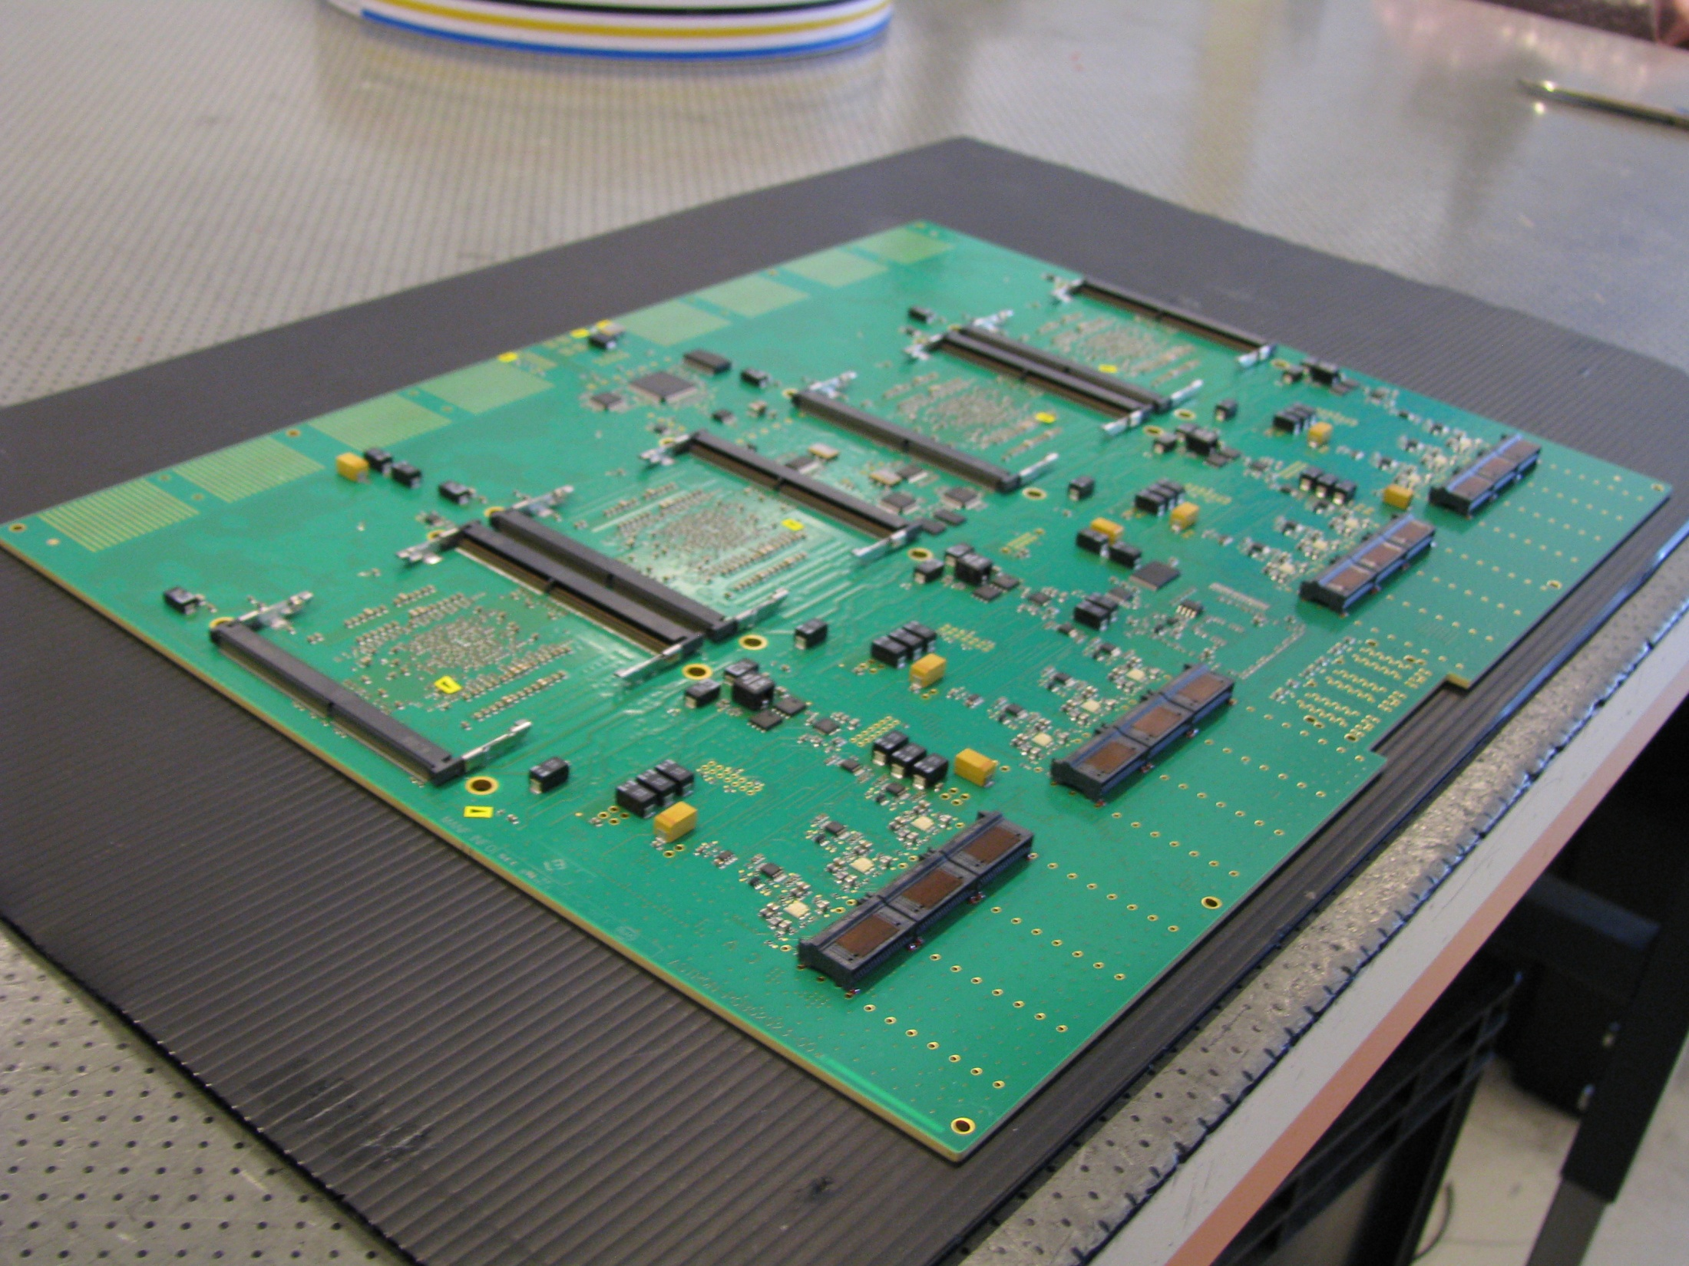

Slide 4
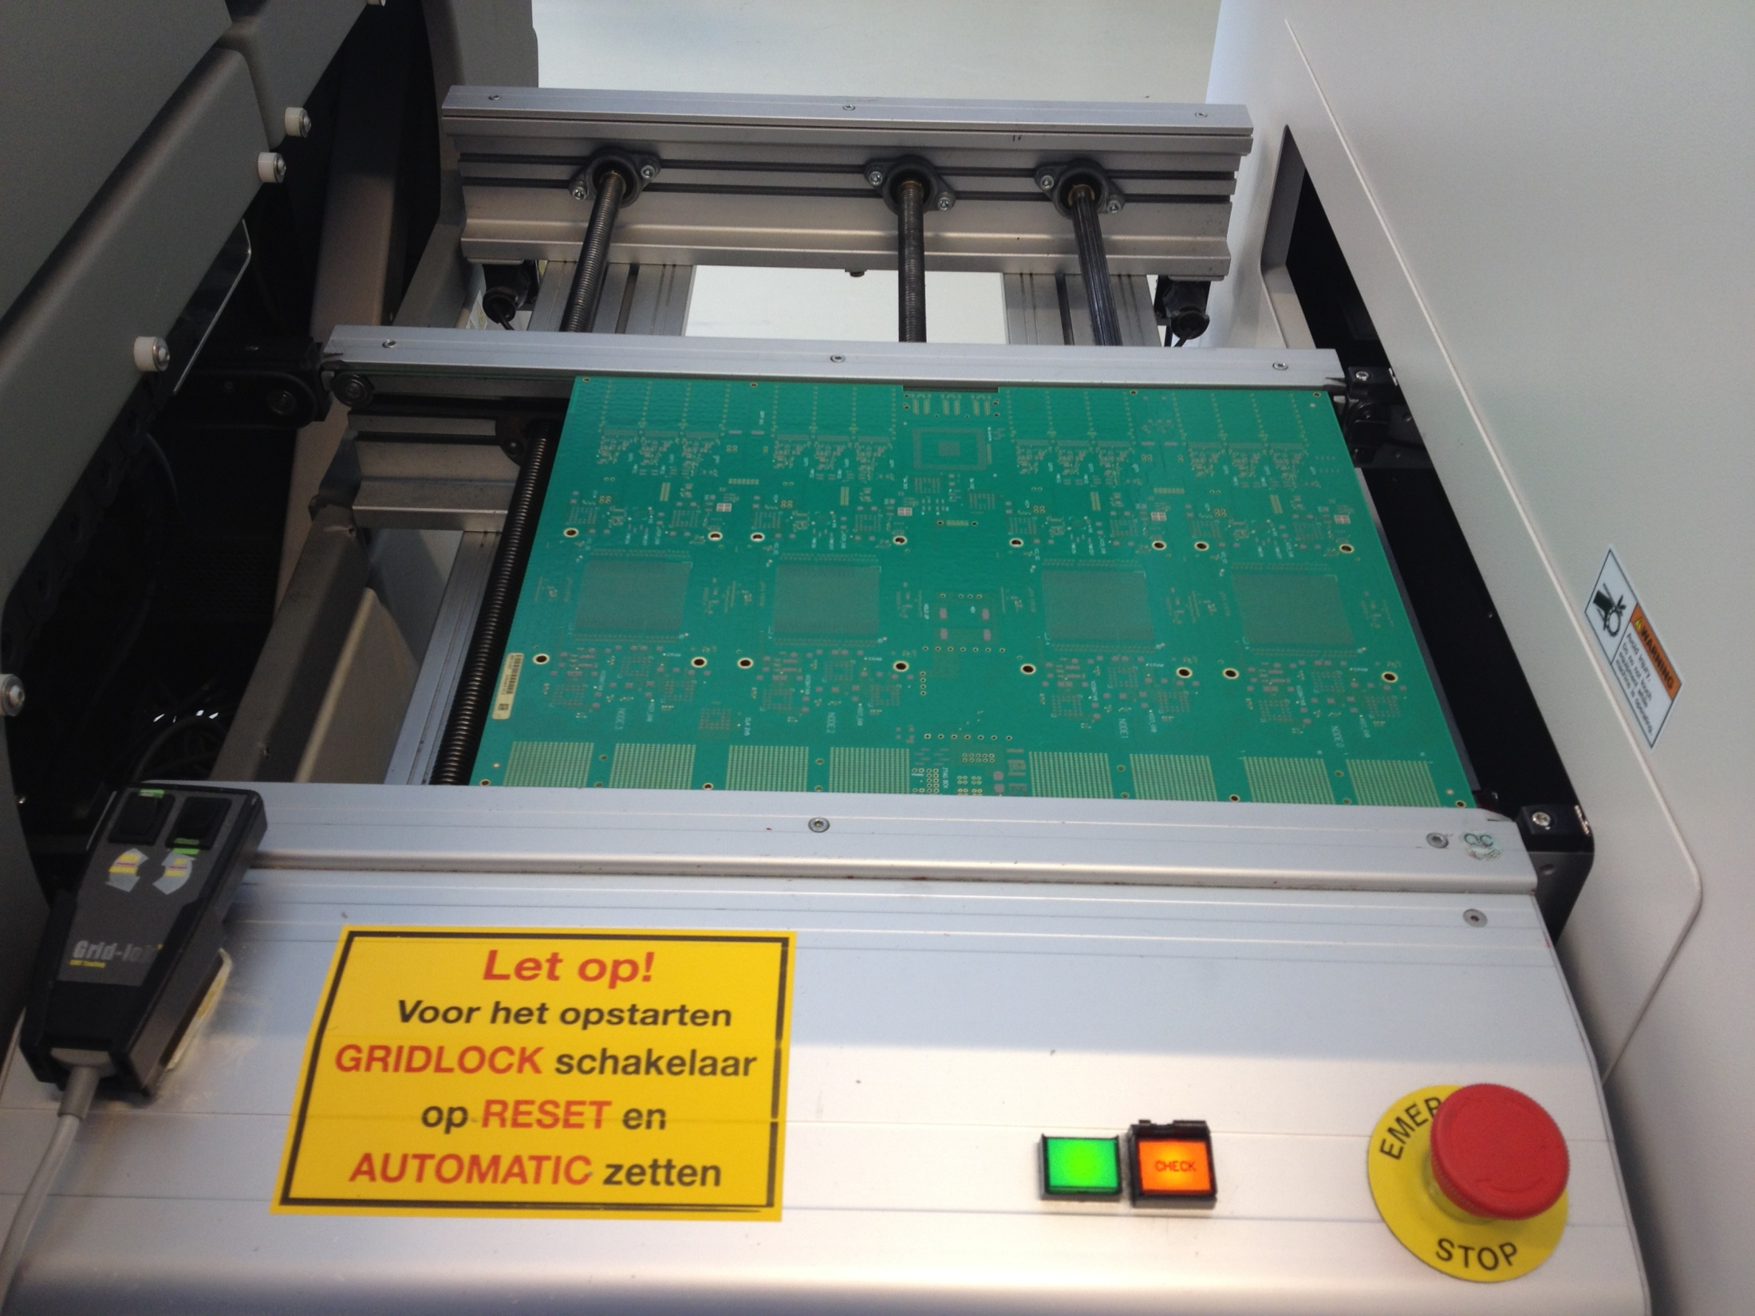

Slide 5
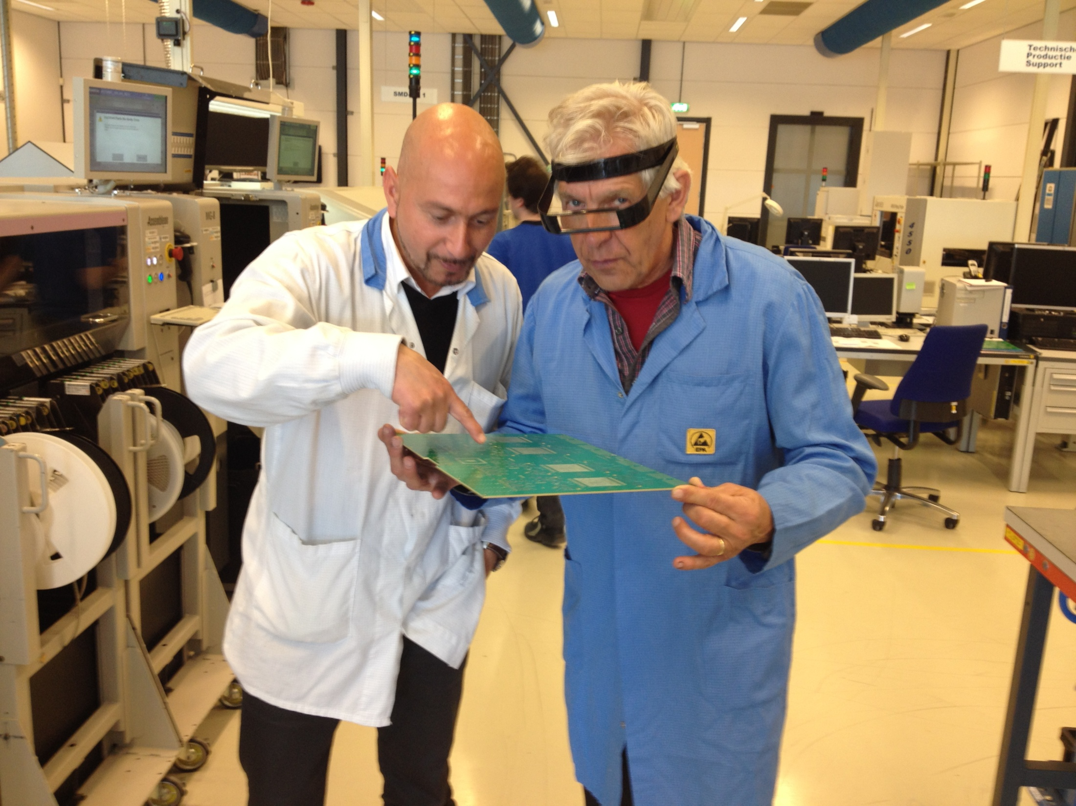

Slide 6
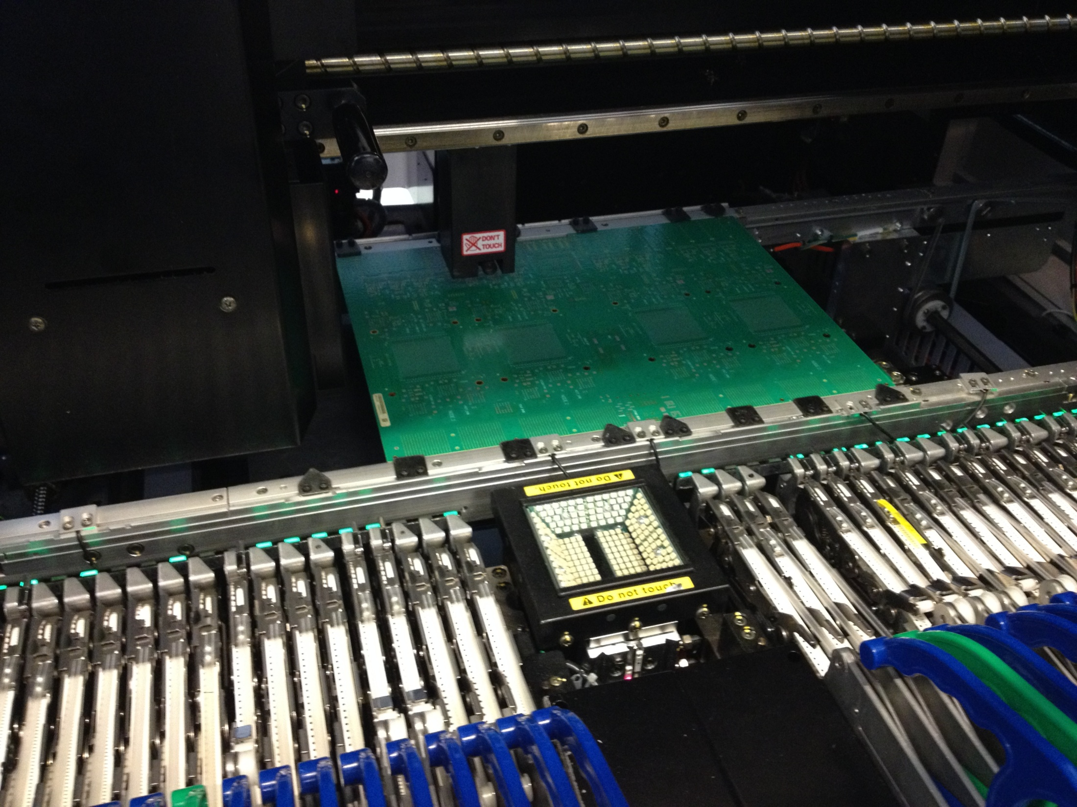

Slide 7
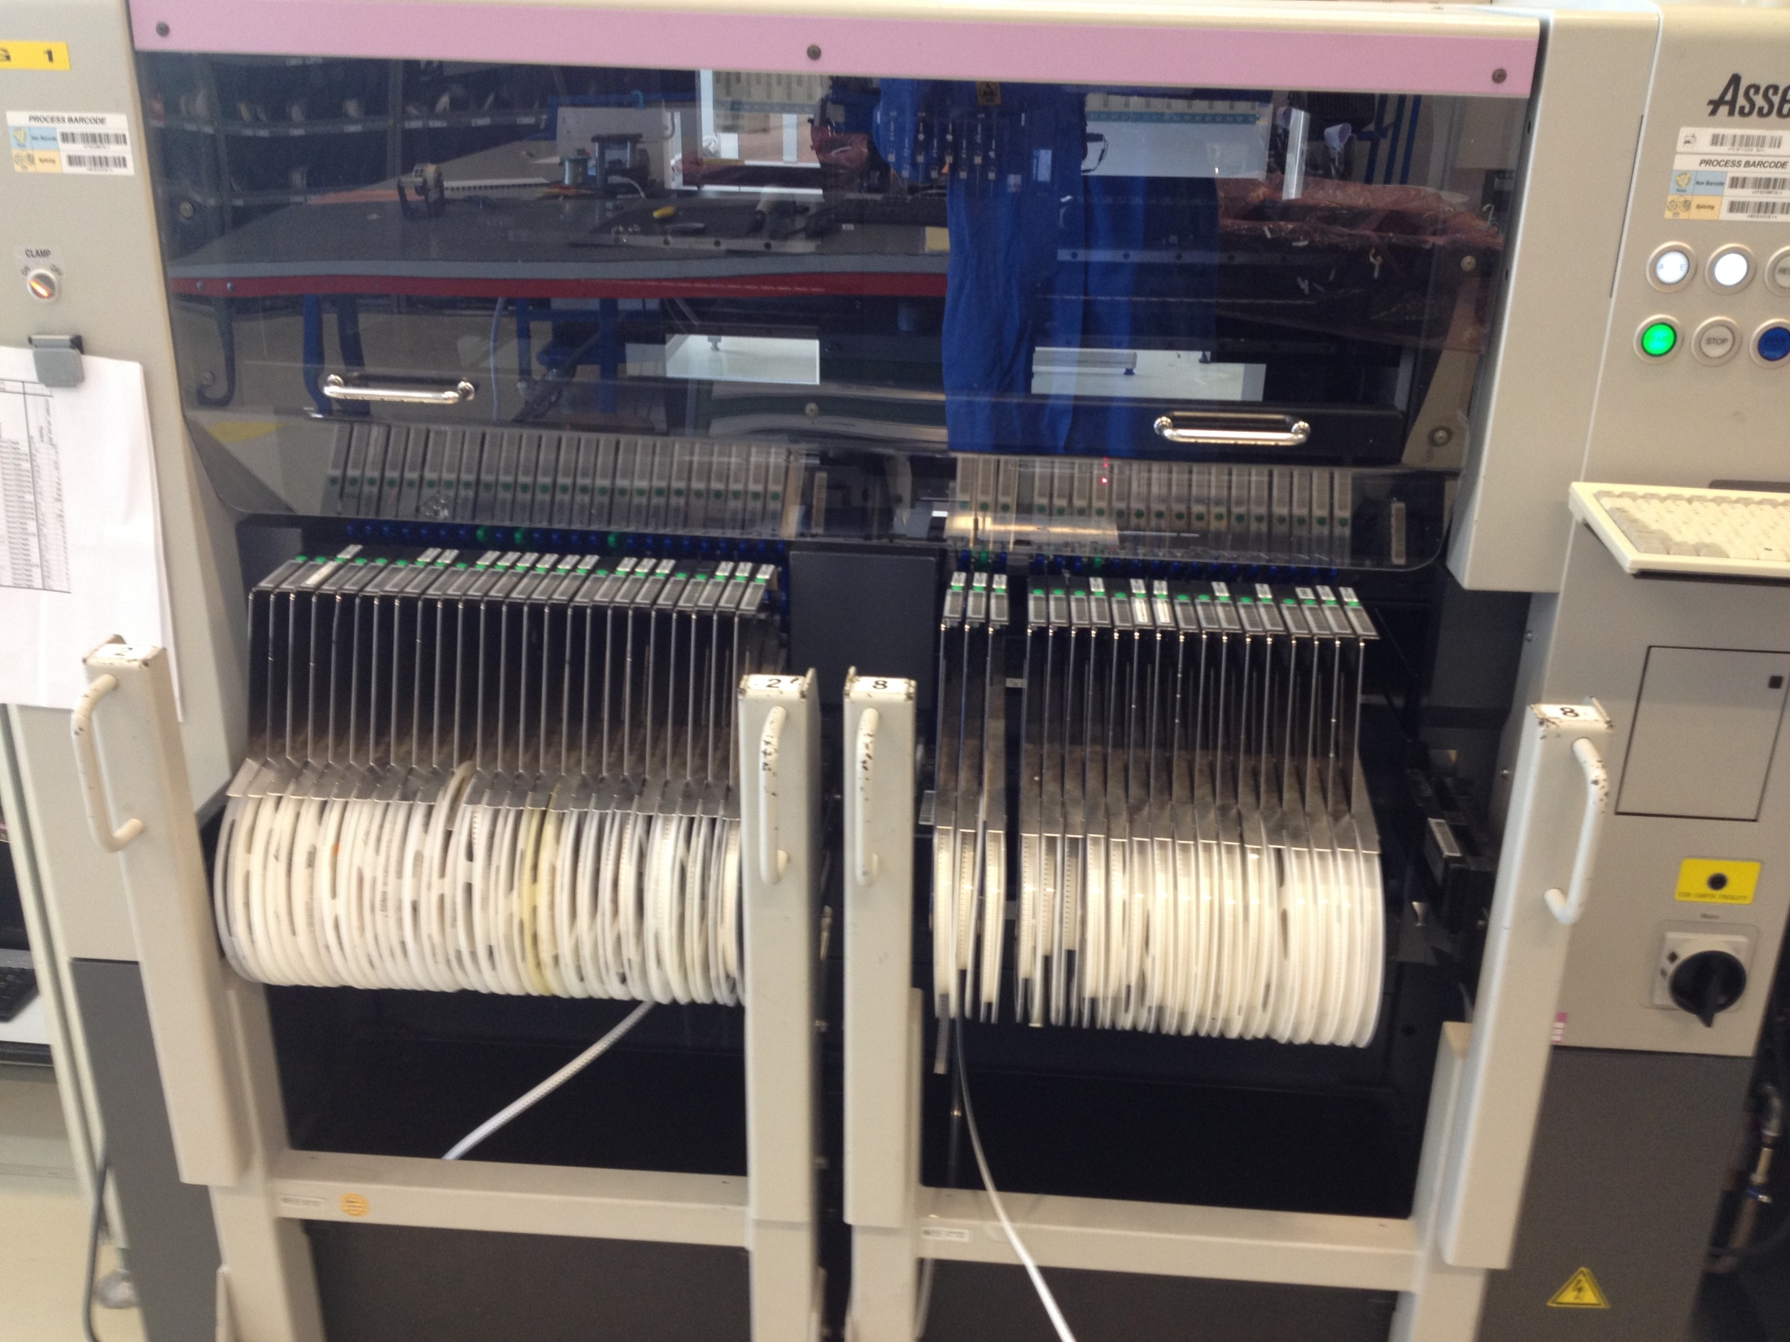

Slide 8
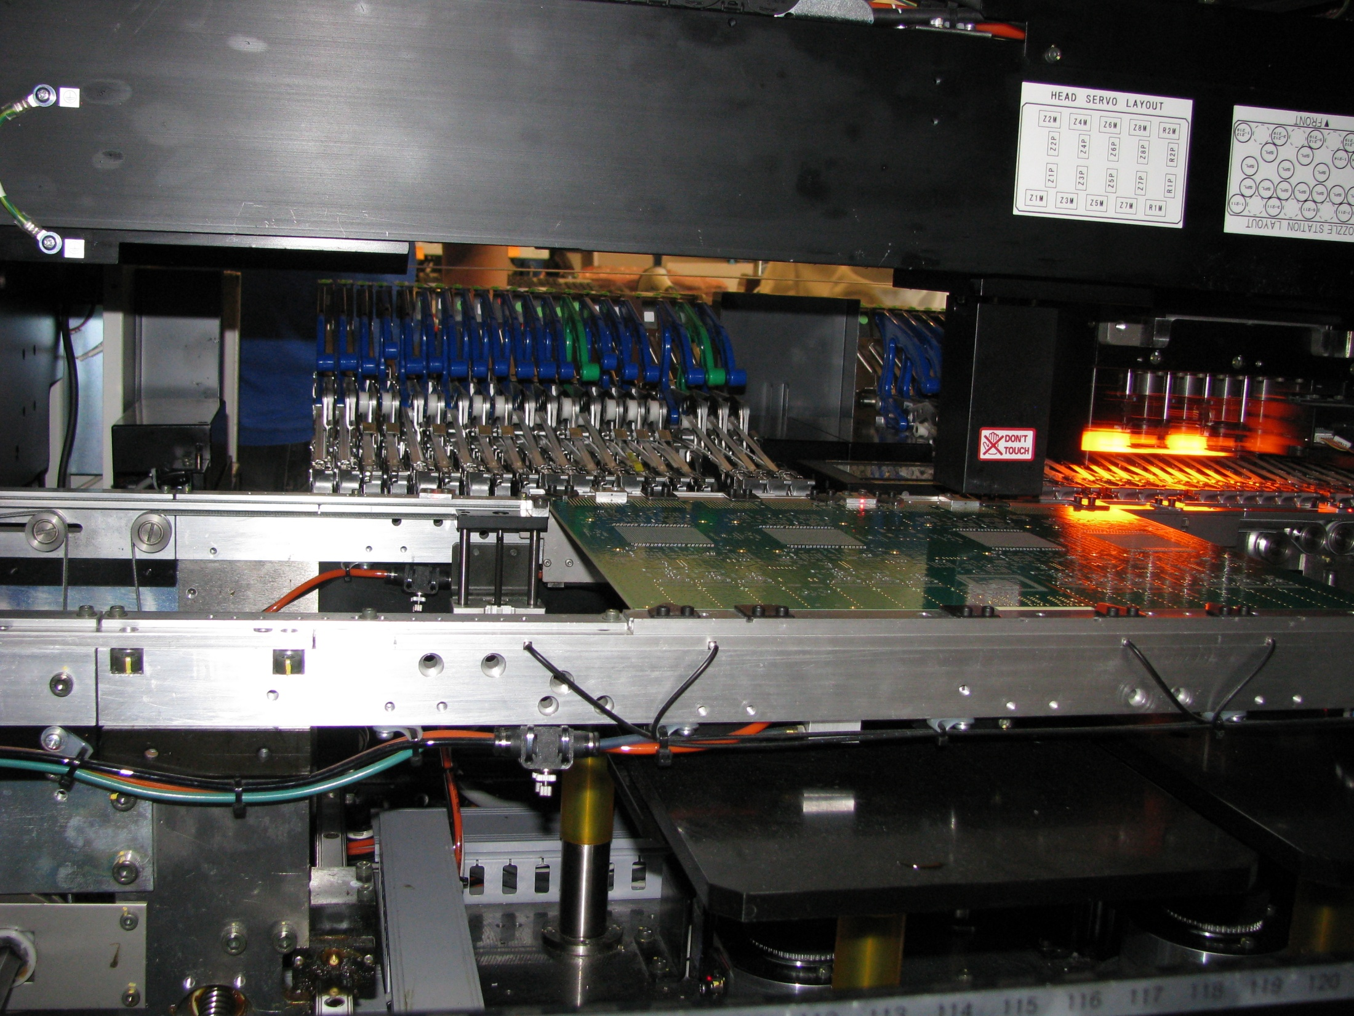

Slide 9
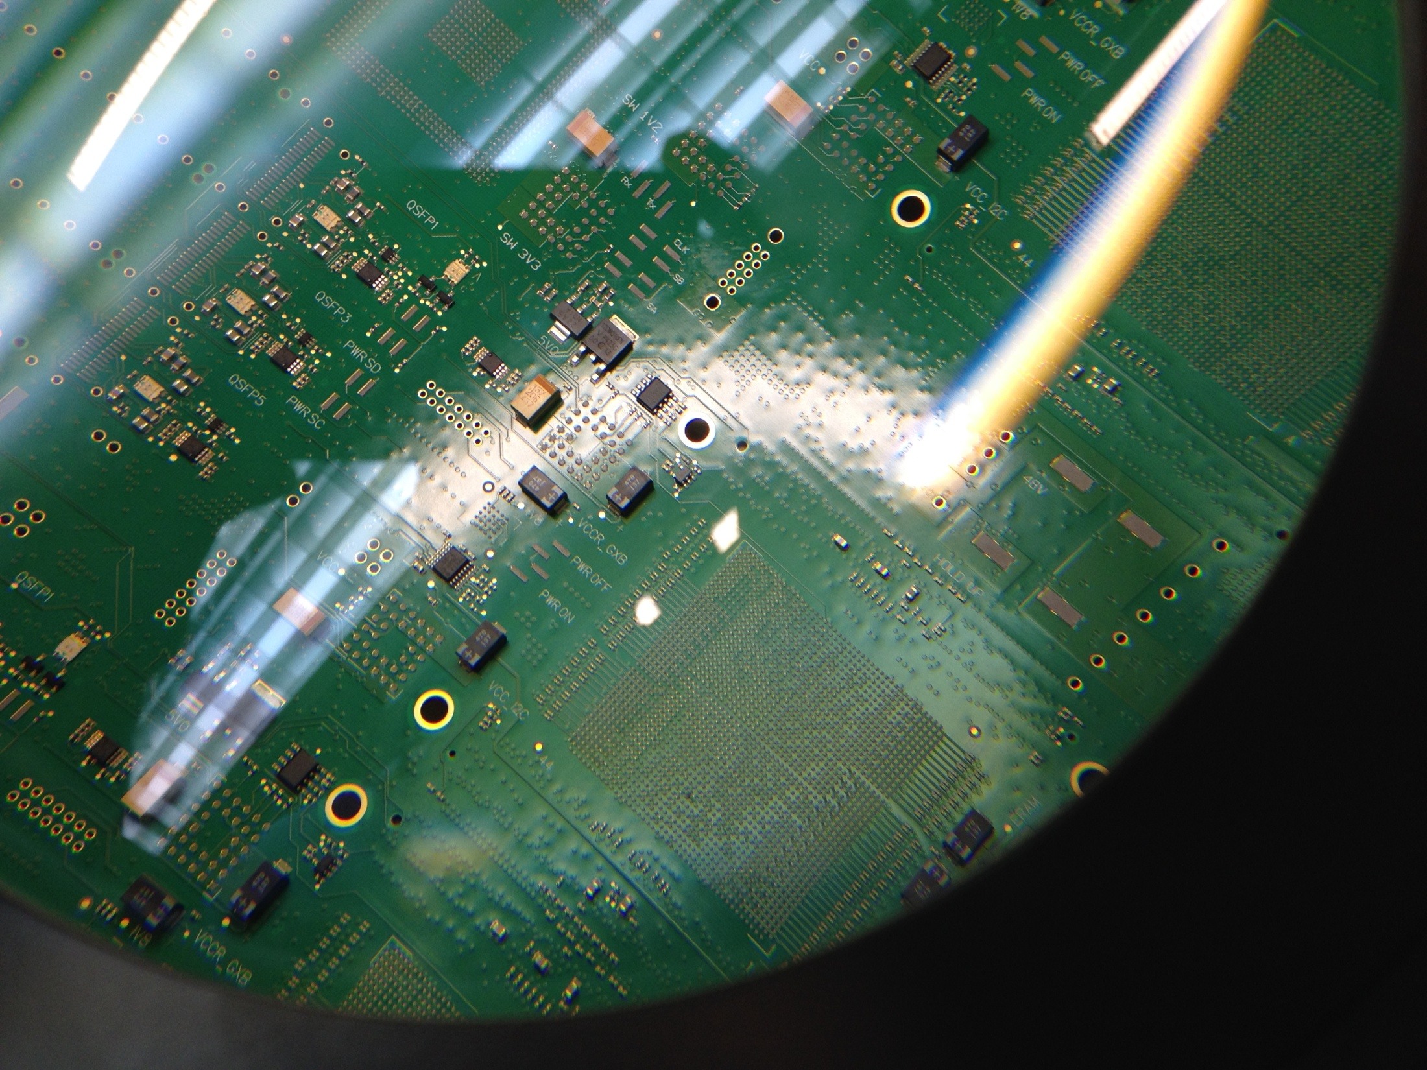

Slide 10
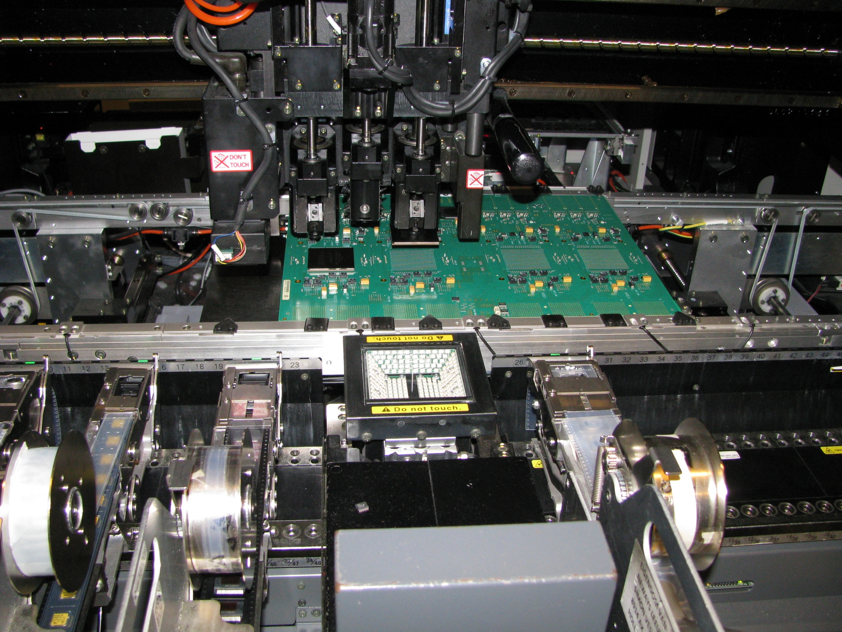

Slide 11
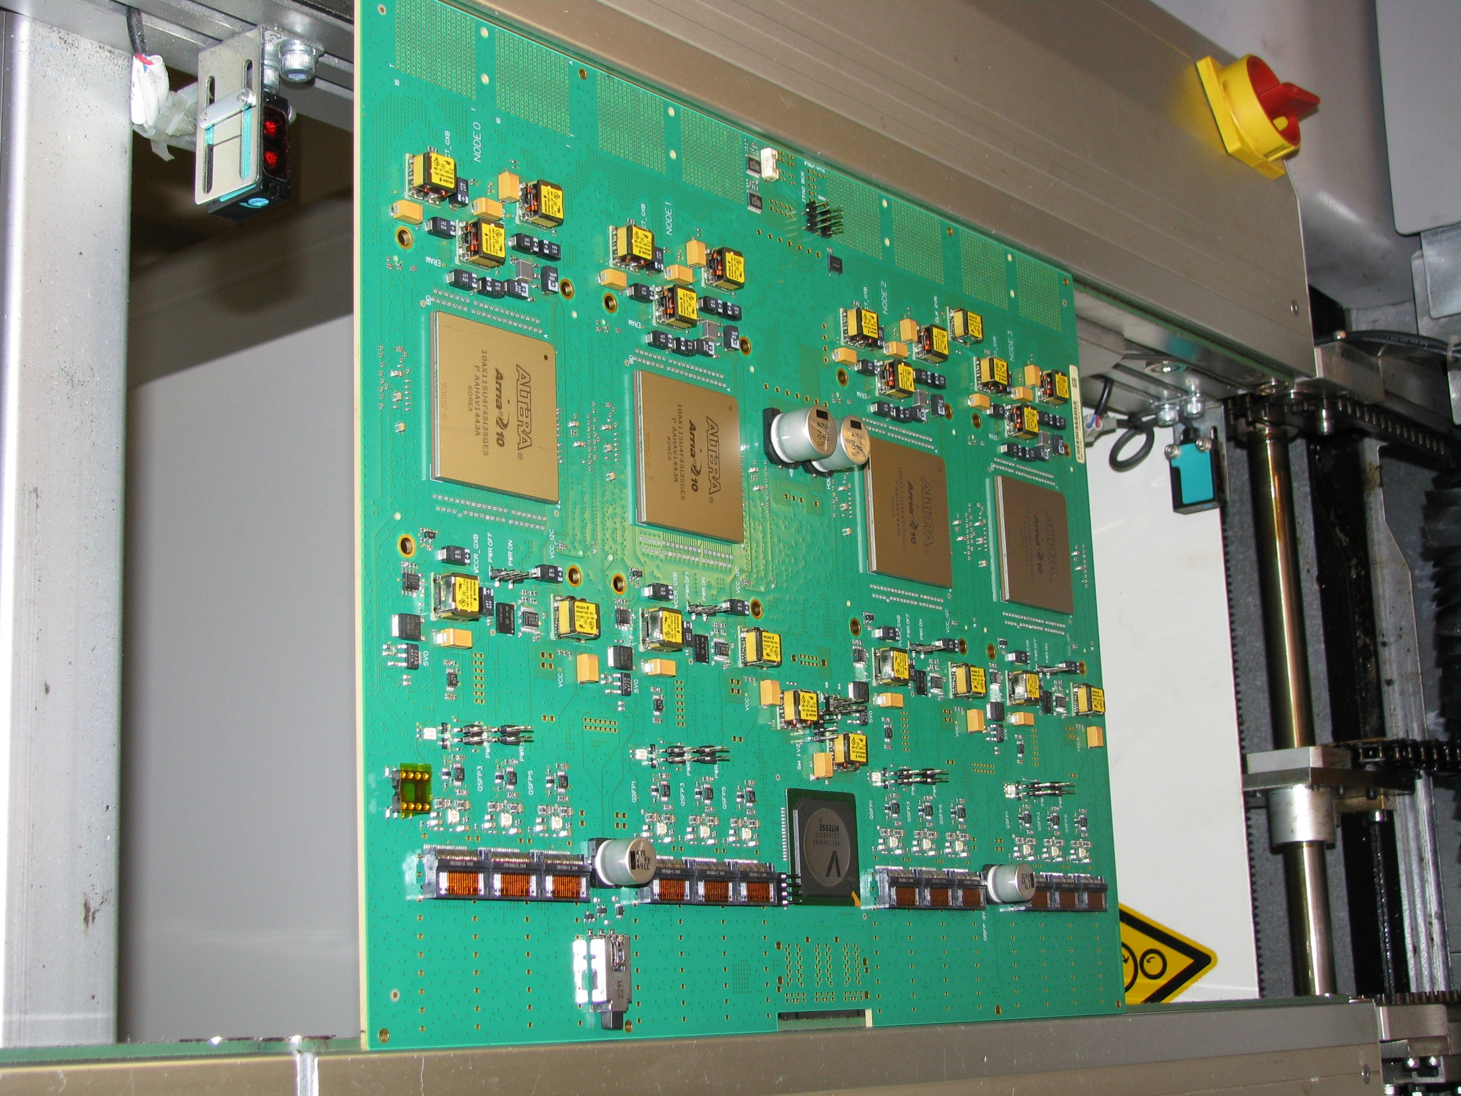

Slide 12
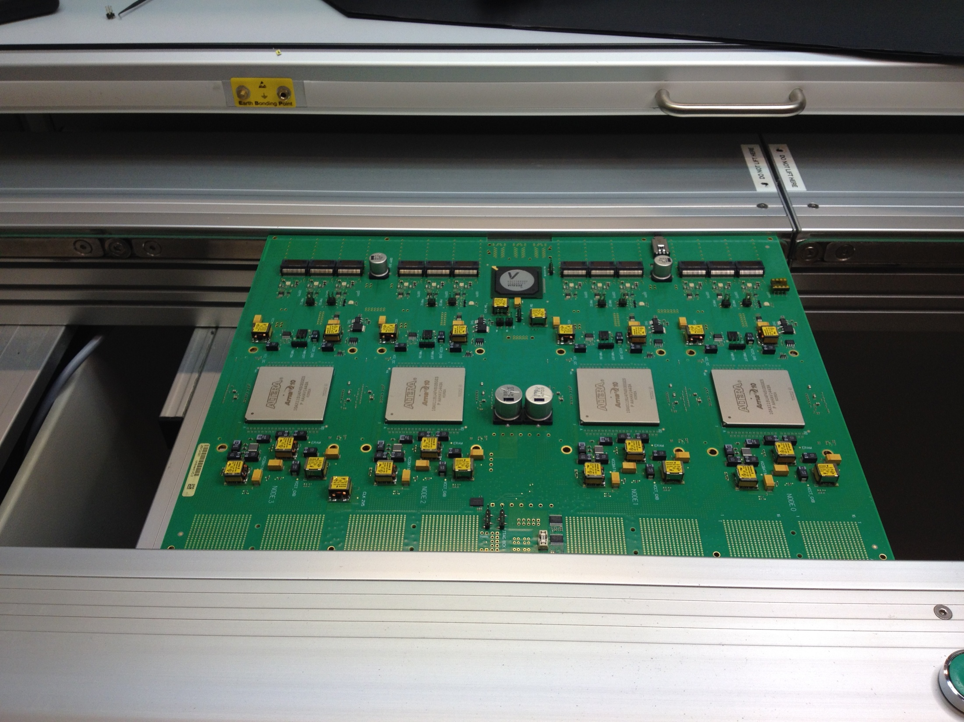

Slide 13
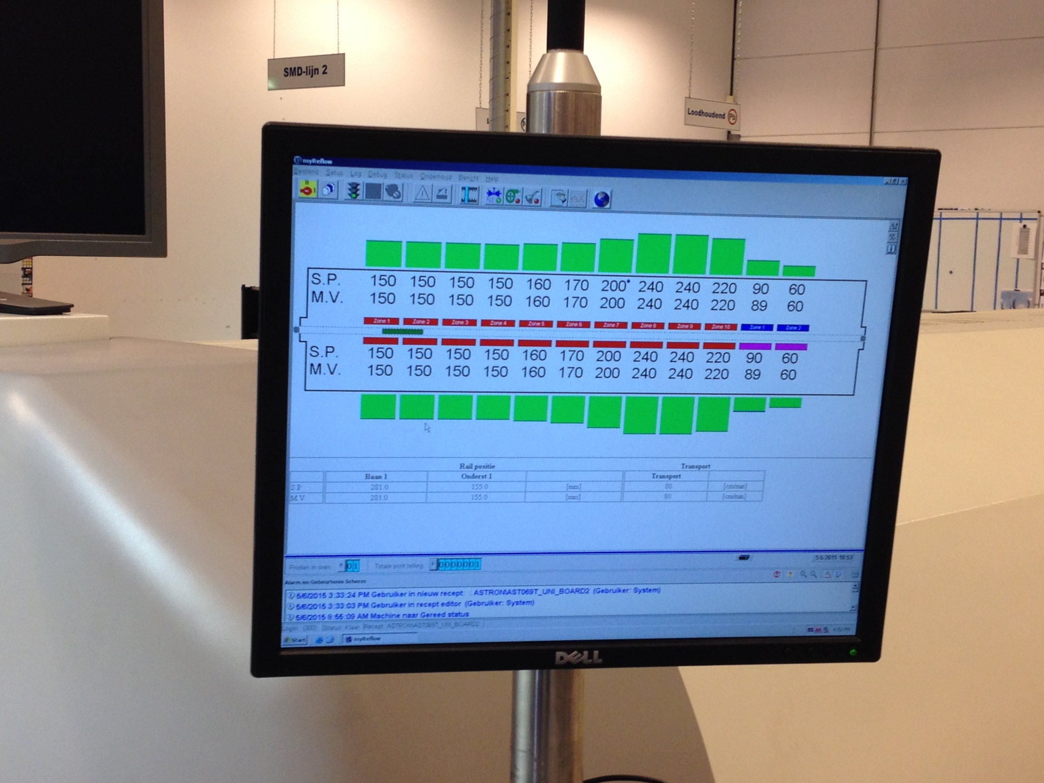

Slide 14
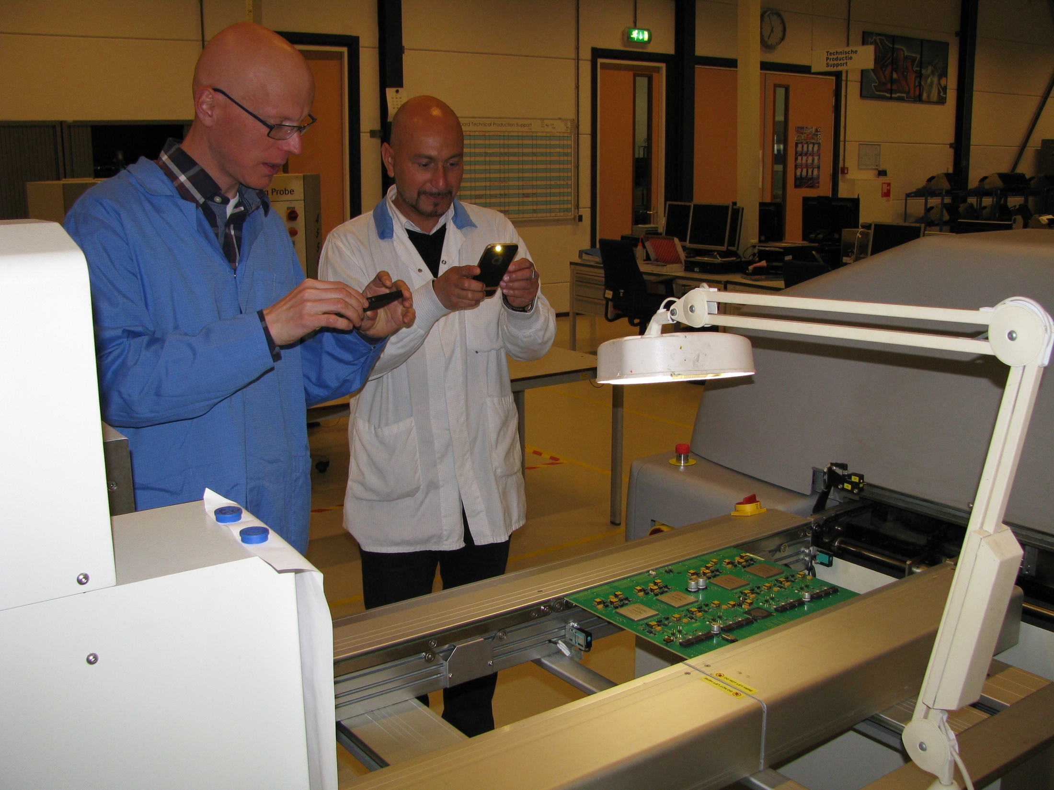

Slide 15
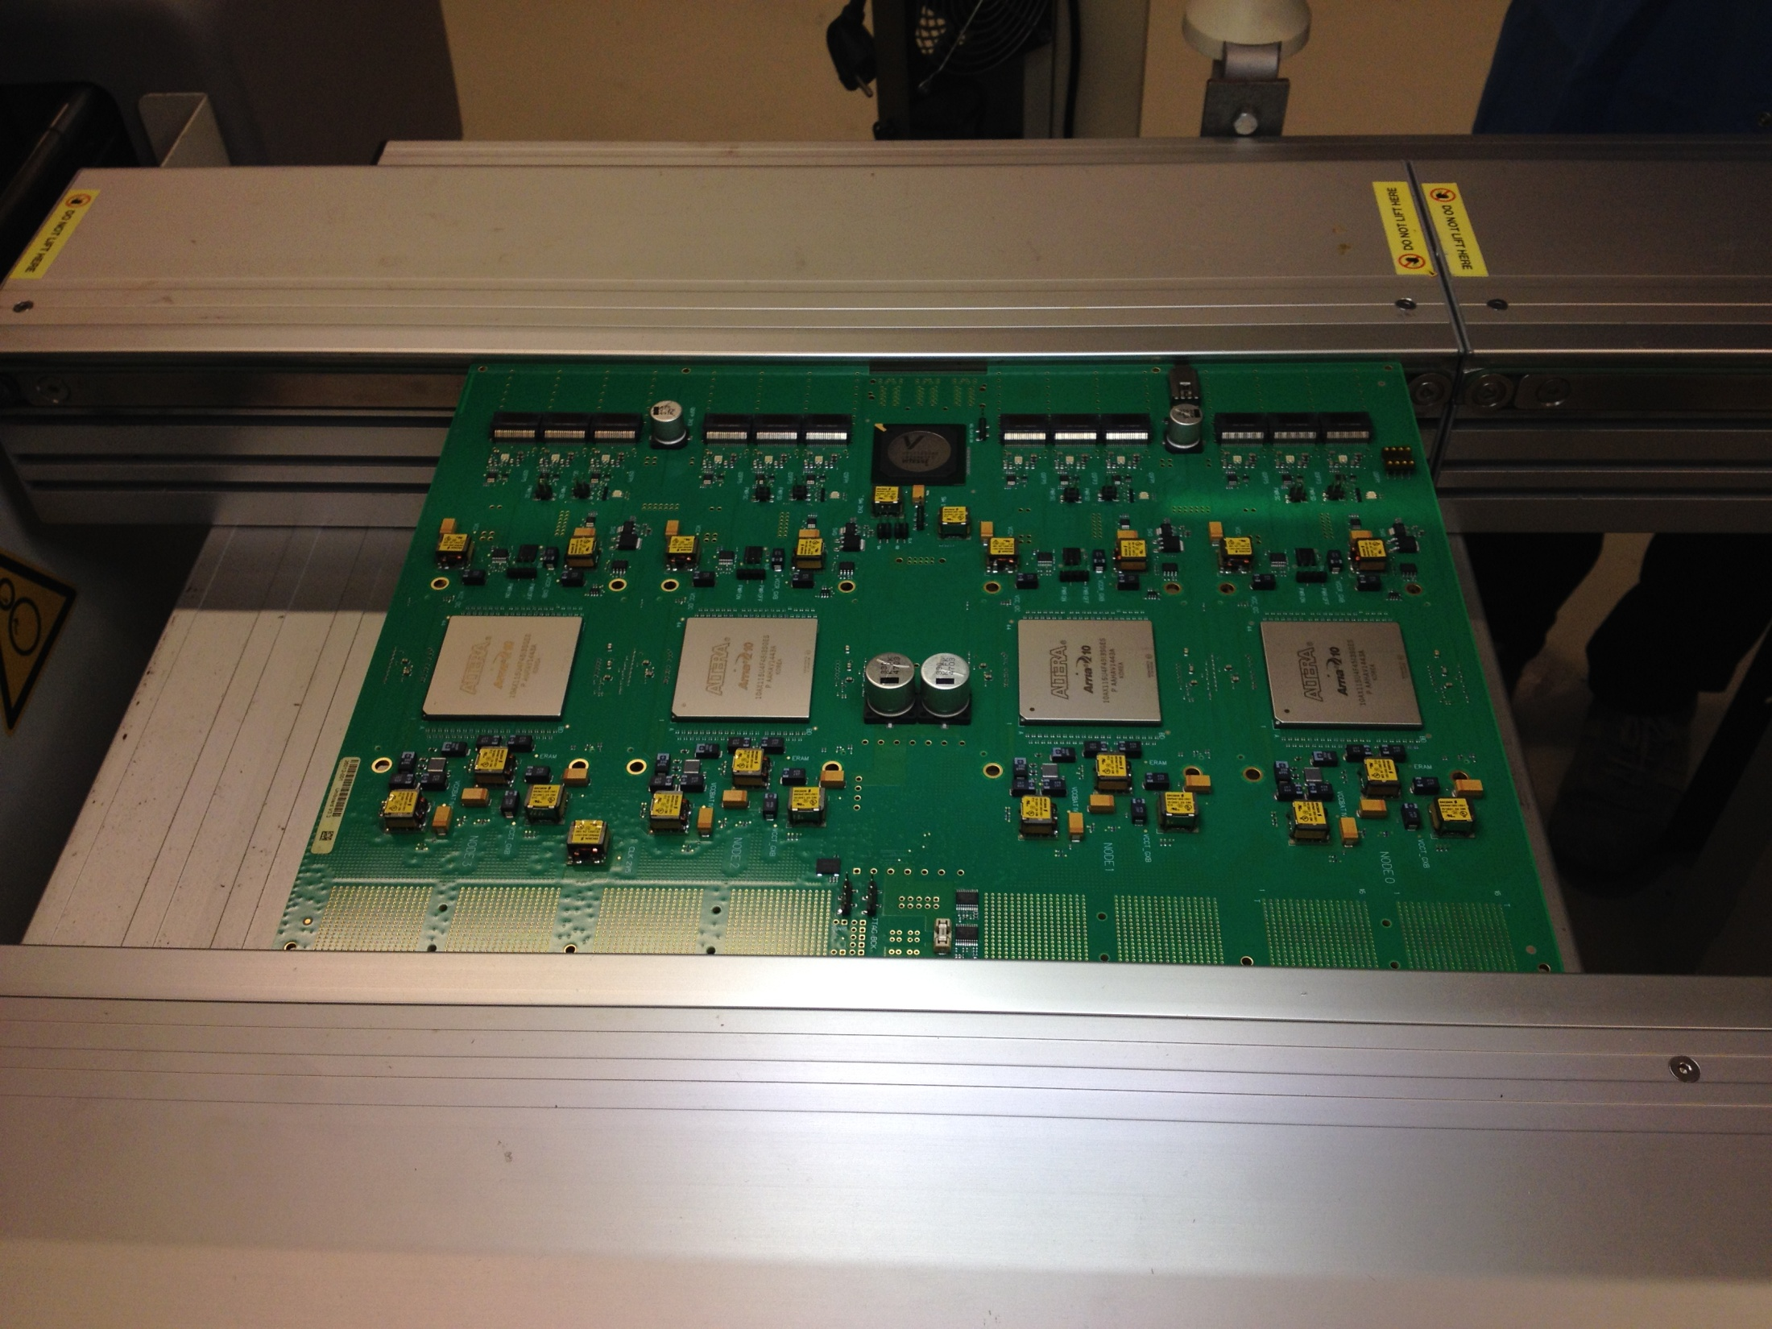

Slide 16
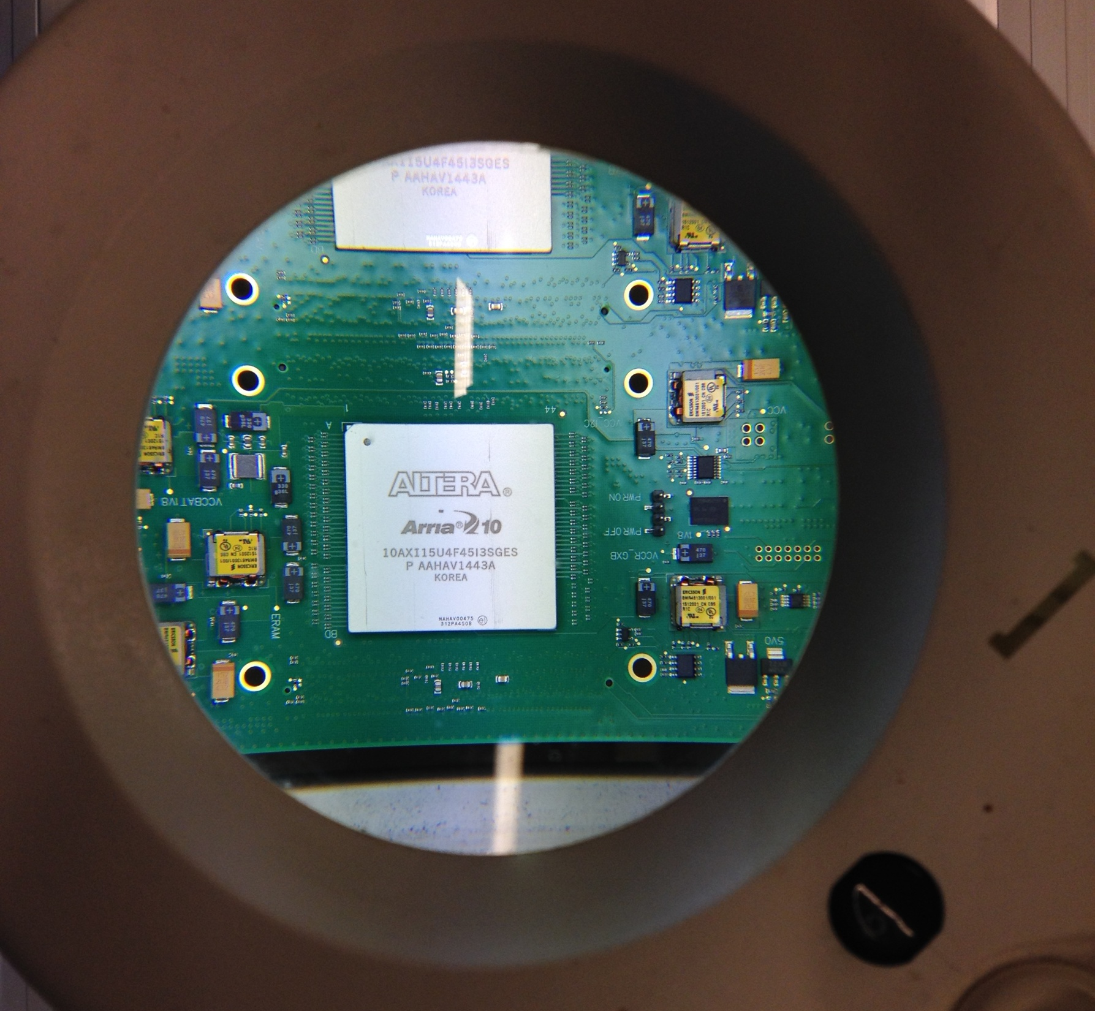

Slide 17
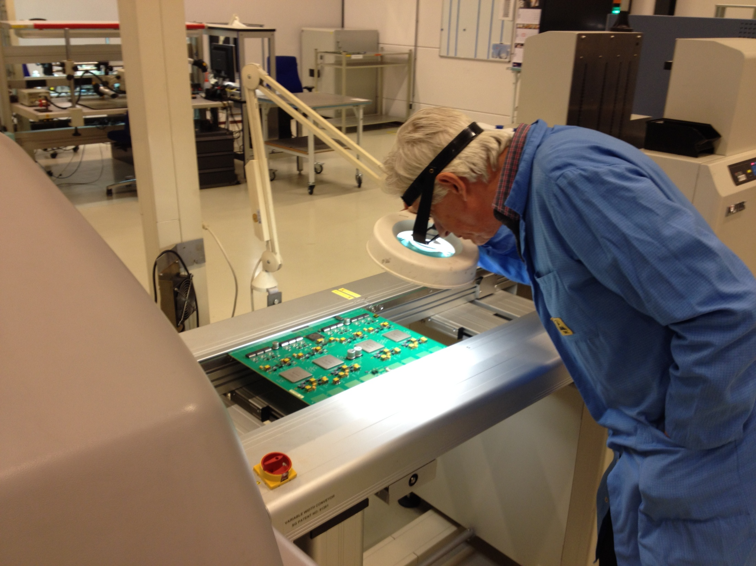

Slide 18
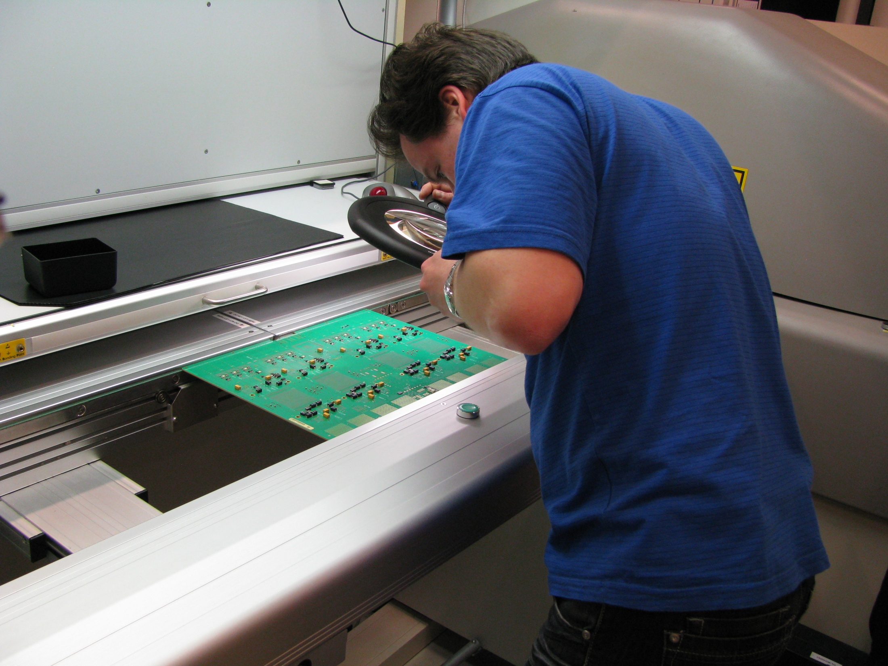

Slide 19
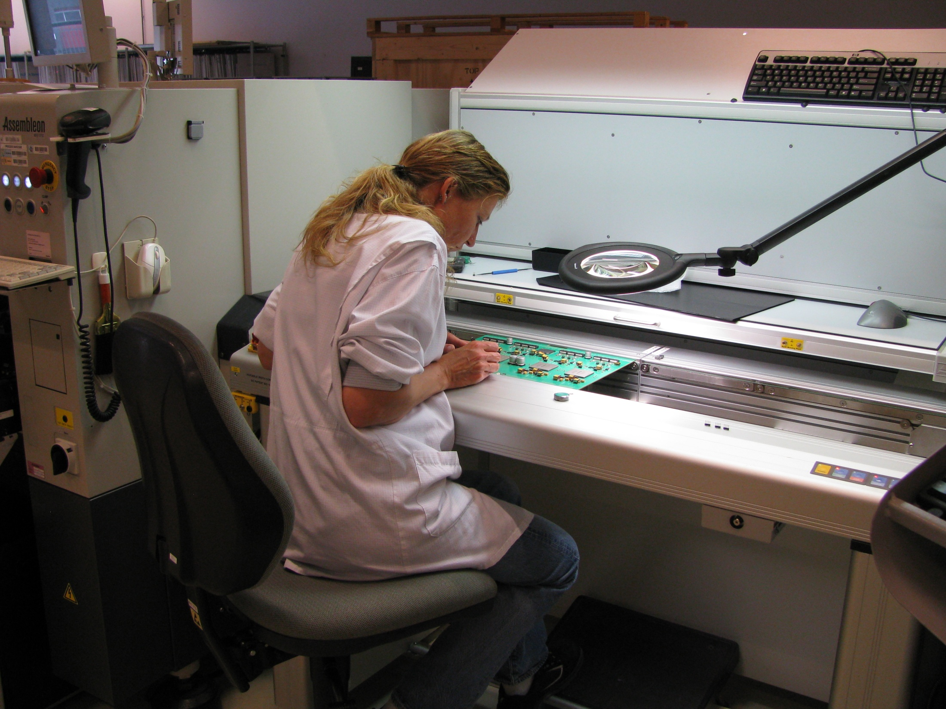

Slide 20
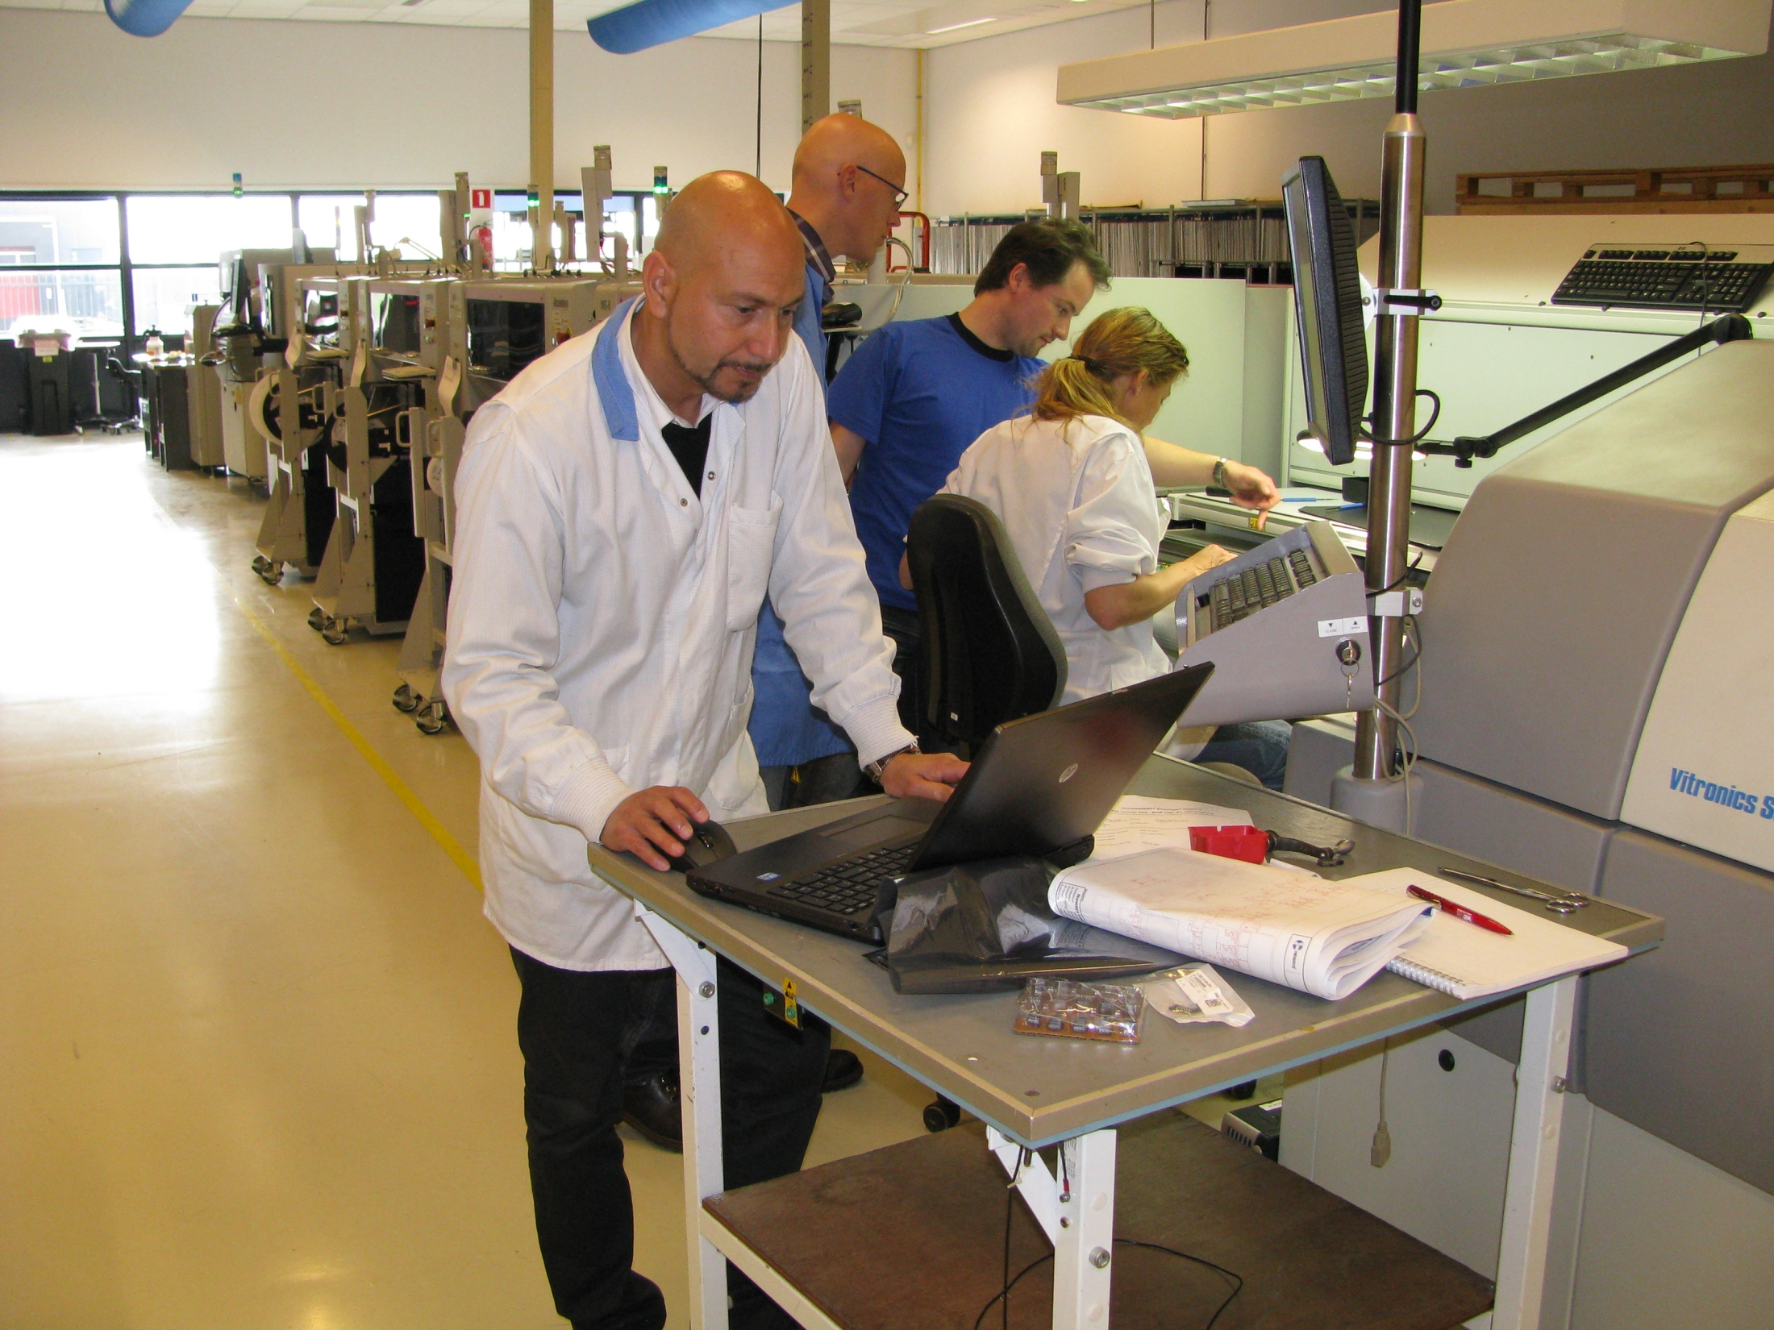

Slide 21
