Slide 1
UniBoard² applied in the Square Kilometer Array
André Gunst
2-12-2014
Notes:
Why UniBoards: we believe in having platforms on the shelf which can be used in projects when the need is there. Currently the technology development is part of designing large systems. We like to have the components already available such that at system level you “only” have to integrate. Hardware, firmware and lower level software.
-Less risk in a projects because some risks are already mitigated
Talk divided in UniBoard and applications
Funding: RadioNet3, Lead: JIVE, other European partners doing independent other work

Slide 2

Notes:
Funding: RadioNet3, Lead: JIVE, other European partners doing independent other work

Slide 3
UniBoard
Notes:
UniBoard targets systems with massive amounts of data and simple processing algorithms
Data coming on the back, Interconnections between the FPGA’s data out on the front. Interface between FPGA running at 5Gbps with an total of 60 Gbps
Explain philosophy: operations per antenna, operation per piece of bandwidth
Why 8 on a board: minimize data transport (data which can remain on chip, keep on chip, board, subrack)

Slide 4
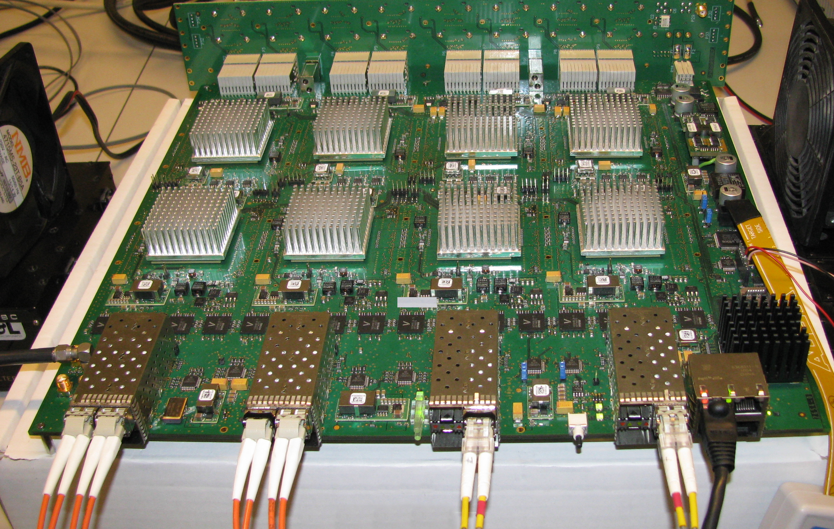

Slide 5


Slide 6
Notes:
4 FPGAs: for density and bf and corr don’t scale the same as filterbanks
-10AX0115U4F45 (engineering sample)
24 transceivers on front, 48 on back, 12 to connect up, 12 connect down
-main aim is to go for Stratix10 which is the next technology step, pin compatible
-we are at front of technology

Slide 8
UniBoard Comparison
 | UniBoard1 (Stratix IV) | UniBoard² (Arria10) | UniBoard² (Stratix10)
Throughput rate | 160 Gbps | 960 Gbps | 2400 Gbps
Processing | 2 TMAC/s | 4.8 TMAC/s | 20 TMAC/s
Nof PCB layers | 14 | 18 | 18
Memory | DDR3 | DDR4 | DDR4
Technology | 40nm | 20nm | 14nm
SerDes | 3.125 Gbps | 10 Gbps | 25 Gbps
Operational | 2012 | 2015 | 2016

Slide 9
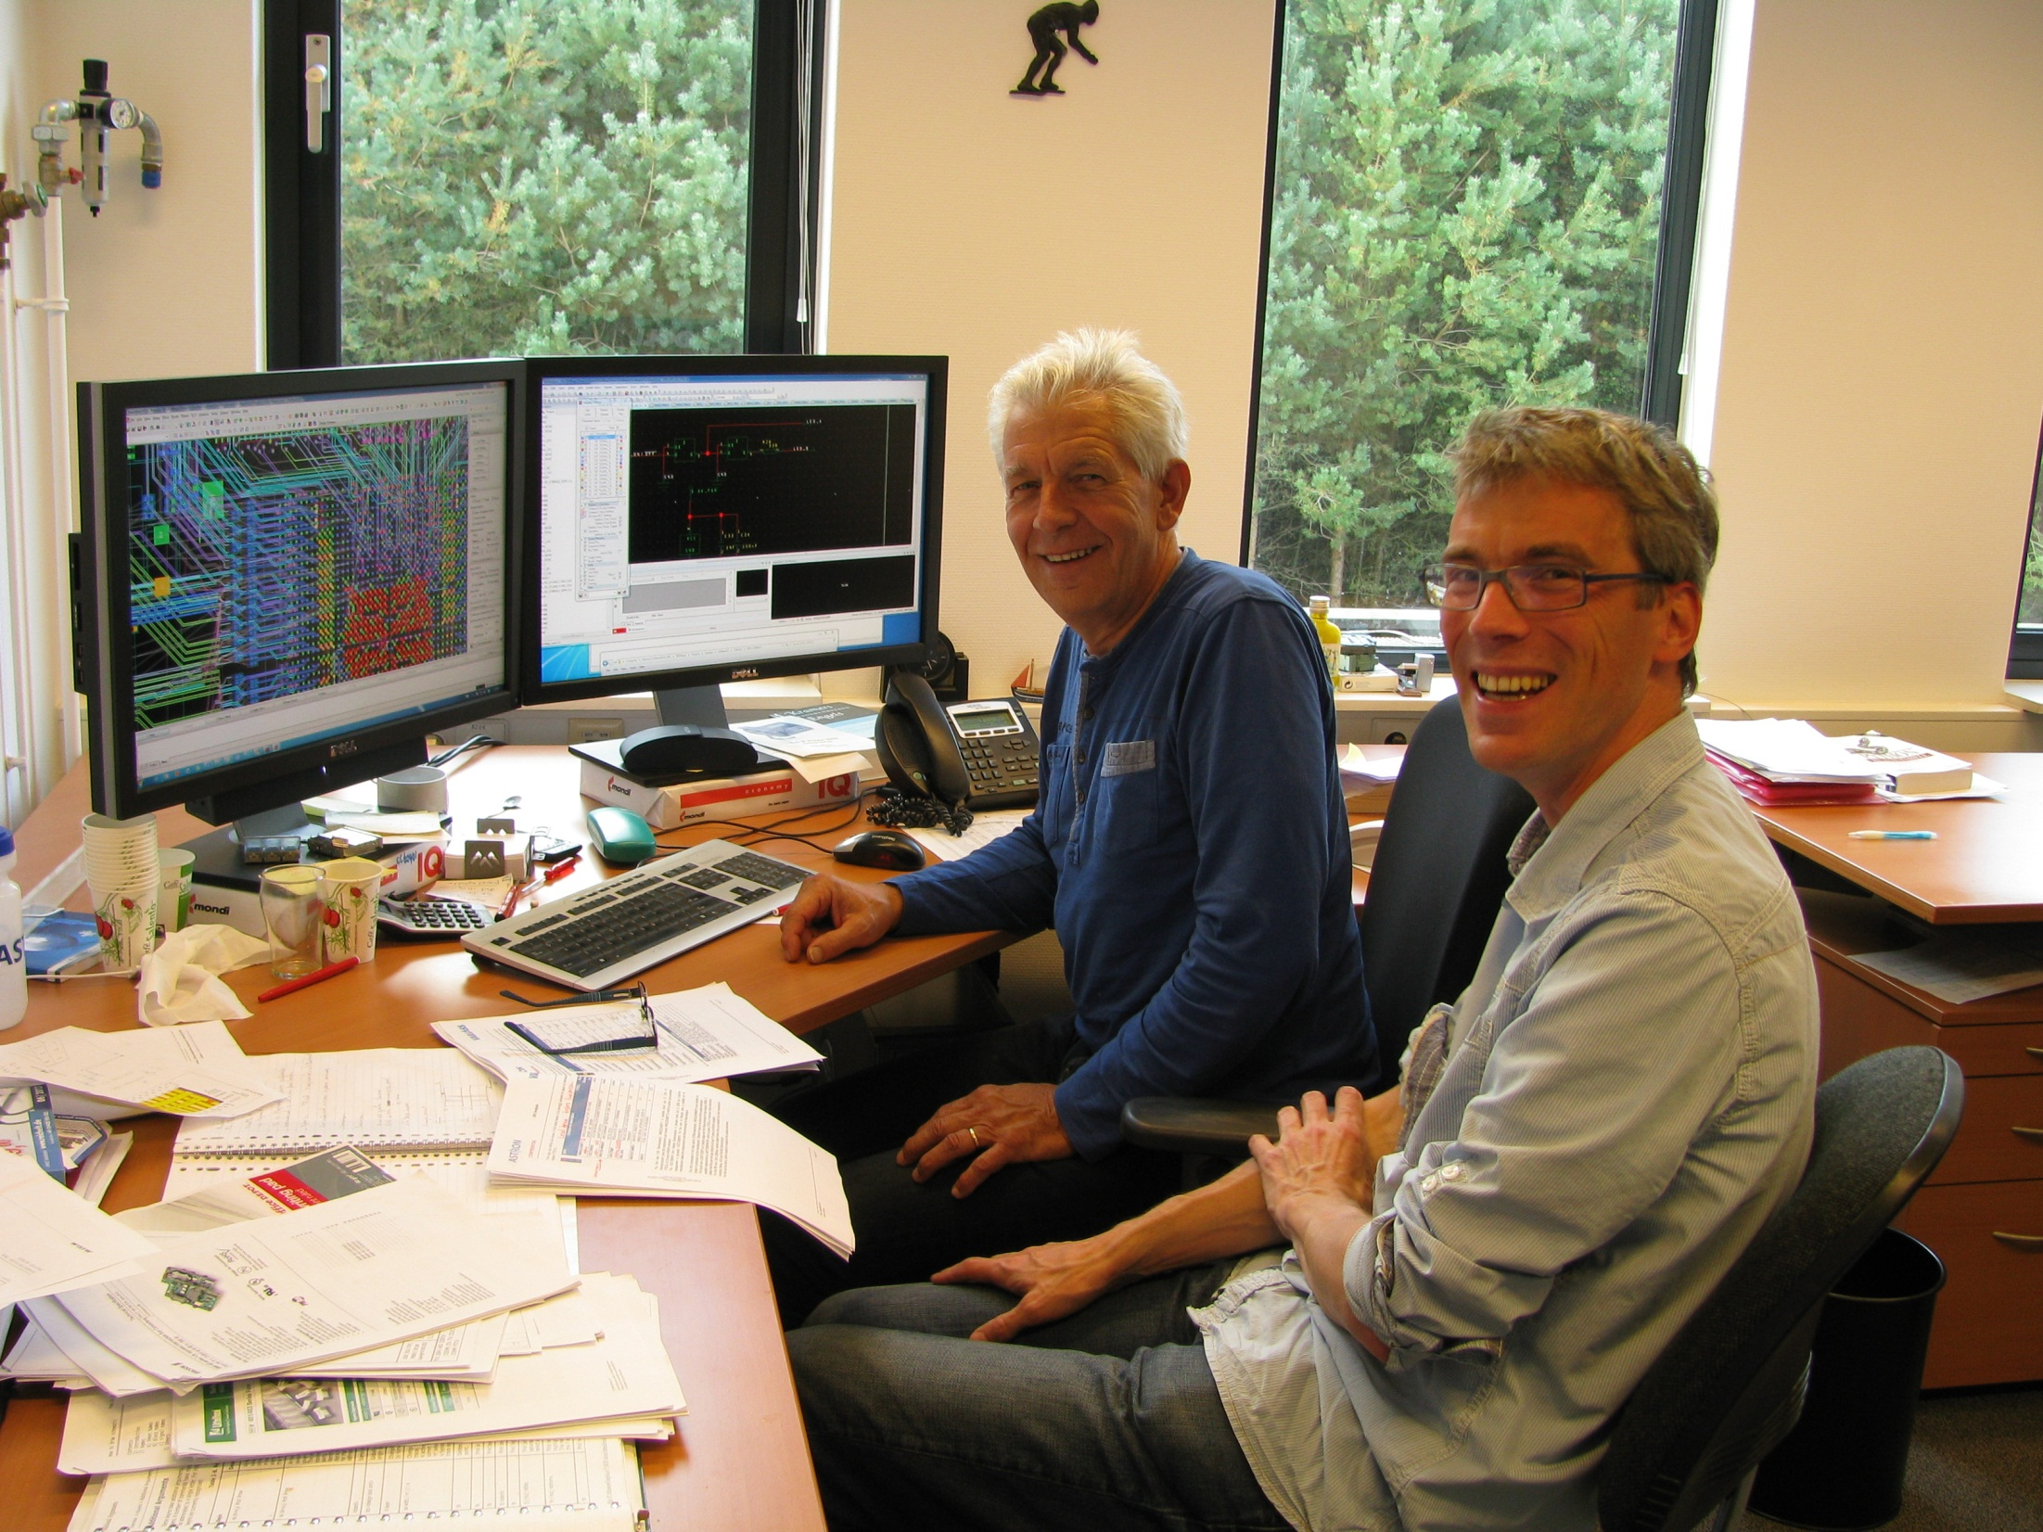

Slide 10
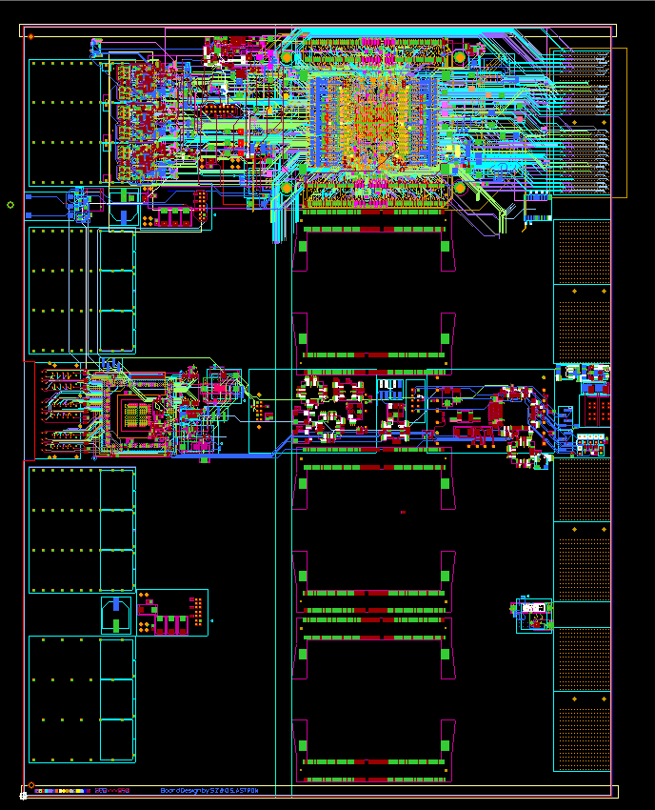
PCB
Notes:
Complex door vele transceivers, Arria10 eisen veranderen steeds (engineering sample)

Slide 11
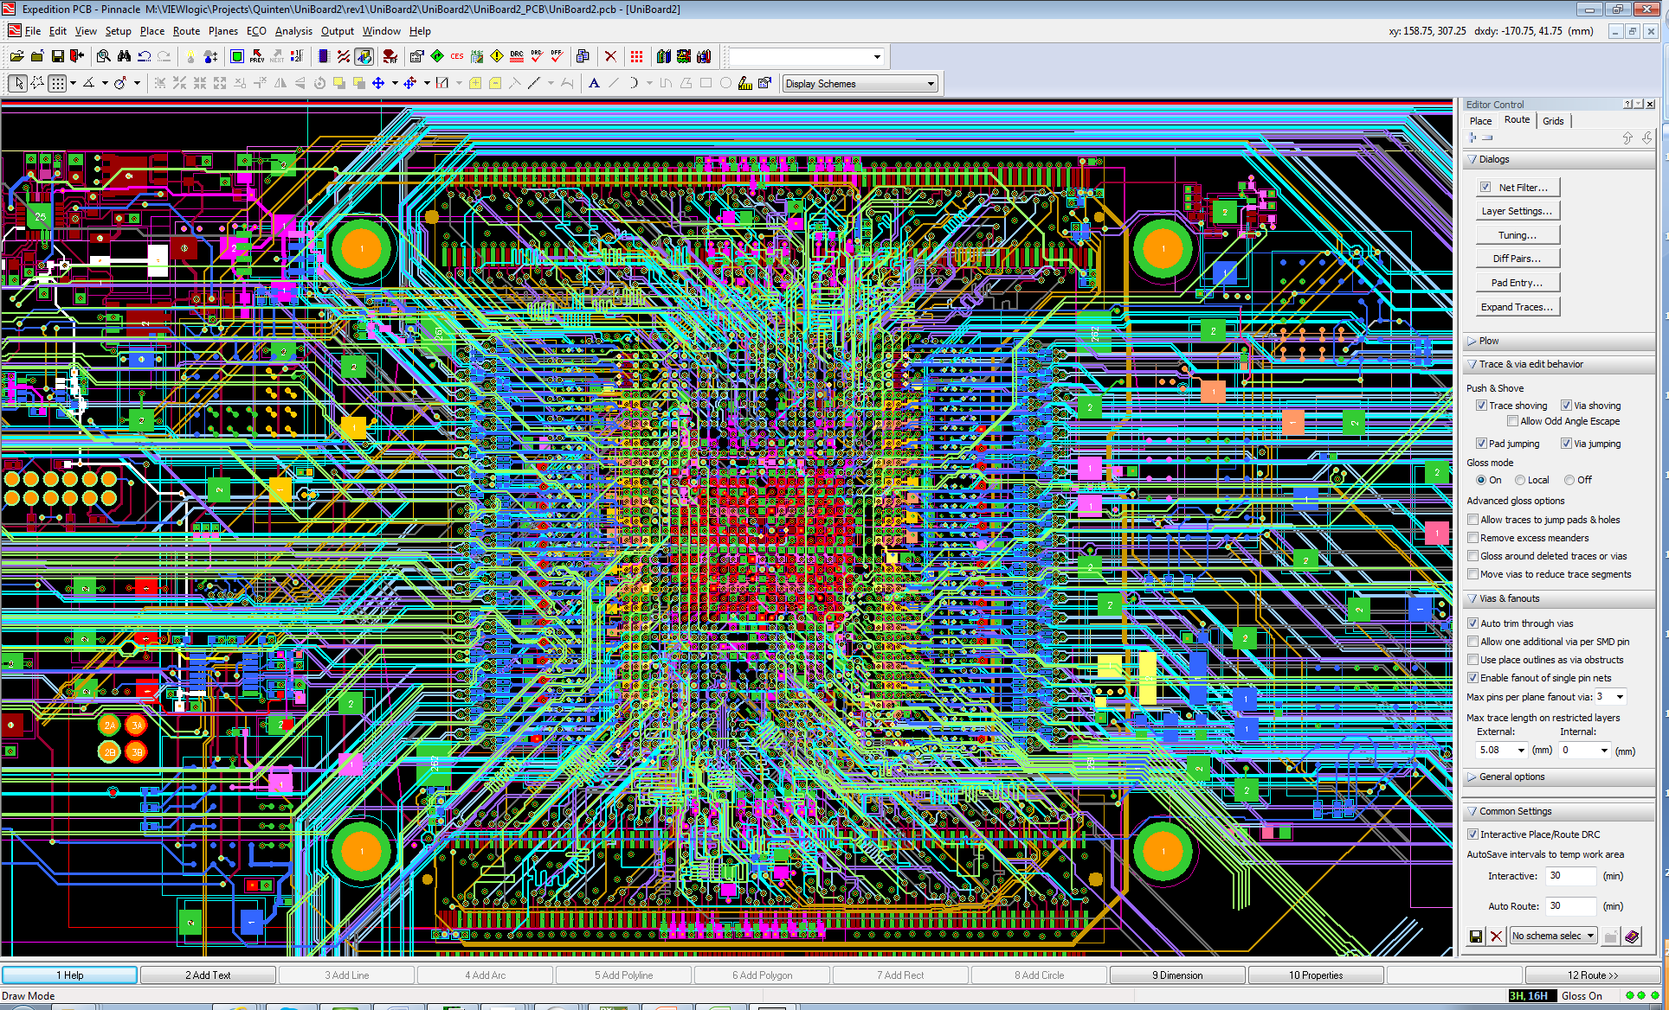

Slide 12
Notes:
Thorough Signal Integrity simulations are done and the board is simulated for 14 G currently. Works also at 25 G but the eye is than smaller.
-Without FPGA corrections

Slide 13


Slide 14
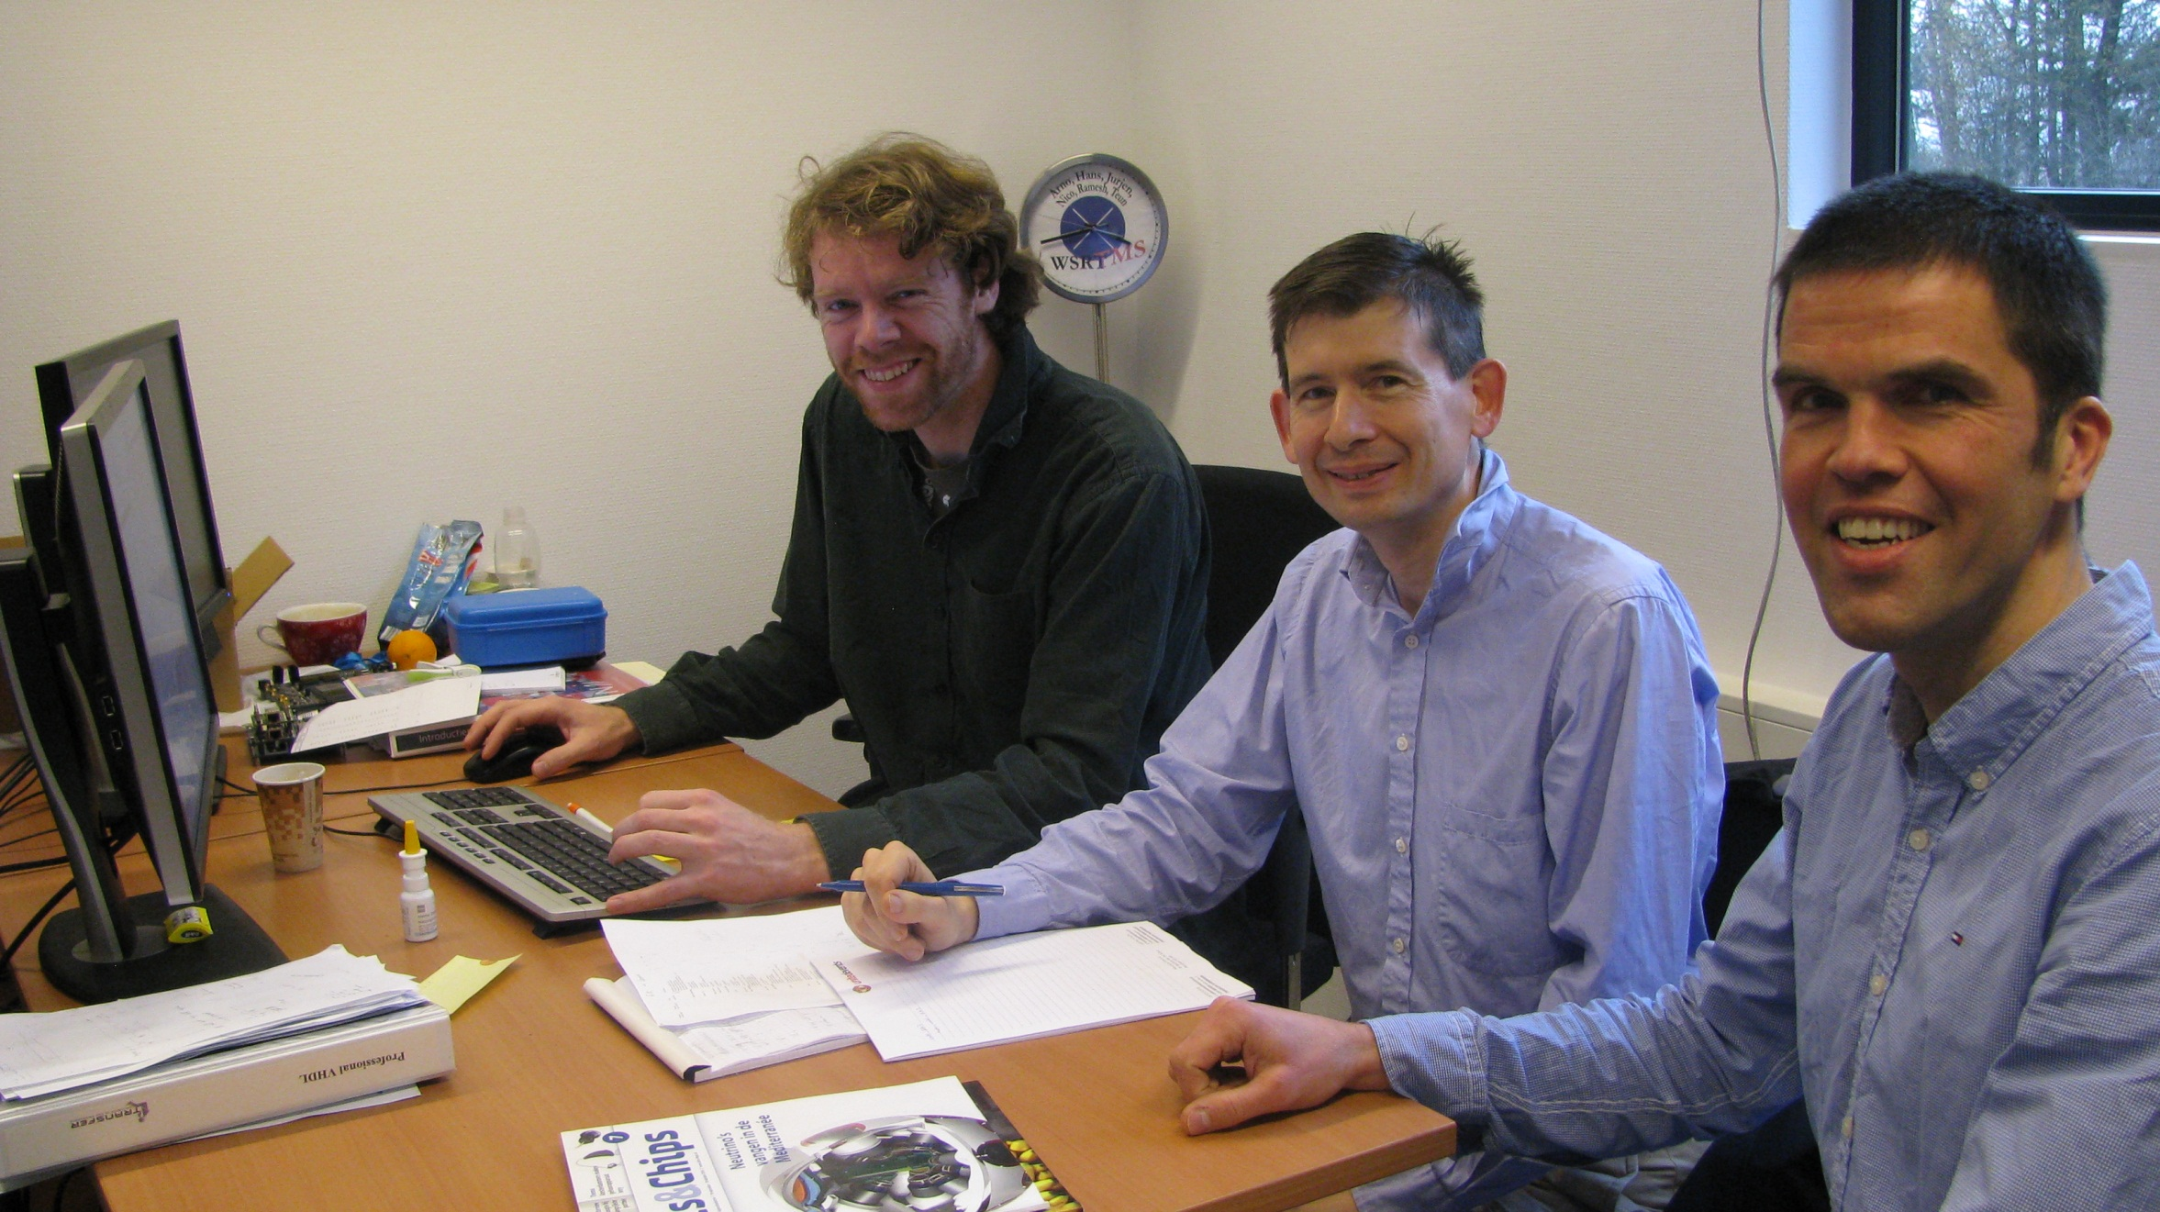

Slide 15
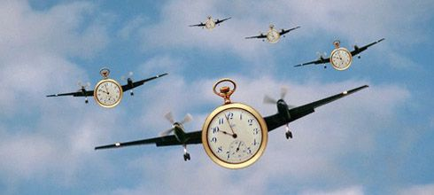
Notes:
Time flies
Waar zit de tijd in: interfaces, data distributie (op juiste plek, op juiste tijd) en control
-Why does it take so long.

Slide 16
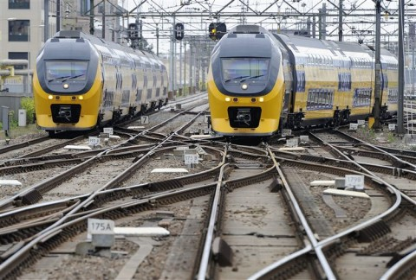
Notes:
Metafoor:
Nederlandse spoorwegnet is het drukst bereden spoor van de EU en na Zwitserland en Japan het drukste spoorwegnet ter wereld
-in firmware minder crossings en geen stops, maar de treinen (pakketten) zitten tegen elkaar aan waardoor het ook complex is en je wilt vermijden

Slide 17
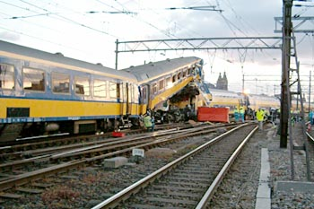

Slide 18
Firmware
Notes:
-One of the ways to decrease development time and done already for UniBoard is defining modules with standard interfaces.
-By using a board support package you can use same functions in another technology
-but we are still not there

Slide 19

Notes:
Reduce development time: automatiseren (code generatie), regressie testen (automatisch)

Slide 20

Notes:
Simplify workflow

Slide 21

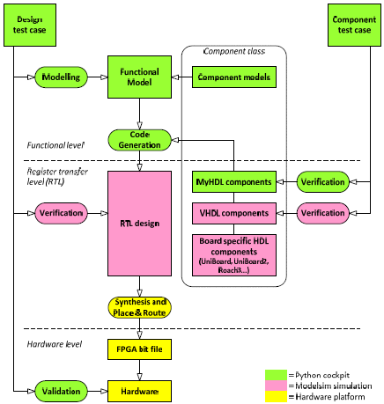
Towards a “one-click” flow
Notes:
Nice thing is that there are still ways to improve on speed
Toekomst: automatic code generation, regression testing, technology independence, modelling
-Same test case for model (functional level, register level and hardware level)
-people busy with this are shown on the next slide

Slide 22
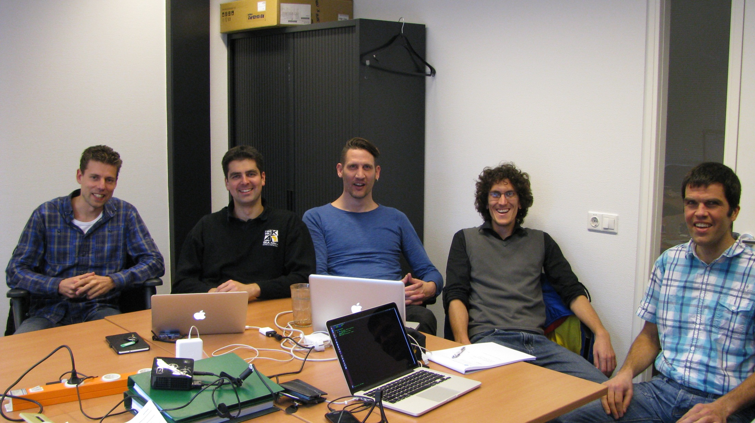
Notes:
It is always hard to strike a balance between the work to improve the work flow and the pressure of projects

Slide 23
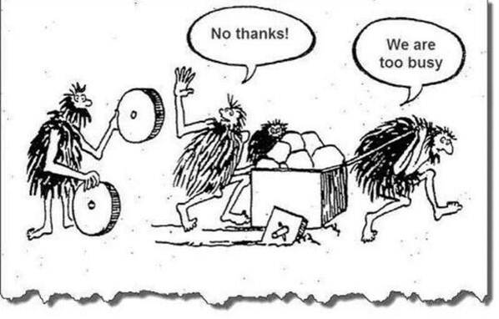

Slide 24
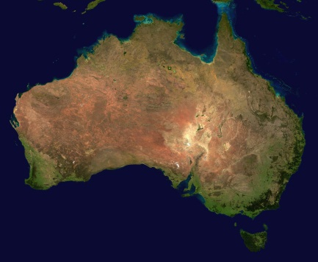
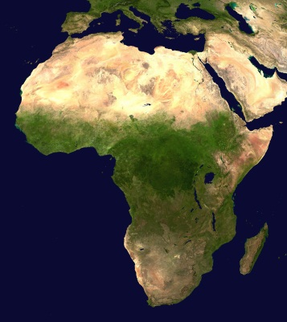
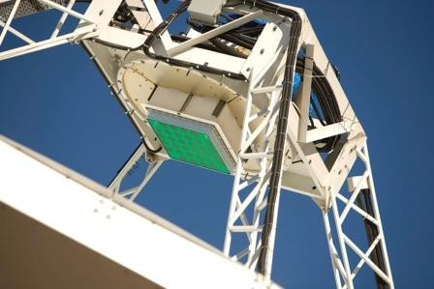
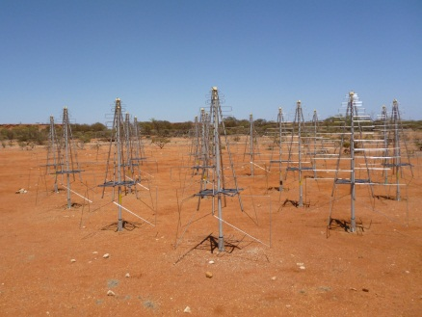

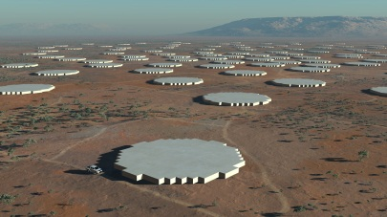
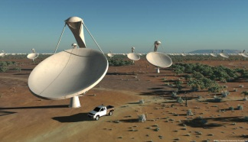
SKA Receptors
Site:
Western Australia
Site:
Southern Africa
SKA Dishes
Mid Frequency Aperture Arrays
ASKAP Phase Array Feeds
Low Frequency Aperture Arrays
Meer KAT Dishes

Slide 25
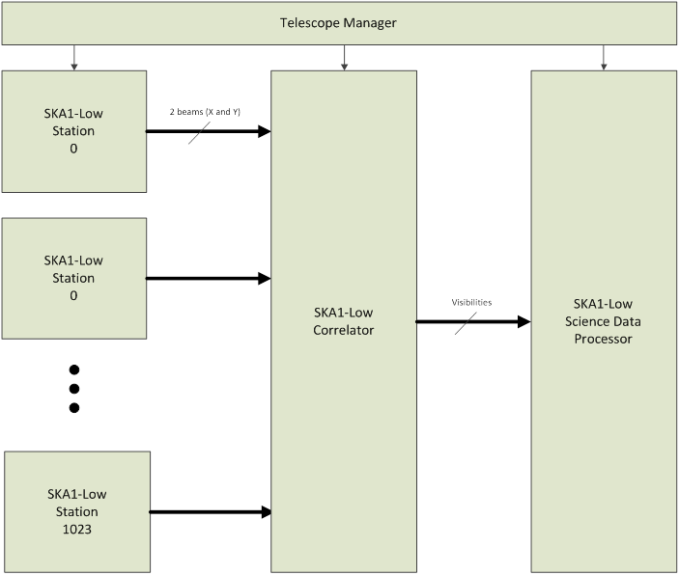
Notes:
1024 stations with each 256 antennas, 2 polarisations

Slide 26
LFAA Station Functional Diagram
Notes:
Processing required 2.4 TMAC/s
-bandwidth is bottle neck

Slide 27
Proposed LFAA Beamformer Implementation
Notes:
Less beams out: ring structure more economic

Slide 28
Routing the Data
192 signal paths / UniBoard²
Notes:
Analog does not scale as nicely as digital
In LOFAR 32 ADC channels for 4 digital boards
APERTIF 64 ADC channels for 4 digital boards (LVDS)
UniBoard^2 192 ADC channels for 1 board (serial lines)

Slide 30
SKA Low Correlator

Slide 31
Notes:
Big switch can be 128 small switches of each 16 ports (in LFAA)

Slide 32
Correlator Section Interconnections

Slide 33
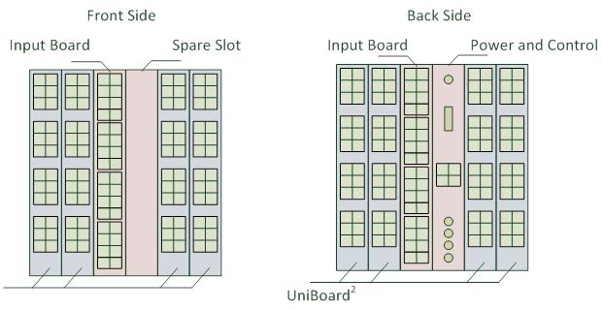
Notes:
10 Gbps connections per station (1024 stations x 10 Gbps), 60 Tbps coming out of the correlator

Slide 34
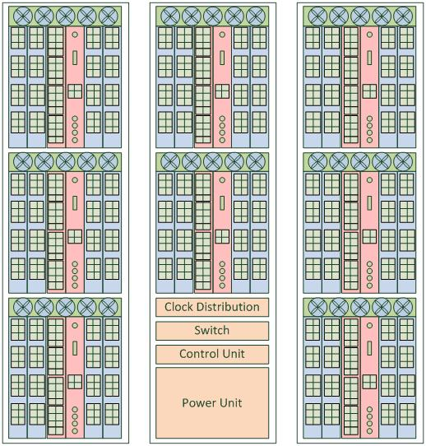
Notes:
In total 64 boards required

Slide 35
Integrated Beamformer & Correlator

Slide 36
Conclusions
UniBoard(²) aims for data intensive and streaming systems using simple operations on loads of data
UniBoard(²) targeted for large systems (like the SKA)
Standard interfaces increases the usability (not restricted to radio astronomy)
Busy with a continuous effort to reduce firmware dev. time
Notes:
From the outside it does not always look what is inside

