Slide 1
Square Kilometer Array
Low Central Signal Processor
(SKA CSP_LOW)
André Gunst
3-12-2014
Notes:
CSP consortium led by NRC Herzberg Institute of Astrophysics in Canada, large consortium
Since last year our (Astron’s) effort has been increased in order to basically push UniBoard^2 technology in CSP.
The work involved to do the same for LFAA decreased.
Just recently held the PDR
“Bureaucracy is the art of making the possible impossible”
Held December last year. External people in panel and internal people.
Panel report not available yet.
Calibration
Not all doc’s where in the same state: 140
Inconsistency between ADD and requirements.
Some L1 req’s were not there and consortium should have made assumptions. But they were not always traceable.
Reliability of cost estimation. There is still some pretty margin in it.
Delta PDR will be held to: include the re-baselining and the proposed changes, amongst one of them is a SKA-LOW beamformer

Slide 2

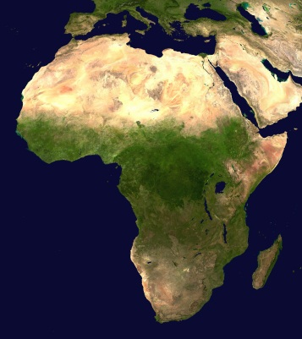
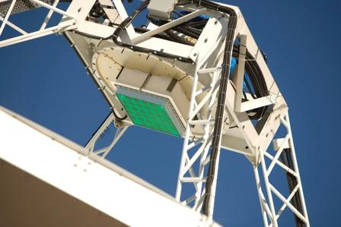
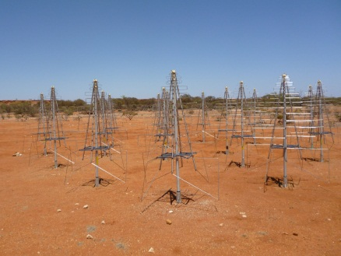
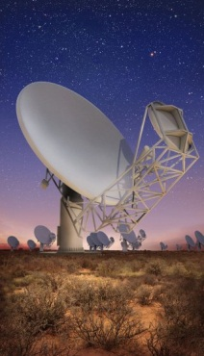
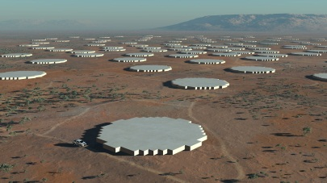
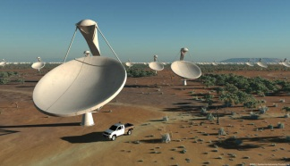
SKA Receptors
Site:
Western Australia
Site:
Southern Africa
SKA Dishes
Mid Frequency Aperture Arrays
(phase 2)
ASKAP Phase Array Feeds
Low Frequency Aperture Arrays
Meer KAT Dishes
CSP_SURVEY
CSP_LOW
CSP_MID
Notes:
Basically SKA Phase 1 will deliver 3 instruments. Independently.
Organised per function instead of per instrument: CSP will deliver 3 correlators for basically 3 different instruments.

Slide 3
Tasks ASTRON
Architectural design targeted to UniBoard²
Hardware development
UniBoard² firmware development (interfaces)
Notes:
We are in multiple workpackages of CSP. Today we will talk about SKA-LOW and therein we do the following.

Slide 4
Context

Slide 5
LFAA
(Low Frequency Aperture Array)
CSP
(Central Signal Processor)
SDP
(Science Data
Processor)

Slide 6
Key Numbers
2048 input signals
300 MHz bandwidth in 1024 subbands
One beam
256 channels
Integration time 0.6 seconds

Slide 7
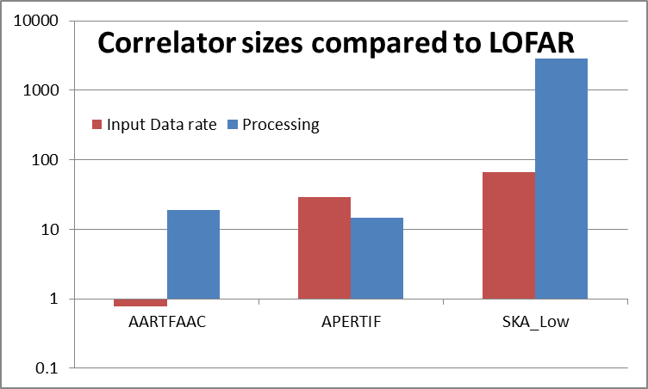
The Problem
Notes:
Its all about size. Size does matter.
Data rate not much higher than APERTIF, but processing is. Cause: more inputs, 1 beam

Slide 8
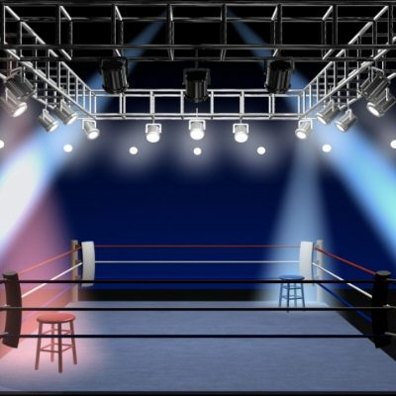


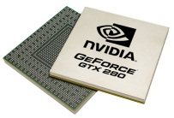
The Solutions
Strengths GPUs
Dev. time
Flexible
Easy to replace
Low risk
Strengths FPGAs
Cost
Power
Long lifetime
Dense
Notes:
Sometimes it feels like a battle, but it is really not. For some applications its better to use one, while for others its better to use the other.

Slide 9
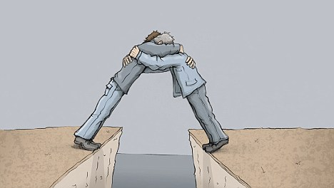

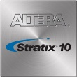
Notes:
Within SKA-LOW we try to shake hands and use the optimal technology in the right phase. Hence we are thinking off using first GPUs for the prototype (while the FPGA design is not done yet) and replace this later with FPGAs.

Slide 10
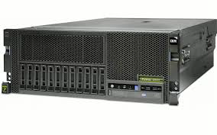
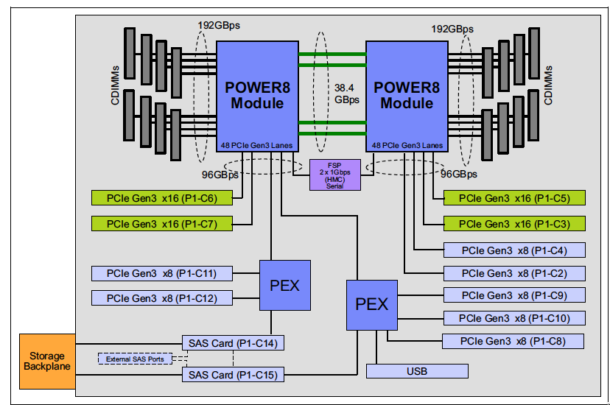
GPU Solution
GPU
IBM Power 8
S824 server
Notes:
1) 512 IBM Power 8 S824 servers each housing [52 19” racks]
a. 2 x Pascal GPU each in x16 PCIe Gen3 slots
b. 2 x dual FDR (or single EDR) Infiniband host adapter each in x16 PCIe Gen3 slots
c. 1 x single FDR Infiniband host adapter in a x8 slot
d. 1 x quad 10GbE Ethernet host adapter in a x8 slot
2) 512 Port FDR SX6536 infiniband switch. This is a 648 port chassis with 18x36 port spines
and 36x18 port leafs.

Slide 11
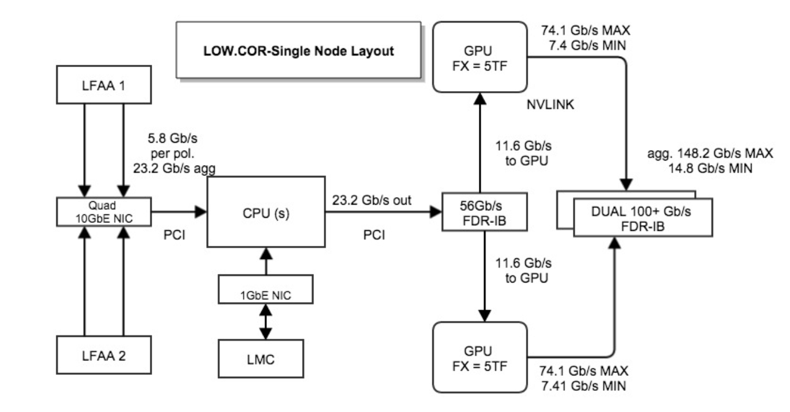
GPU
512 servers required (52 racks)

Slide 12
Redback-4
Notes:
Xilinx XCKU115 (5520 multipliers)
400 MHz clock (2 TMACs)
Redback-3 was in April 2014 in production
Redback-4 in definition phase (start 2015)
1 U approach

Slide 13
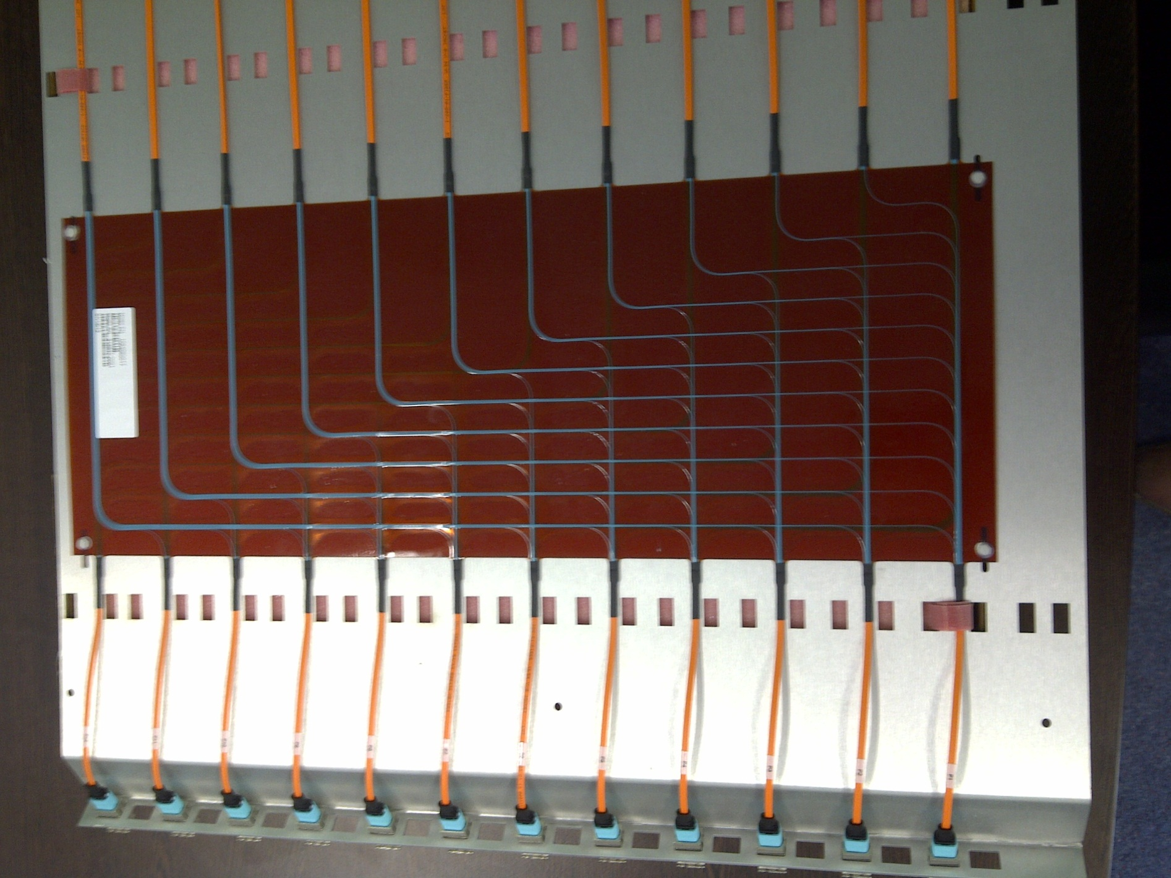
Notes:
138 boards required
-connect boards via fibers

Slide 14
Redback-4
Channeliser: 13 boards
Correlator: 138 boards

Slide 15

Notes:
Philosophy: mezzanine boards which can have dedicated functionalities. Overdesigned motherboard to provide that.

Slide 16
Mezzanine Card
Notes:
Mock up available: end of February
Boards expected in June

Slide 17
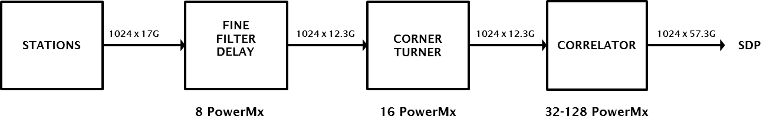
Power-MX mapping

Slide 18
Notes:
Philosophy: integrate more boards in a sub-rack

Slide 19
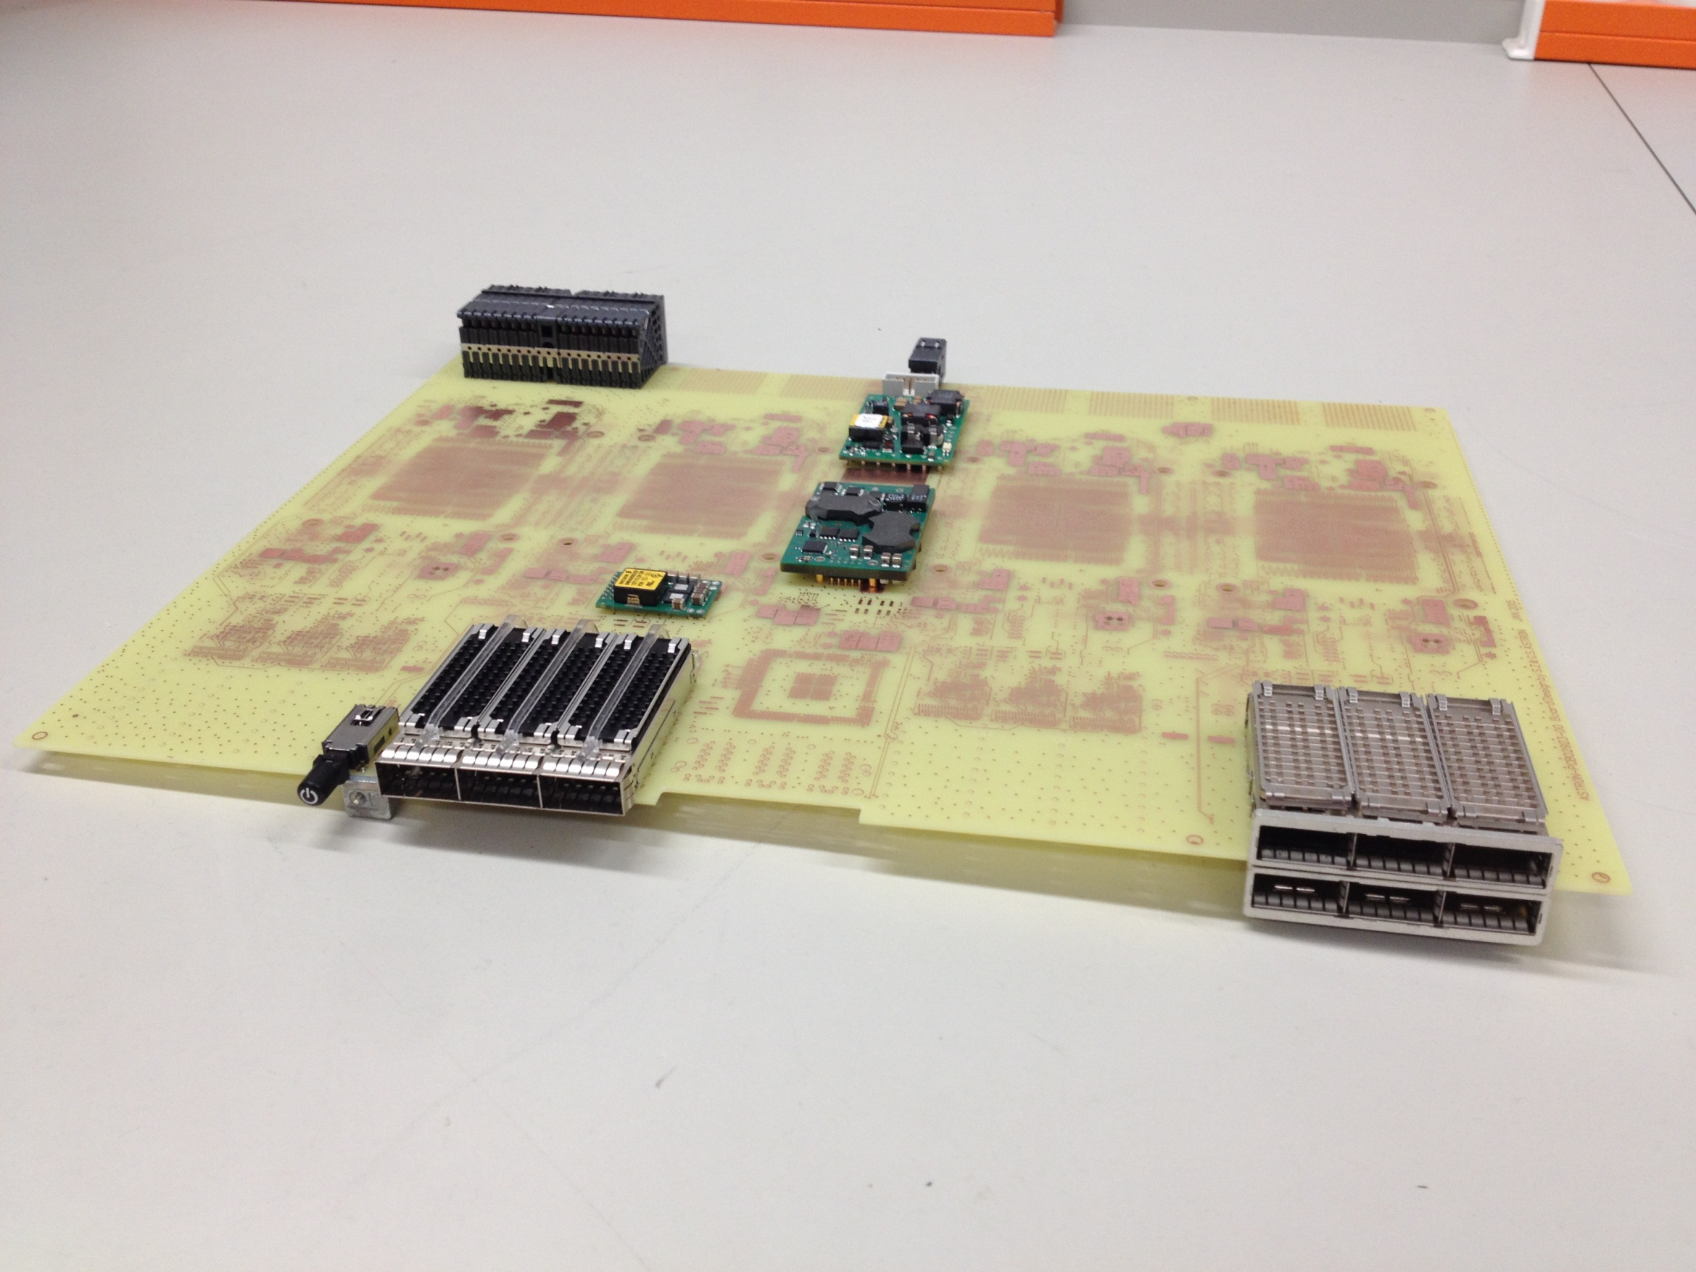
Notes:
64 or 128 necessary
Status: layout finished, will get in production

Slide 20
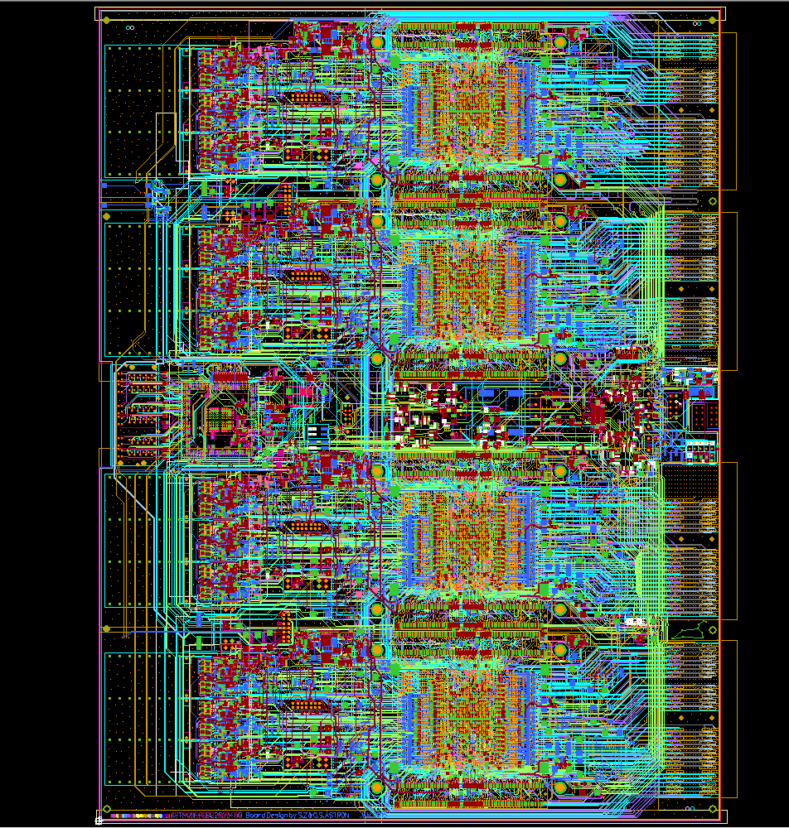
Notes:
Complex door vele transceivers, Arria10 eisen veranderen steeds (engineering sample)
~1-2.4 Tbps (26-64 DVDs per second)
5-21 TMAC/s: (40 - 162 PCs)
-18 layers
-5586 parts
-280 m trace length
Number of multipliers (18x19): 3036
Input data rate: 960 Gbps
Output data rate: 960 Gbps
Board interconnection data rate: 960 Gbps
DDR4 memory: 64 GByte

Slide 21
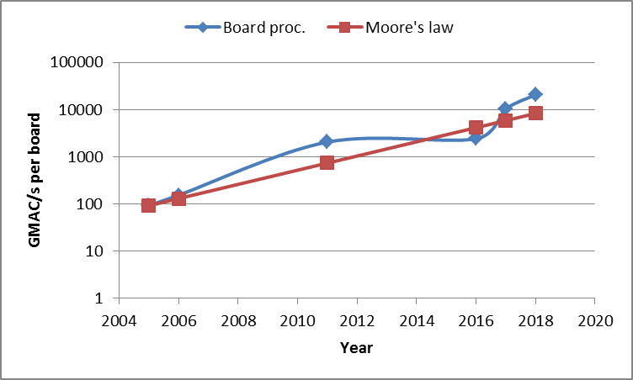
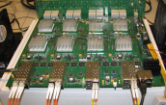

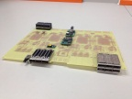

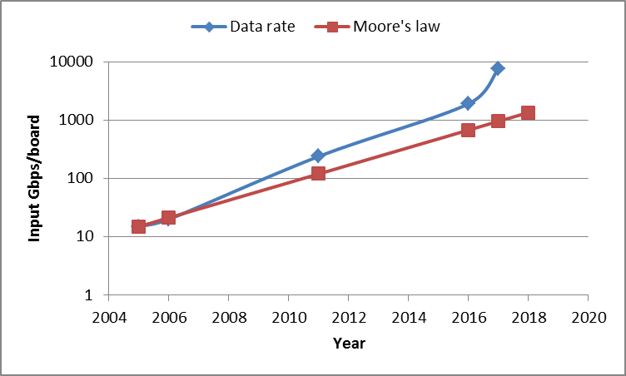
Notes:
Dip is caused by the fact that the # multipliers did not grow much from Uni1 to Uni2 and 4 FPGAs instead of 8

Slide 22
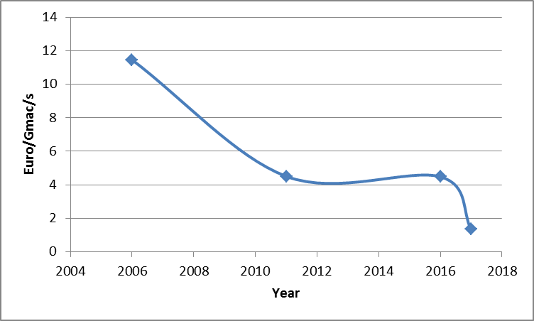
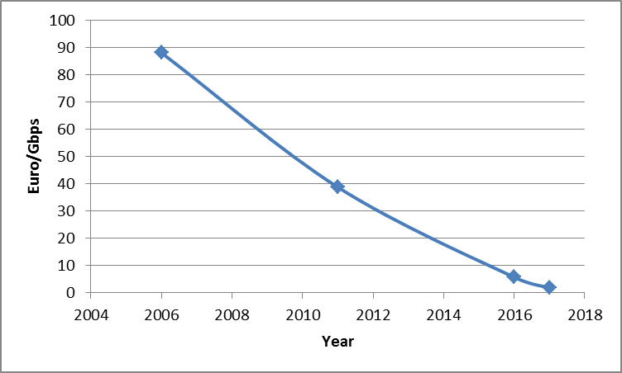

Slide 23
Notes:
Proposed 8 sections of each 8 board
Each section deals with 1/8 th of the bandwidth
Not 1 big switch is required

Slide 24
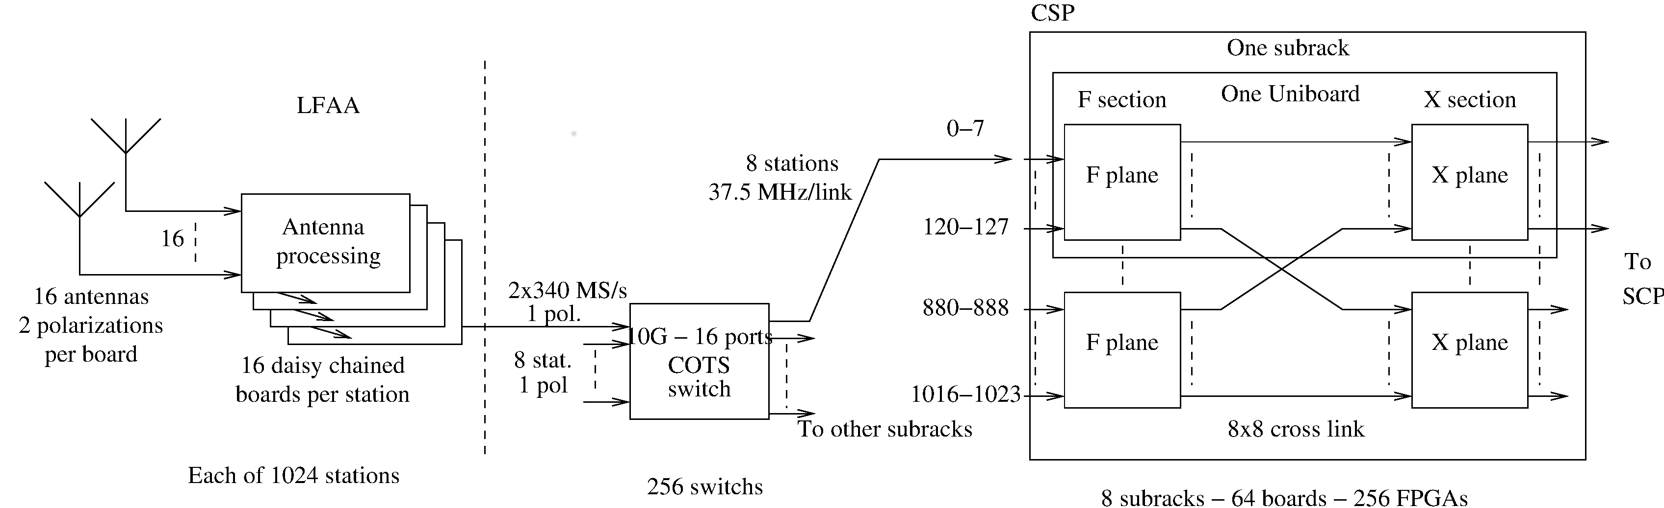
Notes:
Switch takes care of sending 1/8 th of bandwidth of 8 stations to one correlator section
Within a section the distribution of stations for a smaller part of the bandwidth is done
Such that each node receives the data of all stations for a small part of the bandwidth

Slide 25
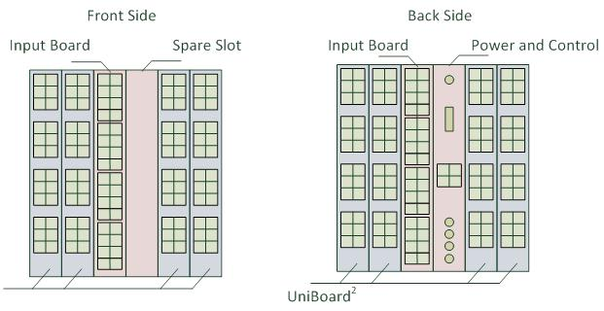
Notes:
10 Gbps connections per station (1024 stations x 10 Gbps), 60 Tbps coming out of the correlator
-input boards not necessary if 40 G is possible
-conservative 8 boards per sub-rack. Can be cranked up to 16.

Slide 26
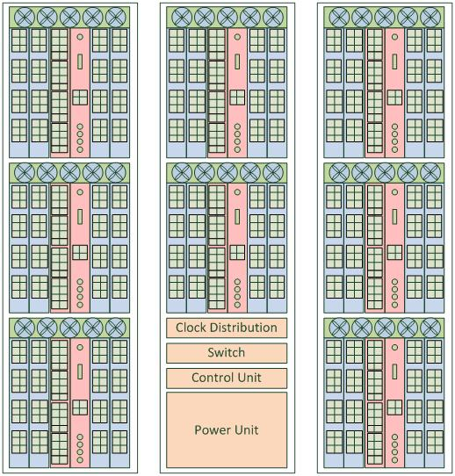
Notes:
In total 64 boards required or 128 …
8 subracks or maybe 4

Slide 27
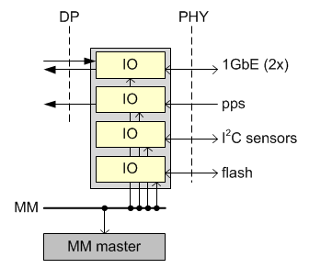
Firmware (factory image)
Notes:
Status of firmware for Uni^2

Slide 28
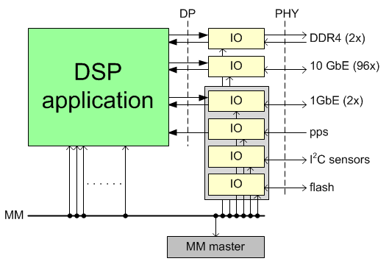
Test image
Notes:
By using the standard DP and MM interfaces the CSP design can focus on the Data Reorder and DSP functionality

Slide 29
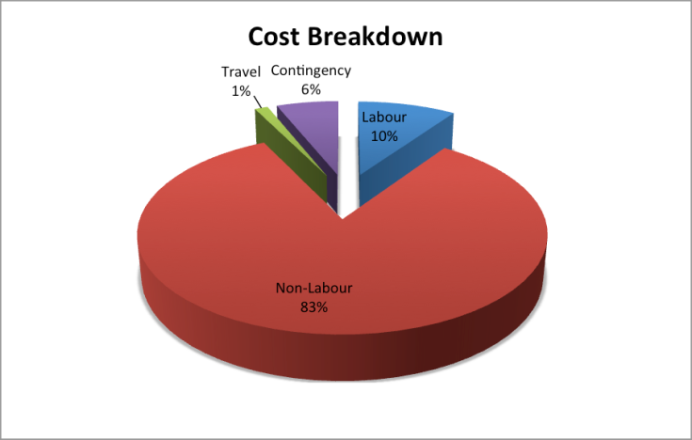
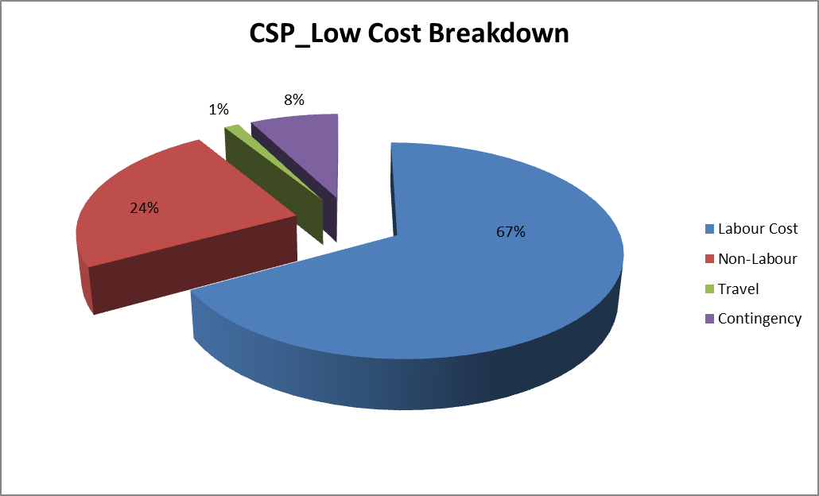
Cost comparison

Slide 30
Conclusions
UniBoard² is a good candidate for CSP_LOW
We are involved in architectural, hardware and firmware design
Firmware uses our framework to develop DSP application independently
Notes:
From the outside it does not always look what is inside

Slide 31


Slide 32
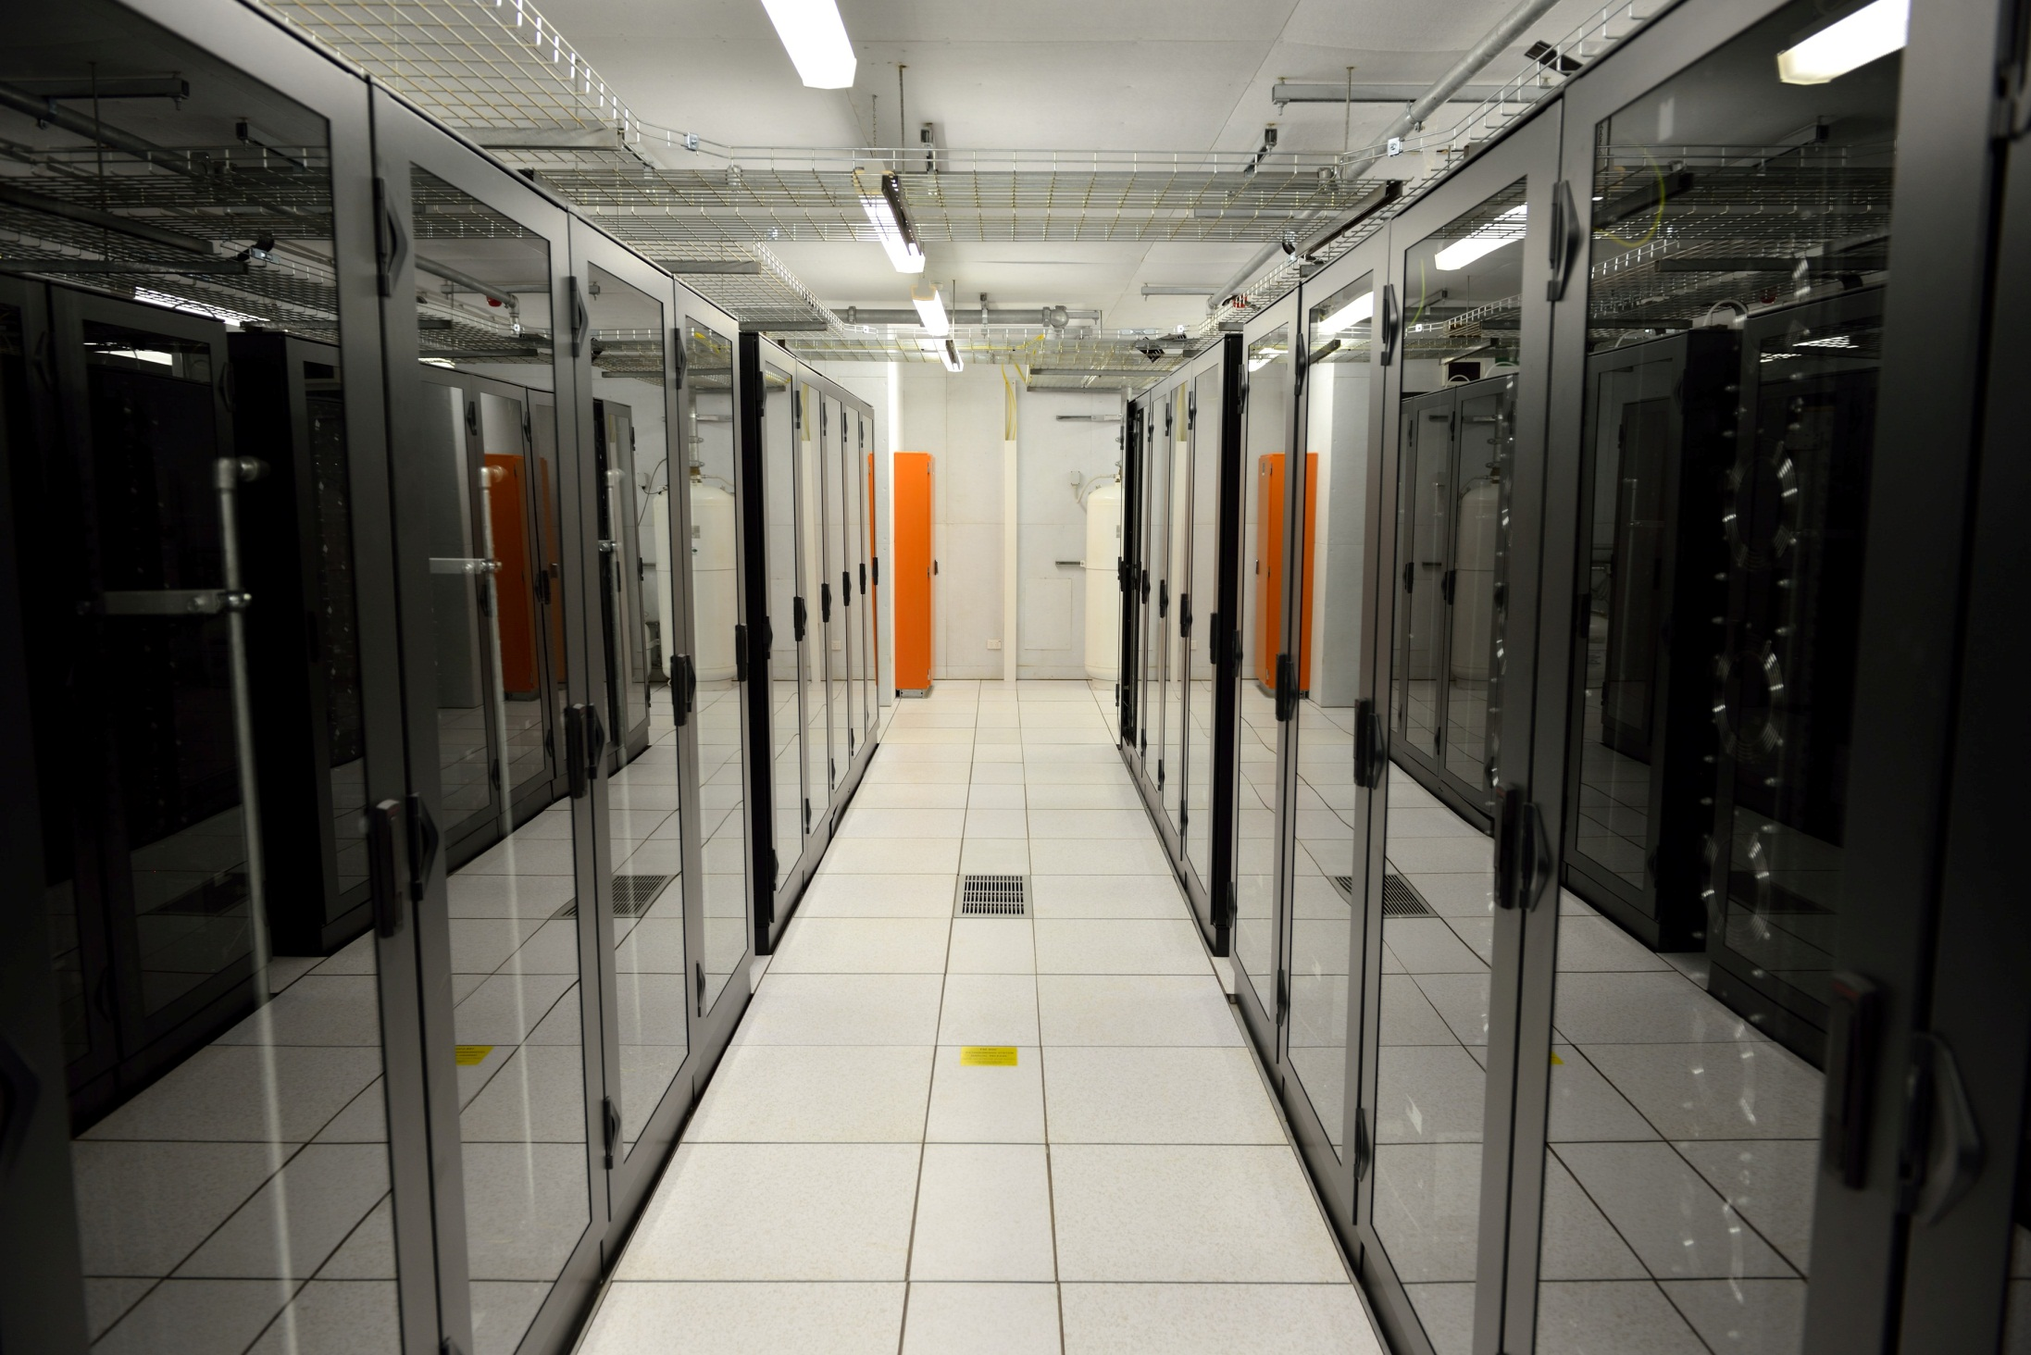

Slide 33
