Slide 1
UniBoard², a high performance digital processing board applied in the Square Kilometer Array
André Gunst
28-10-2014

Slide 2
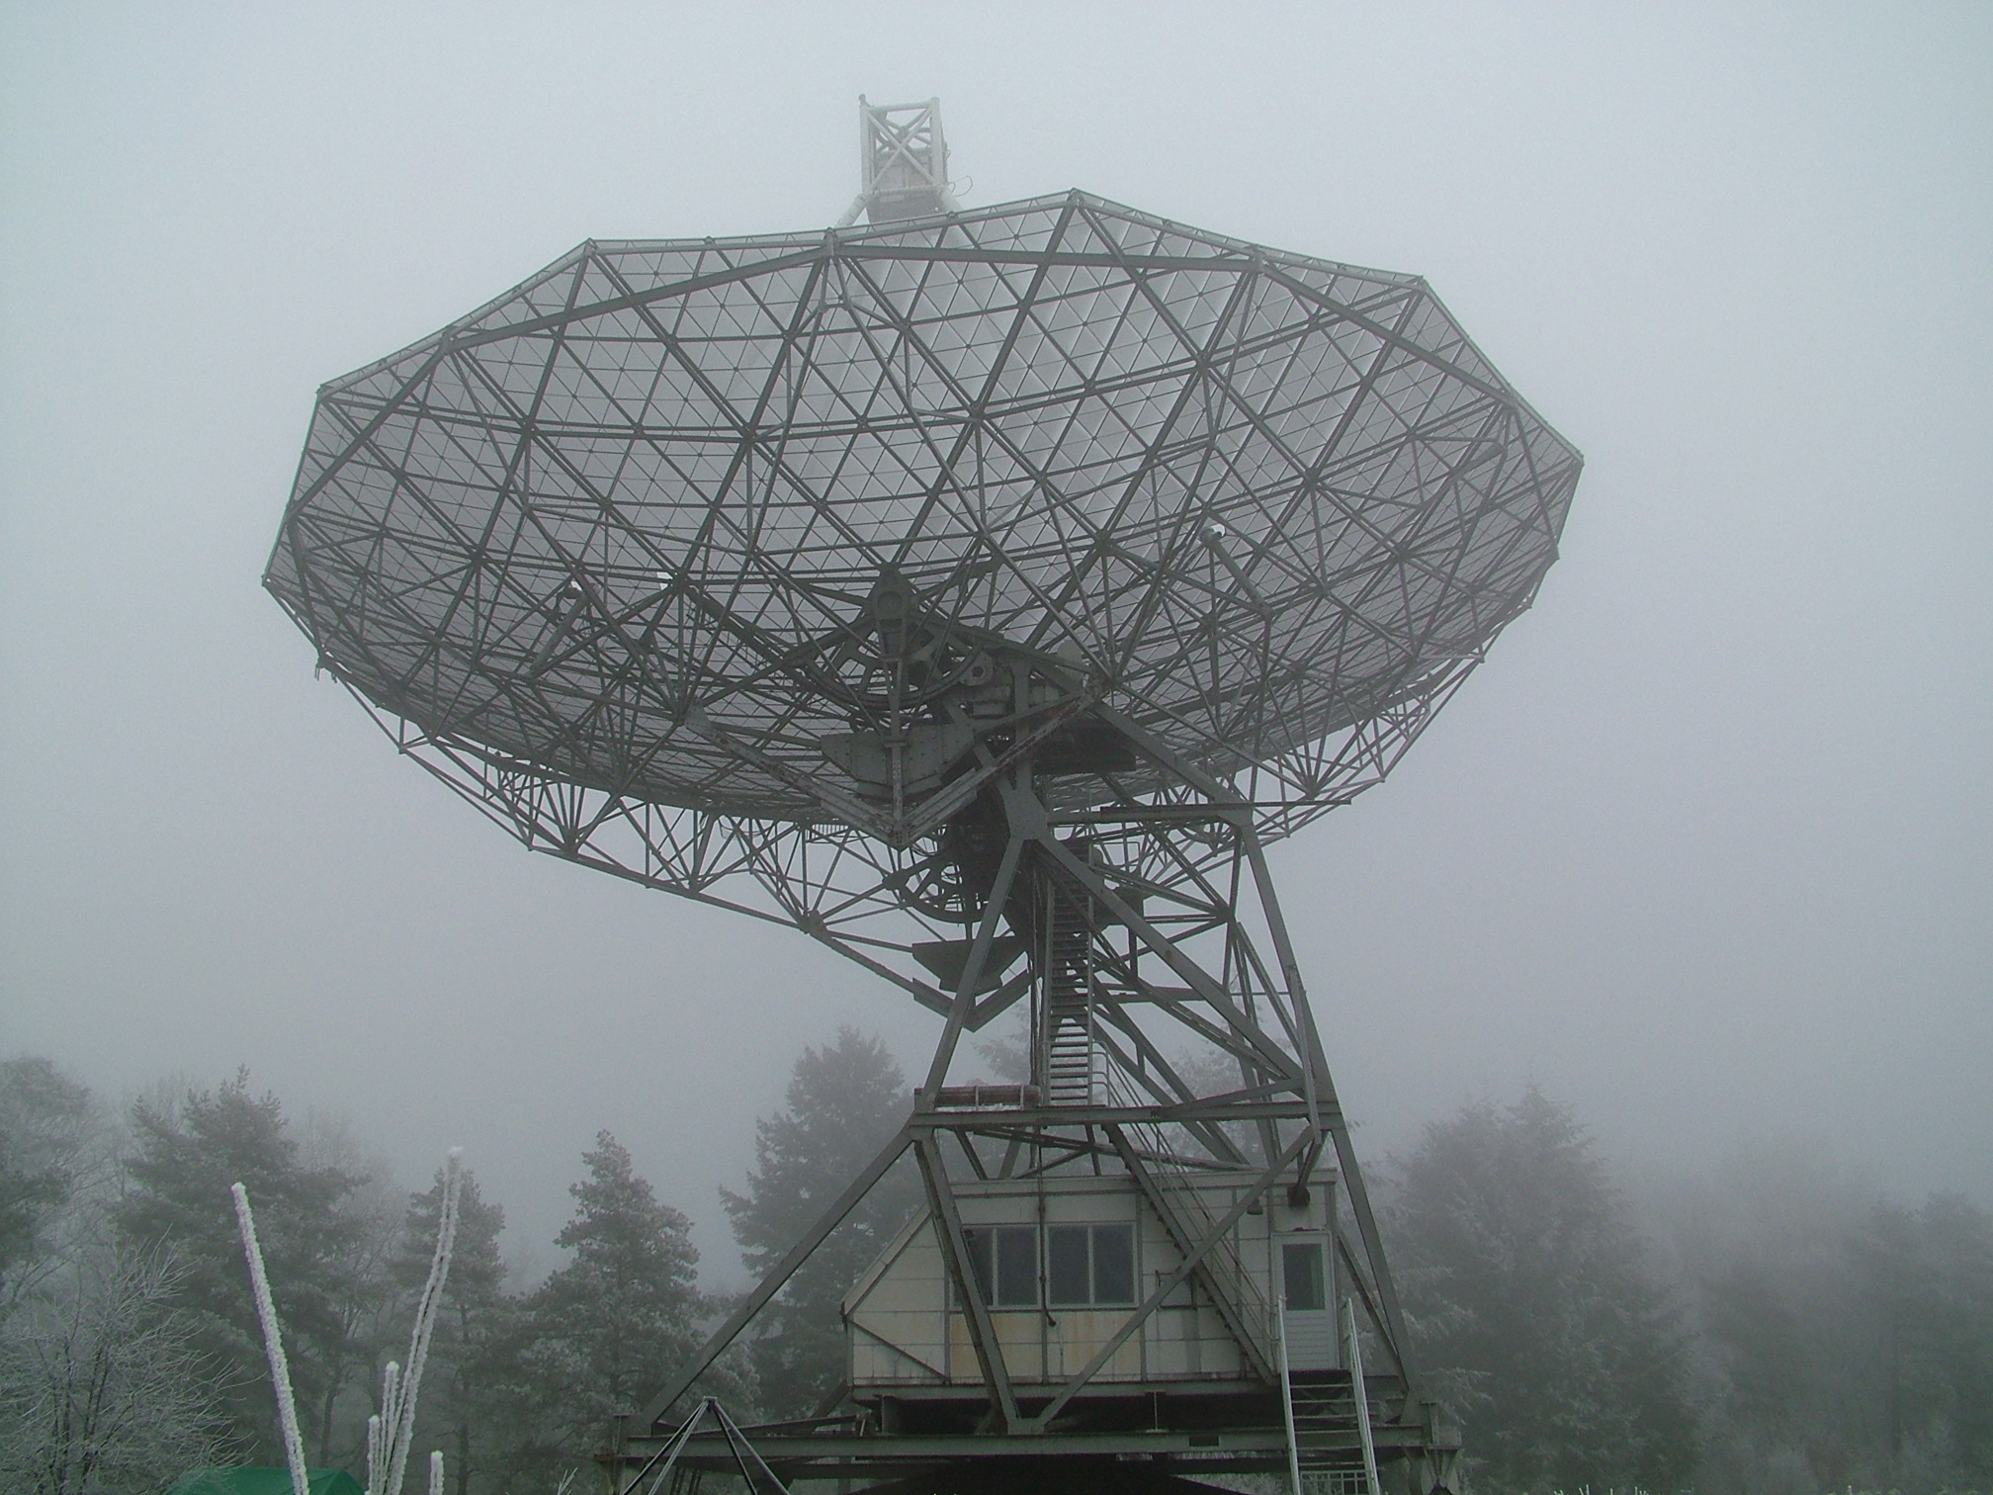

Slide 3
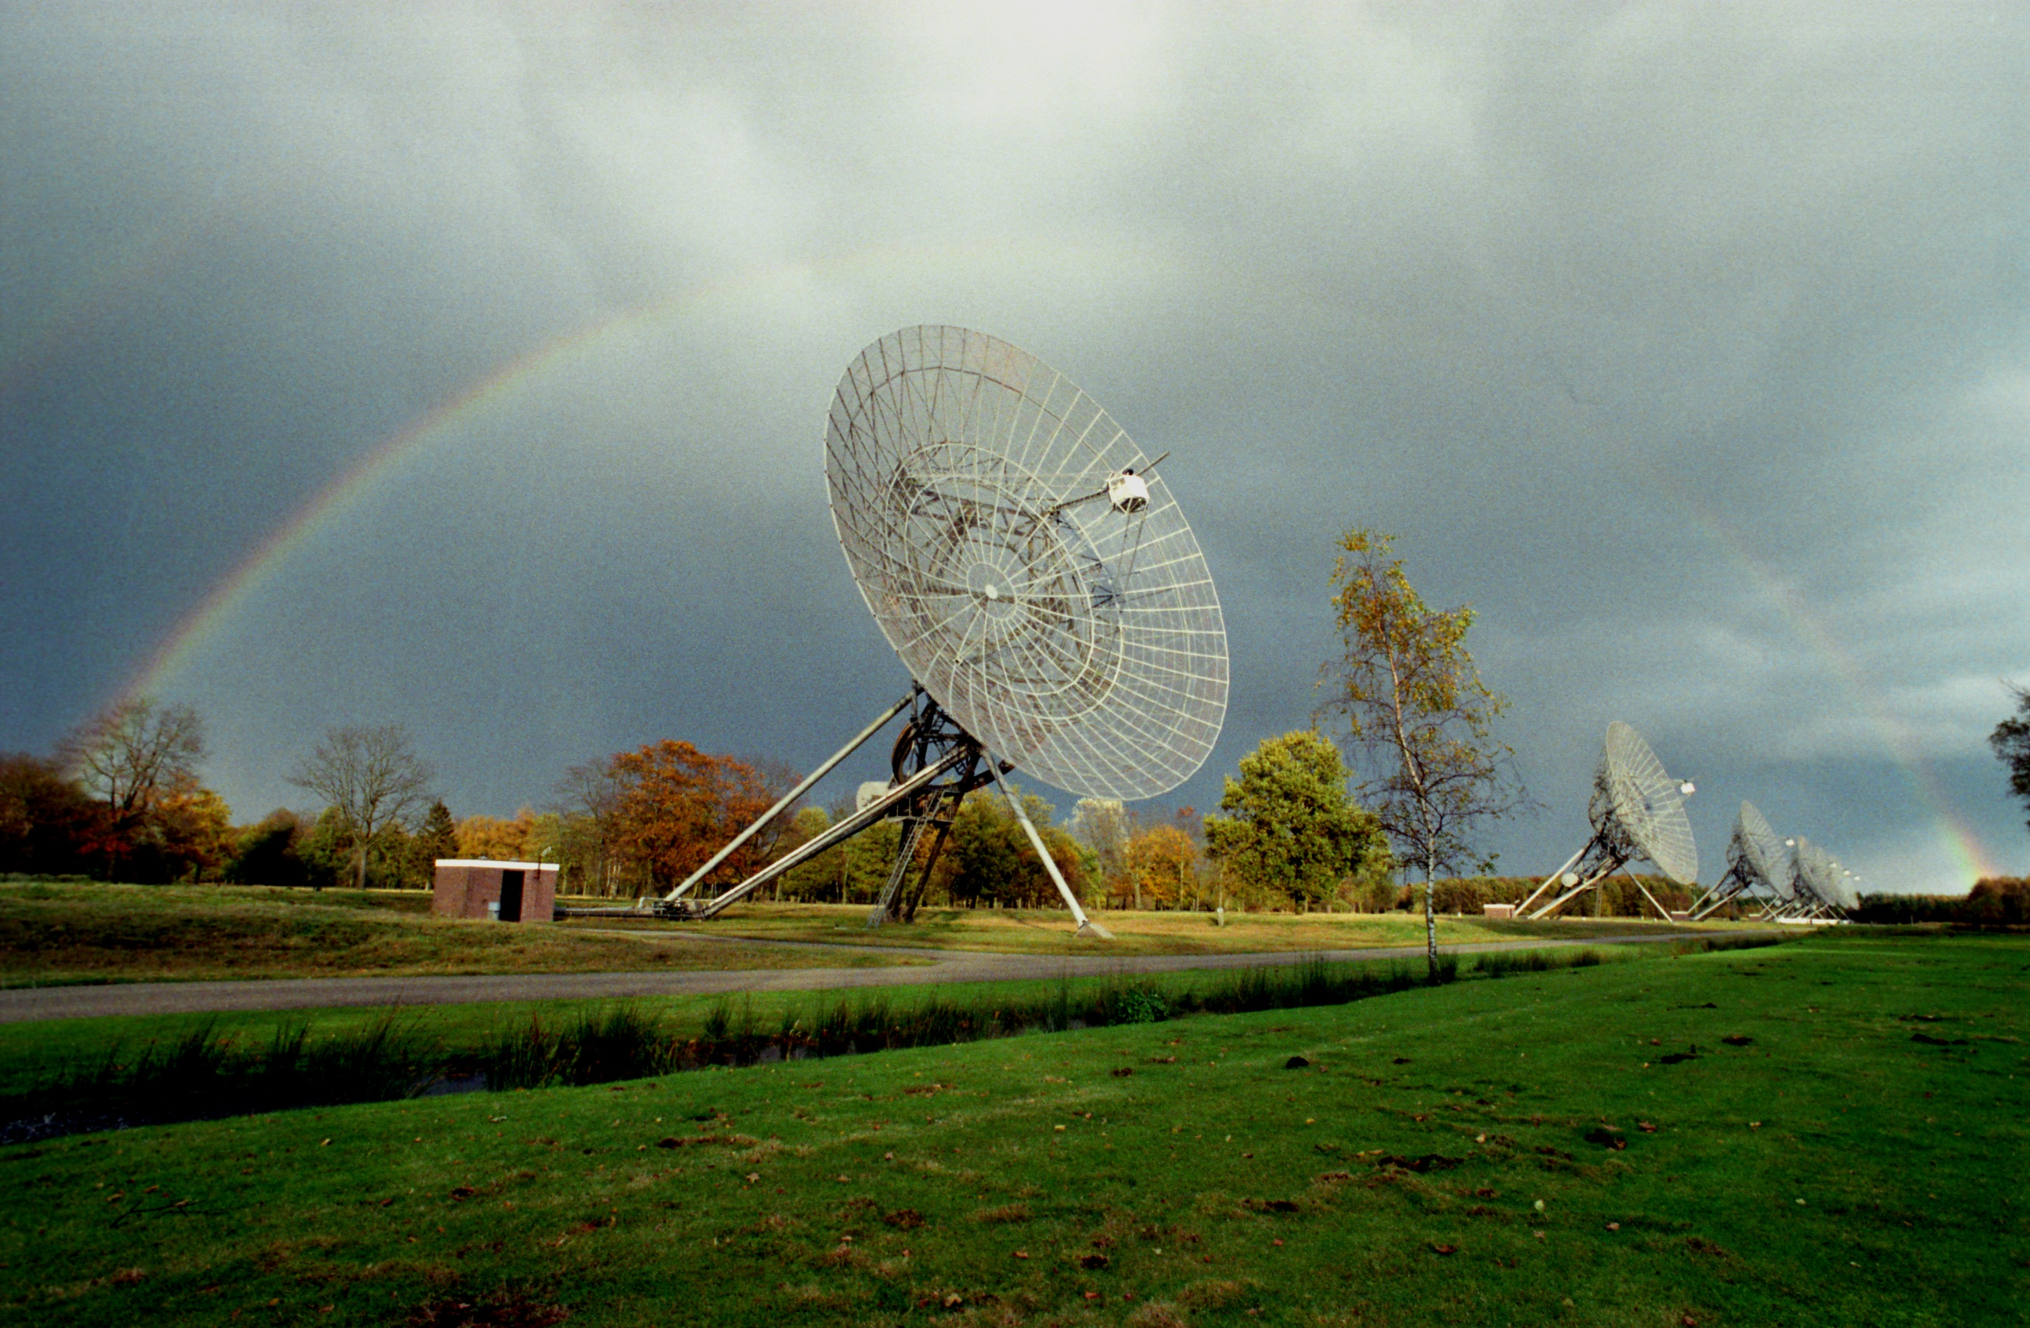

Slide 4
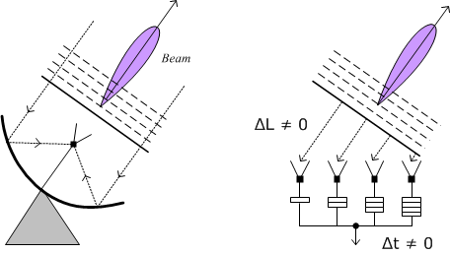

Slide 5
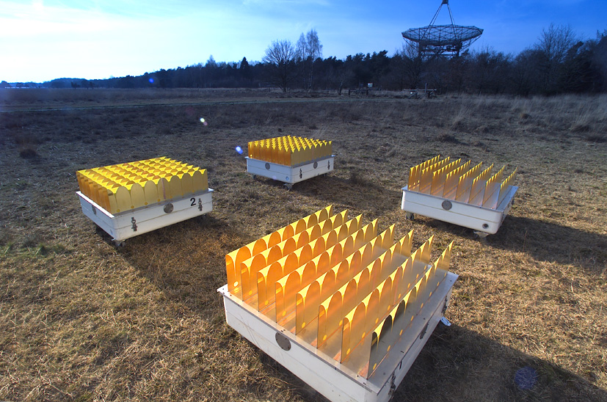

Slide 6
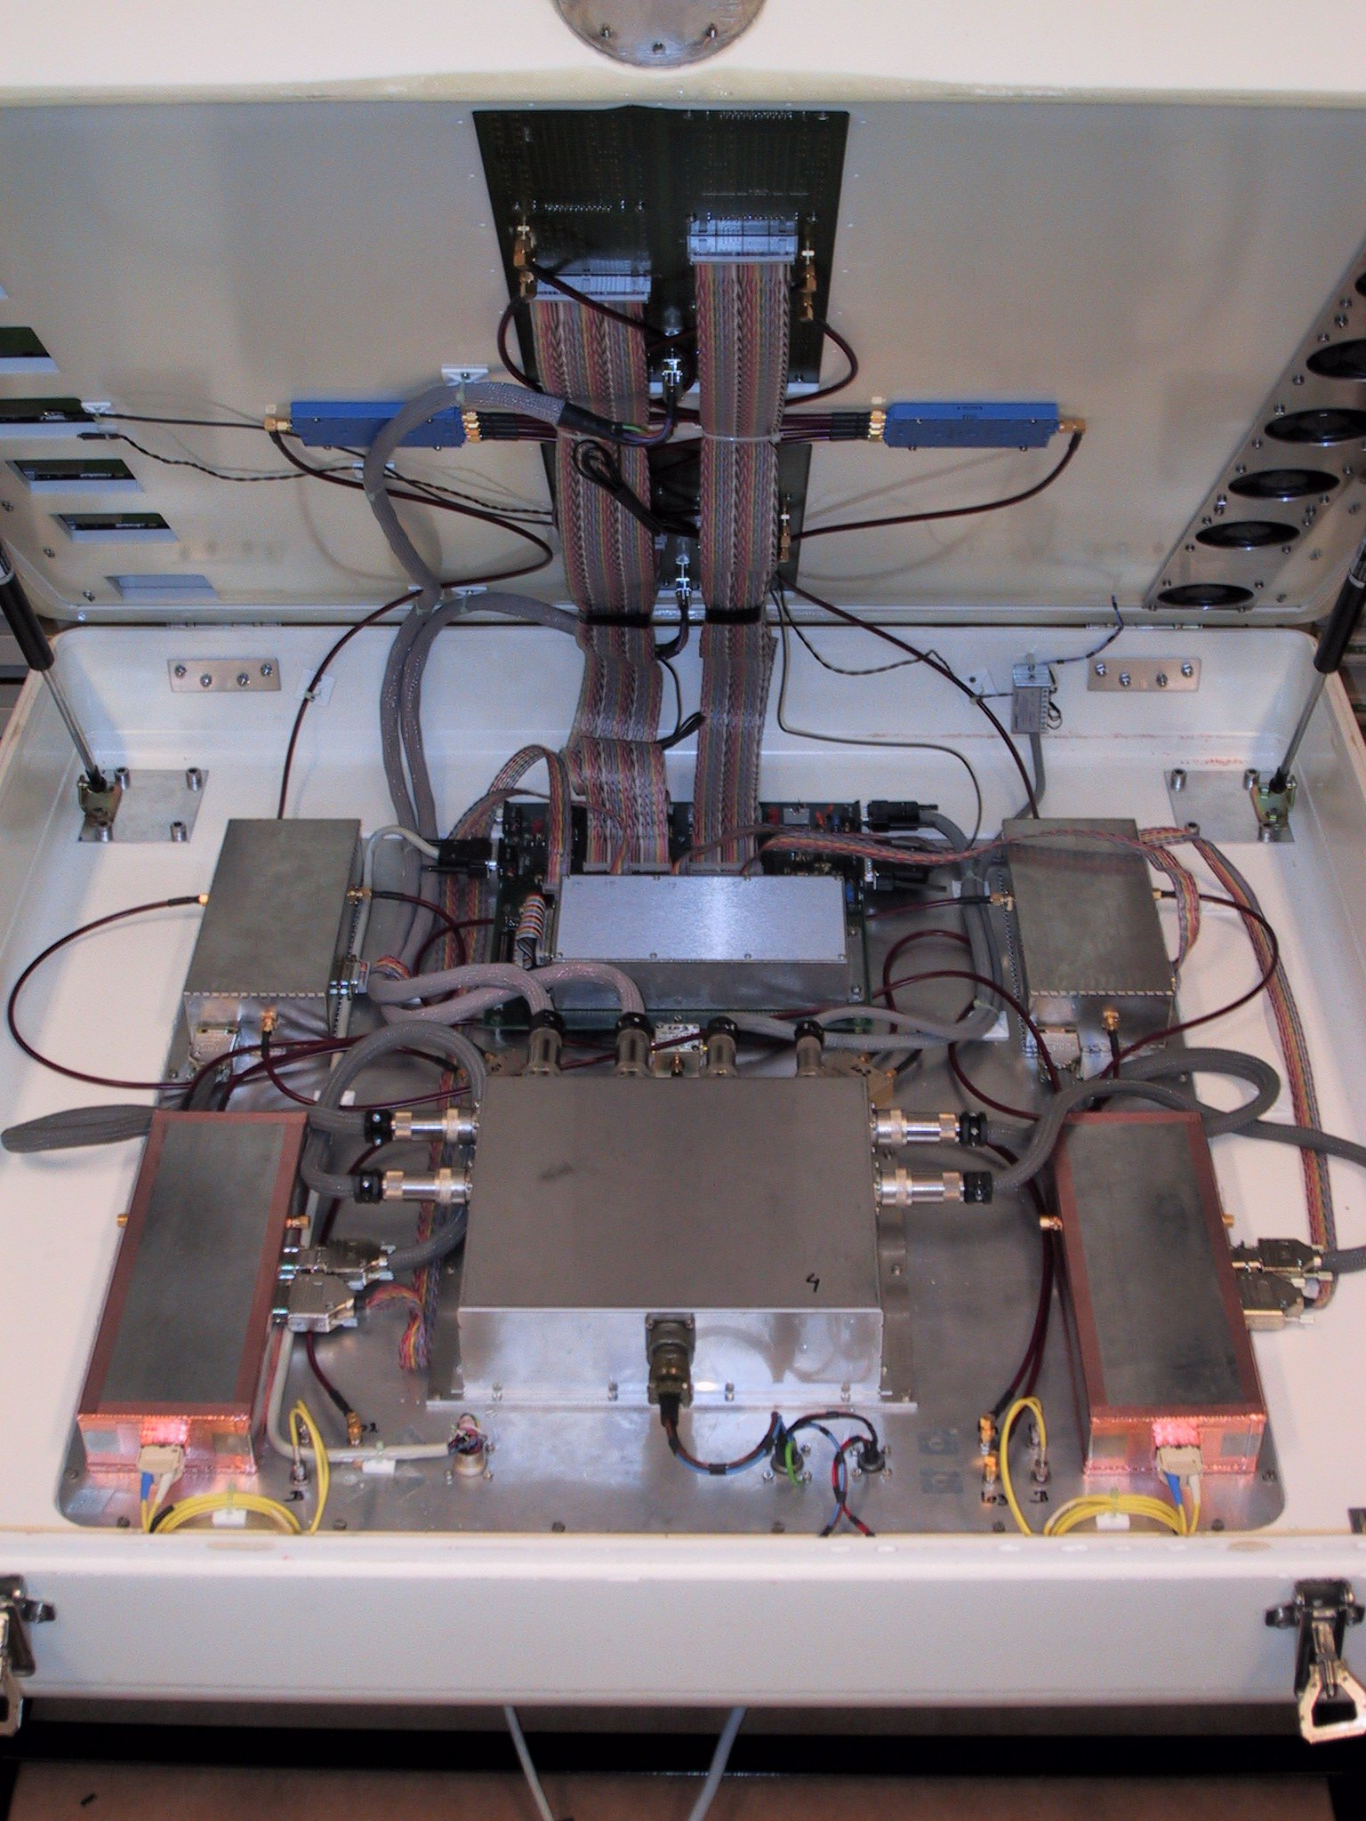

Slide 7
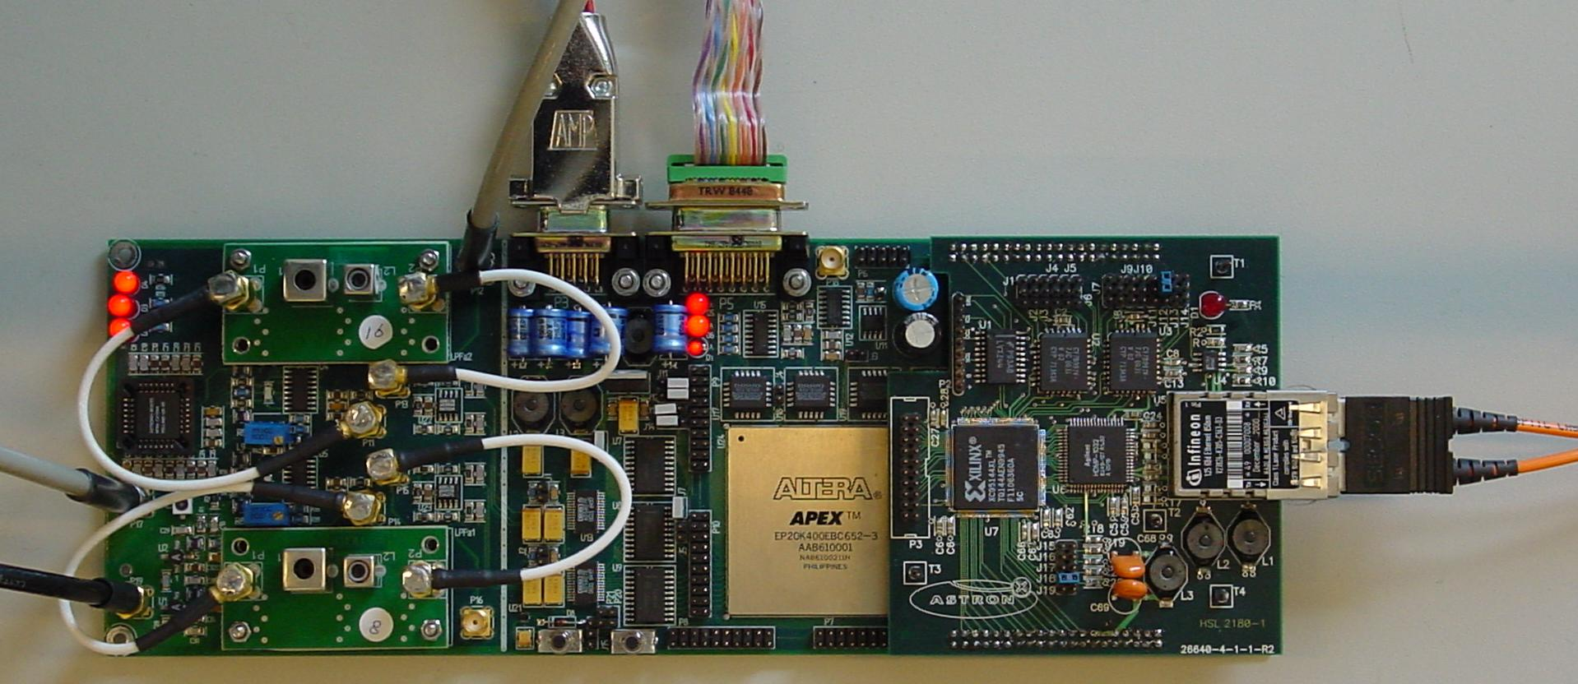

Slide 8
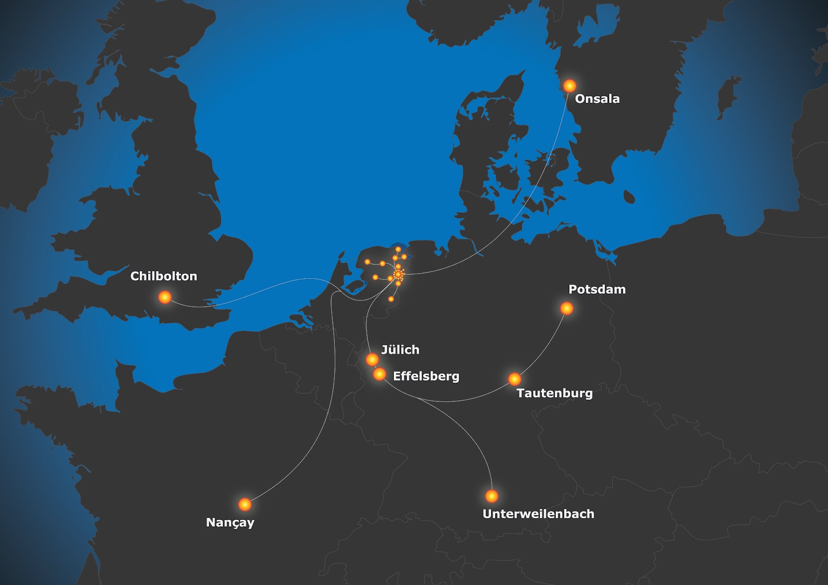

Slide 9
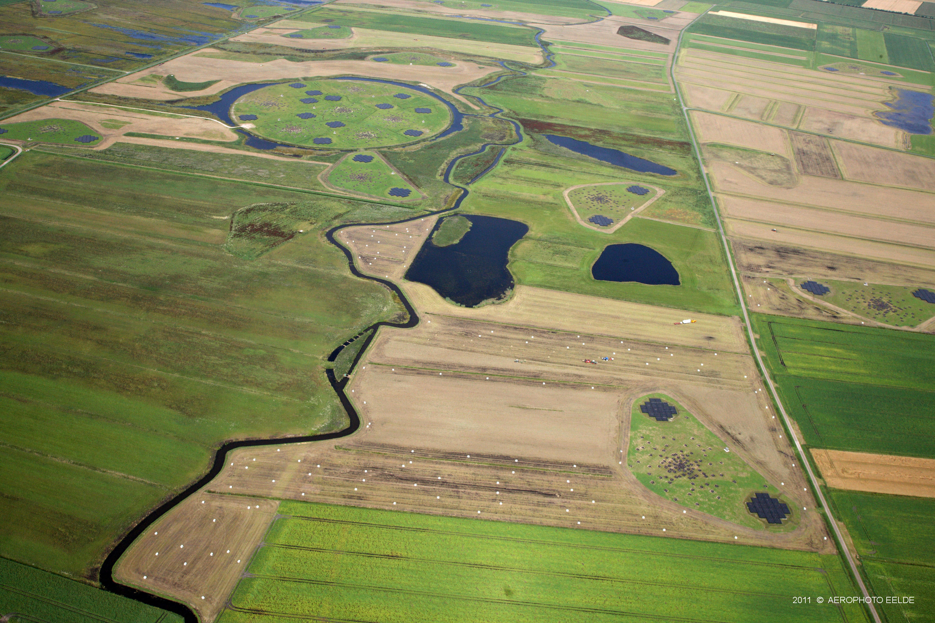

Slide 10
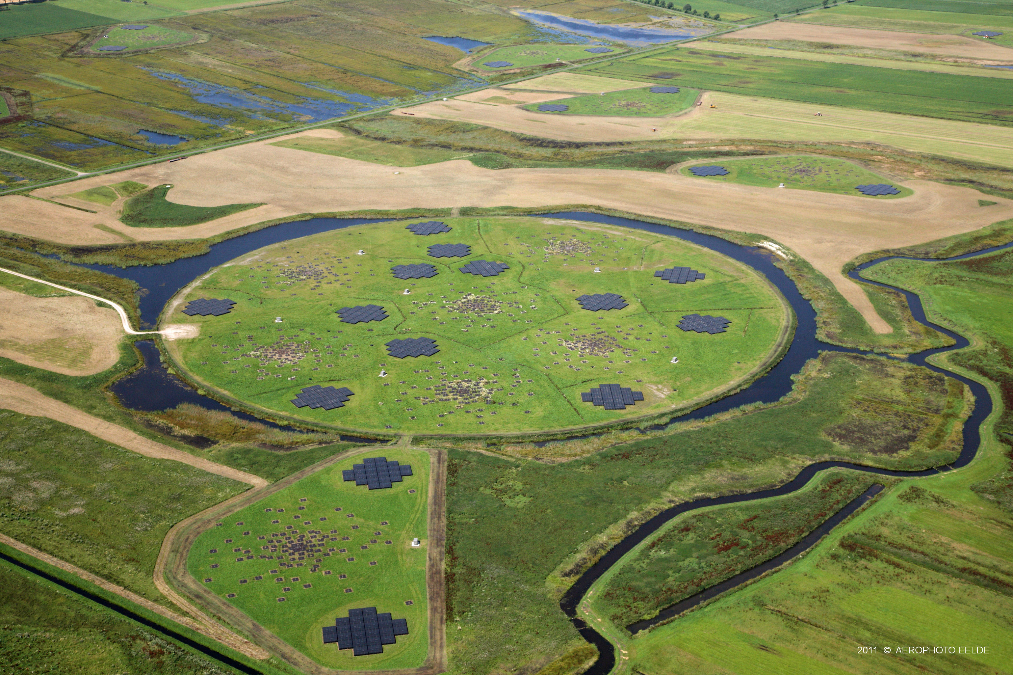

Slide 11
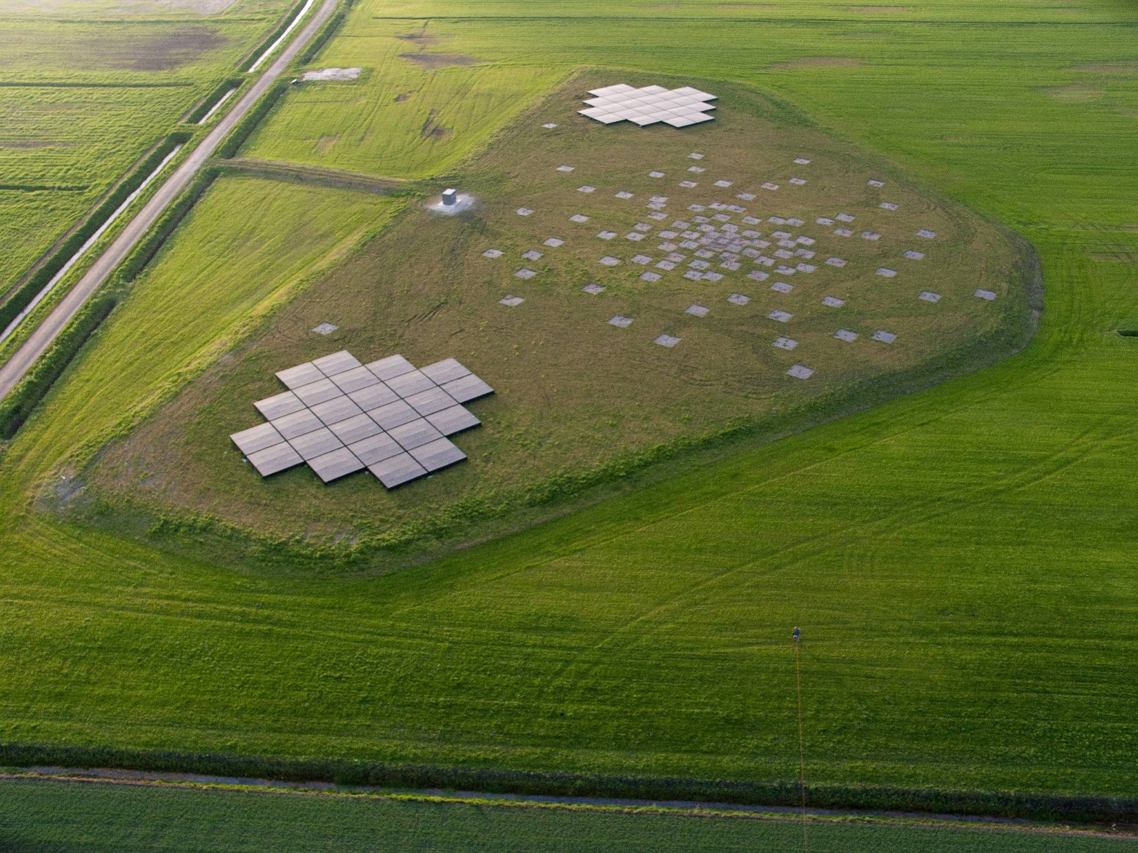
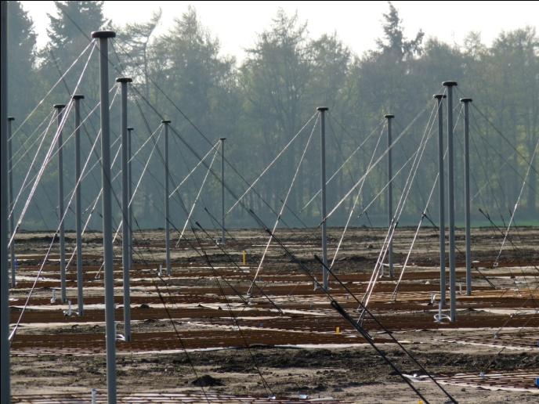
Core Station

Slide 12
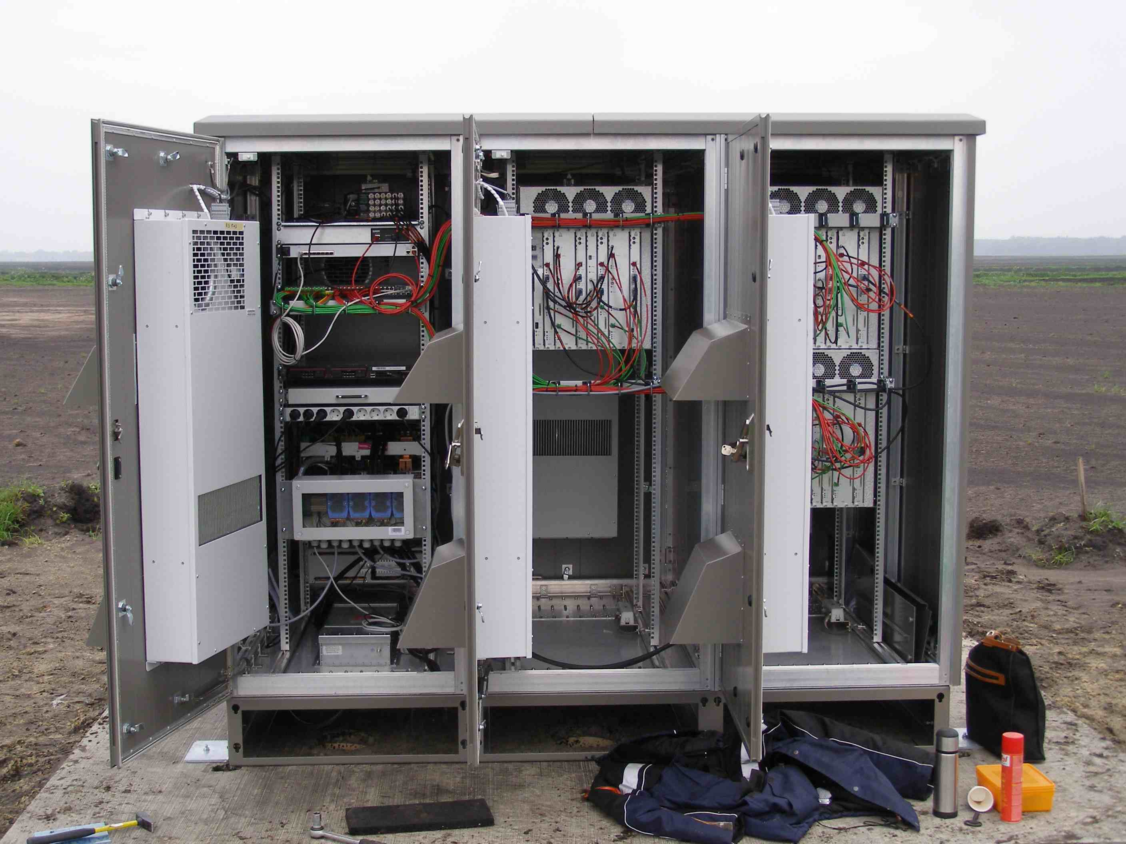

Slide 13
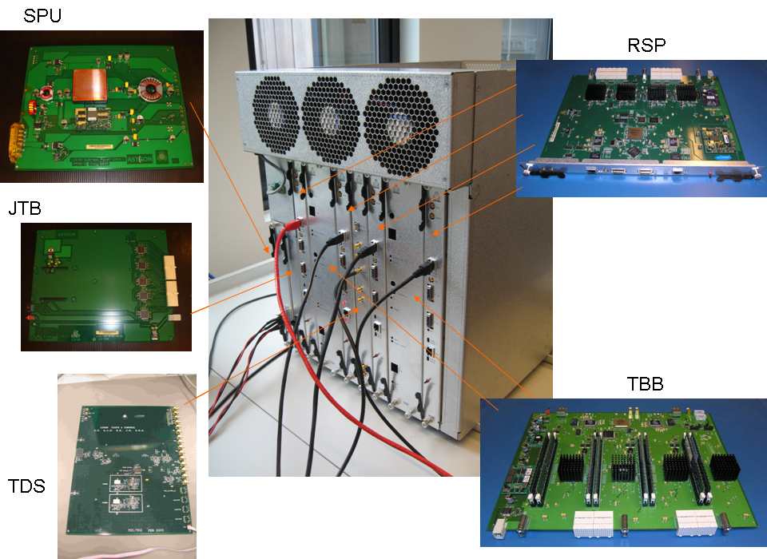

Slide 14
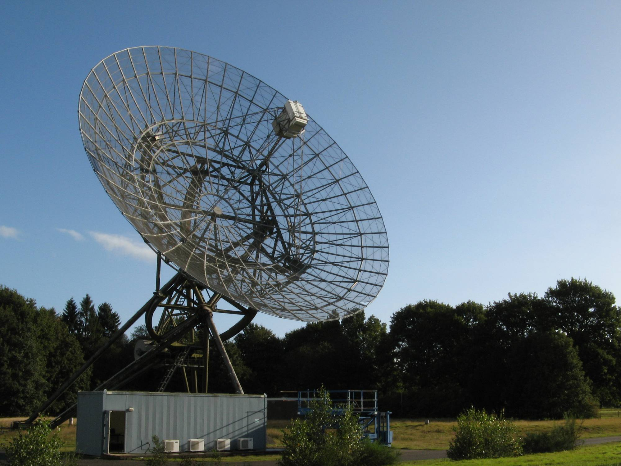
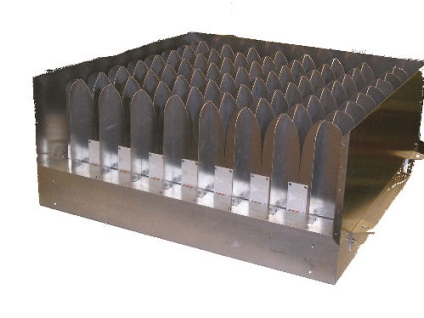
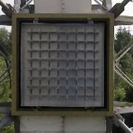
APERTIF
APERTIF prototype

Slide 15
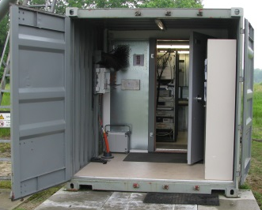
Definition
Dish-level Digital Beamformer

Slide 16
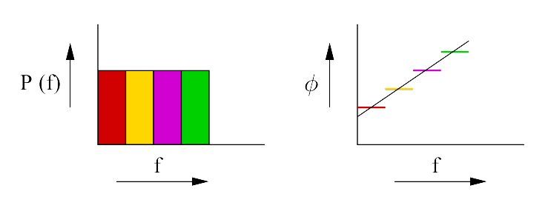
Beamforming

Slide 17
Beamformer Block Diagram
- single polarization
806 GMAC/s
410 Gbps
614.4 Gbps
151.2 Gbps
Notes:
Beamformer that generates an average of 42 beams per subband: total 16128 beams
bandwidth single subband = 0.78125 MHz
complex subband samples : 16-bit real + 16-bit imaginary
input bitrate: 64x384x0.78125x(16+16)=614.4 Gbit/s
What kind of hardware do we need for this beamforming?

Slide 18
Beamformer Implementation
- subband select
Filterbank output:
Very
Flexible

Slide 19
Beamformer Implementation

Slide 20
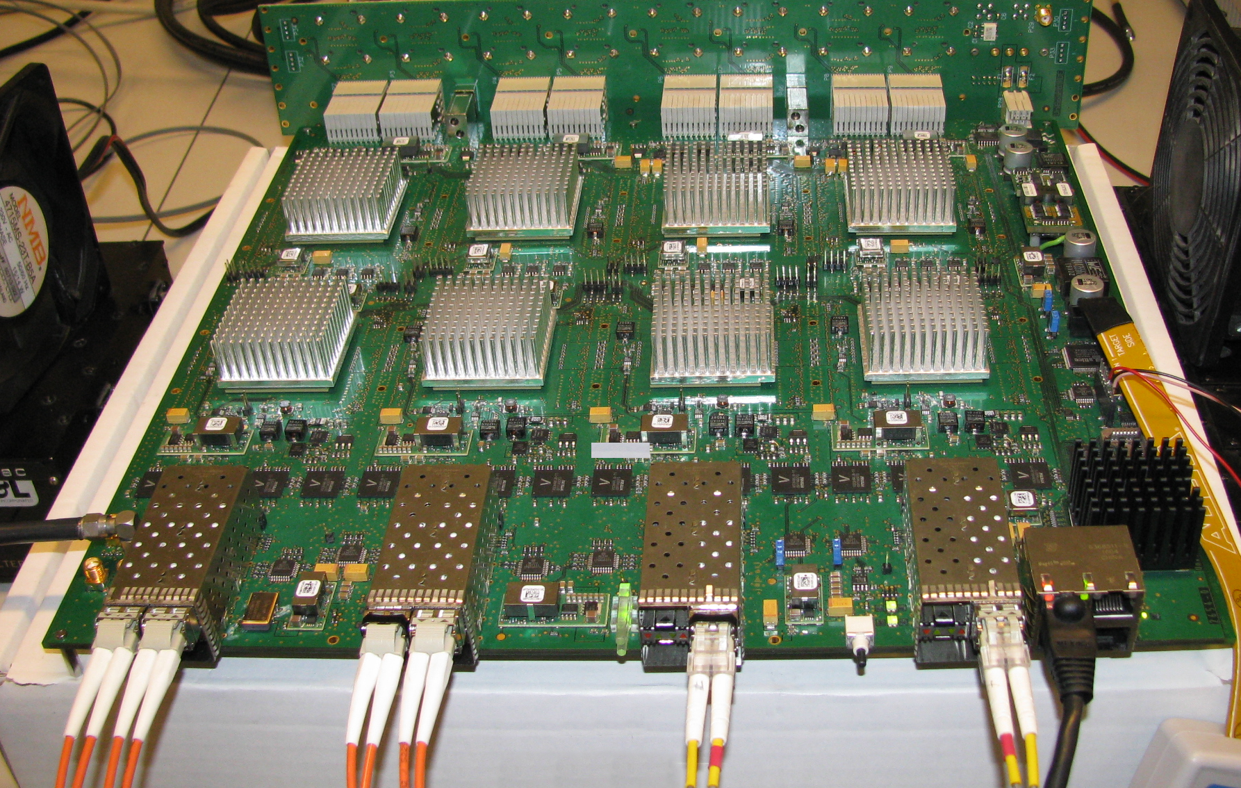

Slide 21
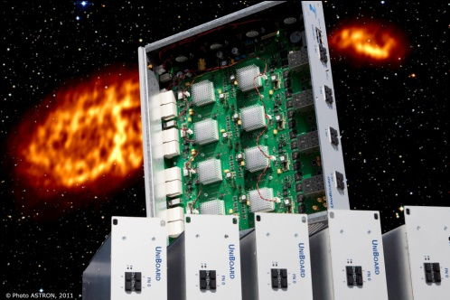
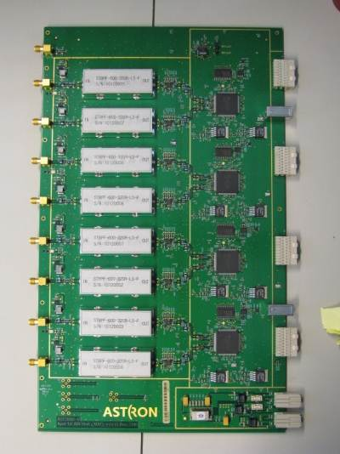
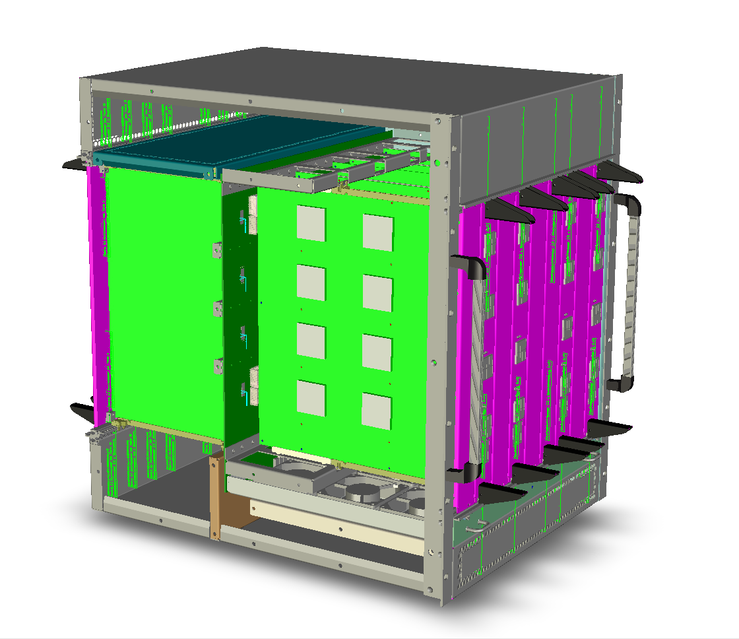
UniBoard in a Sub-rack
ADU
UniBoard

Slide 22
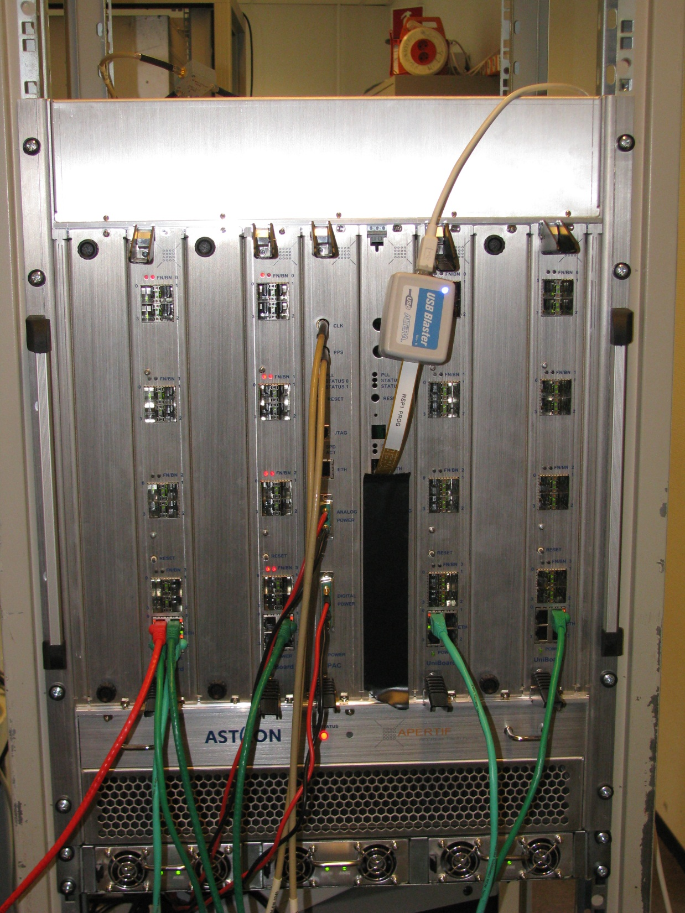
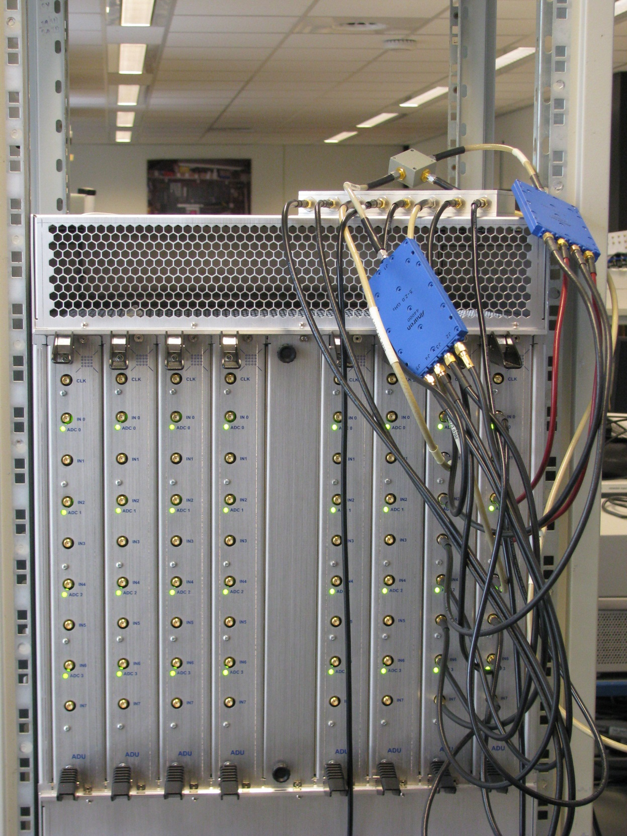
Current Status

Slide 23
Correlator
Correlator

Slide 24
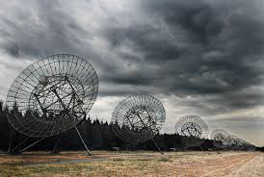
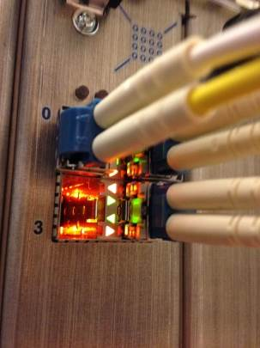
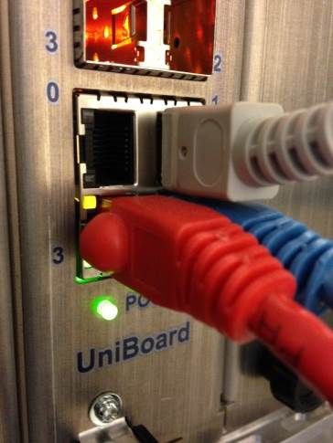
APERTIF Correlator
Data Input:
24 x 16 x 10GbEthernet
Data Output:
32 x 1GbEthernet

Slide 25
Correlator Block Diagram
- functional
Notes:
- Reordering and shuffling data is very easy on a FPGA.

Slide 26
Correlator Implementation
- Single Board option
16 UniBoards → 16384 beamlets
1 UniBoard → 1024 beamlets
1 Node → 128 beamlets
Notes:
Singe board because all channels enter on a single board

Slide 27


Slide 29
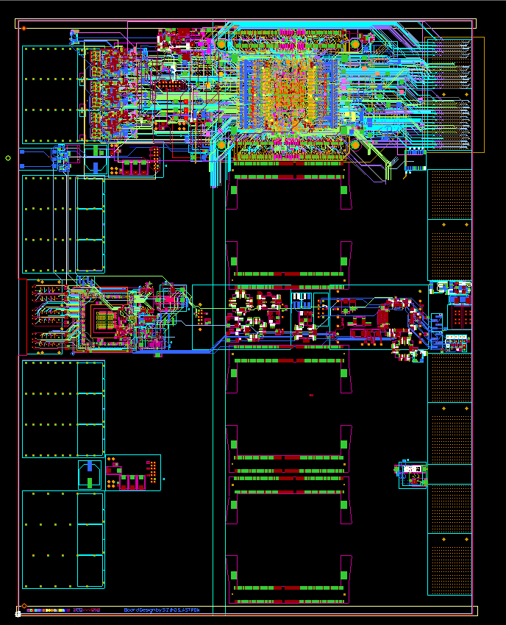
PCB

Slide 30
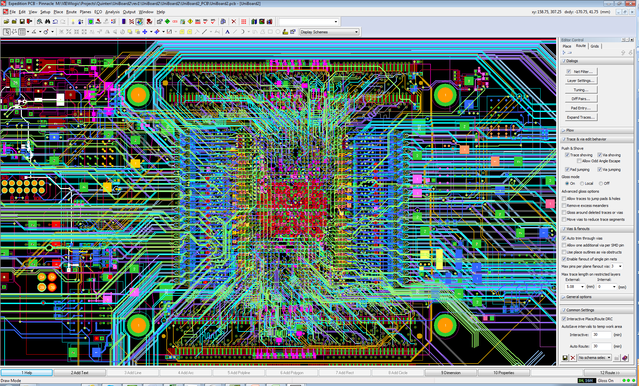

Slide 32
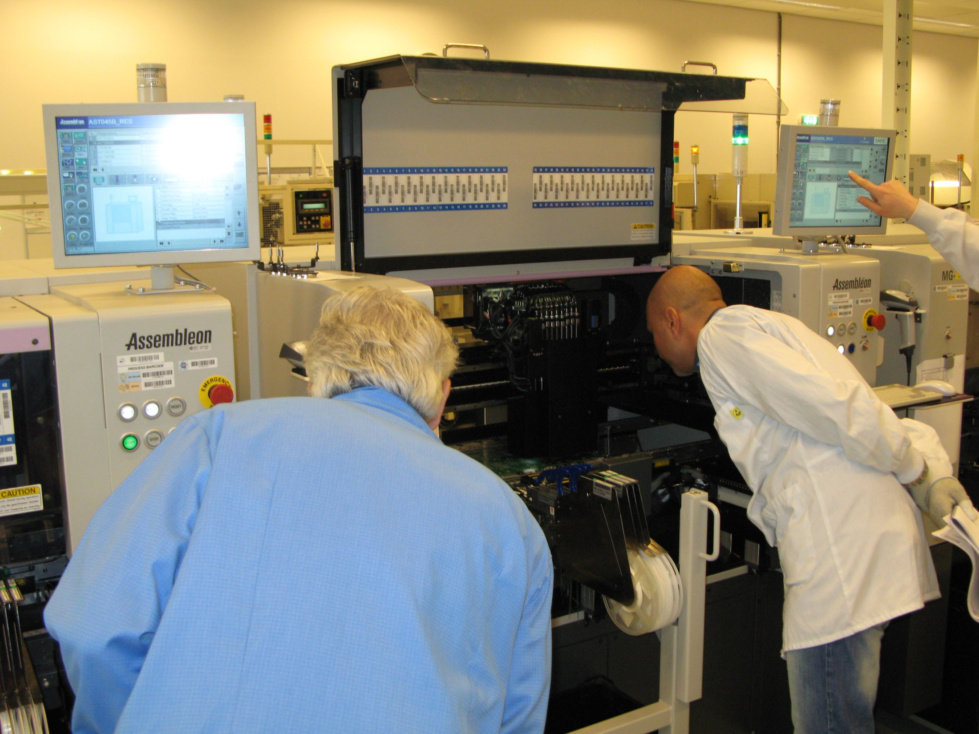
Assemblage

Slide 33
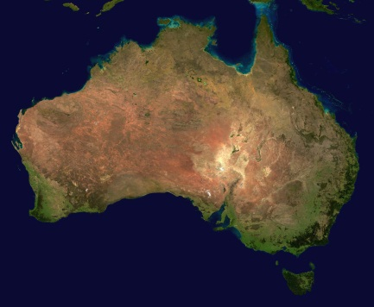
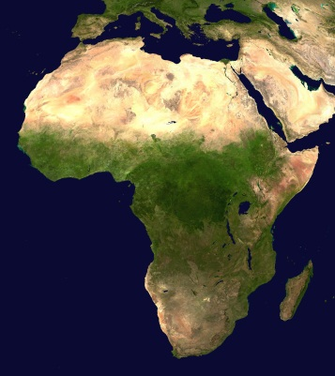
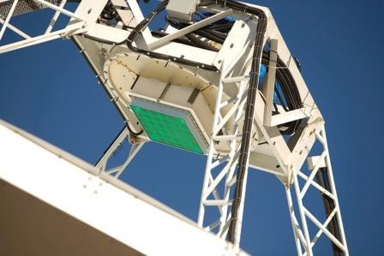
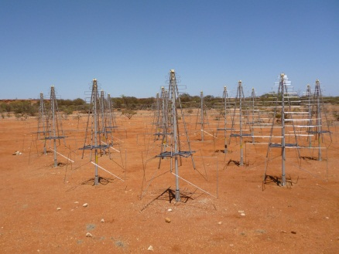
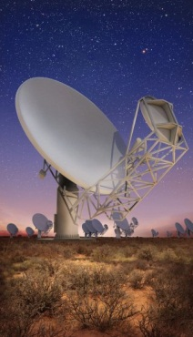
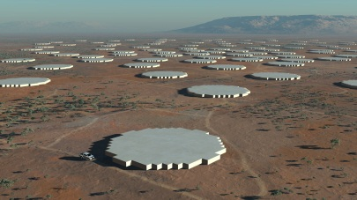
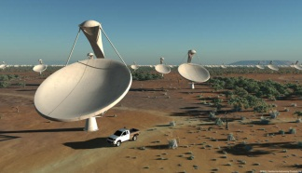
SKA Receptors
Site:
Western Australia
Site:
Southern Africa
SKA Dishes
Mid Frequency Aperture Arrays
ASKAP Phase Array Feeds
Low Frequency Aperture Arrays
Meer KAT Dishes

Slide 34
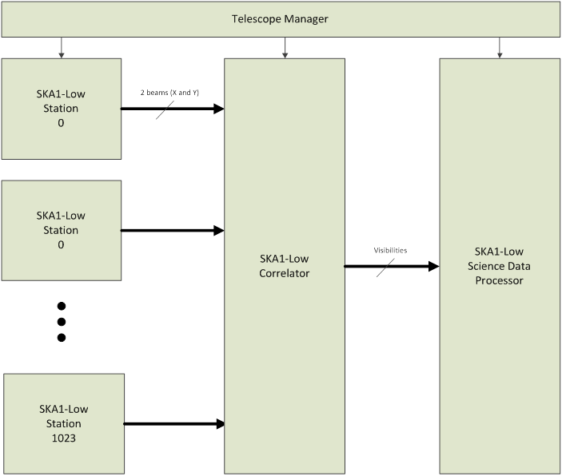

Slide 35
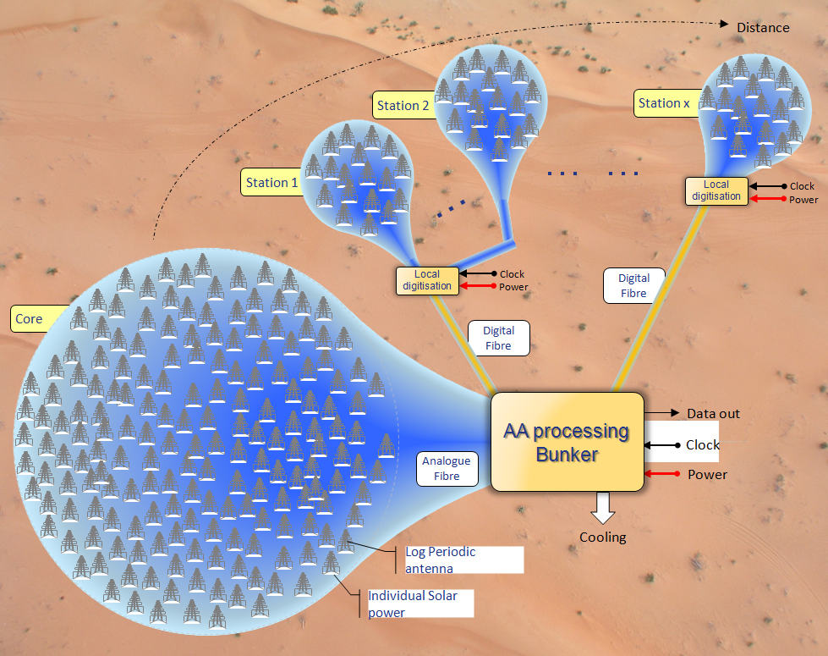
LFAA Configuration

Slide 36
LFAA Station Functional Diagram

Slide 37
Proposed LFAA Beamformer Implementation
Notes:
Less beams out: ring structure more economic

Slide 38
Routing the Data
192 signal paths / UniBoard²

Slide 40
SKA Low Correlator

Slide 42
Correlator Section Interconnections

Slide 43
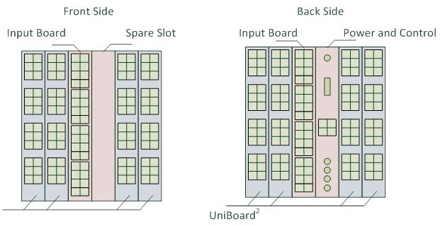

Slide 44
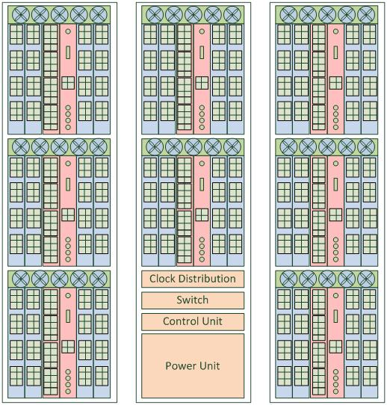

Slide 45
Integrated Beamformer & Correlator

Slide 46
Conclusions
UniBoard(²) aims for data intensive and streaming systems using simple operations on loads of data
UniBoard(²) targeted for large systems (like the SKA)
Standard interfaces increases the usability (not restricted to radio astronomy)
UniBoard² is built on the experiences with UniBoard
  System
  Board
  Firmware
  Software

Slide 47
The End

Slide 48
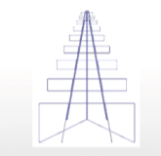
Signal Path
Antenna & LNA
Receiver
Signal Processing
Spectral filters
1st Beamforming
Station beamforming
LNA
RFoF
ADC
Data
out
e/o
o/e
e/o
Antenna
structure
Clock
Control & Monitoring
Solar/copper
Power
Power
Bunker
Power
Local Infrastructure
Monitor & Control

Slide 49
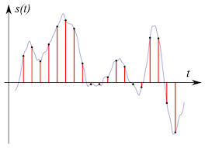
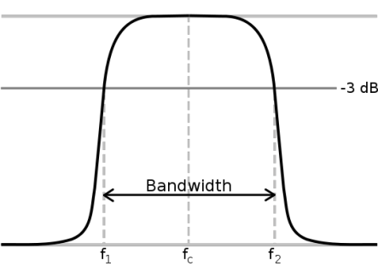
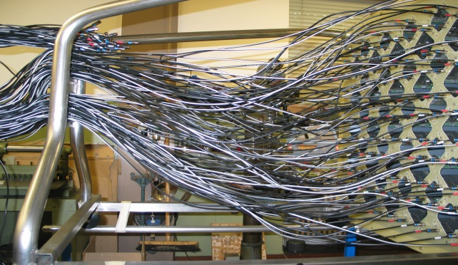
Beamformer requirements
- single polarization (I).
Input:
8 bits @ 800 MSps
400 MHz
512 subbands @
781250 Hz
64 signal inputs

Slide 50
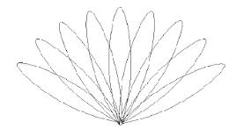
Beamformer requirements
- single polarization(II).
Output:
384 subbands @
781250 Hz
300 MHz
__
37 beams
6 + 6 bits complex

Slide 51
Beamformer Block Diagram
- single polarization
Output ADCs: 64 x 800MHz x 8 bit = 410 Gbit/s
Input Beamformer: 64 x 384 subbands x 781.25 kHz * (16 + 16) bit =
614.4 Gbit/s
Output Beamformer: 42 x 384 x 781.25 kHz * (6 + 6) bit=
151.2 Gbit/s
Processing: 806 Giga-multiplications per second
Notes:
Beamformer that generates an average of 42 beams per subband: total 16128 beams
bandwidth single subband = 0.78125 MHz
complex subband samples : 16-bit real + 16-bit imaginary
input bitrate: 64x384x0.78125x(16+16)=614.4 Gbit/s
What kind of hardware do we need for this beamforming?

Slide 53
Alternative Solution

Slide 54
LFAA Station Functional Diagram
Memory req’s/station:
-5.8 Gbit
-9.6 Gbps

Slide 55
SKA Low Correlator
~ 20 Tbps
59 Tbps

Slide 56
