Slide 1
Digital Board Design @ ASTRON
ASTRON/DESP
Gijs Schoonderbeek
17-06-2015

Slide 2

LOFAR
WORLD LARGEST RADIO TELESCOPE

Slide 3
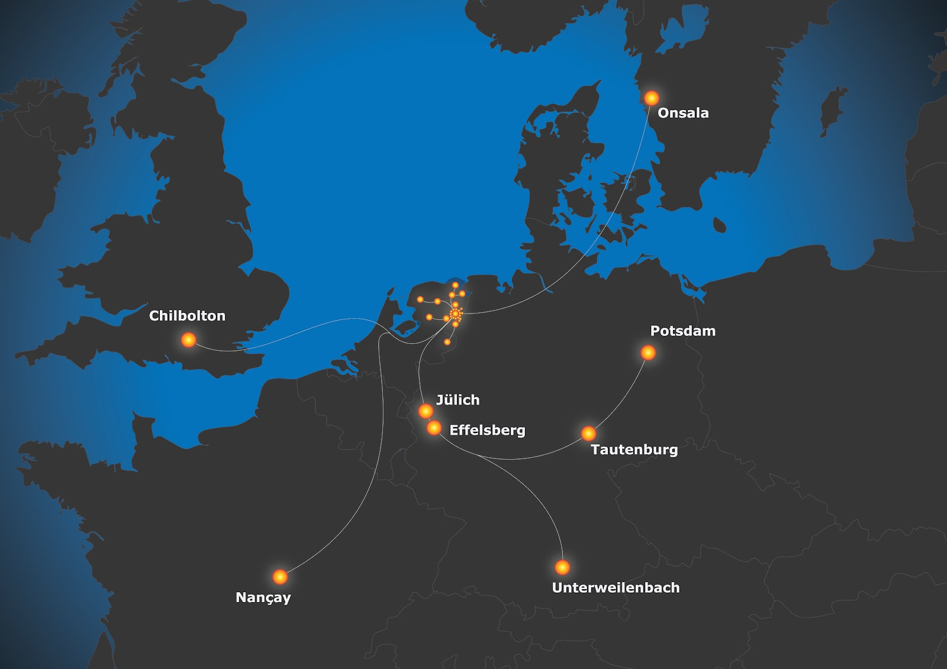

Slide 4
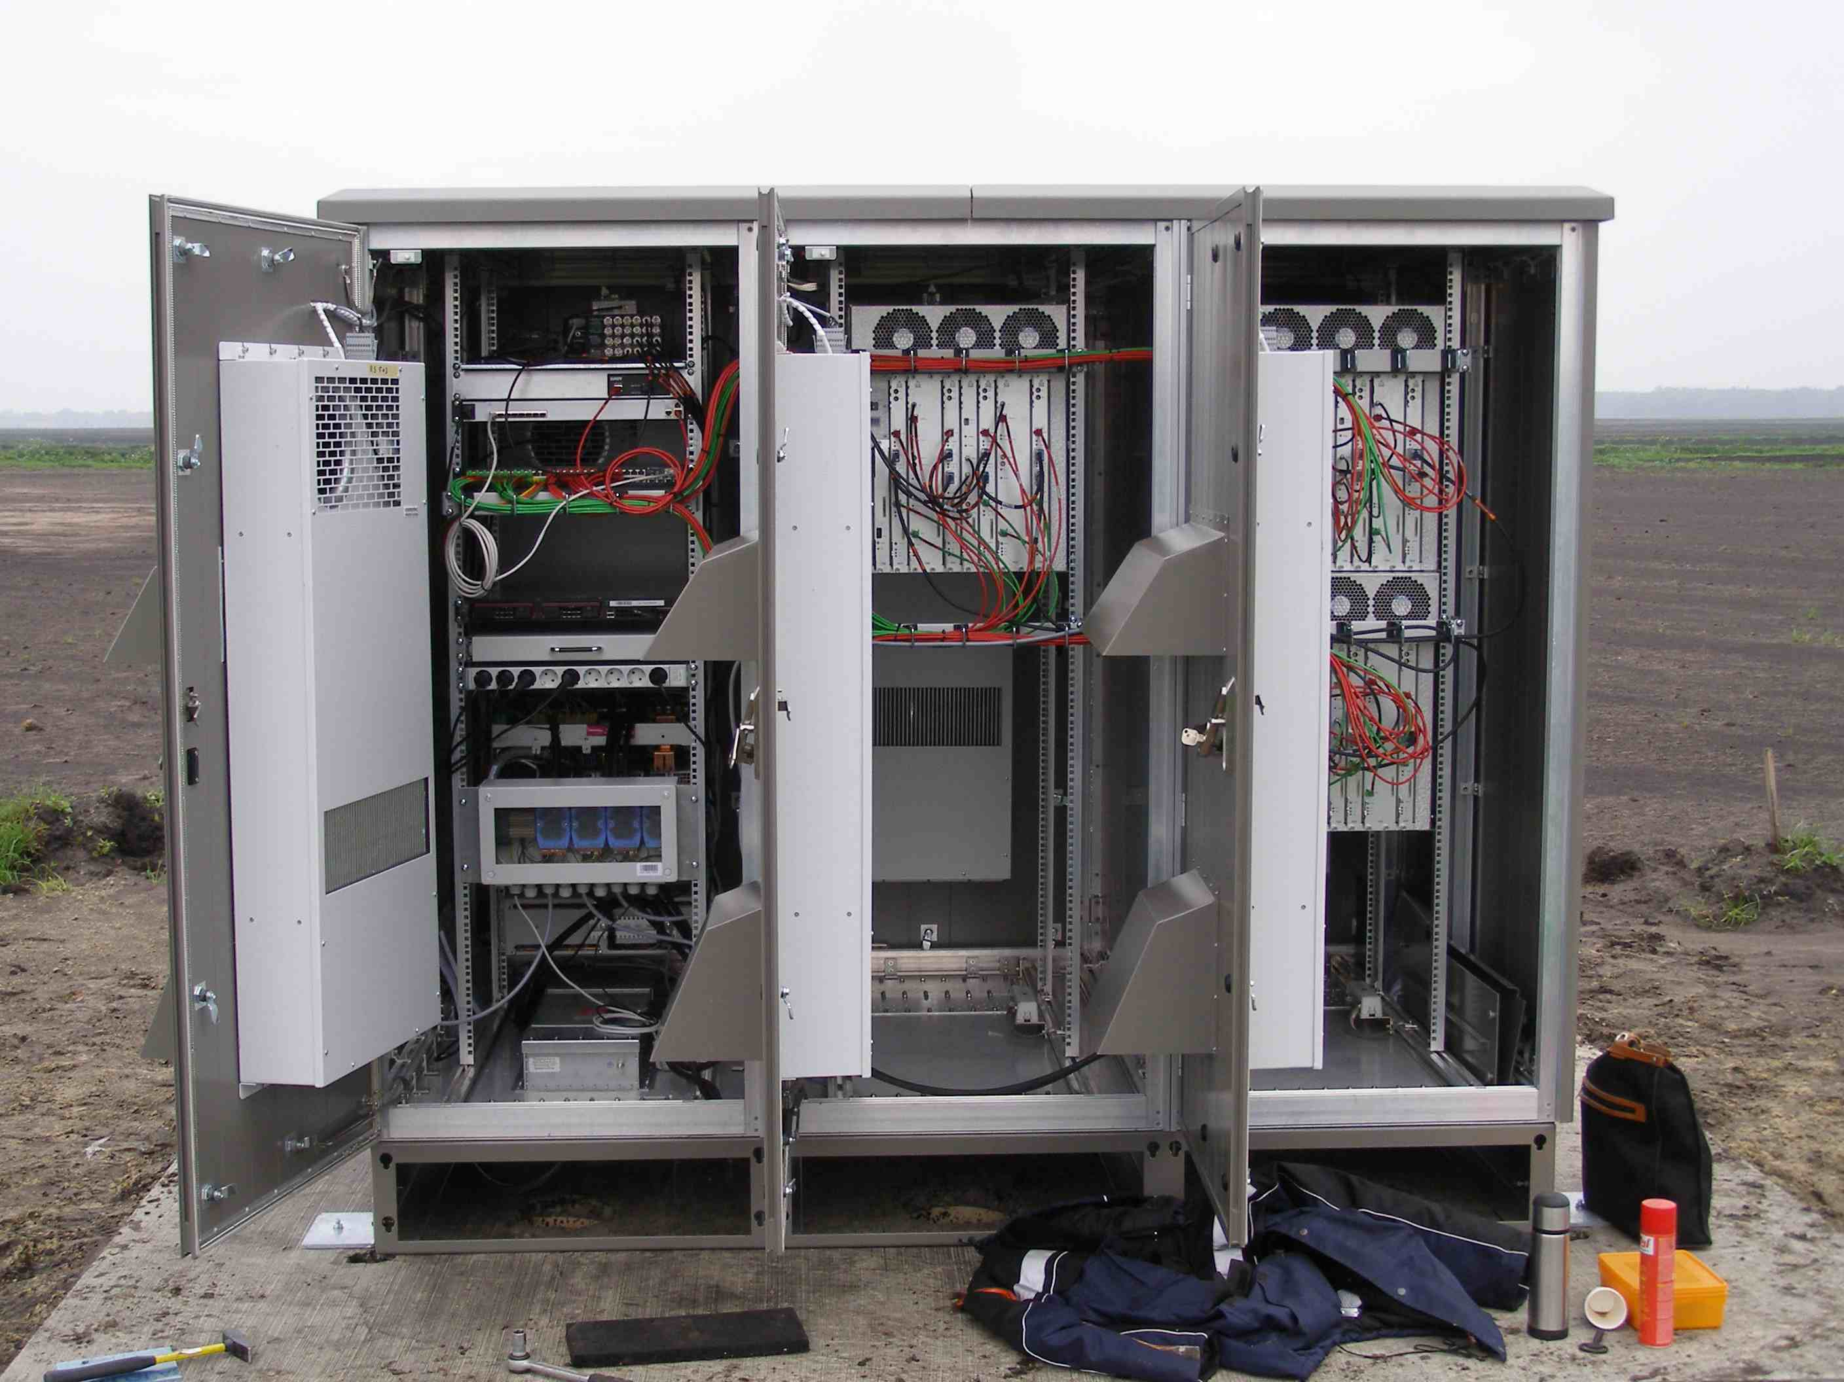

Slide 5
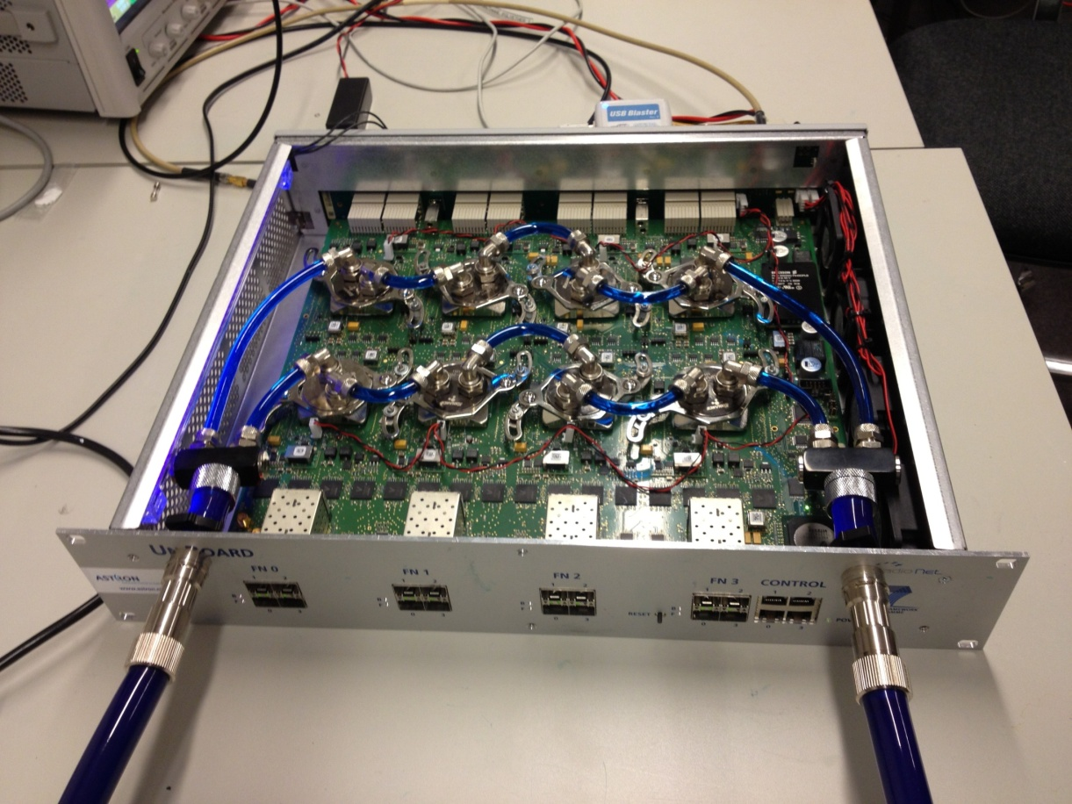

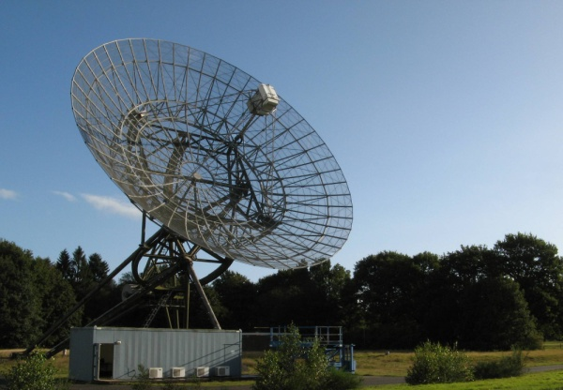
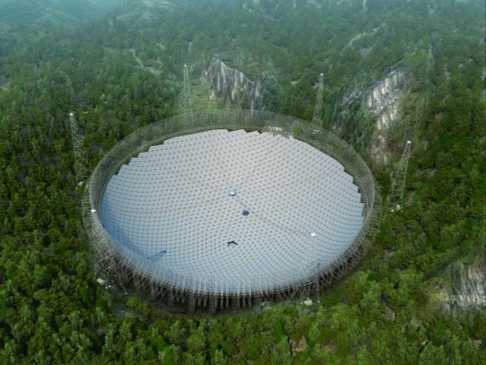
UniBoard
8 FPGA
16x 10GbE interfaces
Used all around the world

Slide 6
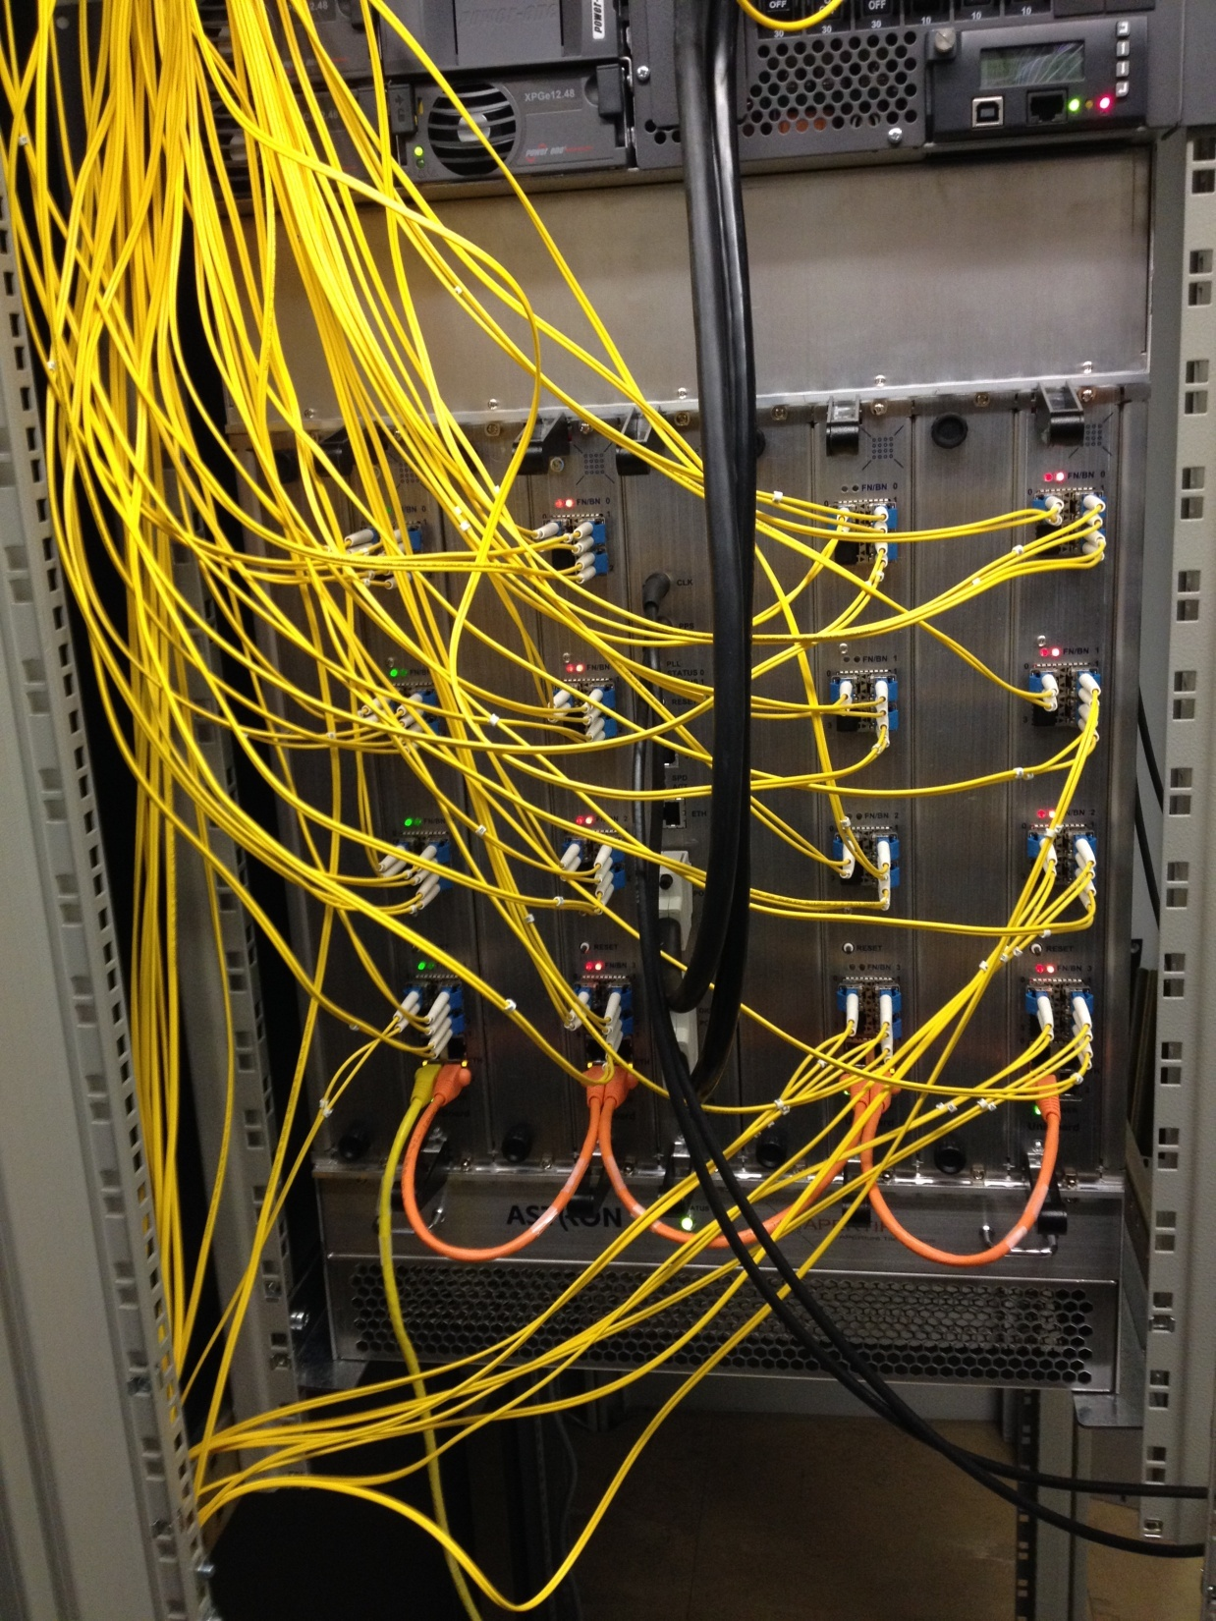
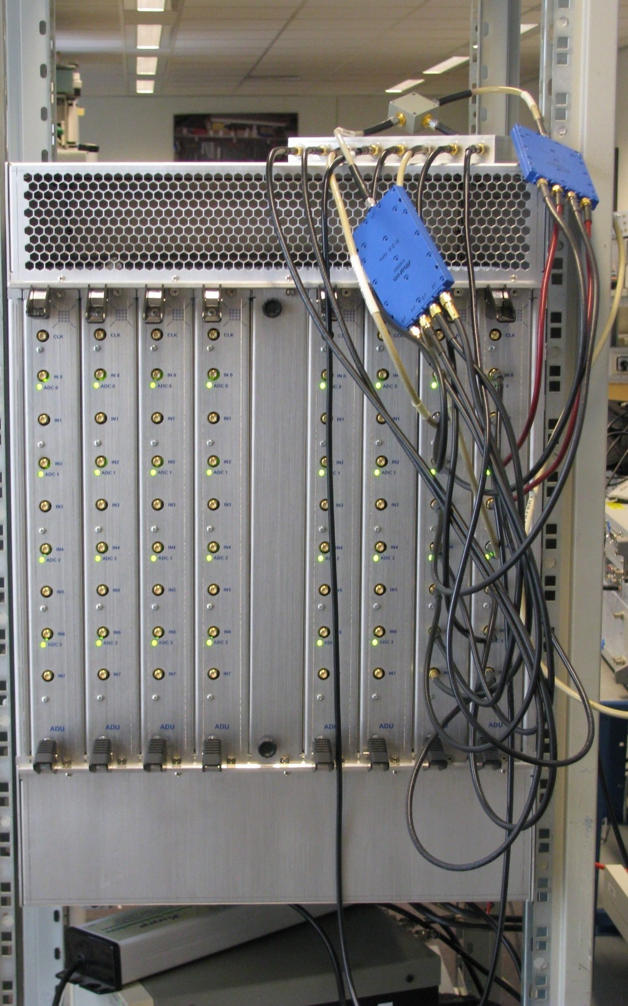

Slide 7
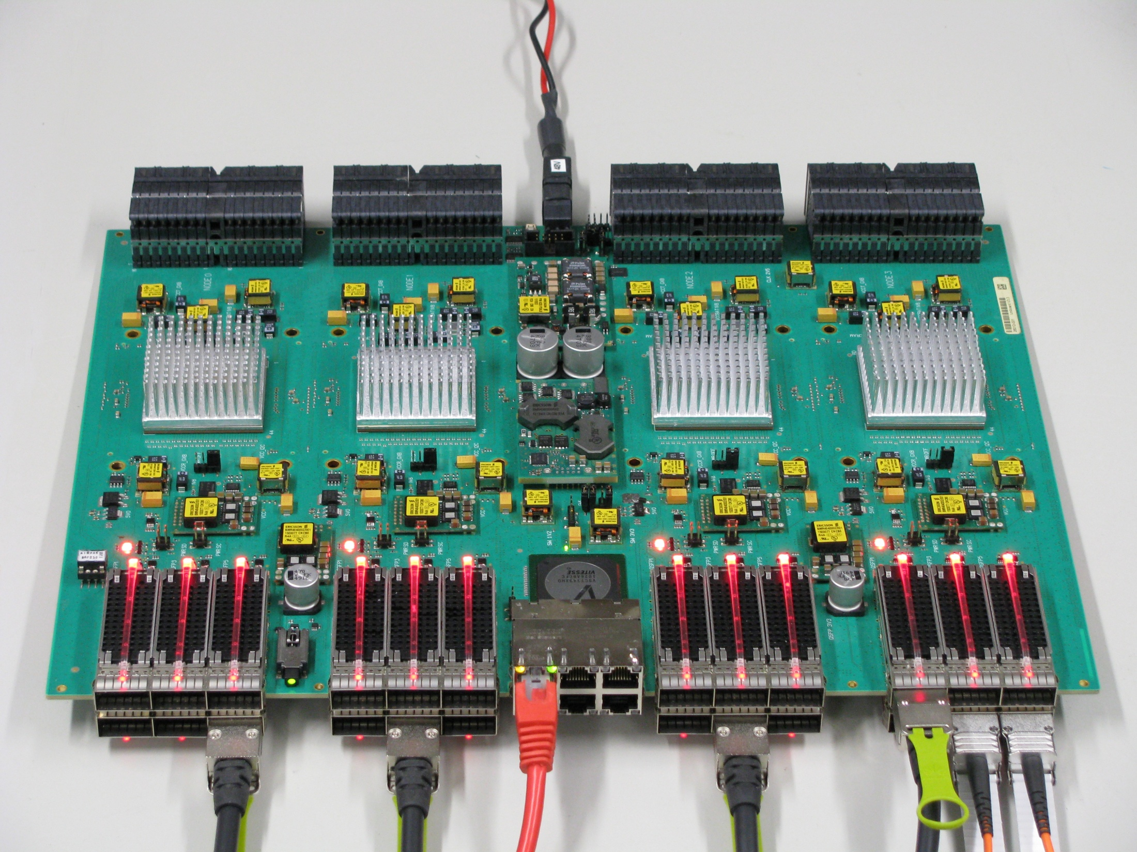
Notes:
UniBoard2
24 x 40Gbps
DDR4
Backplane with 192 10Gbps transceivers

Slide 8

THINK BEFORE YOU ACT

Slide 9
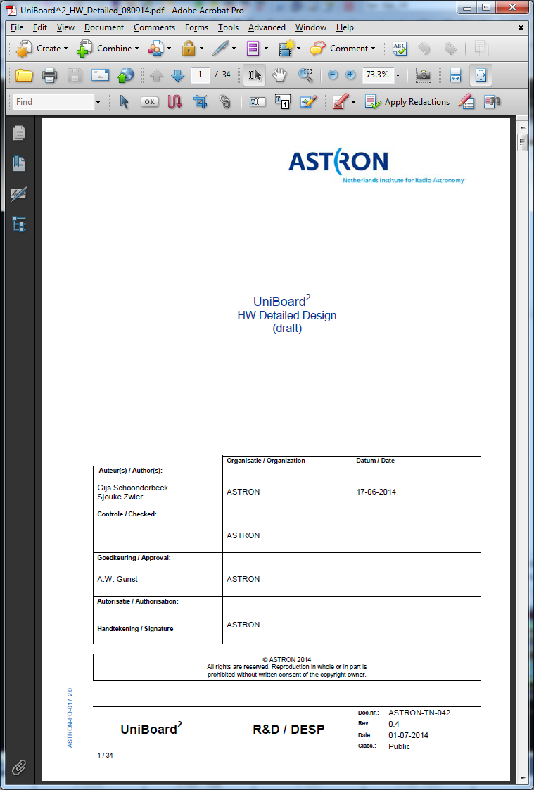

Slide 10
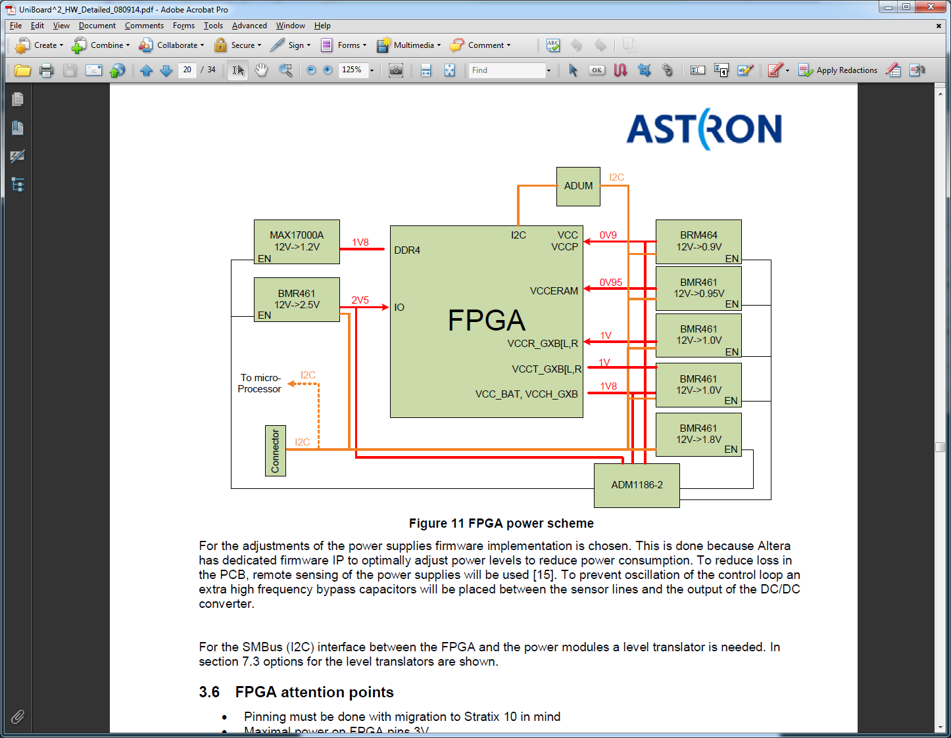

Slide 11
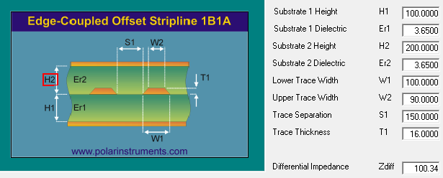
PCB Manufacturer
Notes:
Contact PCB Manf. To know what can be made

Slide 12
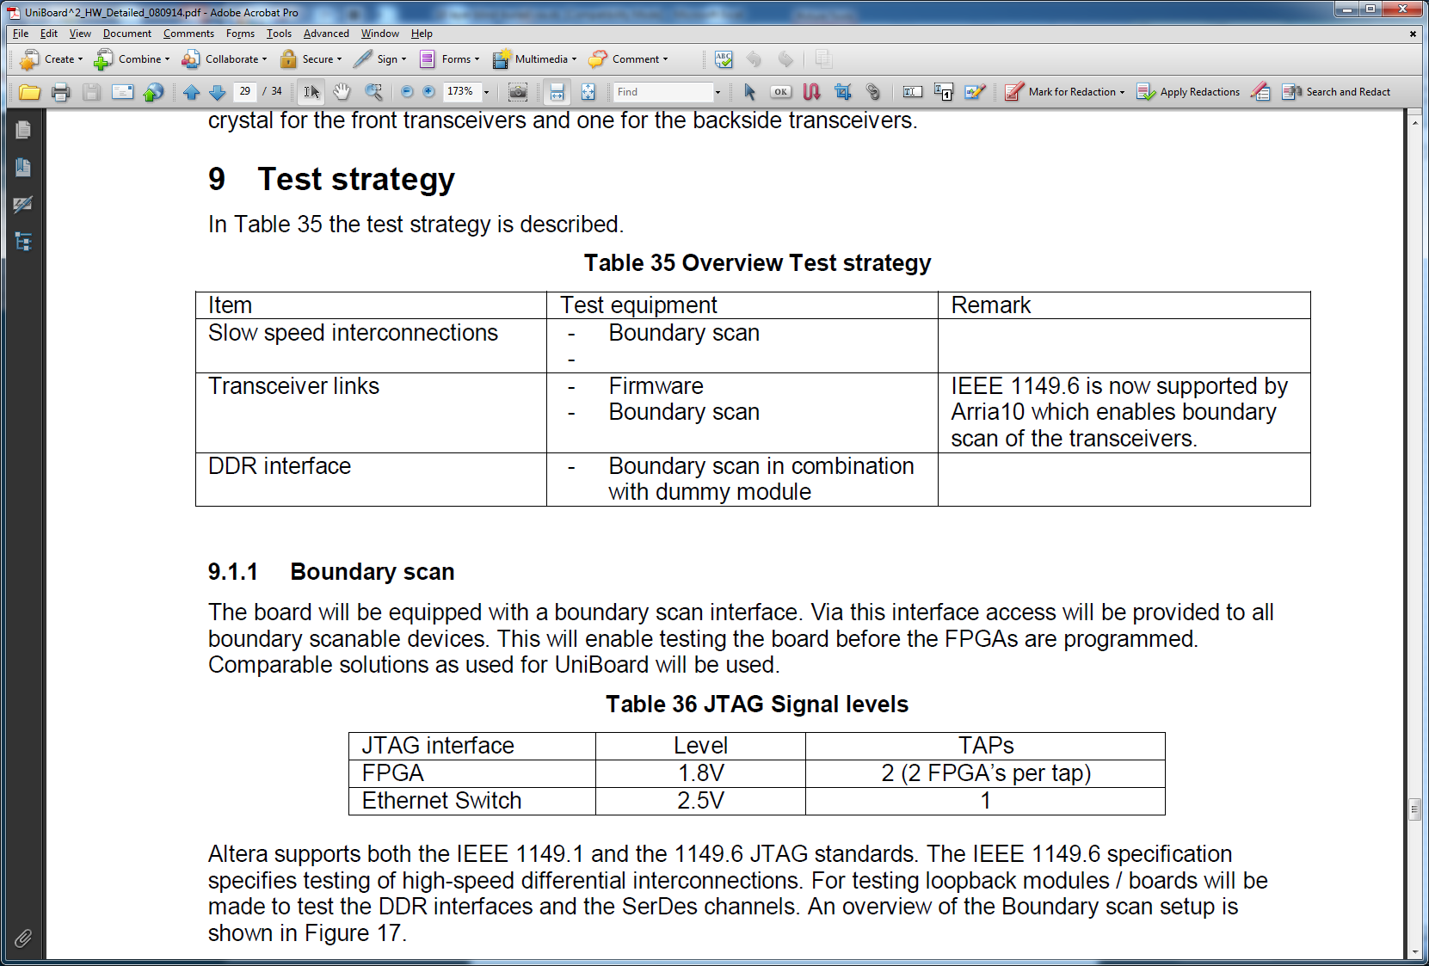
Notes:
If you don’t test it, don’t make it.

Slide 13
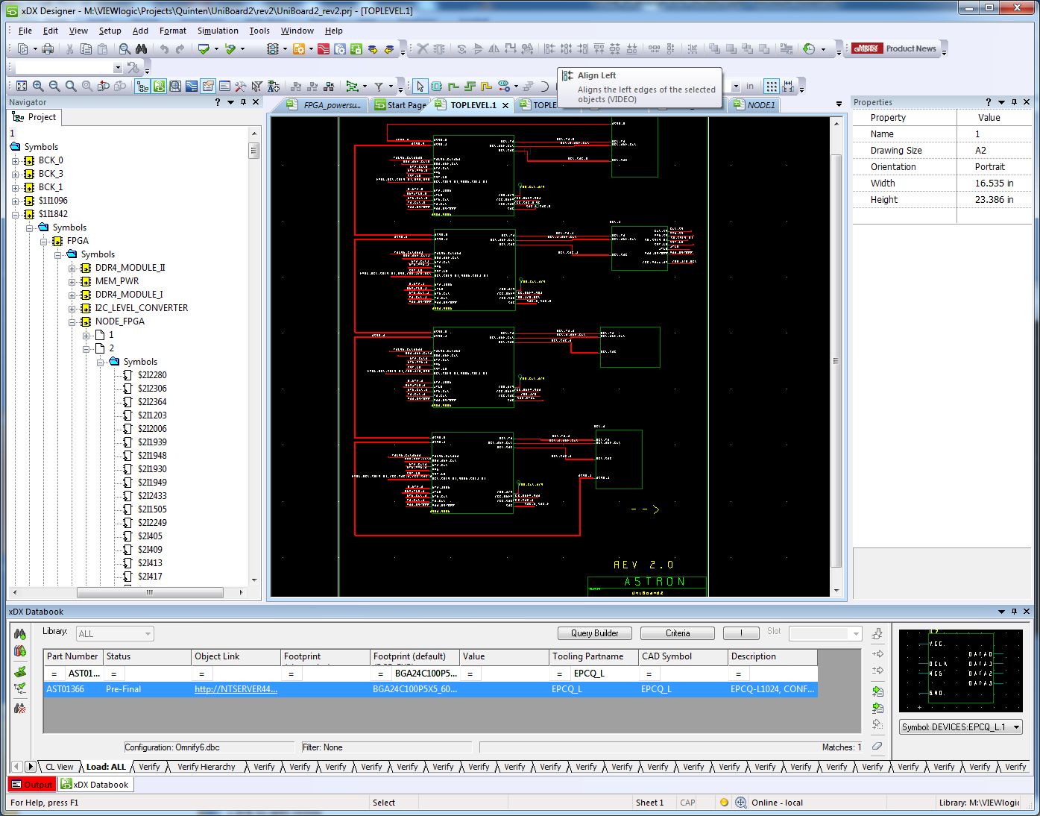

Slide 14
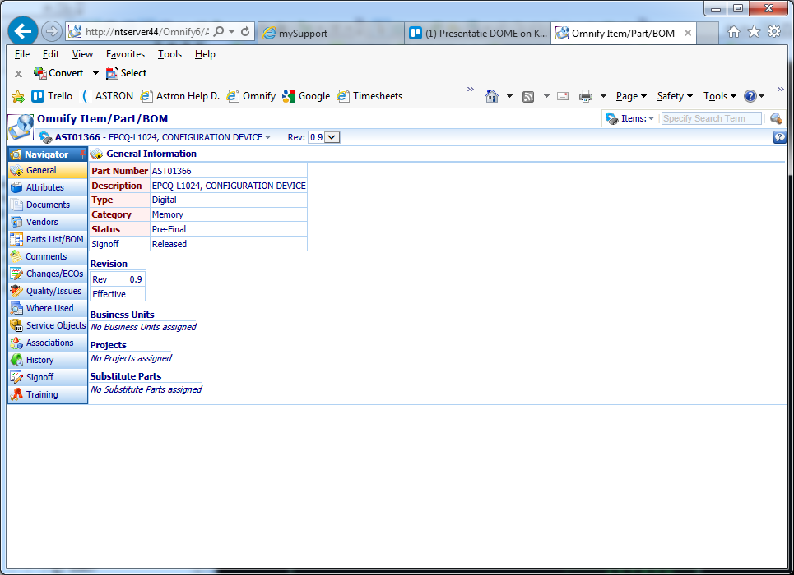

Slide 15
Review
  Schematic
    Design team
    Firmware designers
    Librarian
    Altera FAE

Slide 16
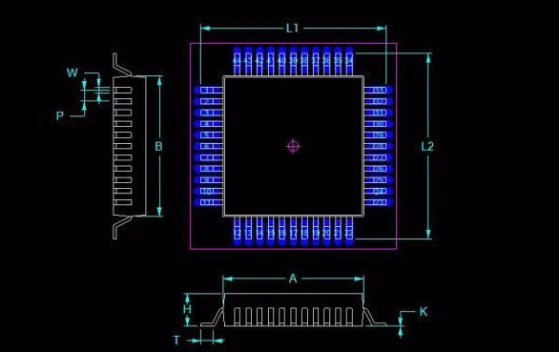
IPC Footprints

Slide 17
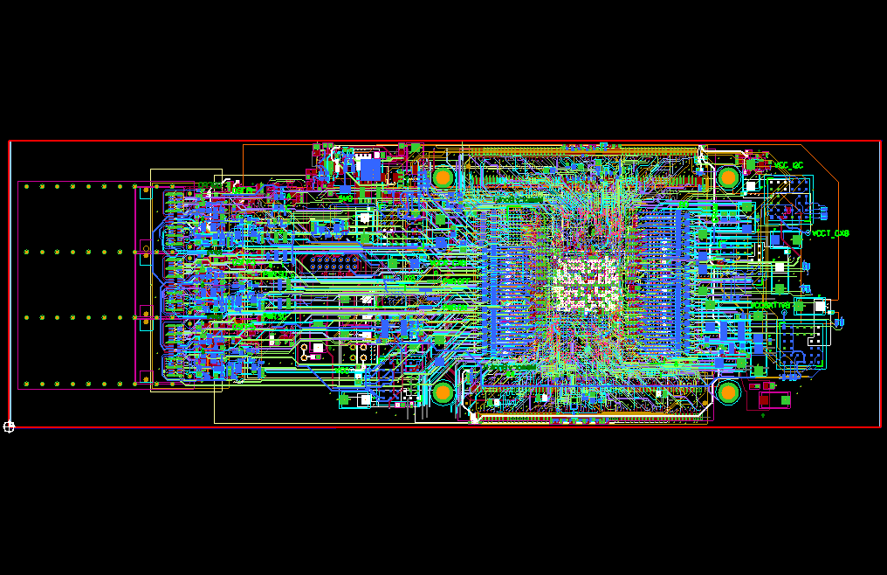
Notes:
Design in Blocks (reusable block)

Slide 18
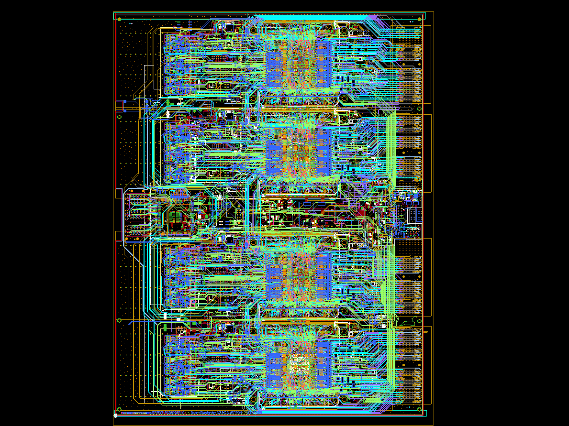
Notes:
Full layout UniBoard2
18 layers, 5650 parts, 20k connections, 1254 differential pairs

Slide 19
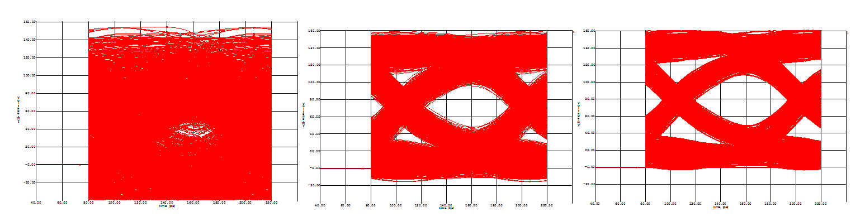
High-Speed Simulation
Notes:
HS simulation of coupling capacitor 1nF, 10nF and 100nF

Slide 20
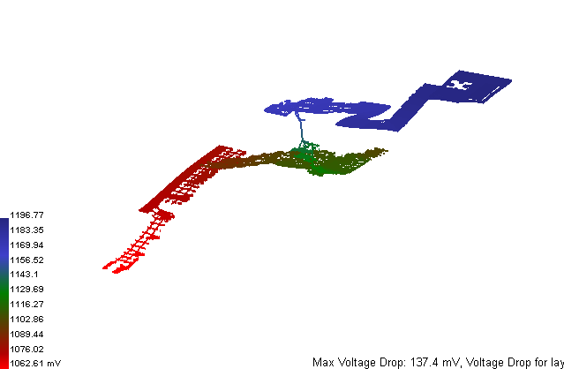
Power Simulations
Notes:
Simulation the power supply

Slide 21
Review
  Layout
    Design team
    Firmware designers, make test design for FPGA
    Librarian, check all footprints
    Checklist …

Slide 22
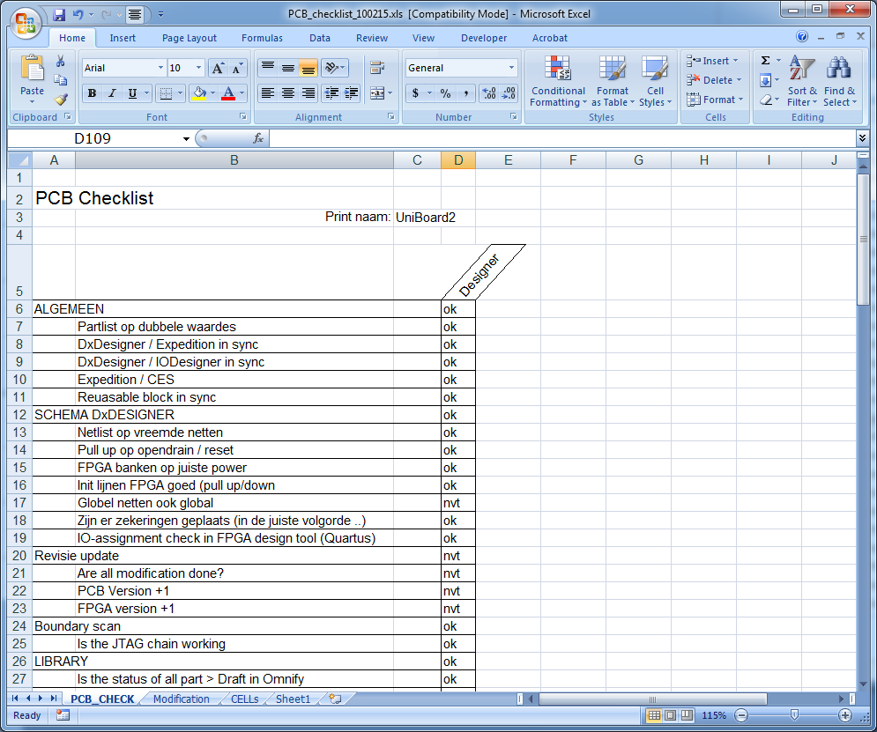
Notes:
Checklist

Slide 23
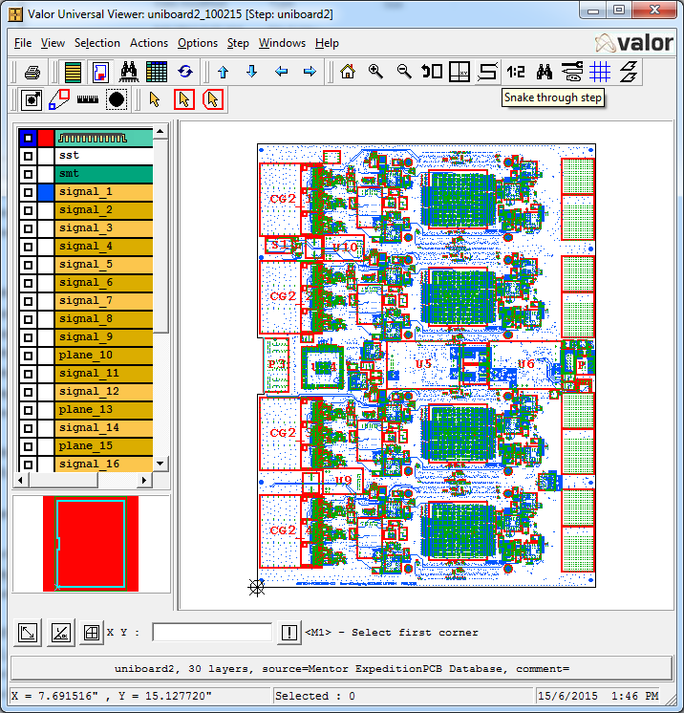
Ready for DATA
ODB++
Excel BOM
Documents:
  PCB Spec.
  Schematic

Slide 24
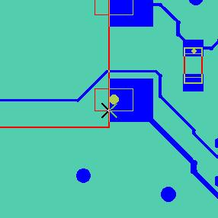

Design For Manufacturing
Notes:
DFM

Slide 25
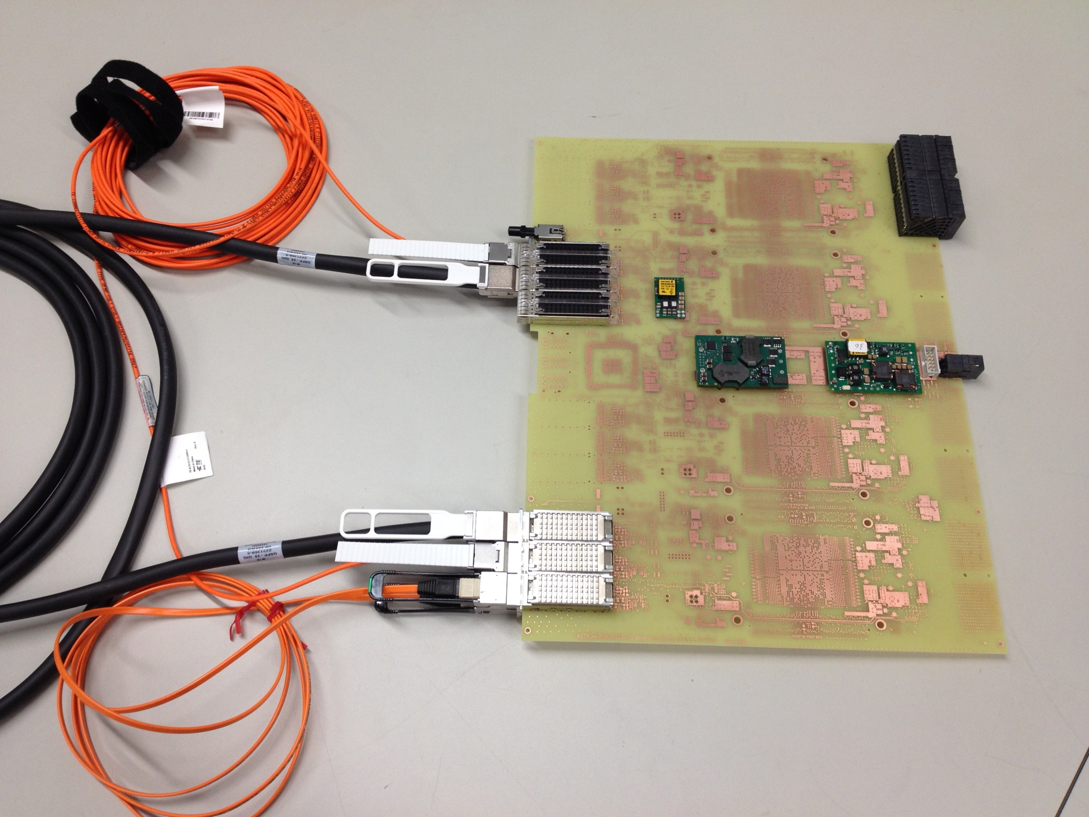

Slide 26
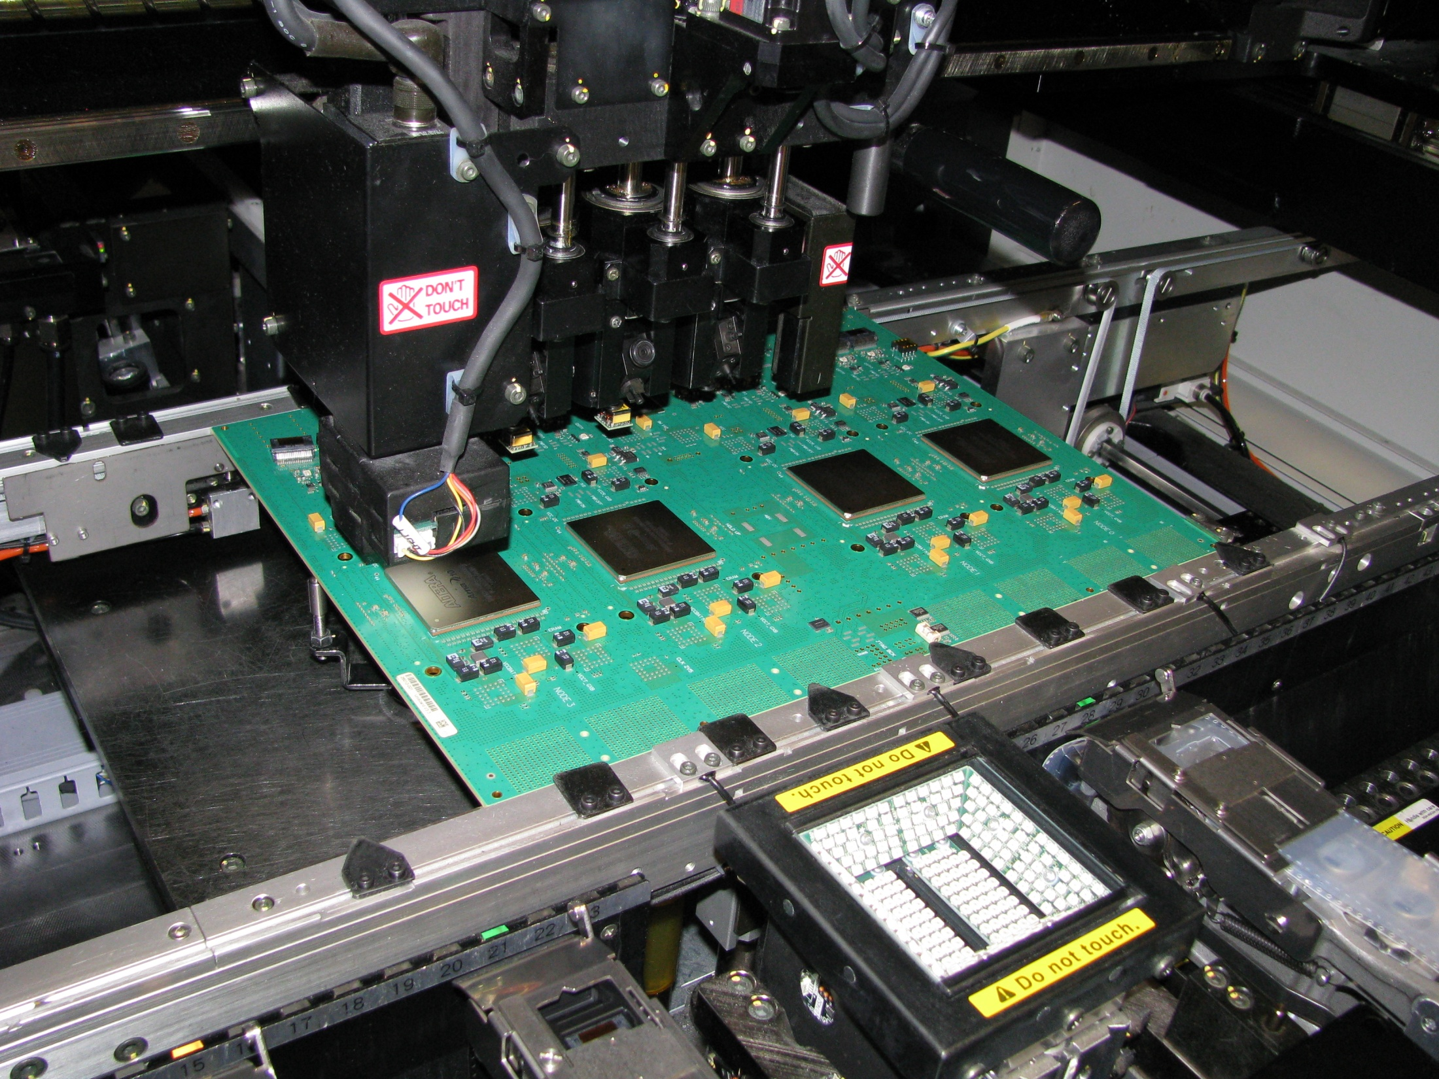

Slide 27
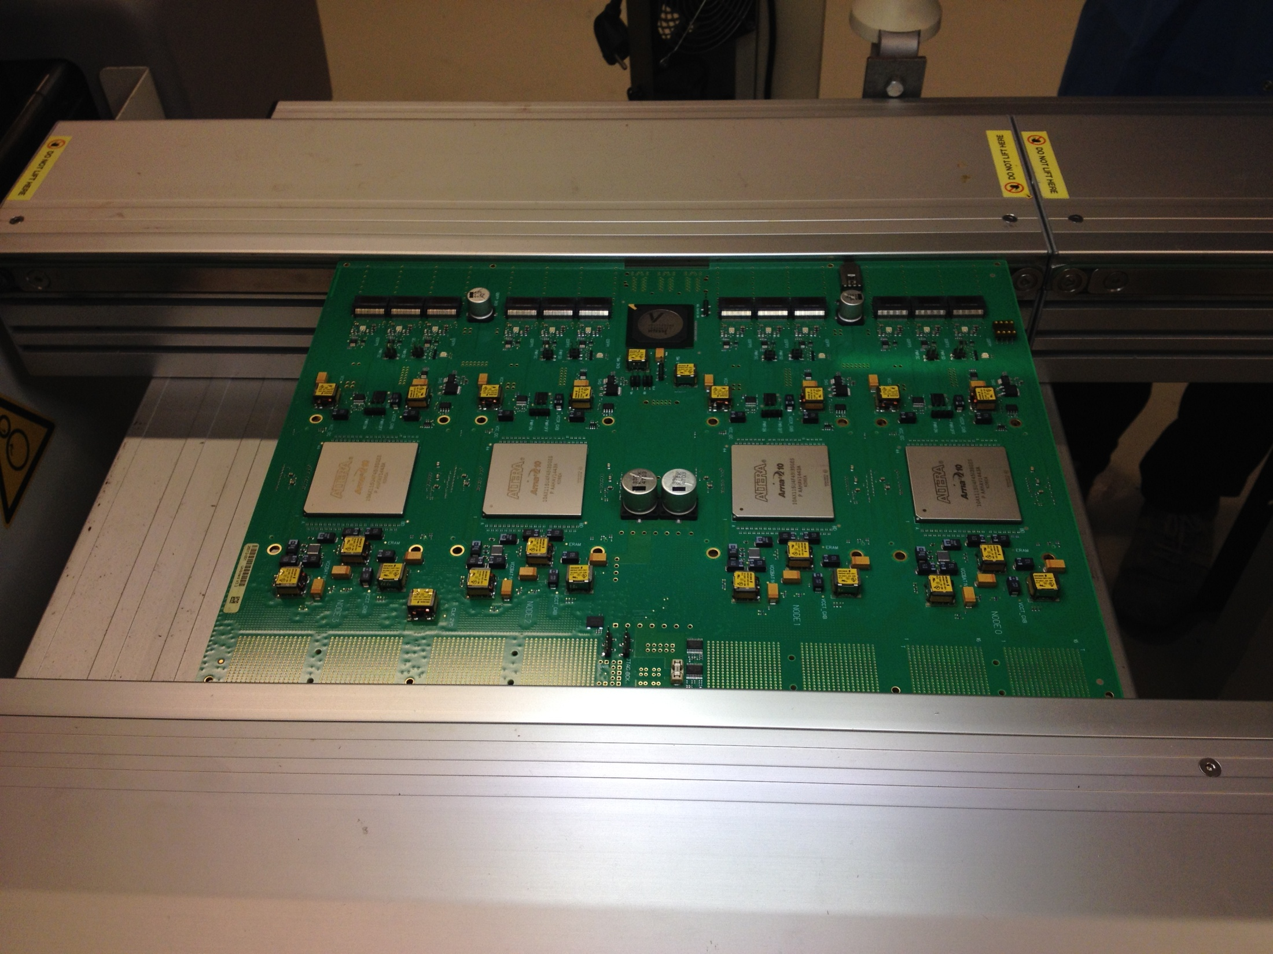

Slide 28
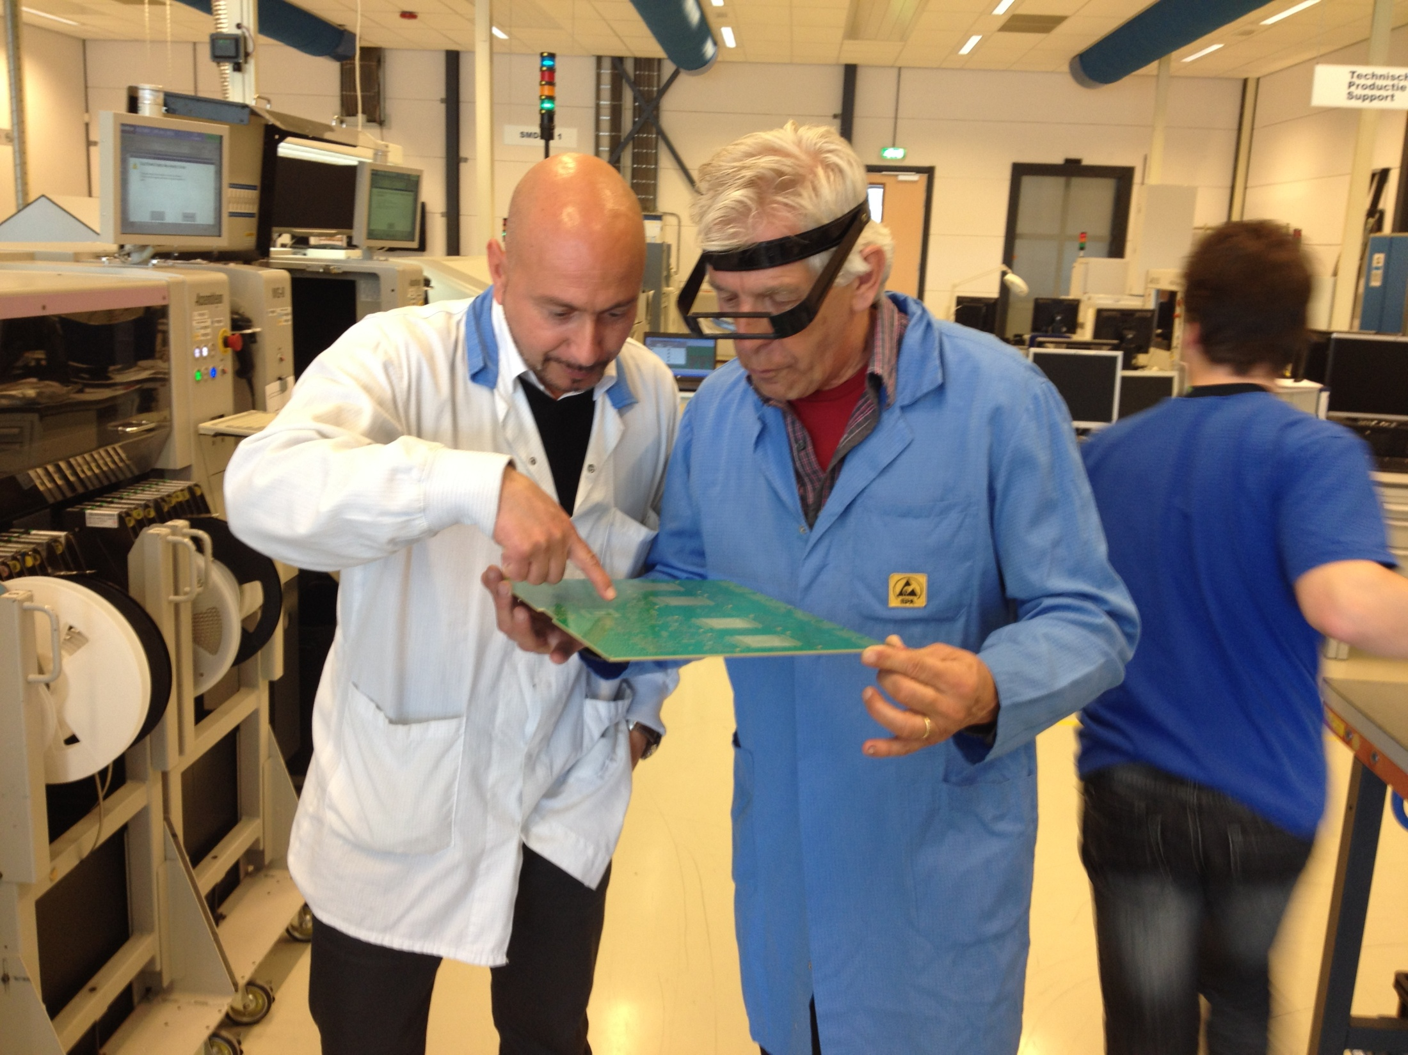

Slide 29
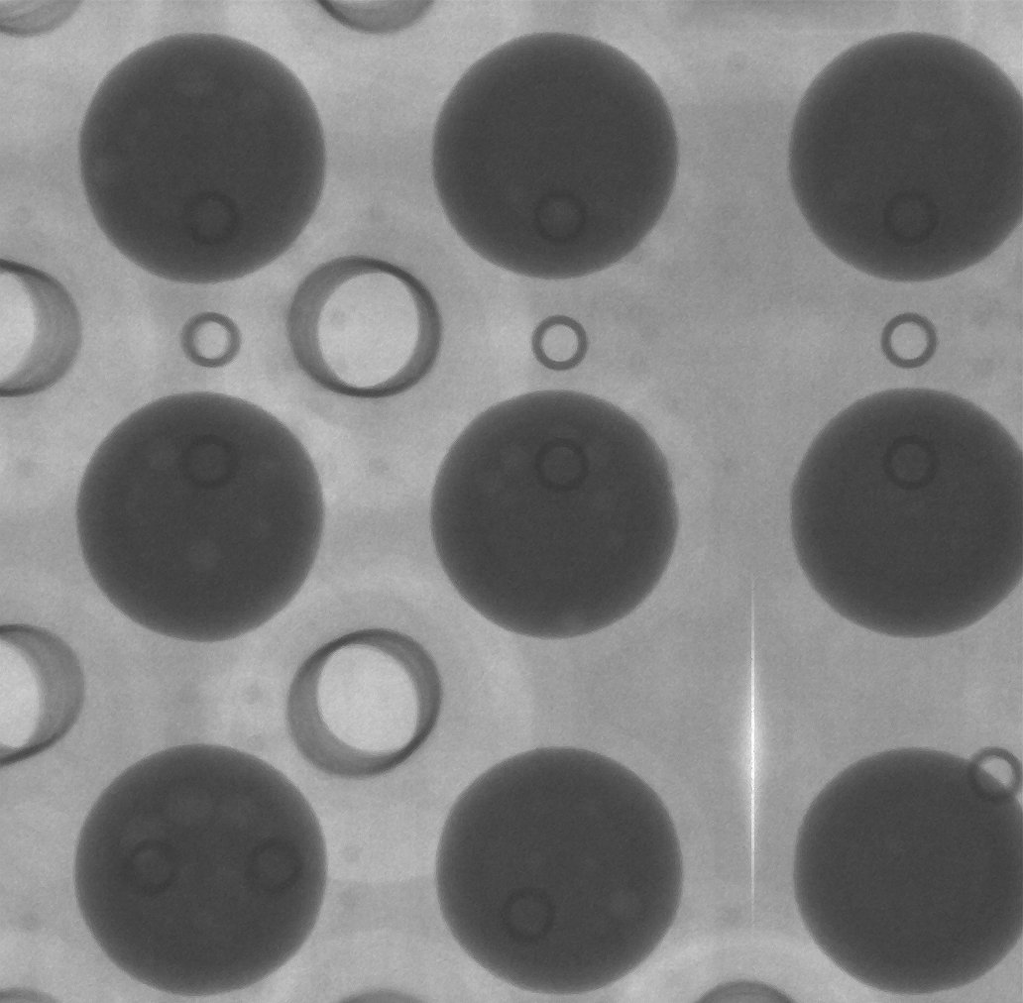
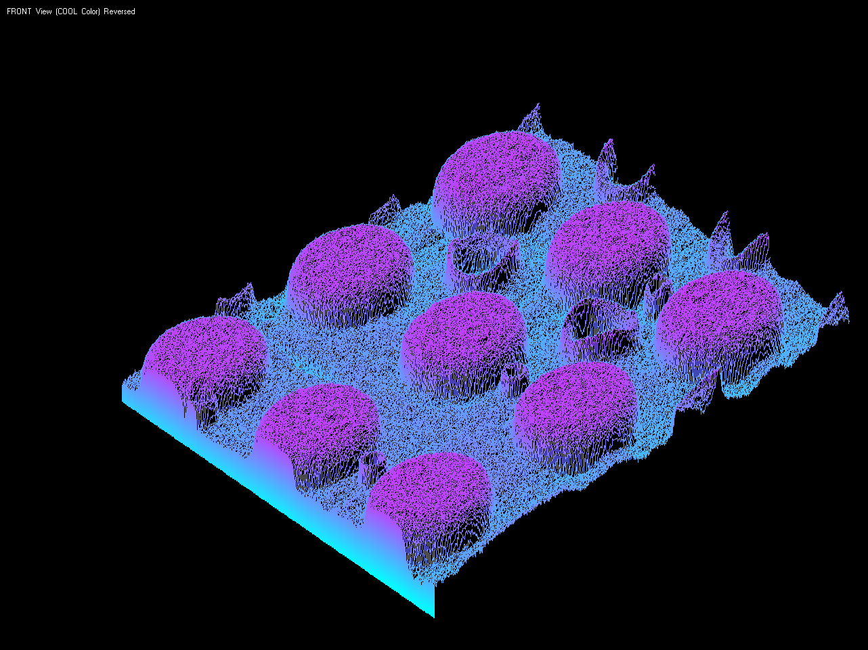
Production Tests, X-RAY
BGA connection
PAD on layer 2
Via in flip-chip package
Outside solder ball
Inside solder on pad
Histogram plot,
dark is pink (more metal)
Board via 2-13
X-Ray machine
Micro via in pad
© ASTRON
29

Slide 30

JTAG Testing
Test
wire bond
Detects
ESD damage
Finds
open
Finds short,
s-a-0 or s-a-1
TAP
BGA
BGA
Power or
GND
Finds solder bridge
under BGA
Provides access to
blind vias, inner layers

Slide 31
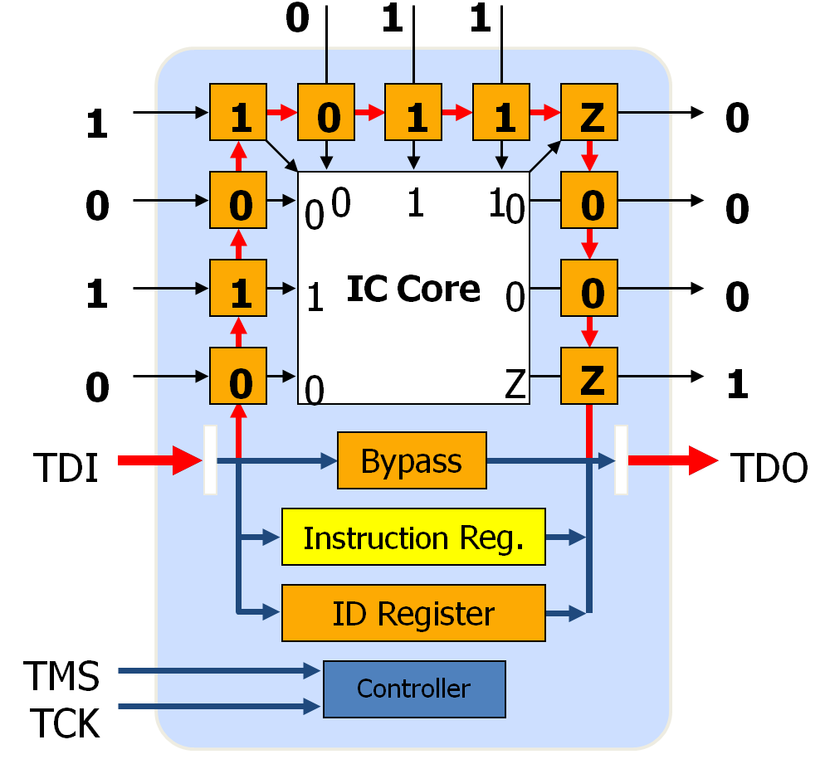
What is boundary-scan?
A chip-level standard, adopted by the IEEE in 1990 (IEEE 1149.1)
4 (or 5) added pins form the Test Access Port (TAP)
Additional logic inside the IC: scan cells on I/Os, controller & registers

Slide 32
Benefit B.S. for proto’s
Check connections
Check right parts are placed.
Check low level logic with JFT (Python scripting)
Move errors to from Firmware to Hardware designers

Slide 33
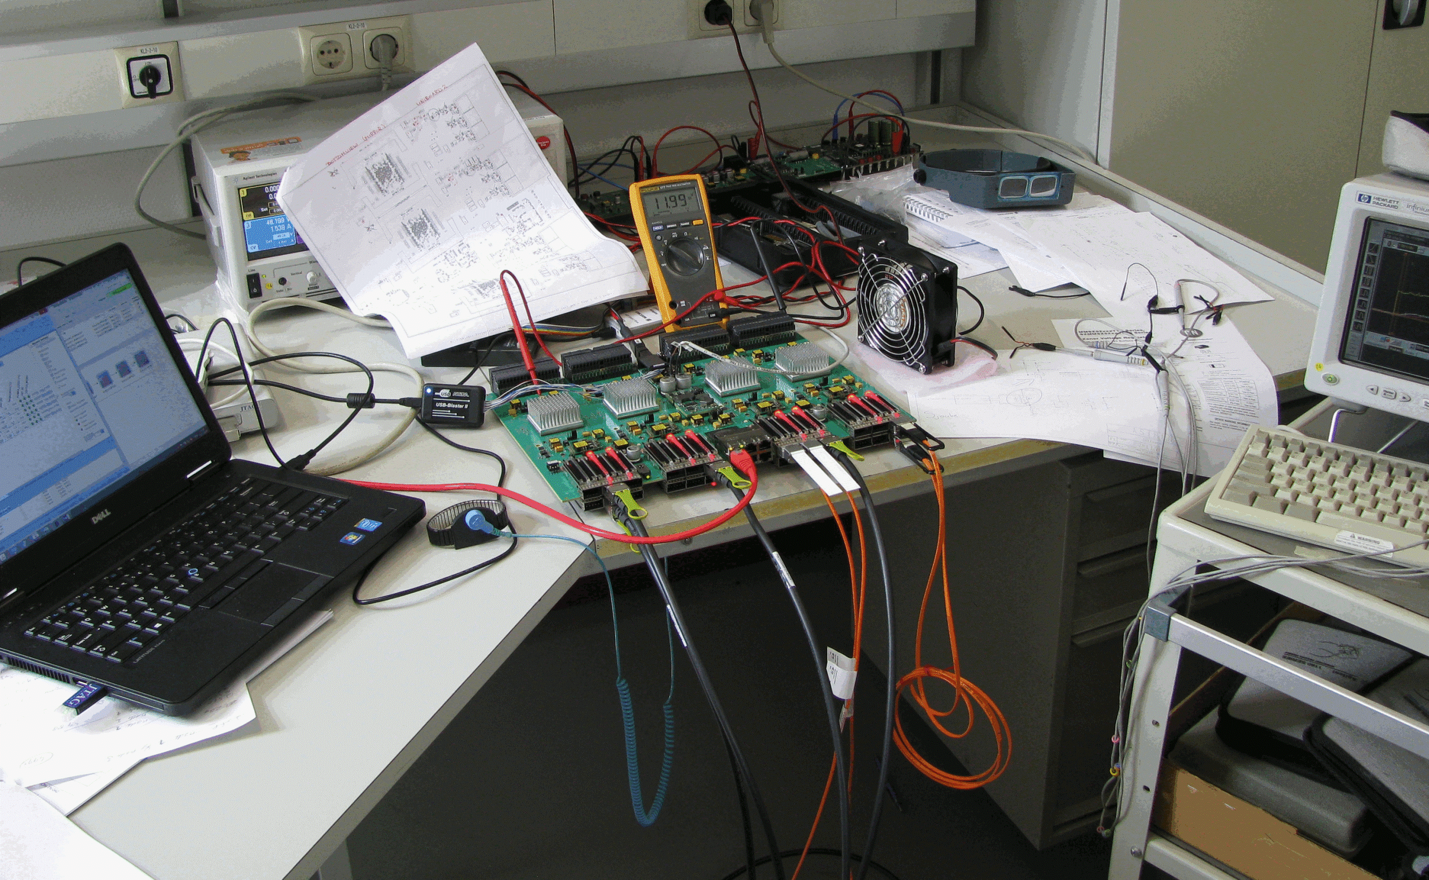

Slide 34
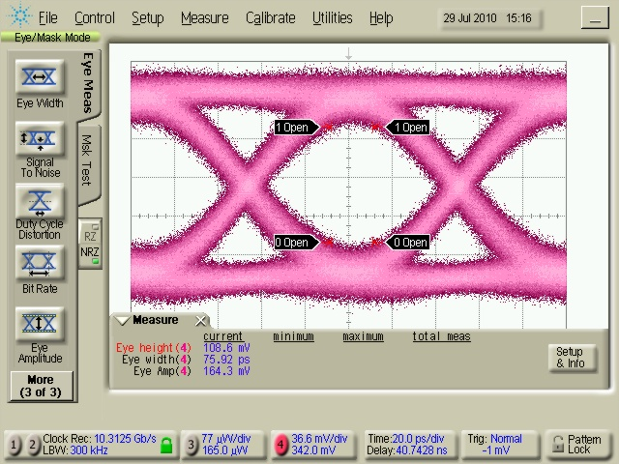
Check Simulation
Notes:
Eye diagram UniBoard1 10GbE (copper S.E.)

Slide 35
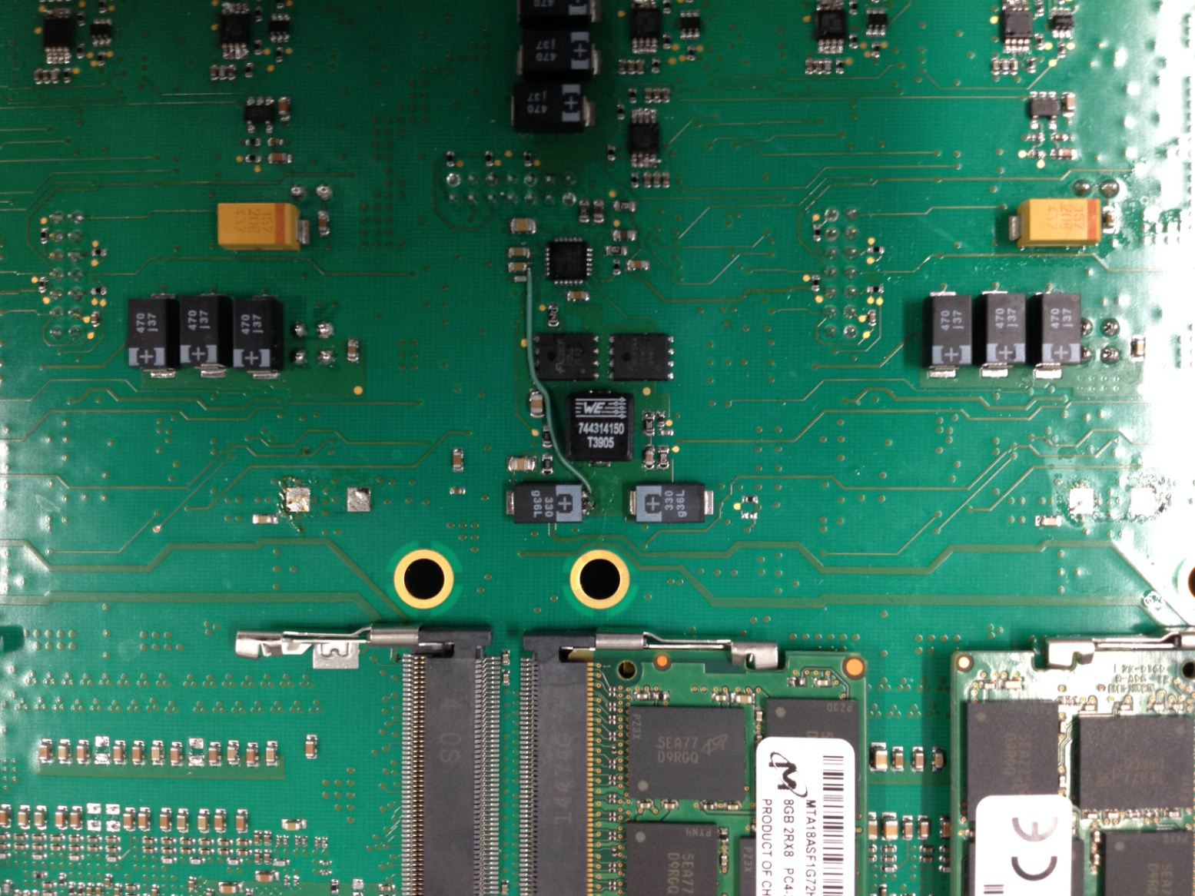
Rework
Notes:
Kind of fixes:
Better Silkscreen
Connection missing (in schematic)
Rotated LED / chip

Slide 36
Notes:
Checklist

Slide 37


LOFAR Cyg. A
Notes:
Visualisatie:
Hoe laten wij de data zien….. Volgende spreken andere manieren van visualisatie van data.

Slide 38
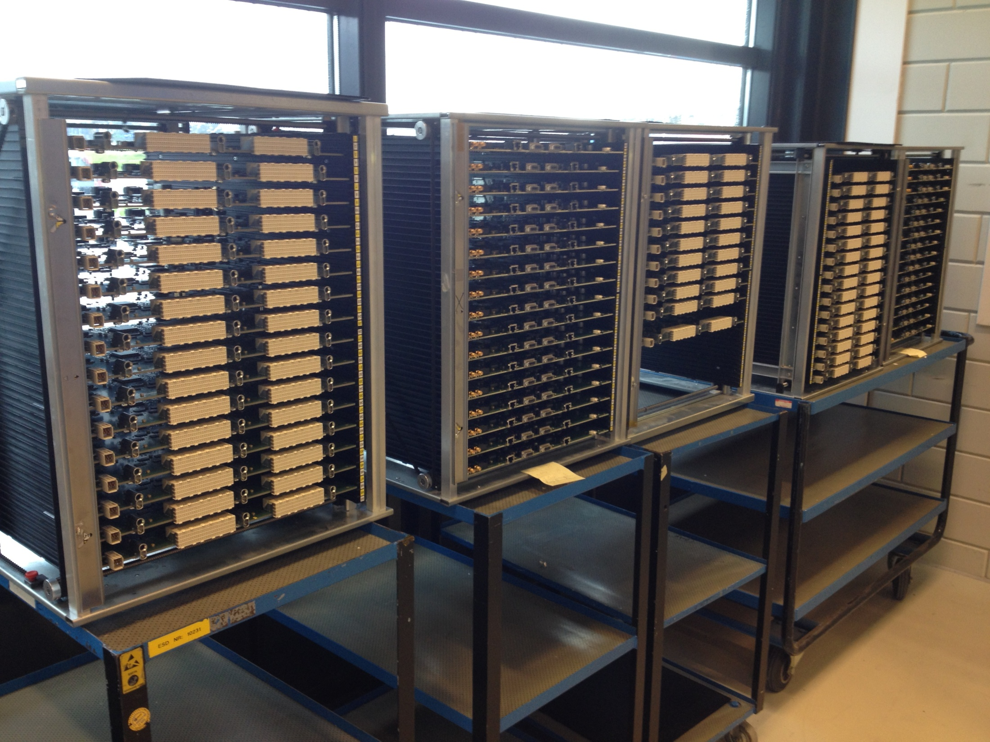
Notes:
Production runs.
75x RSP for POLFAR

