Slide 1
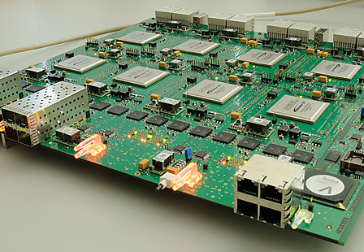


UniBoard and UniBoard²
and beyond?
RadioNet FP7/RadioNet3 Joint Research Activities
Arpad Szomoru, JIVE
Contracts no. 227290, 283393

Slide 2
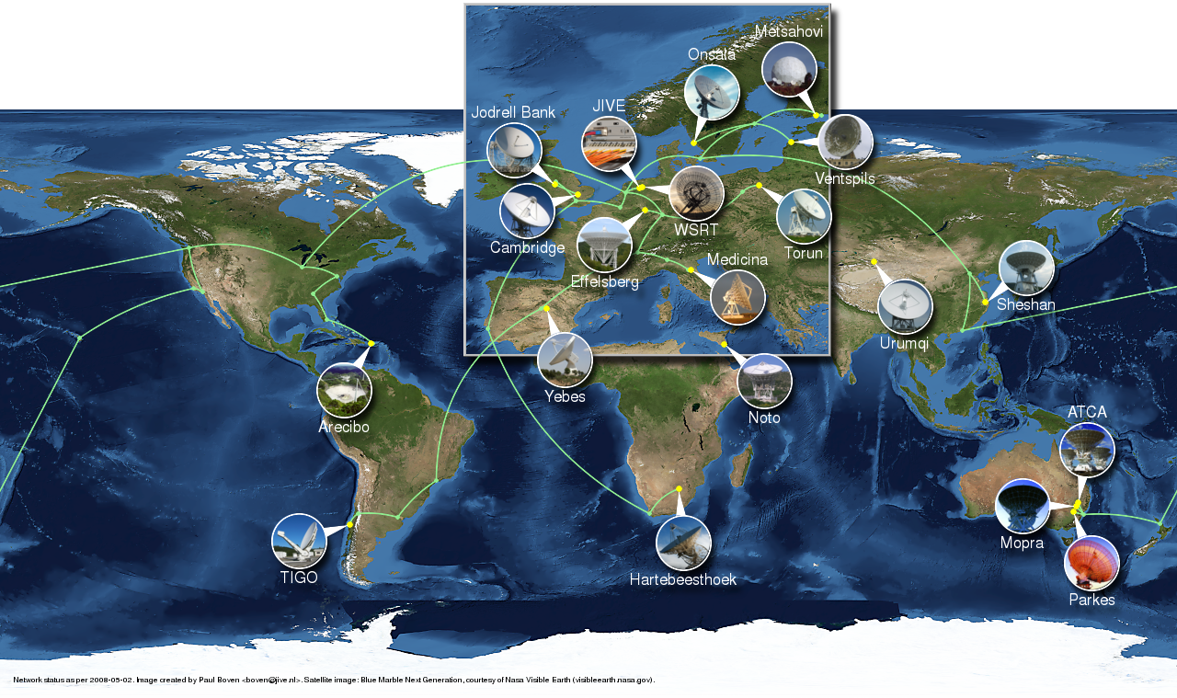
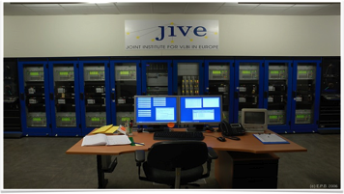
Joint Institute for VLBI in Europe
Promote and advance the use of VLBI for astronomy
  Central correlation for European VLBI Network
  User support
  Innovation
Base budget from partners in 8 countries:
    China, France, Germany, Italy, Spain, Sweden, United Kingdom, the Netherlands, South Africa
  hosted by ASTRON
  About to become an ERIC
No R&D budget!
  All R&D financed through EC and NWO projects

Slide 3
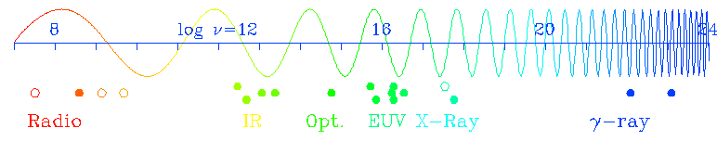
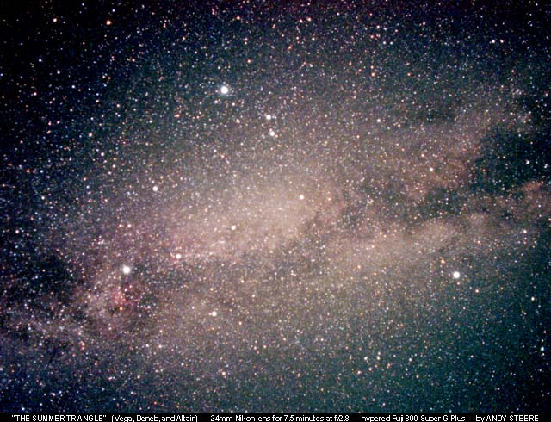
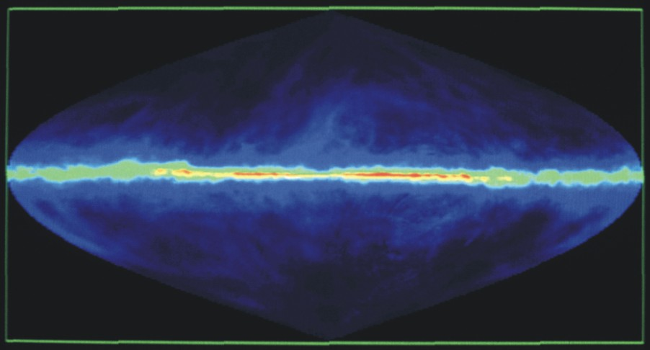
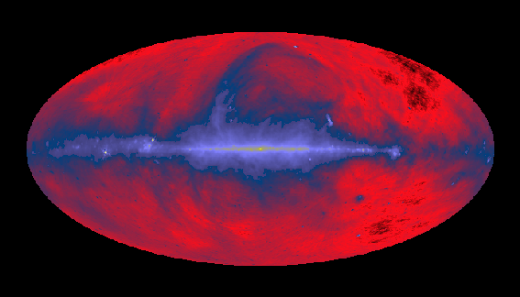
Radio vs. Optical Astronomy
Radio waves with λ of 0.7mm to 90cm
Compared to optical light 400 – 700 nm

Slide 4
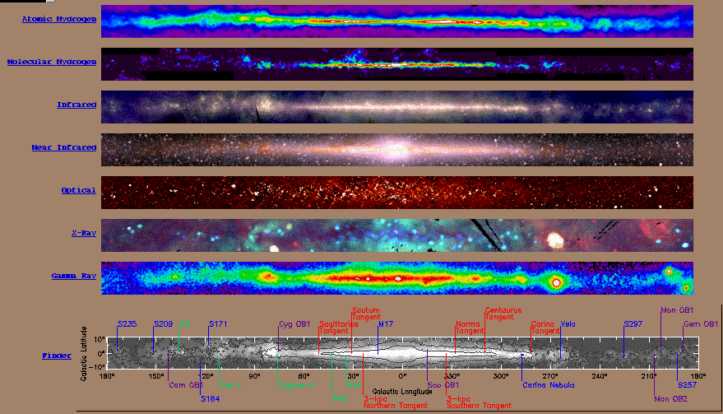
And more wavelengths

Slide 5
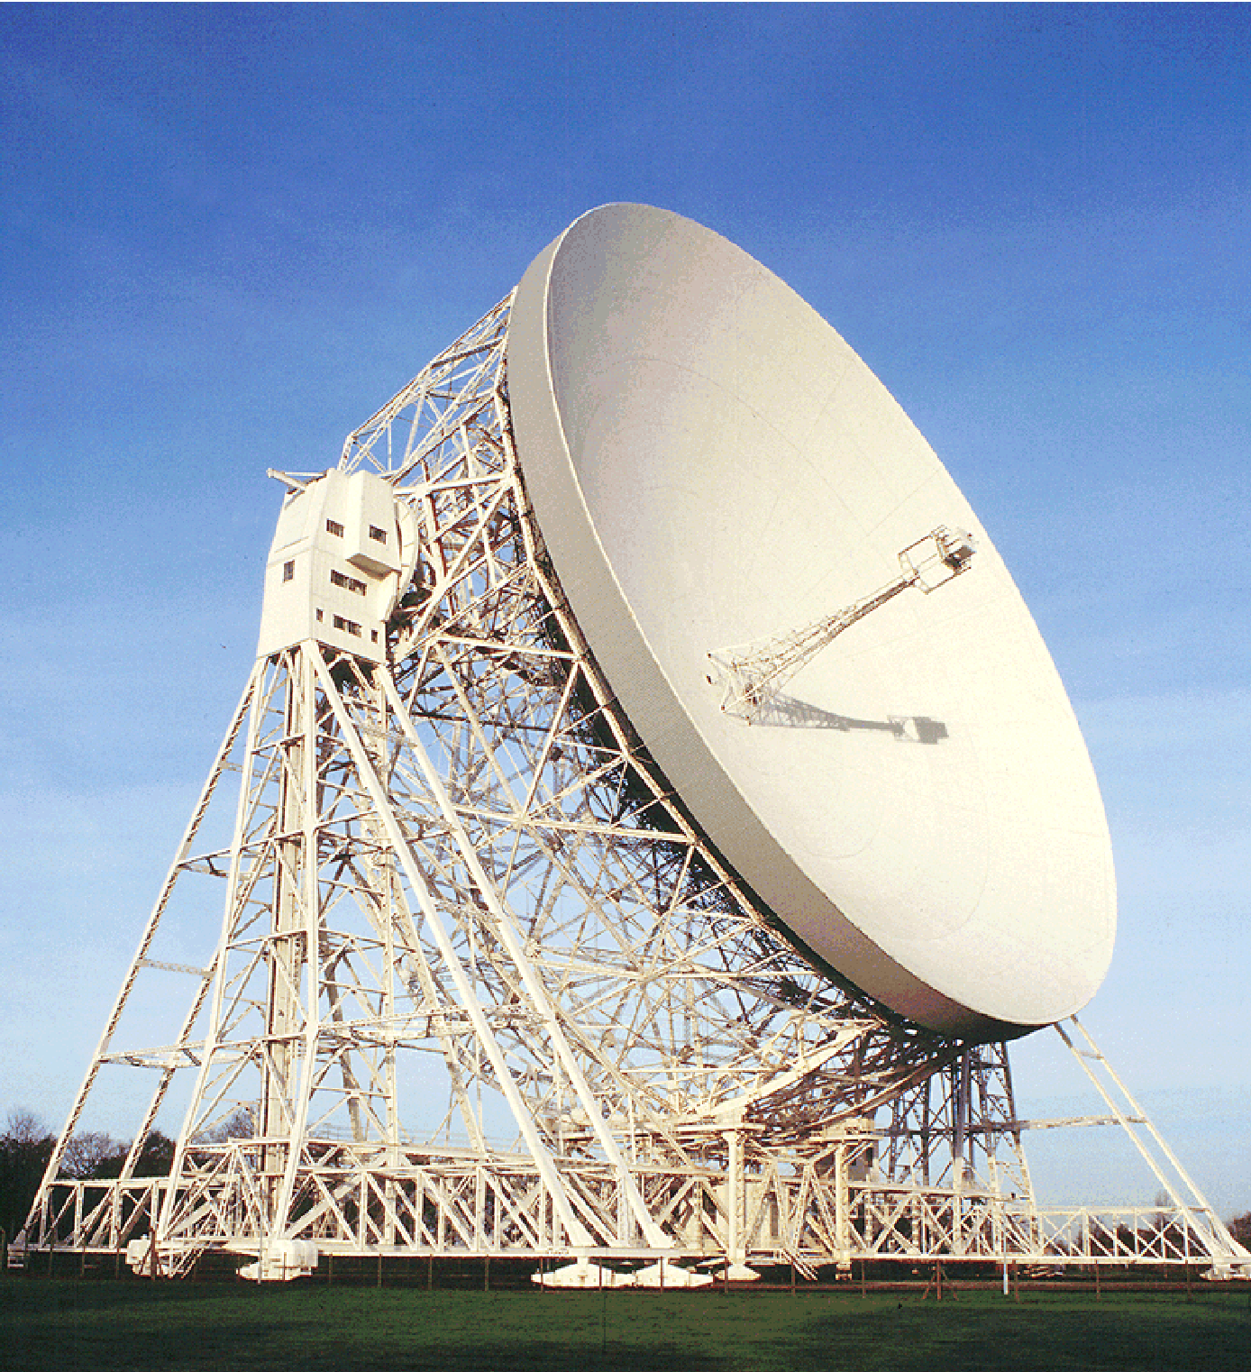
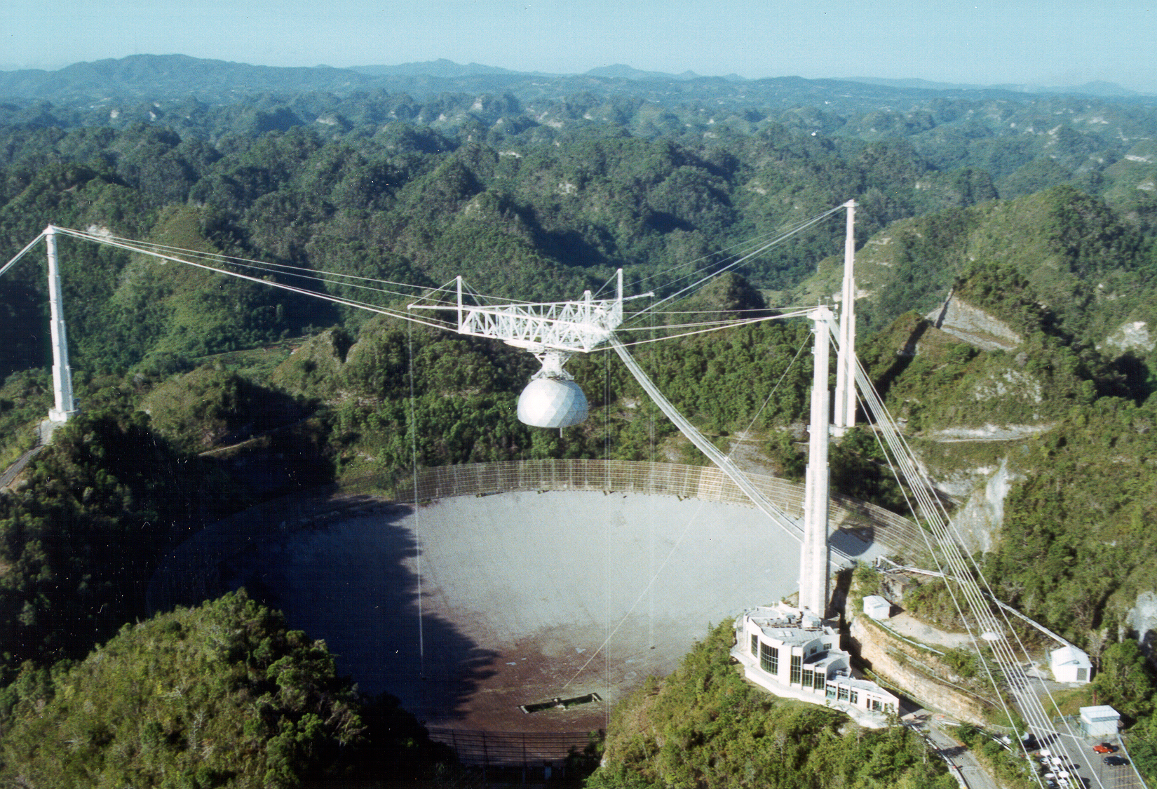
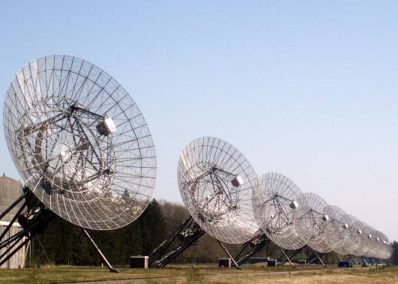
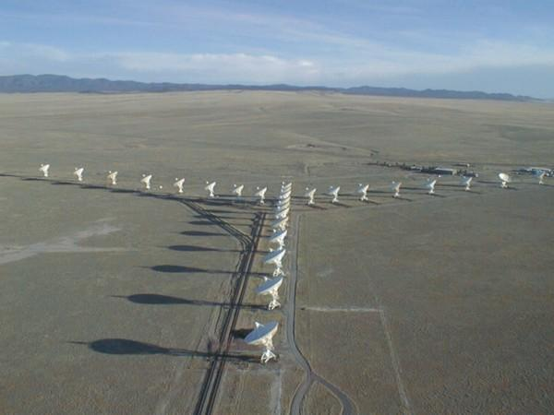
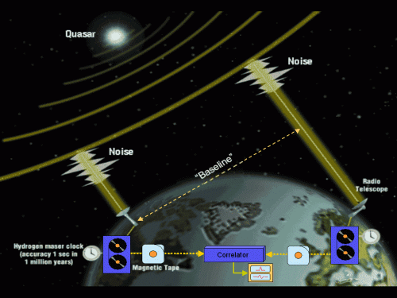
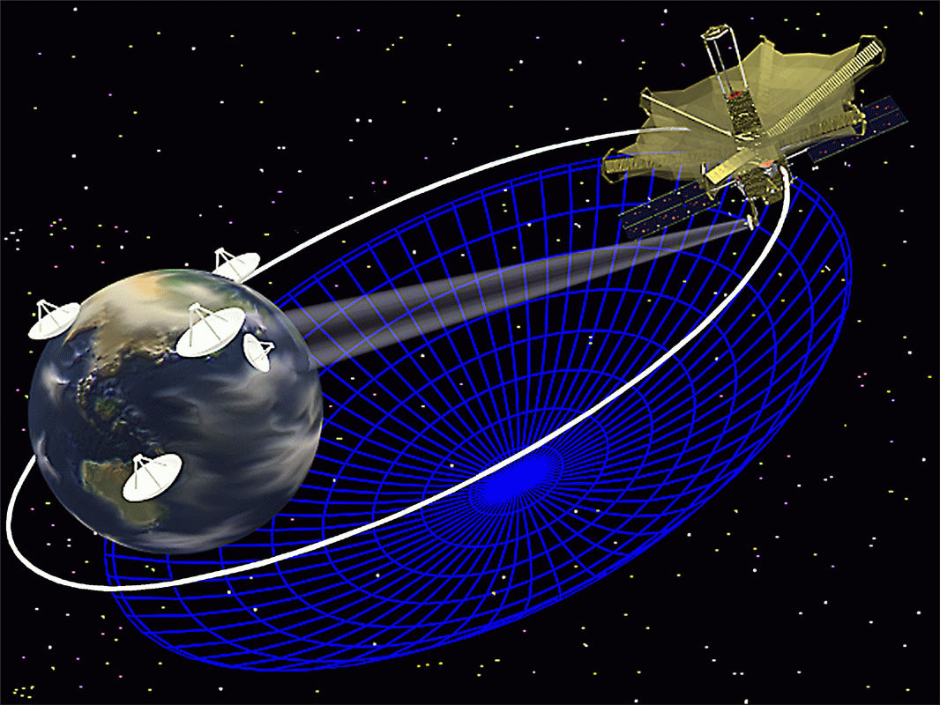
Radio Astronomy and VLBI
Radio emission from astrophysical sources can be detected against the sky with telescopes larger than a few meters
Resolution scales with size and wavelength:
Solution: build larger telescopes!
  Only goes so far....
Or: combine series of telescopes into radio-interferometer
Not necessarily on same continent
Or planet…

Slide 6
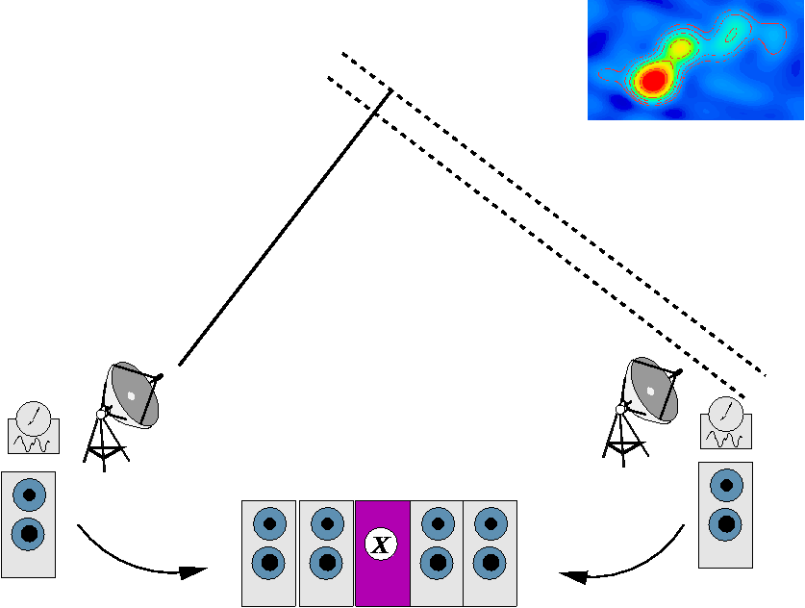
Principle of VLBI
Record same frequency band simultaneously at N telescopes
Use best possible local clocks and frequency standard
Sample and digitize and record (on magnetic medium)
Find all ½N(N-1) correlation coefficients at correlator
Compute back image from thousands of these measurements
Builds up Fourier components of sky image as the earth turns

Slide 7
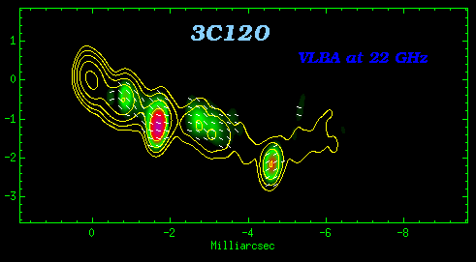
Astronomy in motion
A resolution which is high enough to see things move at cosmological distances
  Like quasars at the edge of the Universe

Slide 8
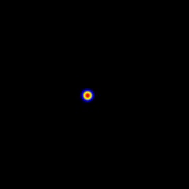
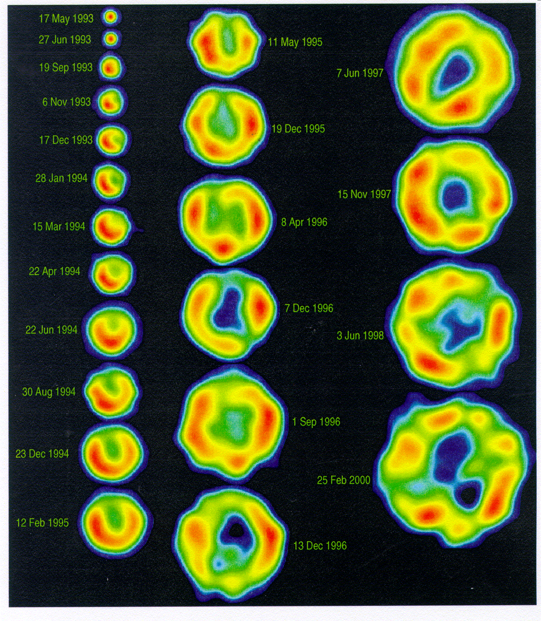
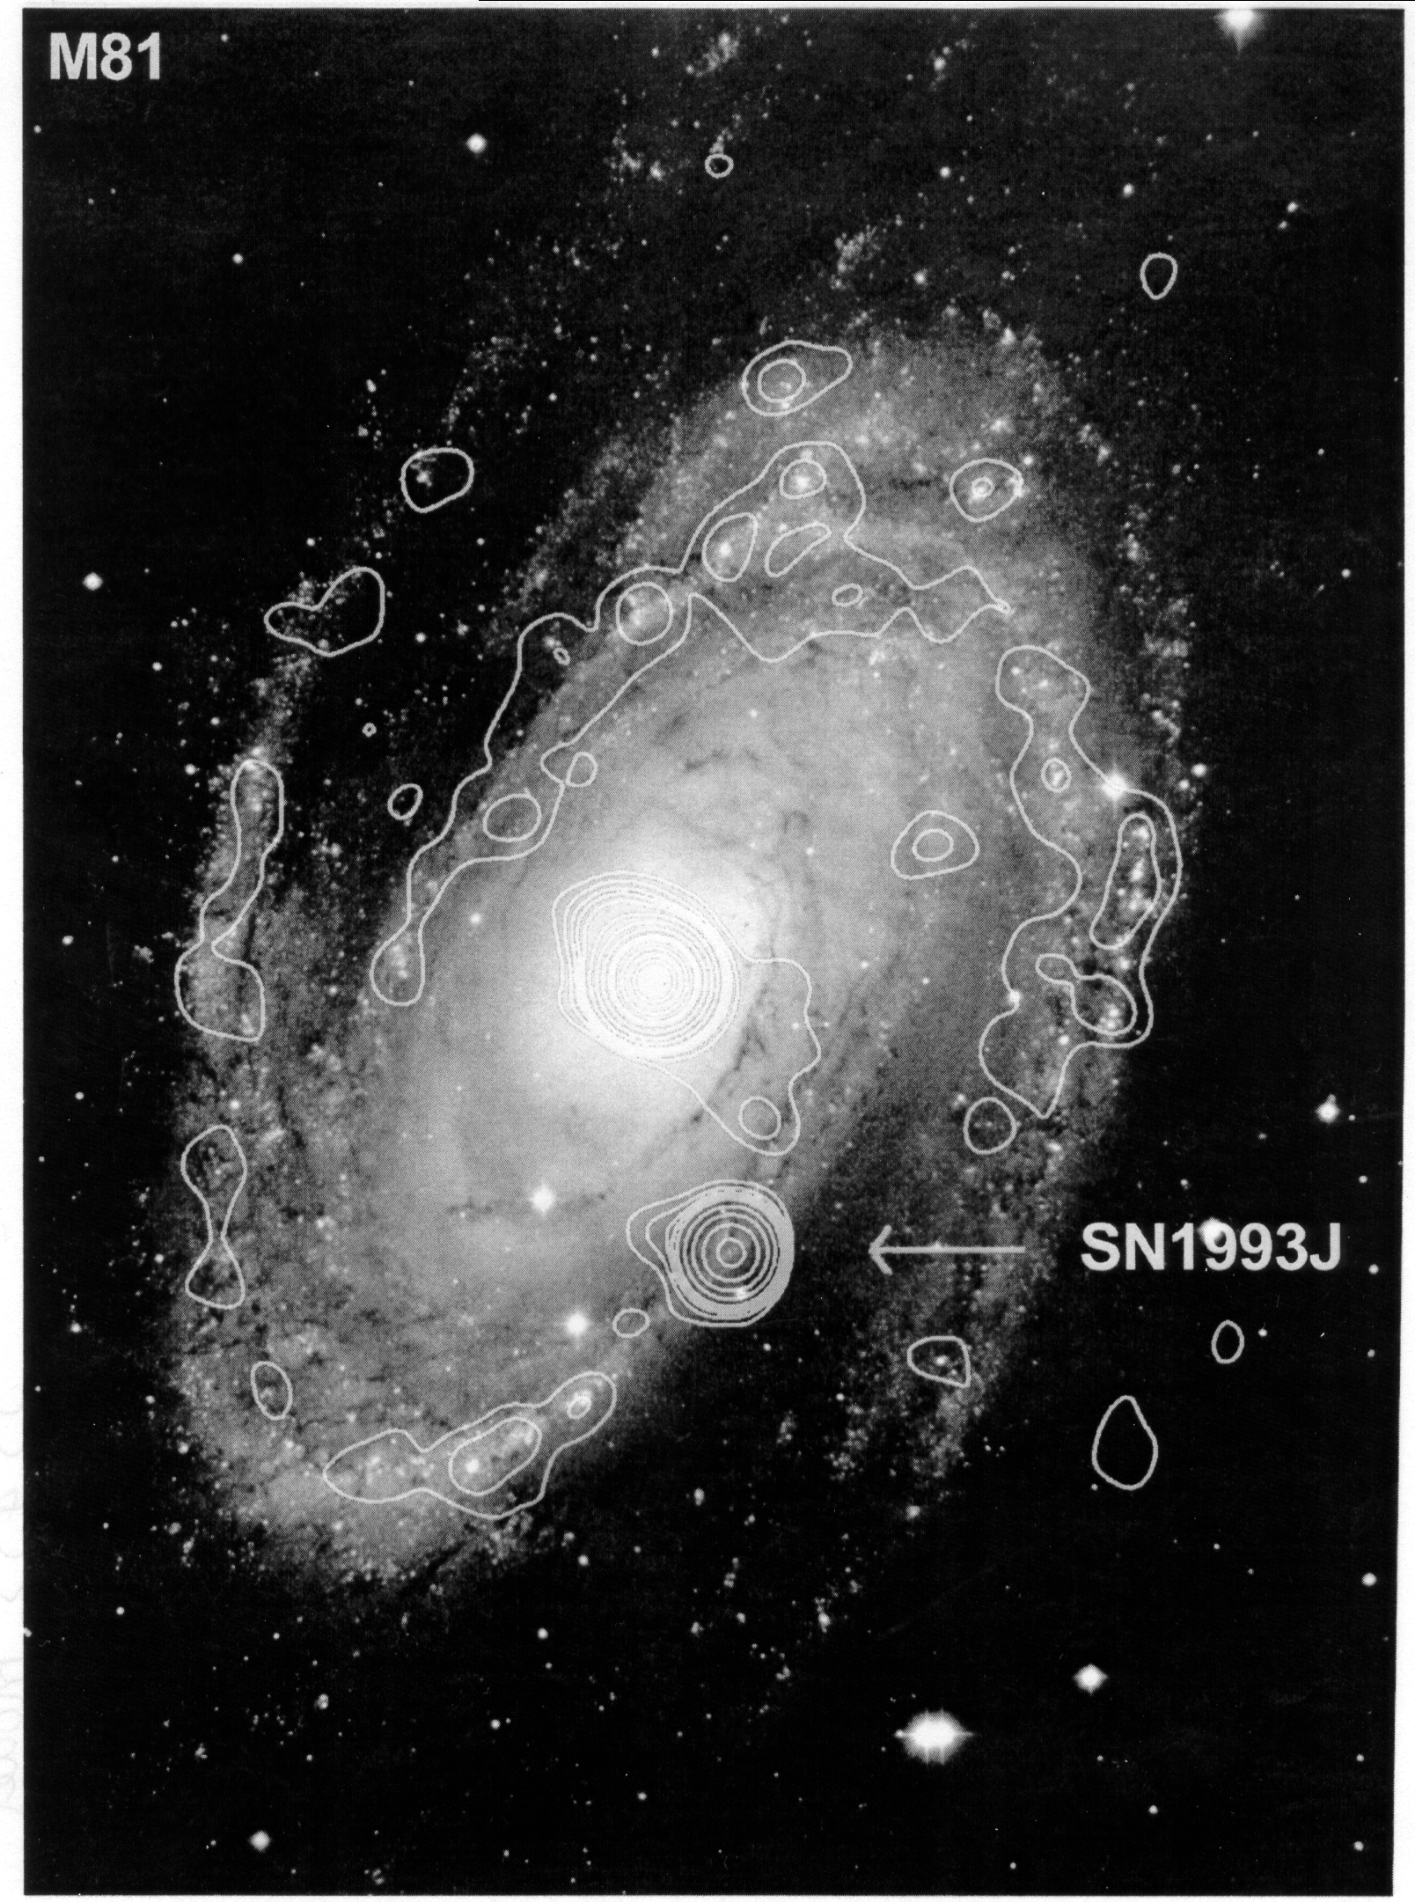
Exploding stars in other galaxies
supernova in M81 (1993)

Slide 9
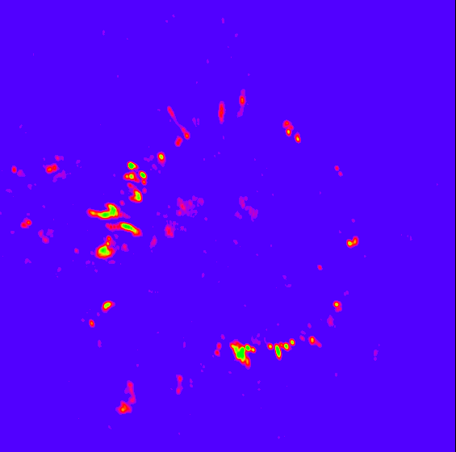
Mass loss around an old star

Slide 10

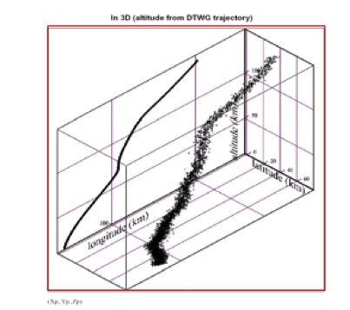
The birth of the JIVE software correlator
Tracking of Huygens probe during descent to Titan
Ad hoc use of the Huygens uplink carrier signal at 2040 MHz
17 radio telescopes around the world
Salvage of Doppler experiment
  Special purpose, narrow band software correlator
3D Huygens descent trajectory
σ_{x} = 1 km
σ_{v} = 3 cm/s

Slide 11
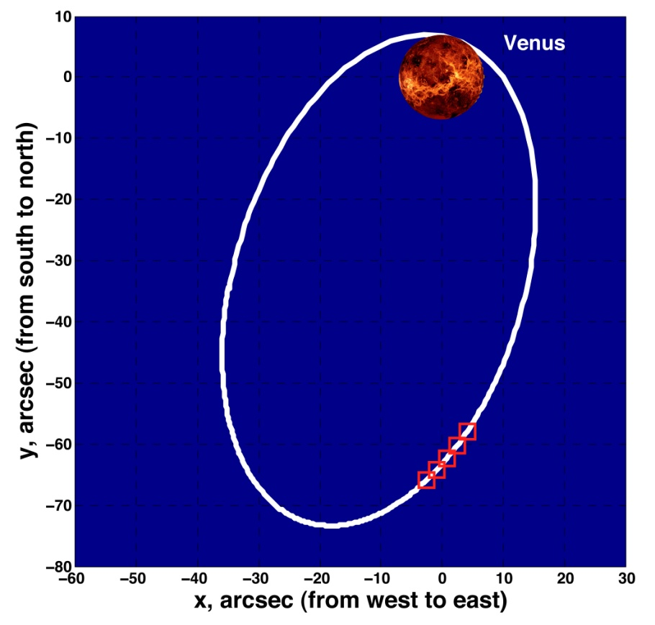
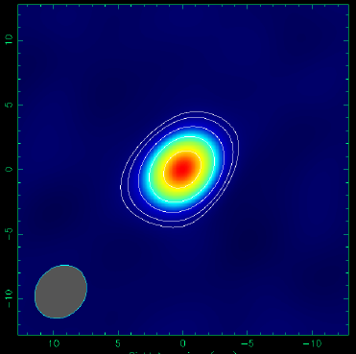
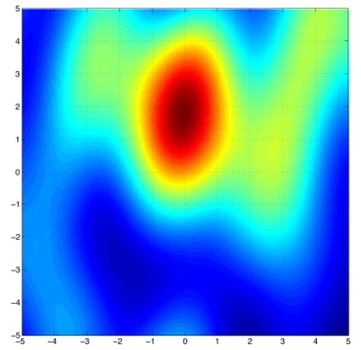
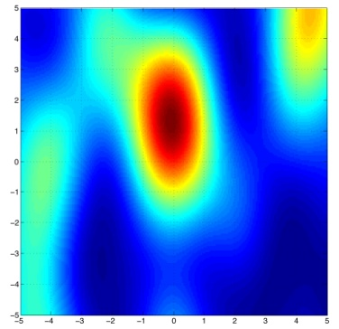
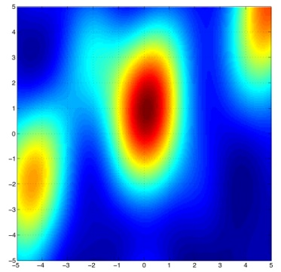
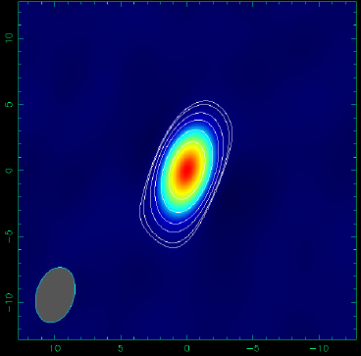
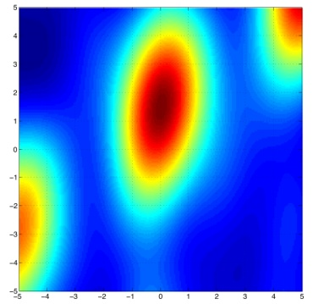
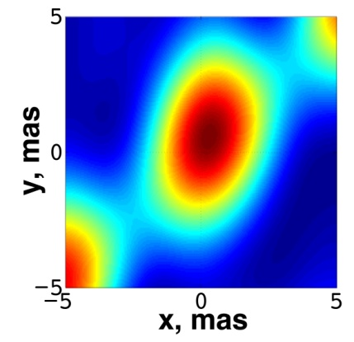
Space Science: tracking of VEX
8.4 GHz
2011.03.28
09^{h}05^{m} TDB
09^{h}30^{m} TDB
-10 dec, mas +10
09^{h}55^{m} TDB
10^{h}20^{m} TDB
10^{h}45^{m} TDB
-10 RA, mas +10
-10 RA, mas +10
EM081c: On, Wz, Mc, Ma, Ys, Mh, Sv, Zc

Slide 12
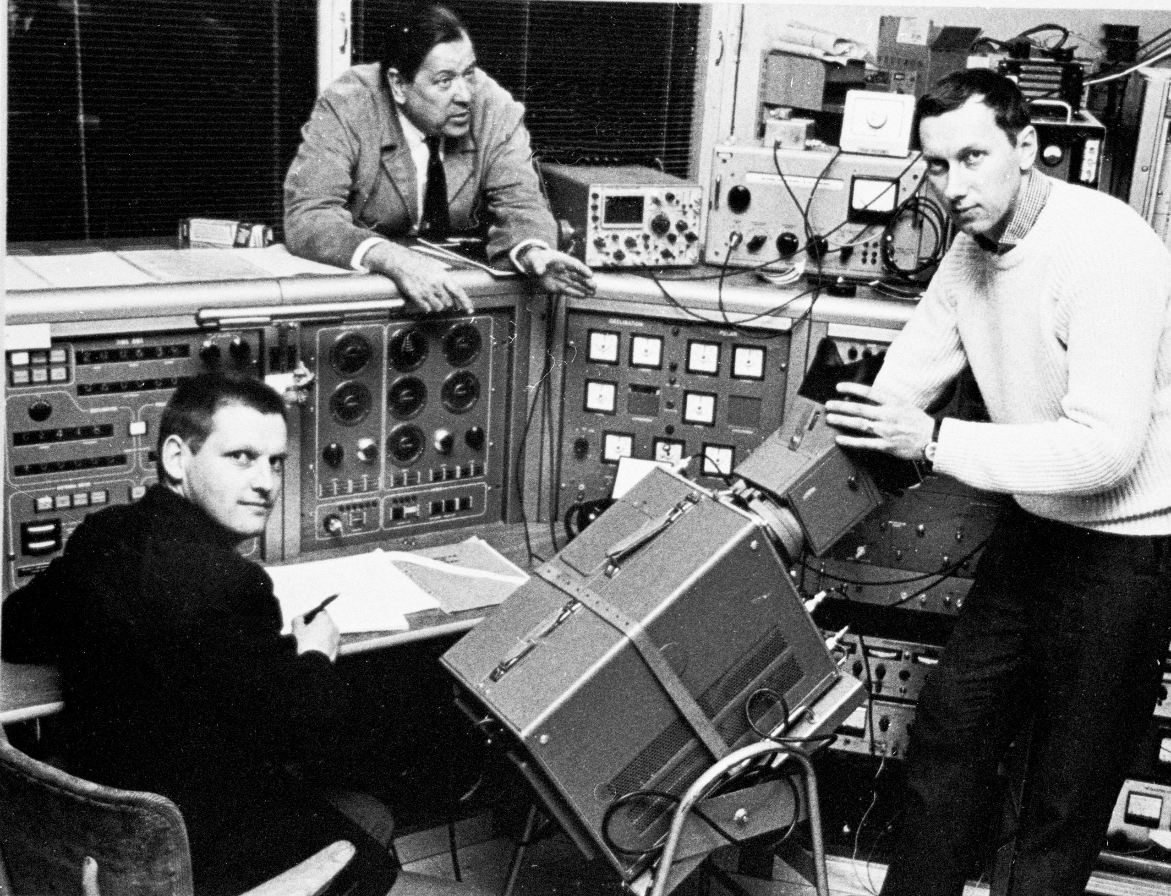
VLBI then
First transatlantic VLBI, Onsala, Sweden, 1968
Notes:
Bert Hansson, Olof Rydbeck (founder of Onsala Space Obs.) Joel Ellder

Slide 13
And now

Slide 14
UniBoard: project setup
UniBoard: Joint Research Activity in RadioNet FP7
  Kick-off January 2009
7 partners at first, 2 joined in later
  JIVE, ASTRON, INAF, Bordeaux, Orleans, UMAN, KASI
  Followed by Oxford and ShAO
Board development + four separate applications
  VLBI correlator
  digital backend
  pulsar binning machine
  RFI mitigation for pulsar binning
Followed by
  APERTIF beamformer
  all-dipole LOFAR correlator
  Filterbank for Effelsberg pulsar machine

Slide 15
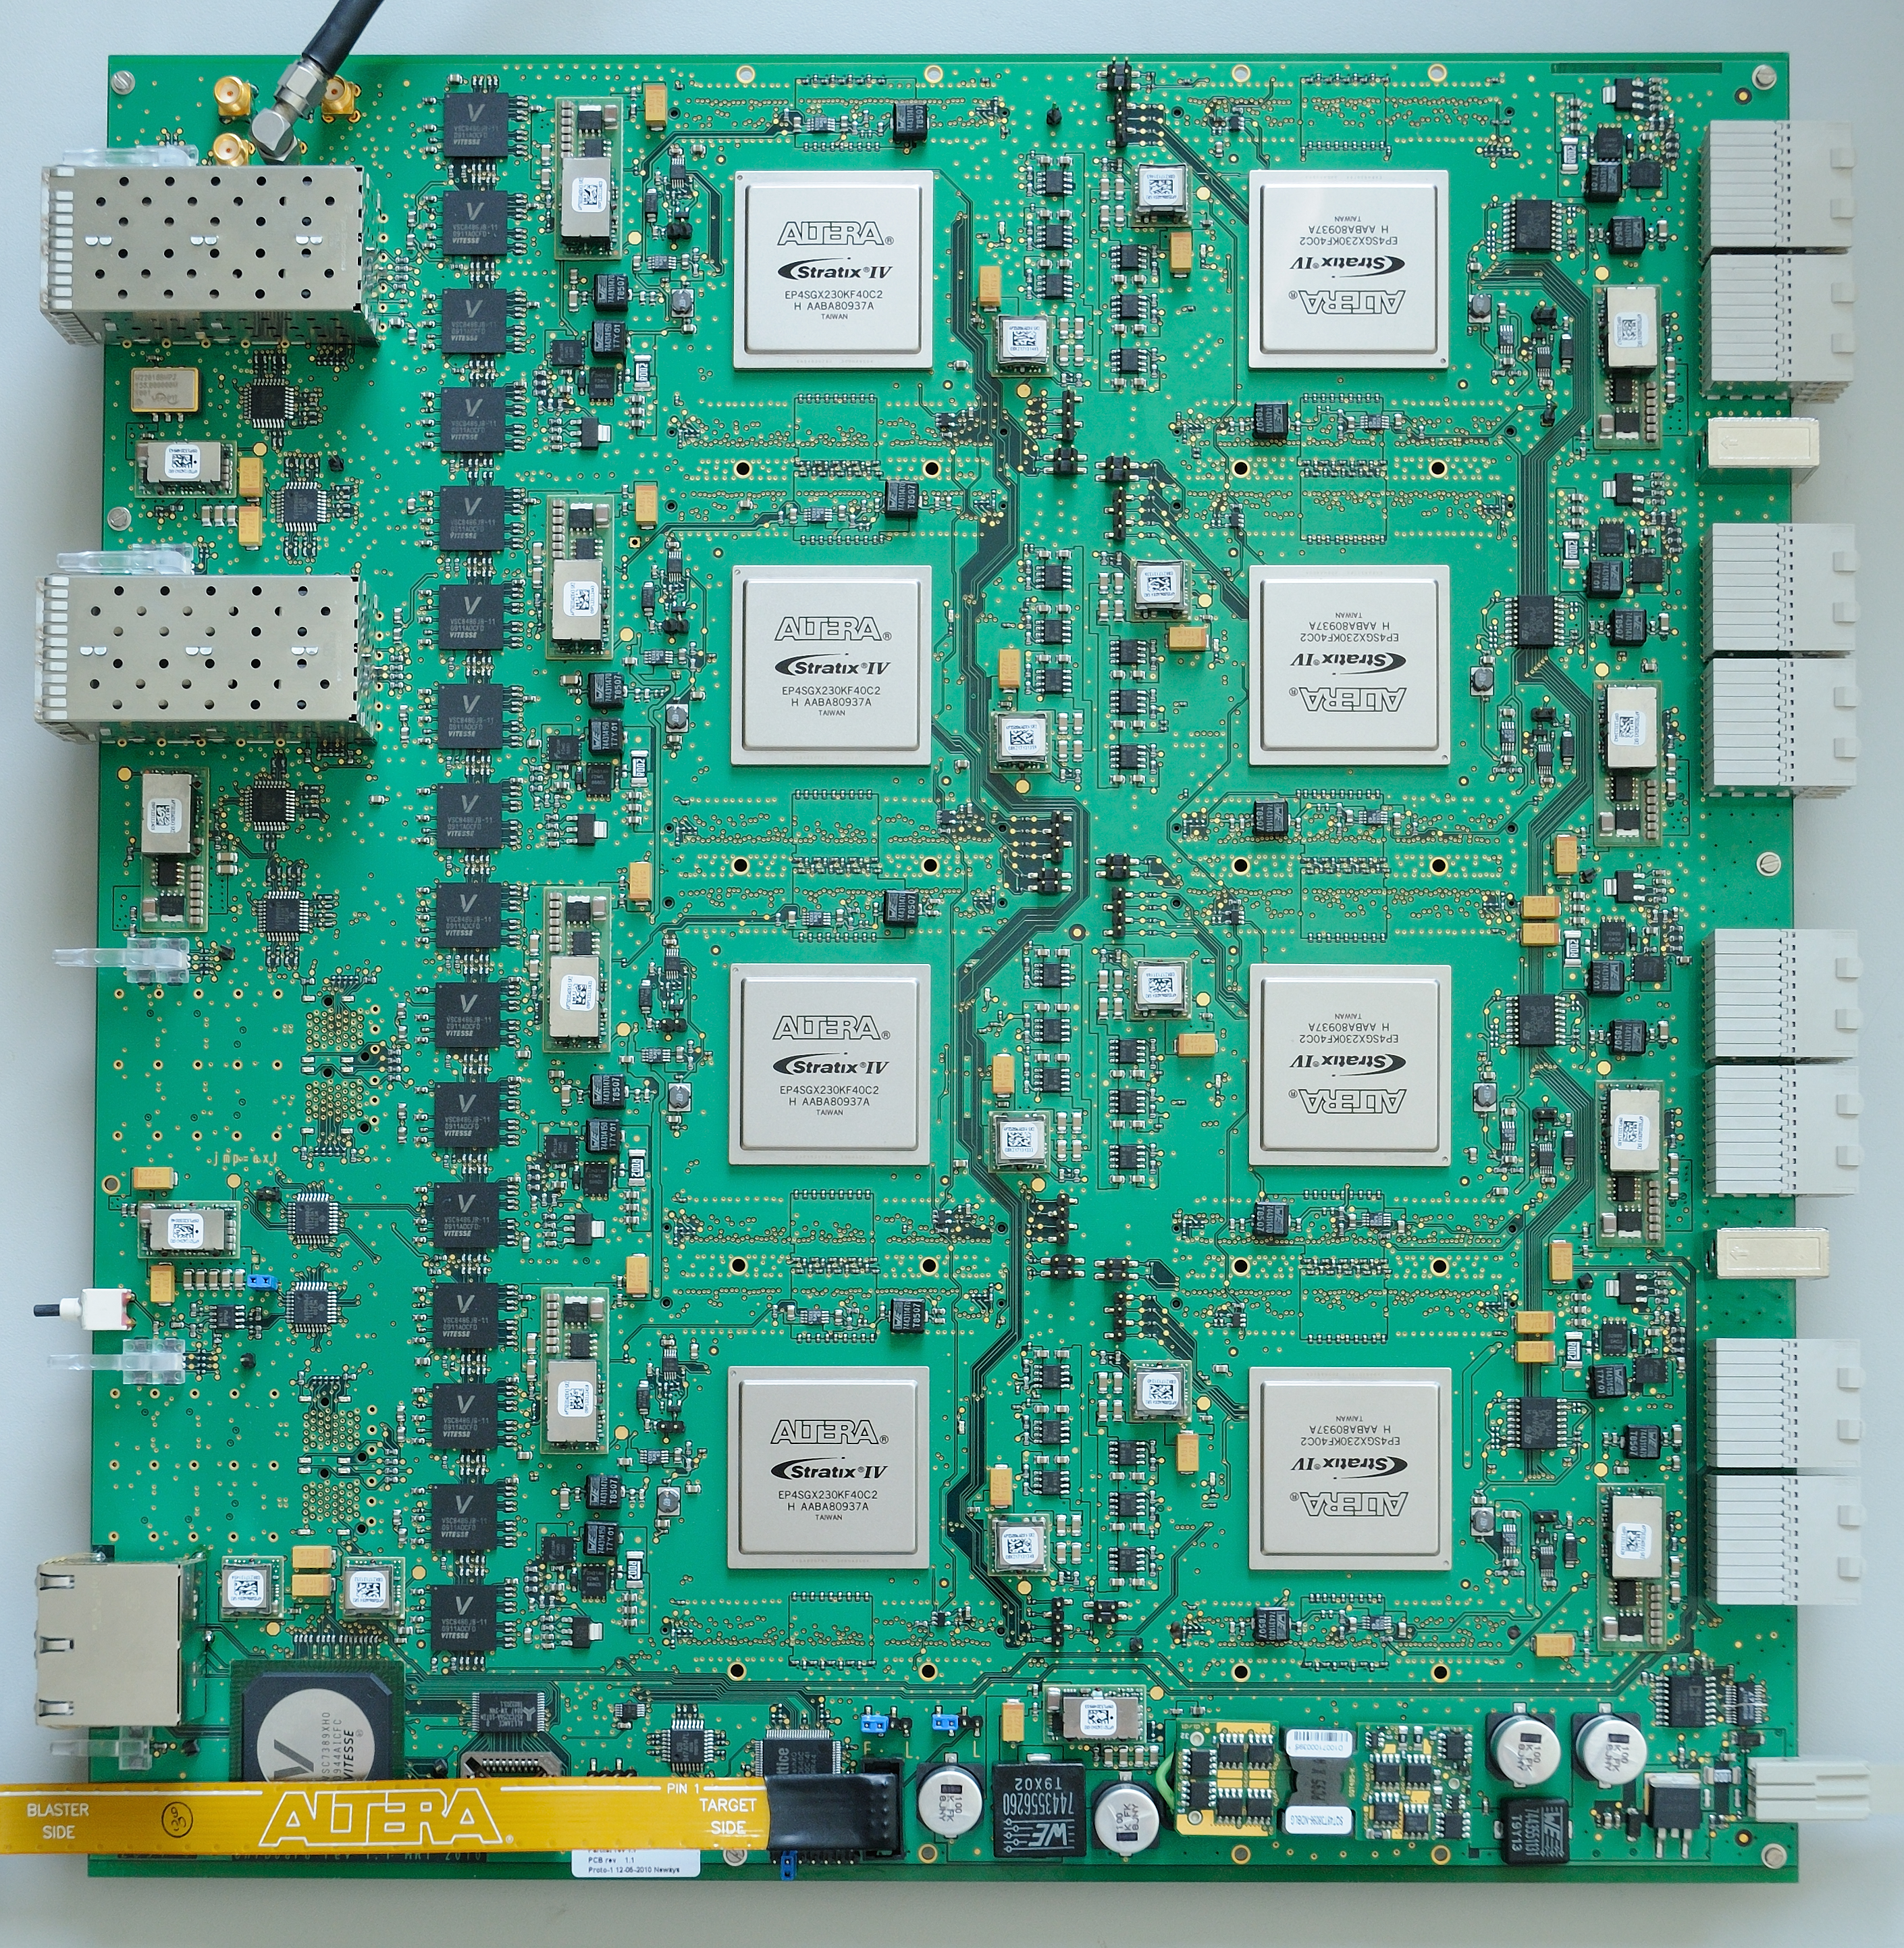
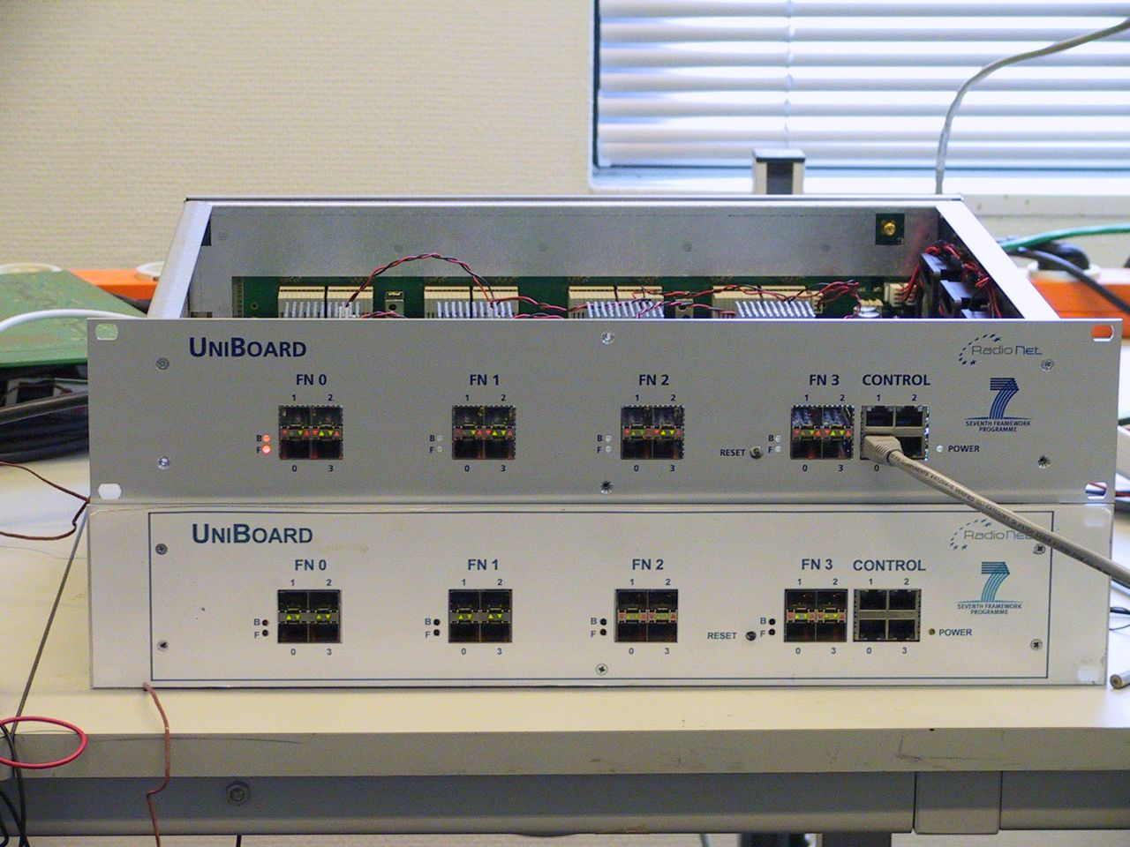
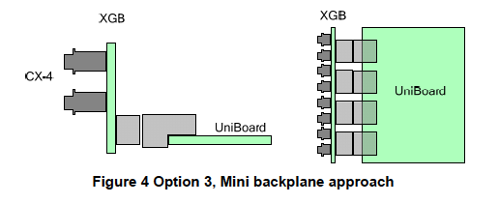
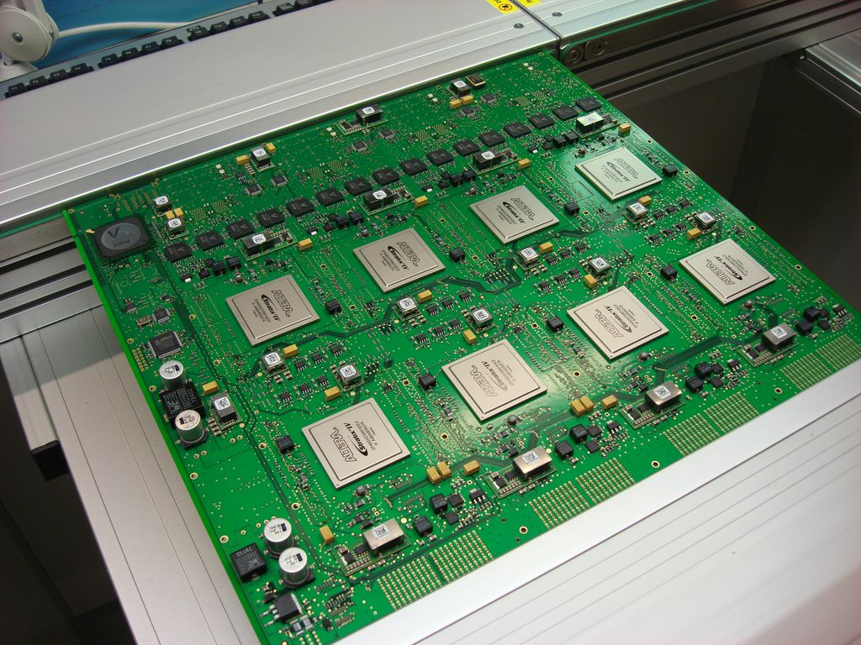
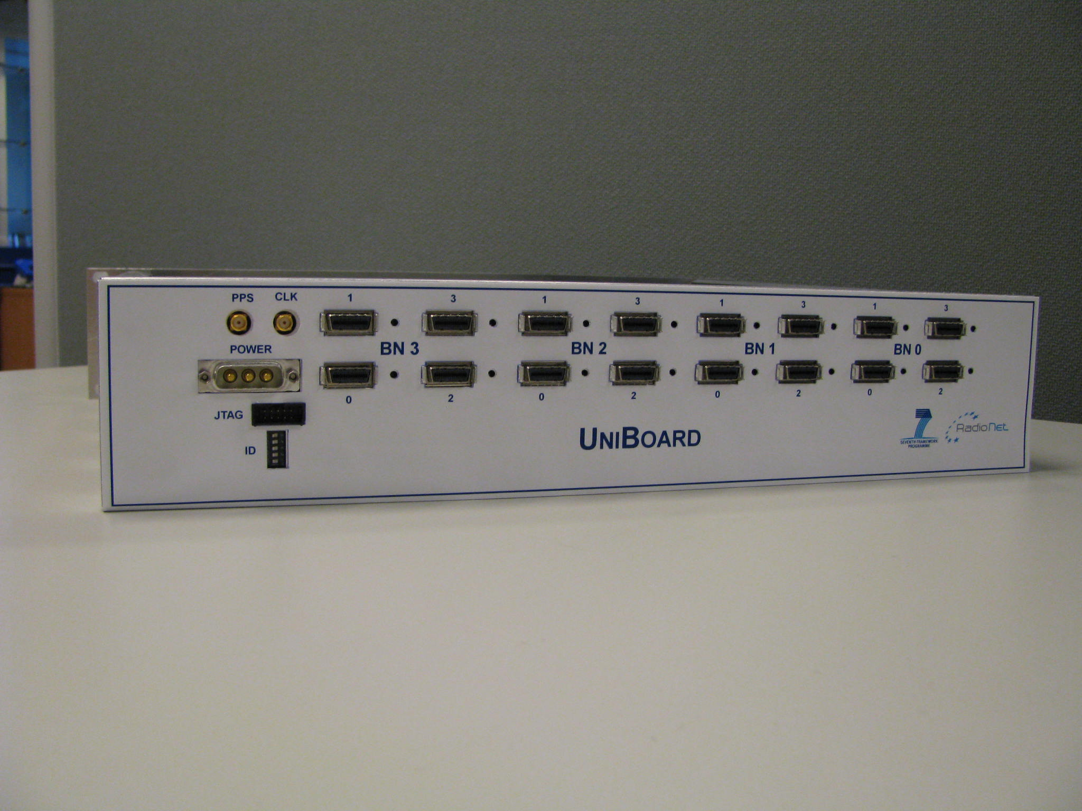
Results: hardware

Slide 16
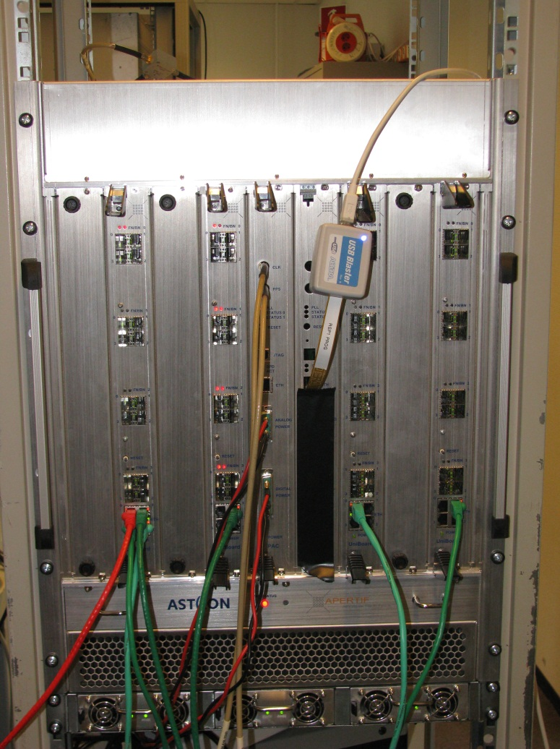
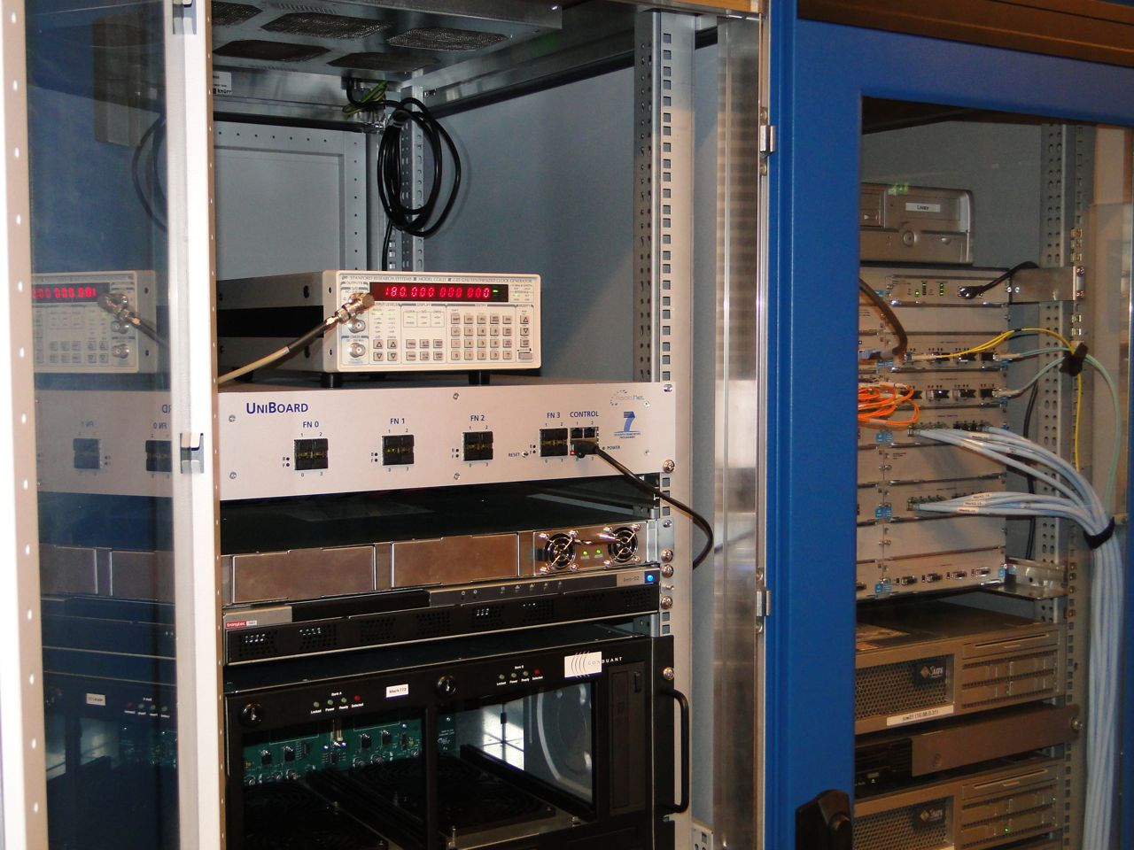
And more hardware

Slide 17

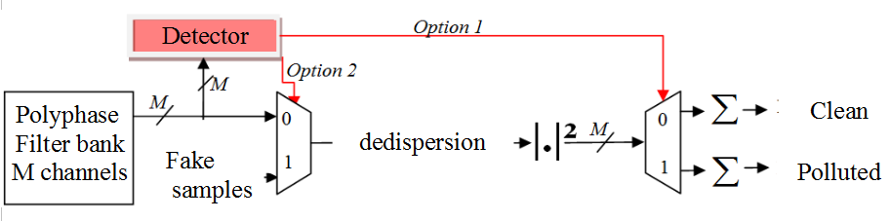

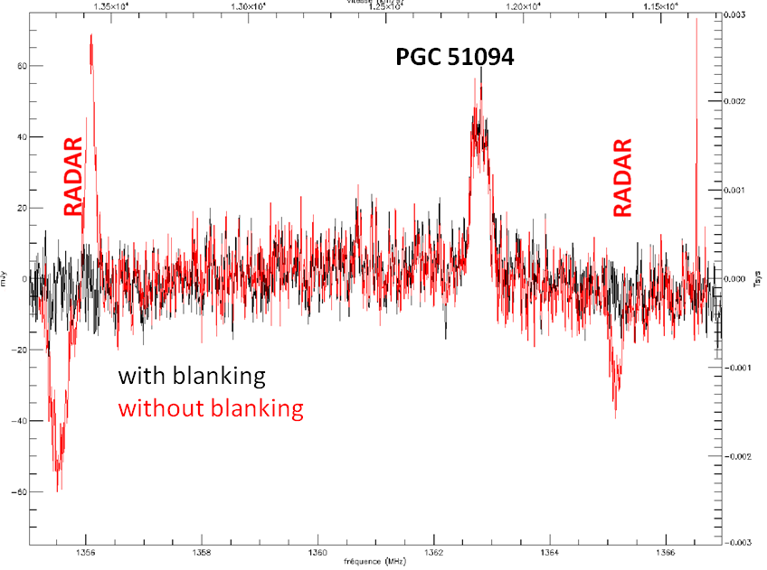
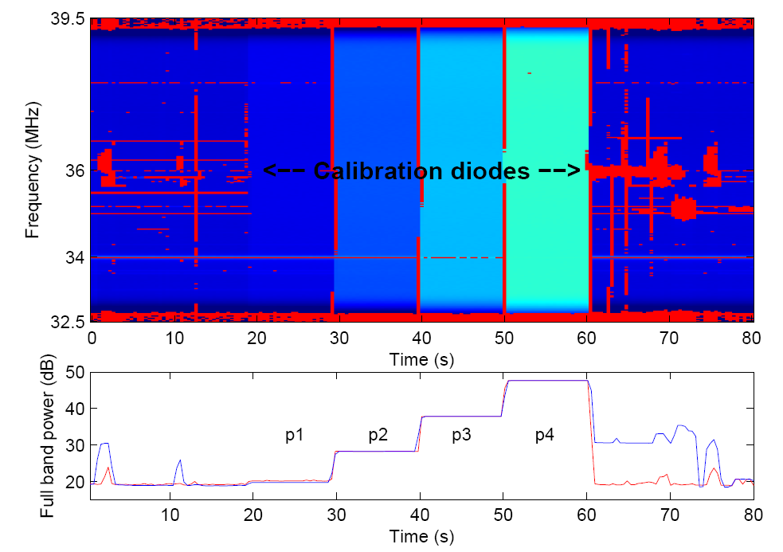
RFI mitigation for pulsar binning machine
Implemented on
UNIBOARD
Robust power detector
Cyclostationary detector
Calibration diodes simulating pulsar pulses
Red = flagged T-F slots
D. AIT-ALLAL, R. WEBER, C. DUMEZ-VIOU, I. COGNARD, AND G. THEUREAU
Rfi Mitigation Implementation For Pulsar Radioastronomy EUSIPCO'10, Aalborg, DN, August 2010.
D. AIT-ALLAL, R.WEBER, C.DUMEZ-VIOU
RFI mitigation at Nancay Observatory: Impulsive Signal Processing in proceedings of “RFI mitigation workshop - RFI2010”, PoS(RFI2010)021, 2010
R. WEBER, S. CHANGUEL ,C. DUMEZ-VIOU ;C. DUMEZ-VIOU Real-time RFI mitigation on a new generation digital board: UNIBOARD, JS 2011, Ursi France, 29-30 March 2011, Paris
Blue= initial total power profile (with RFI)
Red= power profile after blanking
Notes:
Option1 and Option2 are two flags which can be used by other parts of the design :
option 1 : if the detector detects some RFIs, the pulsar folding can be oriented : in other words, you can choose to
fold separately cleaned pulse profiles and polluted pulse profiles. It is not a binary choice, you can decide to
have different levels of polluted pulse profile folding based on detection levels. It is a way to keep all data
information, we just provide a kind of classification based on data quality.
option 2 : you can choose to blank or not (it is a binary choice). When you blank, you can replace polluted samples
by zeros or by random samples extracted from clean part of the signals.
option 1 and option 2 can be set up independently.

Slide 18
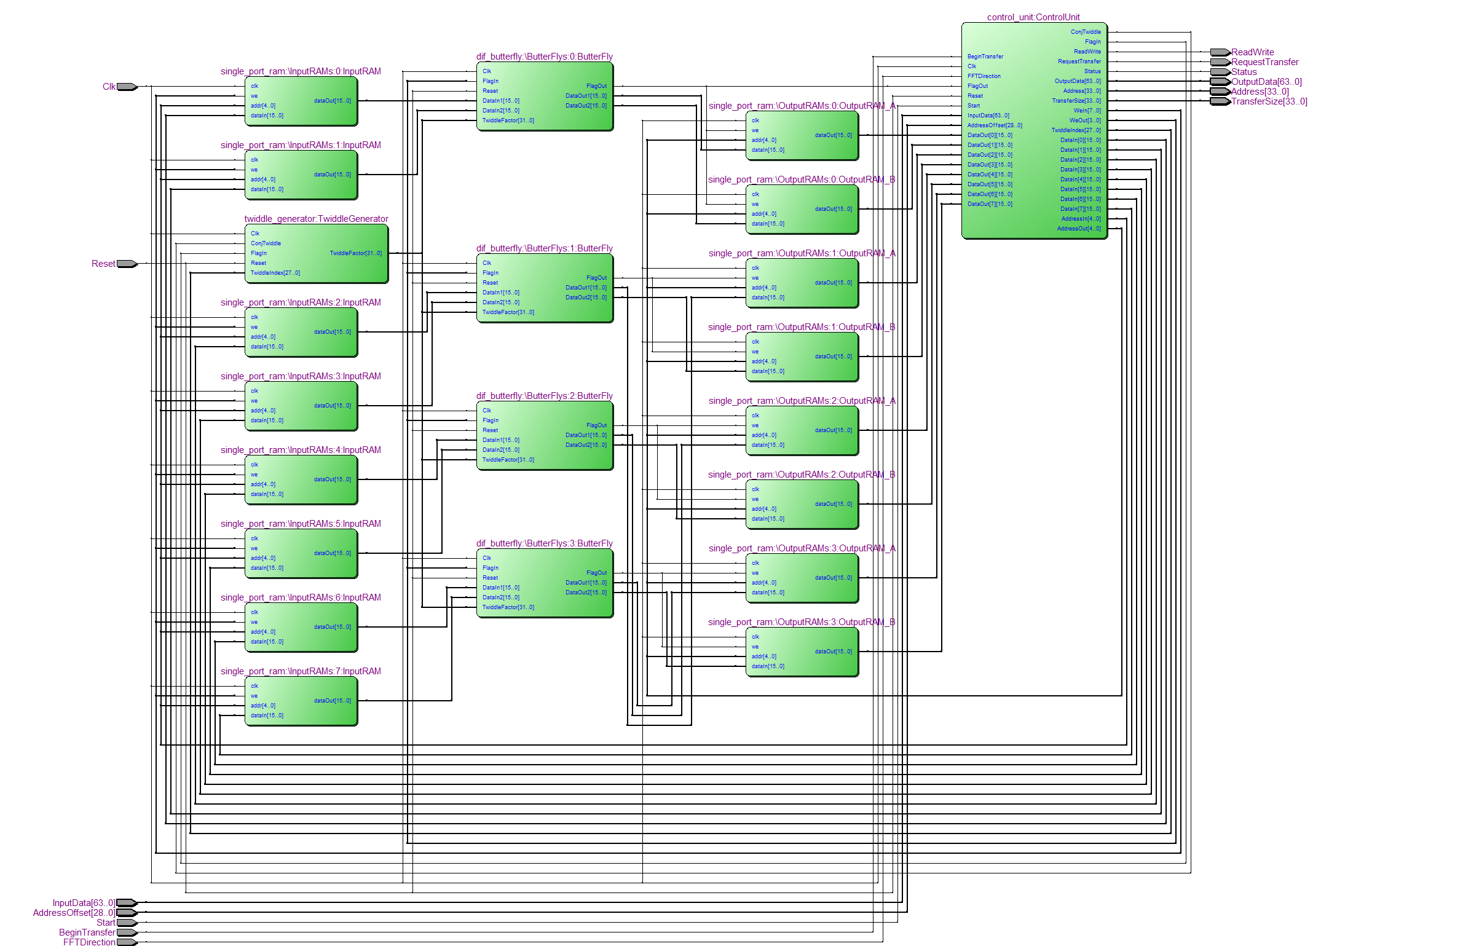
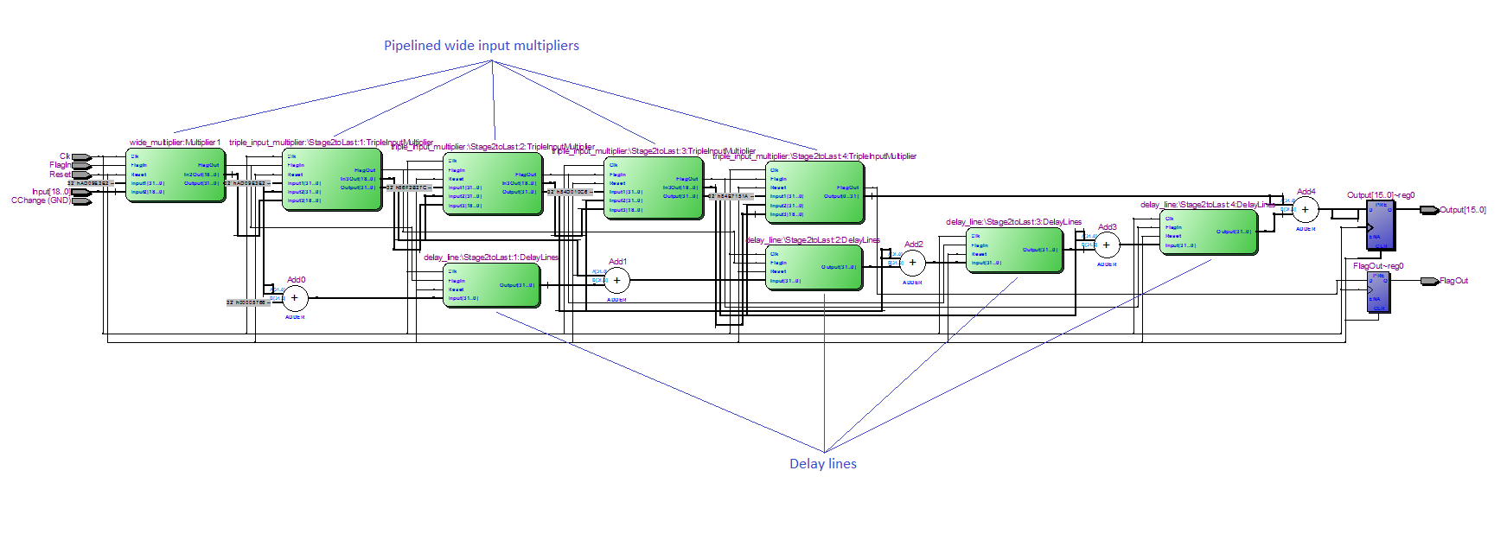
Pulsar binning machine development
FFT module for large transforms:
Technology independent: The core can be used for ASICS or FPGAs from any vendor
Transform size: From 16 to several Giga points. Limited by the size of the external memory
Polynome module for pulsar timing and dedispersion coefficients calculation:
Completely customisable at compile time via a number of constants
MATLAB script for auto pre-processing of the coefficients and generating a VHDL package for them
Minimal use of multipliers
FFT module with 4 parallel butterfly units
Schematic for order 5 polynome
Notes:
Coherent dedispersion

Slide 19
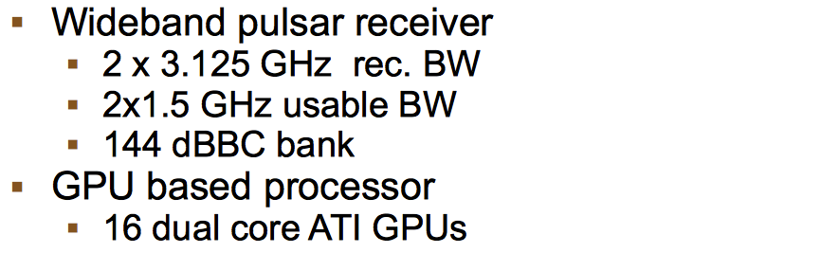
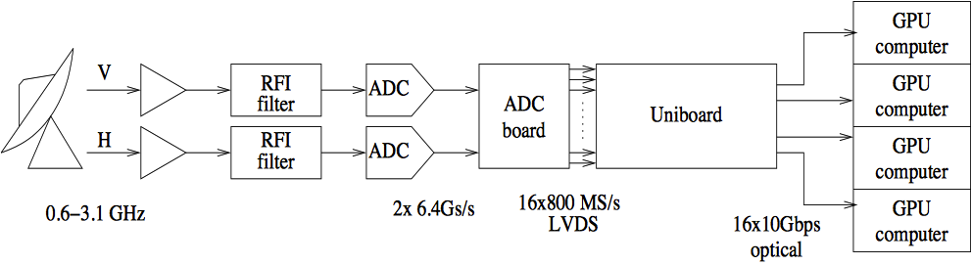
And something we did not think of
Work by G. Comoretto (INAF) and Guenther Knittel (MPG)
Notes:
Coherent dedispersion

Slide 20
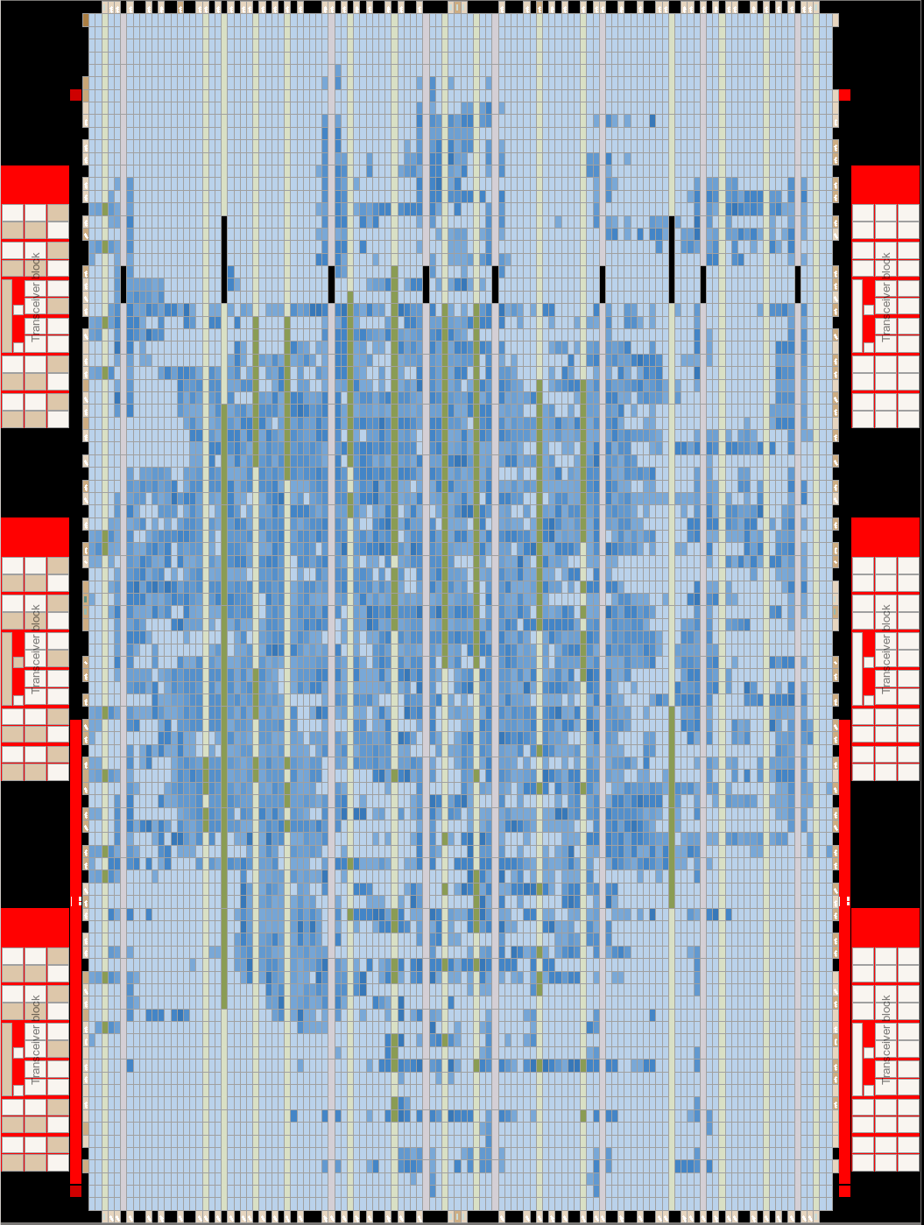
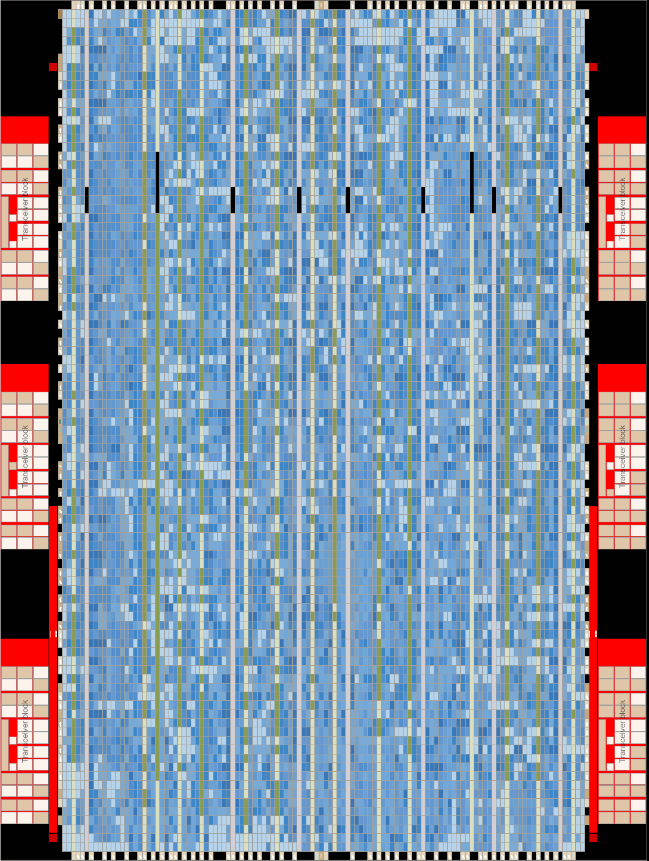
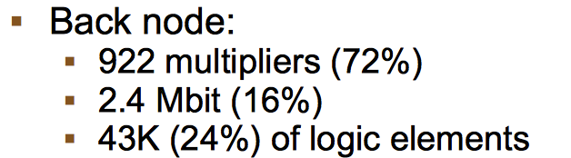
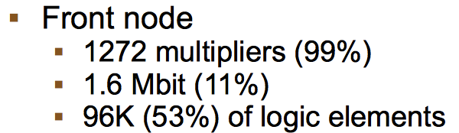
Overkill?
Notes:
Coherent dedispersion

Slide 21
JUC (JIVE UniBoard Correlator)
FX correlator
Data format: VDIF
Delay model: CALC10 (same as SFXC), computed on external control computer
PFB: Blackman Harris window, 6 taps/spectral channel
VEX driven, with JSON configuration file
32 stations, 2 polarizations, 4*16 MHz subbands
Freq. resolution 15.625 kHz
32 MHz personality available, not yet tested
1- and 2-bits, 4 and 8 to follow
All products are calculated all the time, selection at ouput

Slide 22
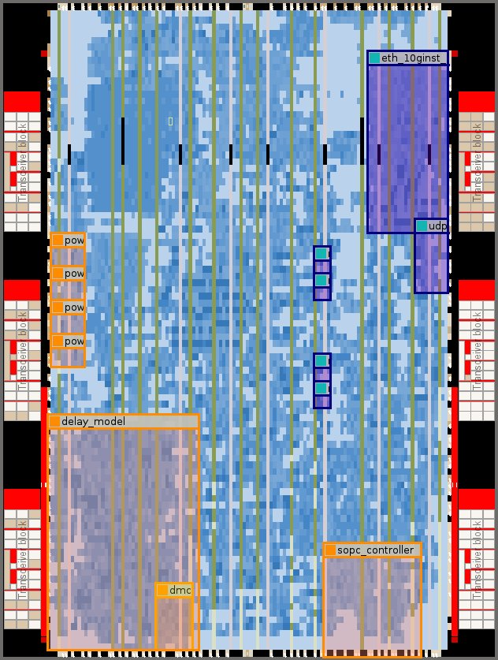
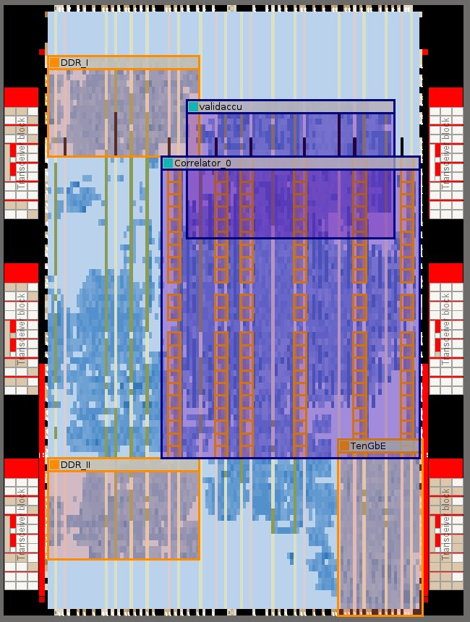
Status
Front and Back Node designs operational
32 MHz design meets timing, needs testing
DDR
ETH Switch
10Gb-Eth
Packet Receiver
Mixer
Pre Filter Structure
FFT
Normalize
Framer
FBI
Mesh
Control Computer
1Gb-Eth
Delay Model
SOPC
DDR_I
Correlator Engine
Formatter
10Gb-Eth
ETH Switch
Mesh
FBI
Deframer
Corner
Turner
Validity
Accu
DDR_II
SOPC
1Gb-Eth
Control Computer
Notes:
The packetRX module (read packets, strip headers, store in memory, apply delay, read out of memory, send to FB) had become a bit of a monstrosity, has been rewritten completely and sanitized and documented (!!) by Salvatore. Data op Mark5 disk packs wordt on the fly naar VDIF vertaald, naar UB gestuurd. Werkt, t/m 11 stations getest, nog steedsniet-ernstige bug in 8 banden (sommige phase slopes verkeerd om), 4 banden werkt prachtig,

Slide 23


UniBoard Correlator
One board roughly equivalent to MarkIV hardware correlator
  At 250 Watt power consumption…
Real results
Close to commissioning
huib 08/06/10
/28

Slide 24
Lessons learned
Number of MUXes definitely not equivalent to available computing power
Big chips with lots of multipliers are great, but, to use all of them one needs more of everything else: registers, SRAM, routing resources
Simple things work great on FPGAs, anything slightly more complicated does not
Plenty of space left on FPGA, but correlator design at (cutting) edge of what is possible
Modularization of VHDL code blocks for re-use by other parties is only possible in limited cases and for limited functionality
  And a waste of time in other cases
But good agreements on level and type of documentation very useful

Slide 25
Next: UniBoard²
Joint Research Activity in RadioNet3, start date July 2012
Generic hardware complemented by a number of applications
Consolidate and build on expertise obtained through UniBoard project
Aimed at large instruments of the future, SKA
Power efficiency (green computing)
Complete re-design, using the newest generation FPGAs, 20nm?
Non-leaded components
Possible use of 40GE, 100GE
Investigation into effects of hard-copy and partial hard-copy
Tuning of algorithms and firmware design to minimize power consumption
Balancing of system parameters and performance to minimize power consumption
Standardized interfaces and coding conventions to facilitate sharing and re-use of firmware

Slide 26
UniBoard², wishlist

Slide 27
UniBoard²
Prototype on 20nm (Altera Arria10)
Production on 14nm (Altera Stratix10) (>10000 multipliers)
Focus was on SKA AAlow beam forming
  SKA AAlow correlator?
Main board: single column of 4 FPGAs
QSFP cages one side, backplane connector other side
Only transceivers, no LVDS, no mesh
Need for many transceivers to feed all the multipliers on Stratix10
Limits number of I/O pins: not enough DDR memory!
Full mesh, Hybrid Memory Cubes and QSFP on break-out board
huib 08/06/10
/28

Slide 28
UniBoard²: possible setup
huib 08/06/10
/28

Slide 29
UniBoard²: high-level design
huib 08/06/10
/28

Slide 30
UniBoard²: what is happening
Lay-out nearly completed
Companies selected for assembly and PCB production
Arria10 engineering samples ordered for prototype
Availability/affordability of Stratix10 may become an issue
Much effort into pinning and test design at JIVE and ASTRON
UMAN, UORL: continue algorithm development
BORD: new digitizers
MPG: beam former

Slide 31
And next?
RadioNet will most likely be continued
UniBoard projects provided opportunity to work with latest technology
  Valuable whether or not the board itself gets incorporated in SKA
Go on, and on, towards UniBoard^{N}...?
Speed (or rather lack of) of development killing projects
  Get overtaken by software correlators, CPU and GPU
Devices ever larger, more complex
  Inordinate amount of time needed for synthesizing
OpenCL? Big devices, can afford hit in efficiency if it buys real ease of programming
Combinations GPU-FPGA-ADC on one board?

Slide 32
Third International VLBI Technology Workshop
Hosted by JIVE
November 10 -13 2014
Groningen + Dwingeloo, the Netherlands
www.jive.nl/ivtw2014
Notes:
TODO: check connection path
TODO: picturs

