Slide 1
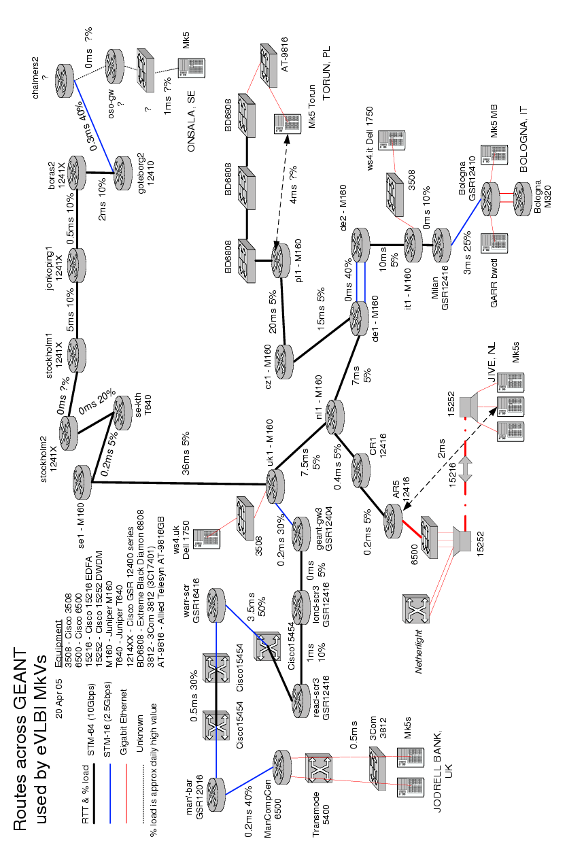
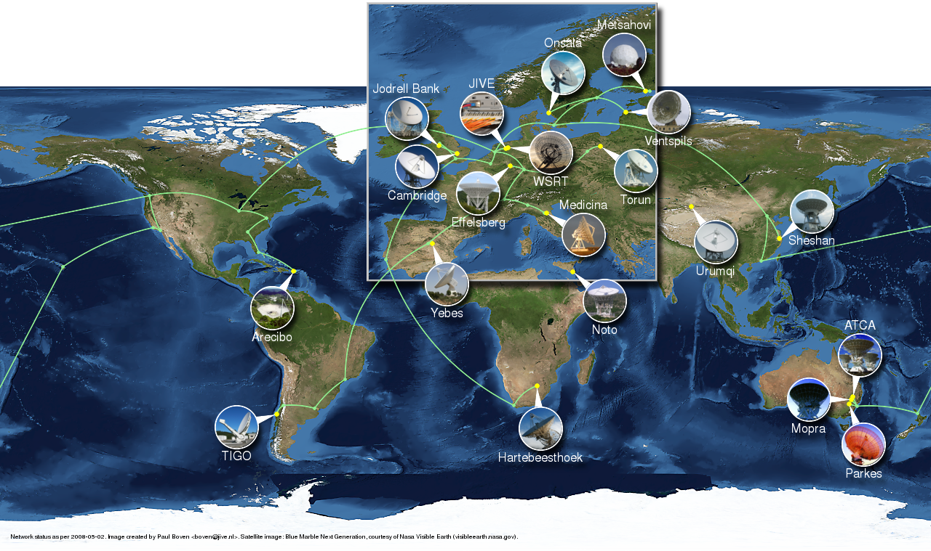
EXPReS and NEXPReS
What next?
Arpad Szomoru, JIVE

Slide 2
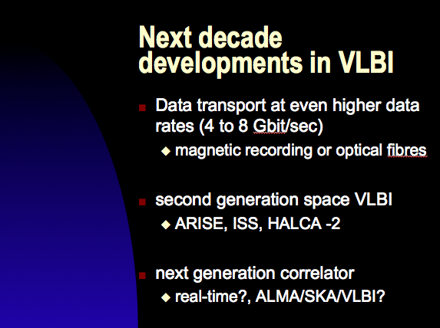
e-VLBI. Why?
Rapid turn-around
Rapid response
Instant feedback
Robustness
Reliability
Logistics
No (less) dependence on magnetic media
Cheaper (…?)
Upgrade path for higher bandwidth
New science
Schilizzi, NAC 1999

Slide 3
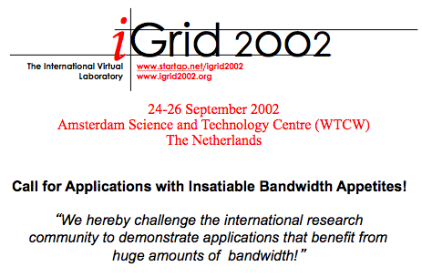
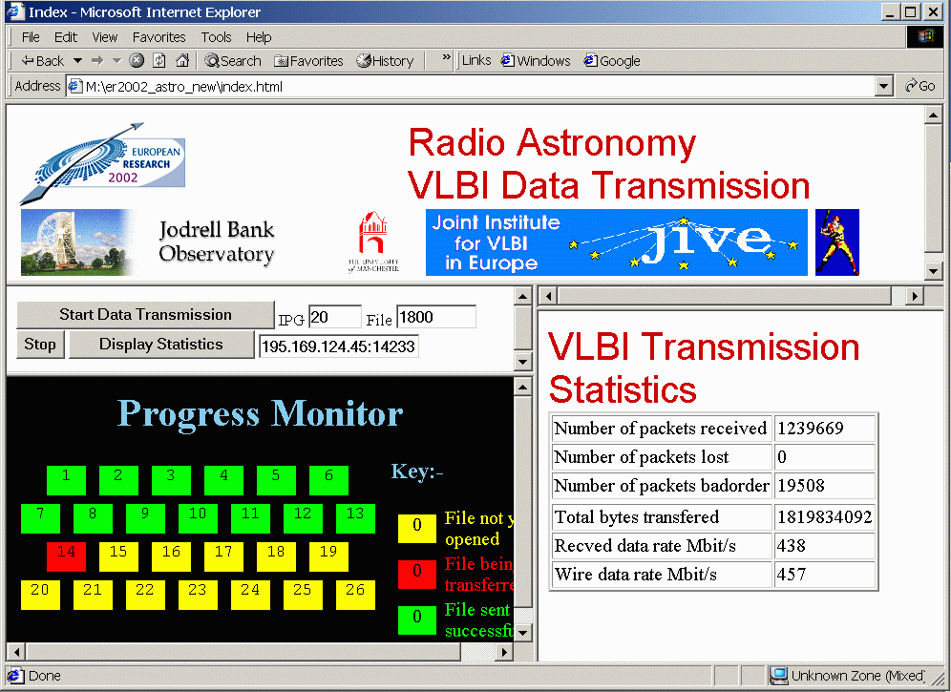
First steps

Slide 4
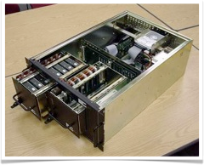
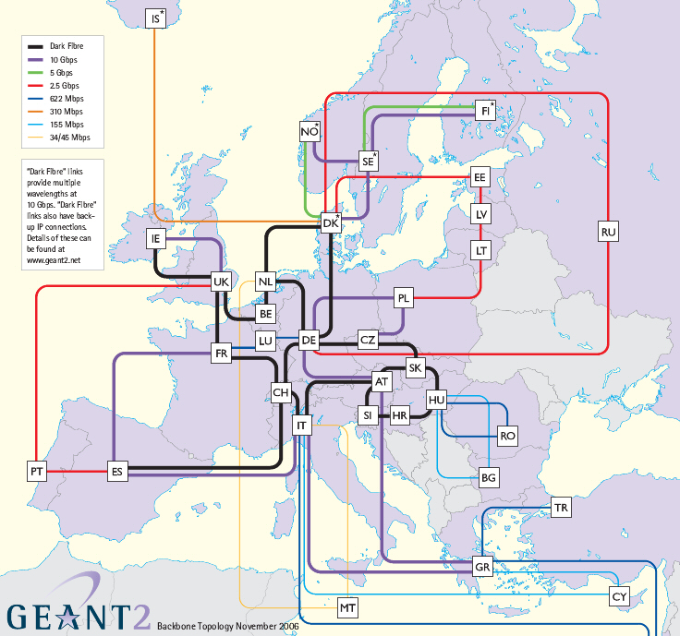
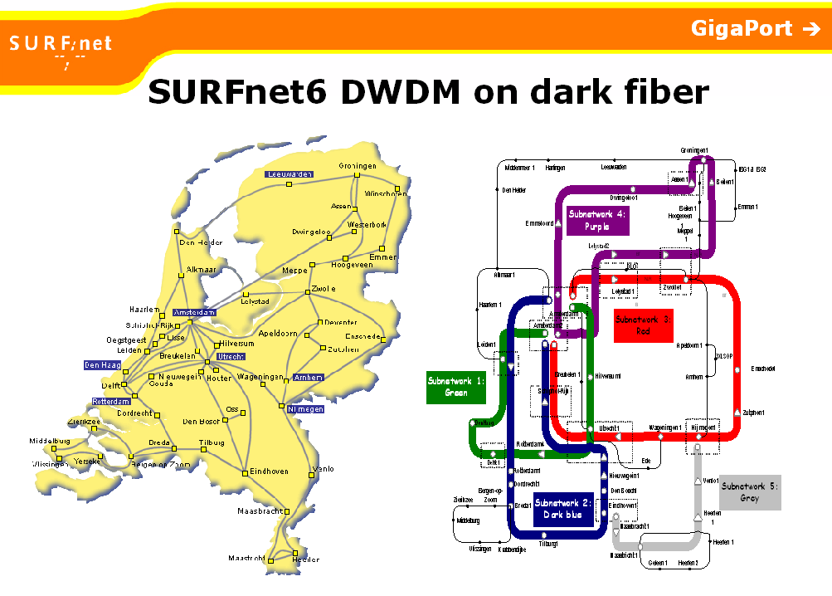
Pieces falling into place
Introduction of Mark5 recording system (game changer)
Emergence of high bandwidth optical fibre networks

Slide 5

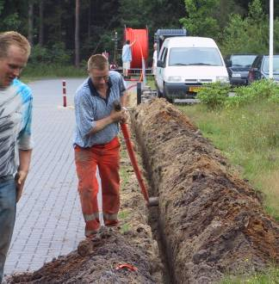
EXPReS
EXPReS project kicked off 2006
What we would do:
  Retrofit correlator to work real-time
  Help solve last mile problem at telescopes
  Work with NRENs on robust connectivity
  Push to 1024 Mbps limit
  Bring in the big telescopes

Slide 6
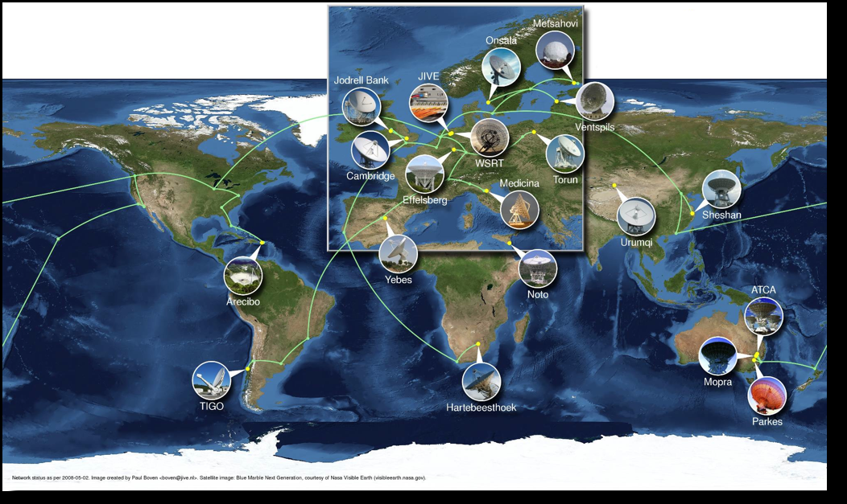
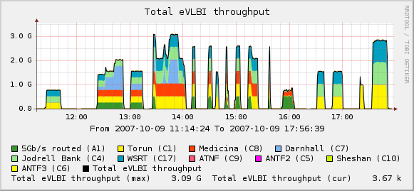
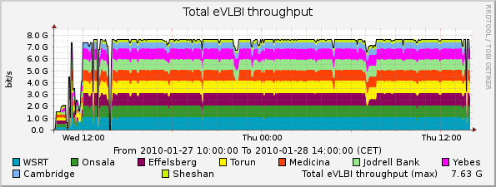
And we did
Connections work great!
Dedicated lightpaths, VPNs, routed connections
Optimized transport protocol
Instant feedback: very robust

Slide 7

Demonstrations (which led to science)
Real-time demo during opening ceremony of IYA, 15-16 January 2009 in Paris
  UNESCO building in Paris
  ~800 invitees
  Many dignitaries, Nobel prize winners, students
  24 (33) hours real-time tracking of one (three) source(s)
  6 (5) - continent e-VLBI
  17 telescopes, 4 of which new for us
  4 data acquisition systems,
  2 frequencies

Slide 8
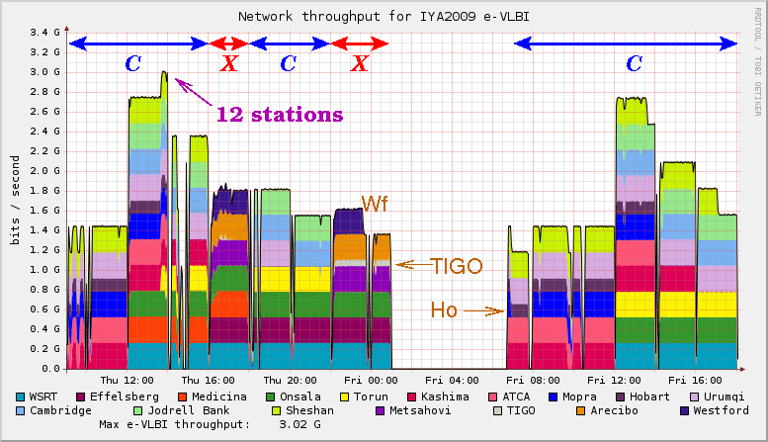
The result

Slide 9

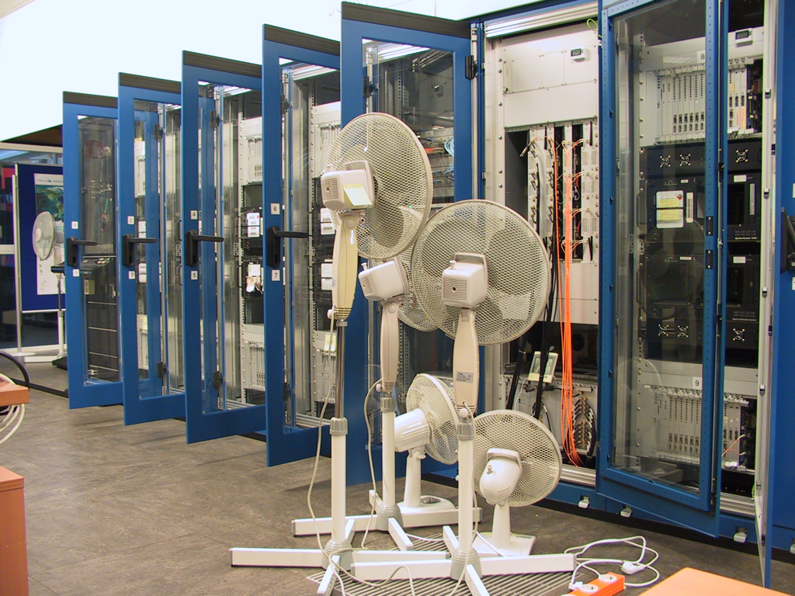
Stuff breaks
Introduce real-time element in all VLBI observations
  Continue collaboration with NRENs
Implement 4 and 10 Gbps international BoD
  Taking advantage of upcoming 100 Gbps technology
Address technological questions wrt future instruments
  Broadband storage, long-term archiving, data retrieval
Development of high-speed read/write buffers
  Using COTS components
Introduction of observations with sub-sets of EVN telescopes
  semi-automatically generated schedules and control
  Automatic triggered transient response, multi-epoch campaigns
Remote control and monitoring of telescopes (at Wetzell)
huib 08/06/10
/28

Slide 10
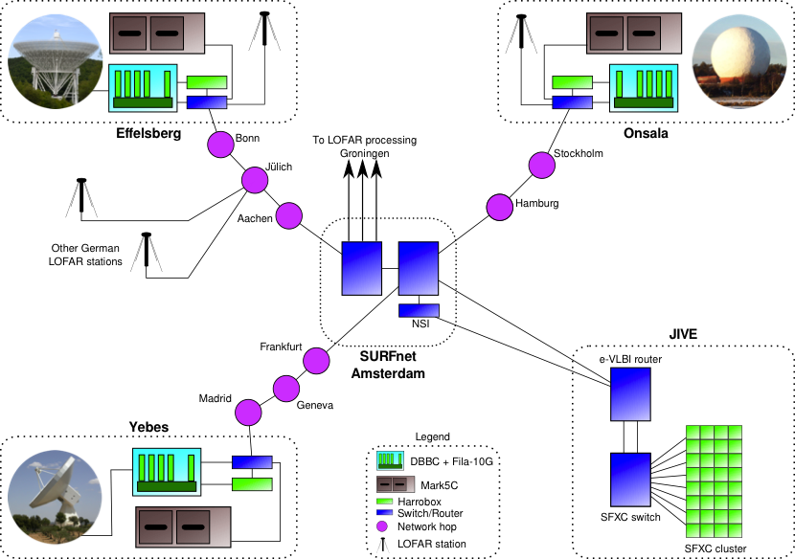
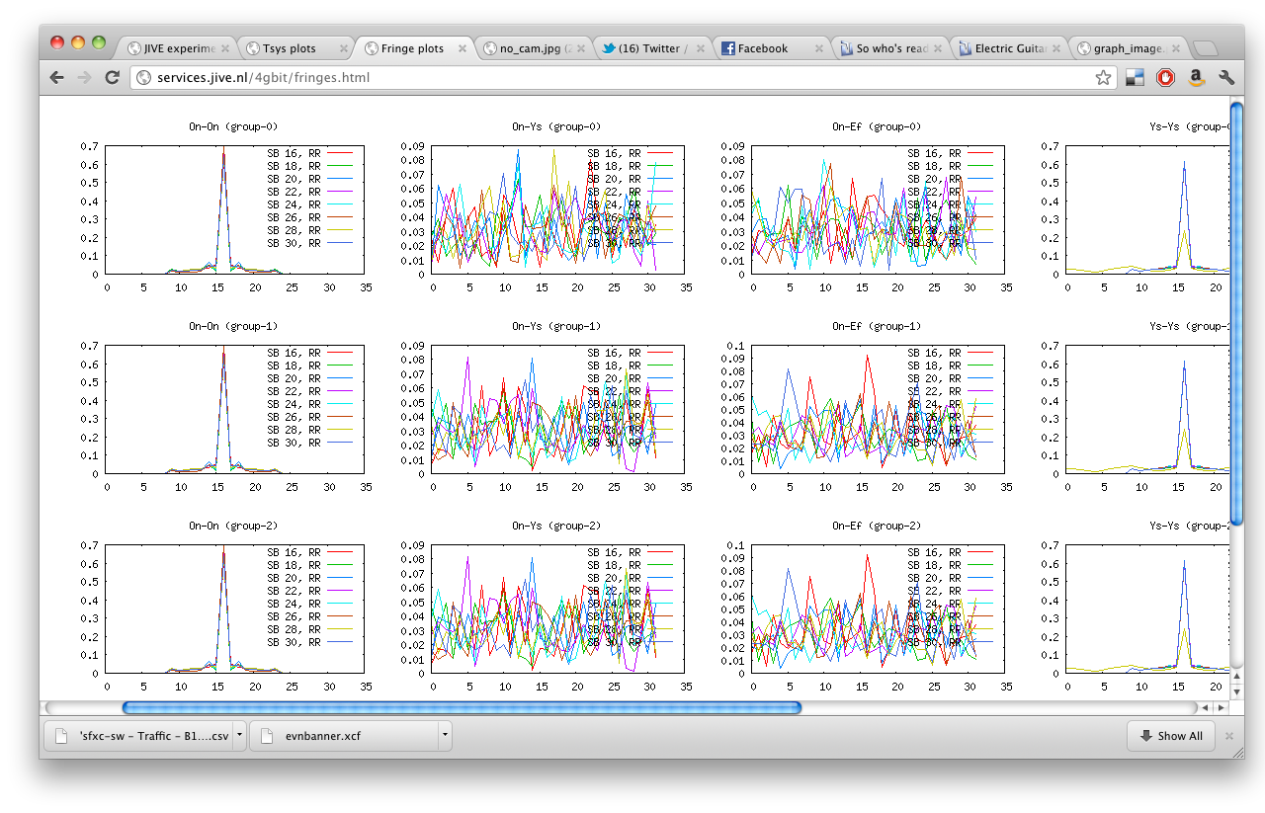
4 Gbps simultaneous recording/real-time

Slide 11
Who needs testing?
Early 2013: everything tested that could be tested
  But serious problems with production of Fila10G boards
Summer arrives
  Still no Fila10G
  No new firmware
  Ef under maintenance
  People go on vacation!!
Beginning of August: Hh joins the team
  But equipment needed, LO setting
End of August: new firmware!!
  Only Mh available for tests
Two weeks before demo: Fila10G arrives at On
Friday before demo: Fila10G at Ys, HarroBox and networking equipment arrive at Hh
Monday September 16: first opportunity EVER to run setup with real telescopes
  At end of day: fringe Mh – Ys, 16Gbps into JIVE
Director of JIVE feels adventurous
  Proposes live demo, with fringes, during NEXPReS final review (September 2013)
  What could possibly go wrong…
Wednesday September 18: actual fringes….

Slide 12
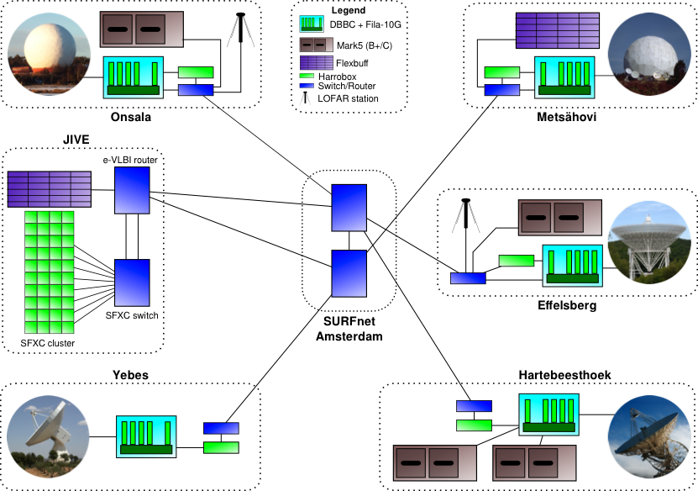
Final setup

Slide 13
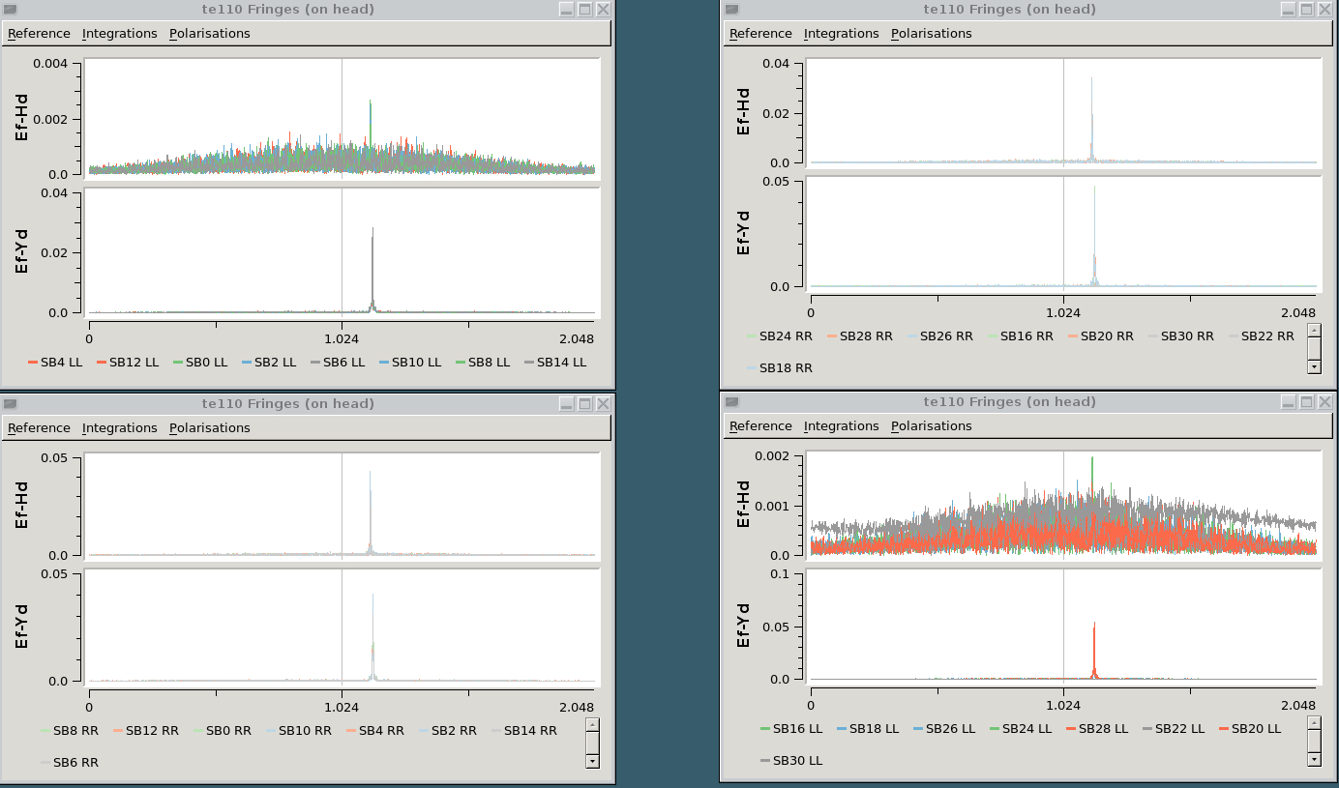
Result…..

Slide 14
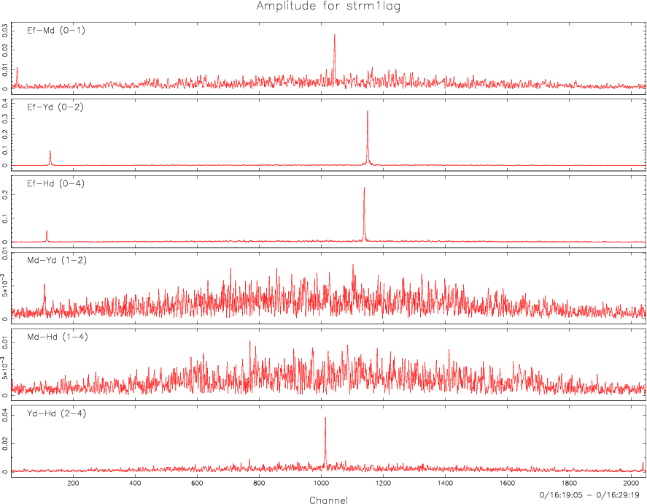
Result…?
EXCELLENT!!

Slide 15
SFXC Software correlator
Home grown
Now used for all correlation at JIVE
Increasing functionality:
  Pulsar gating/binning
  Multiple phase centers
  VDIF support
  Mixed bandwidth correlation
  Phased array mode
huib 08/06/10
Data from 2008 NME C band 10 stations
/28

Slide 16
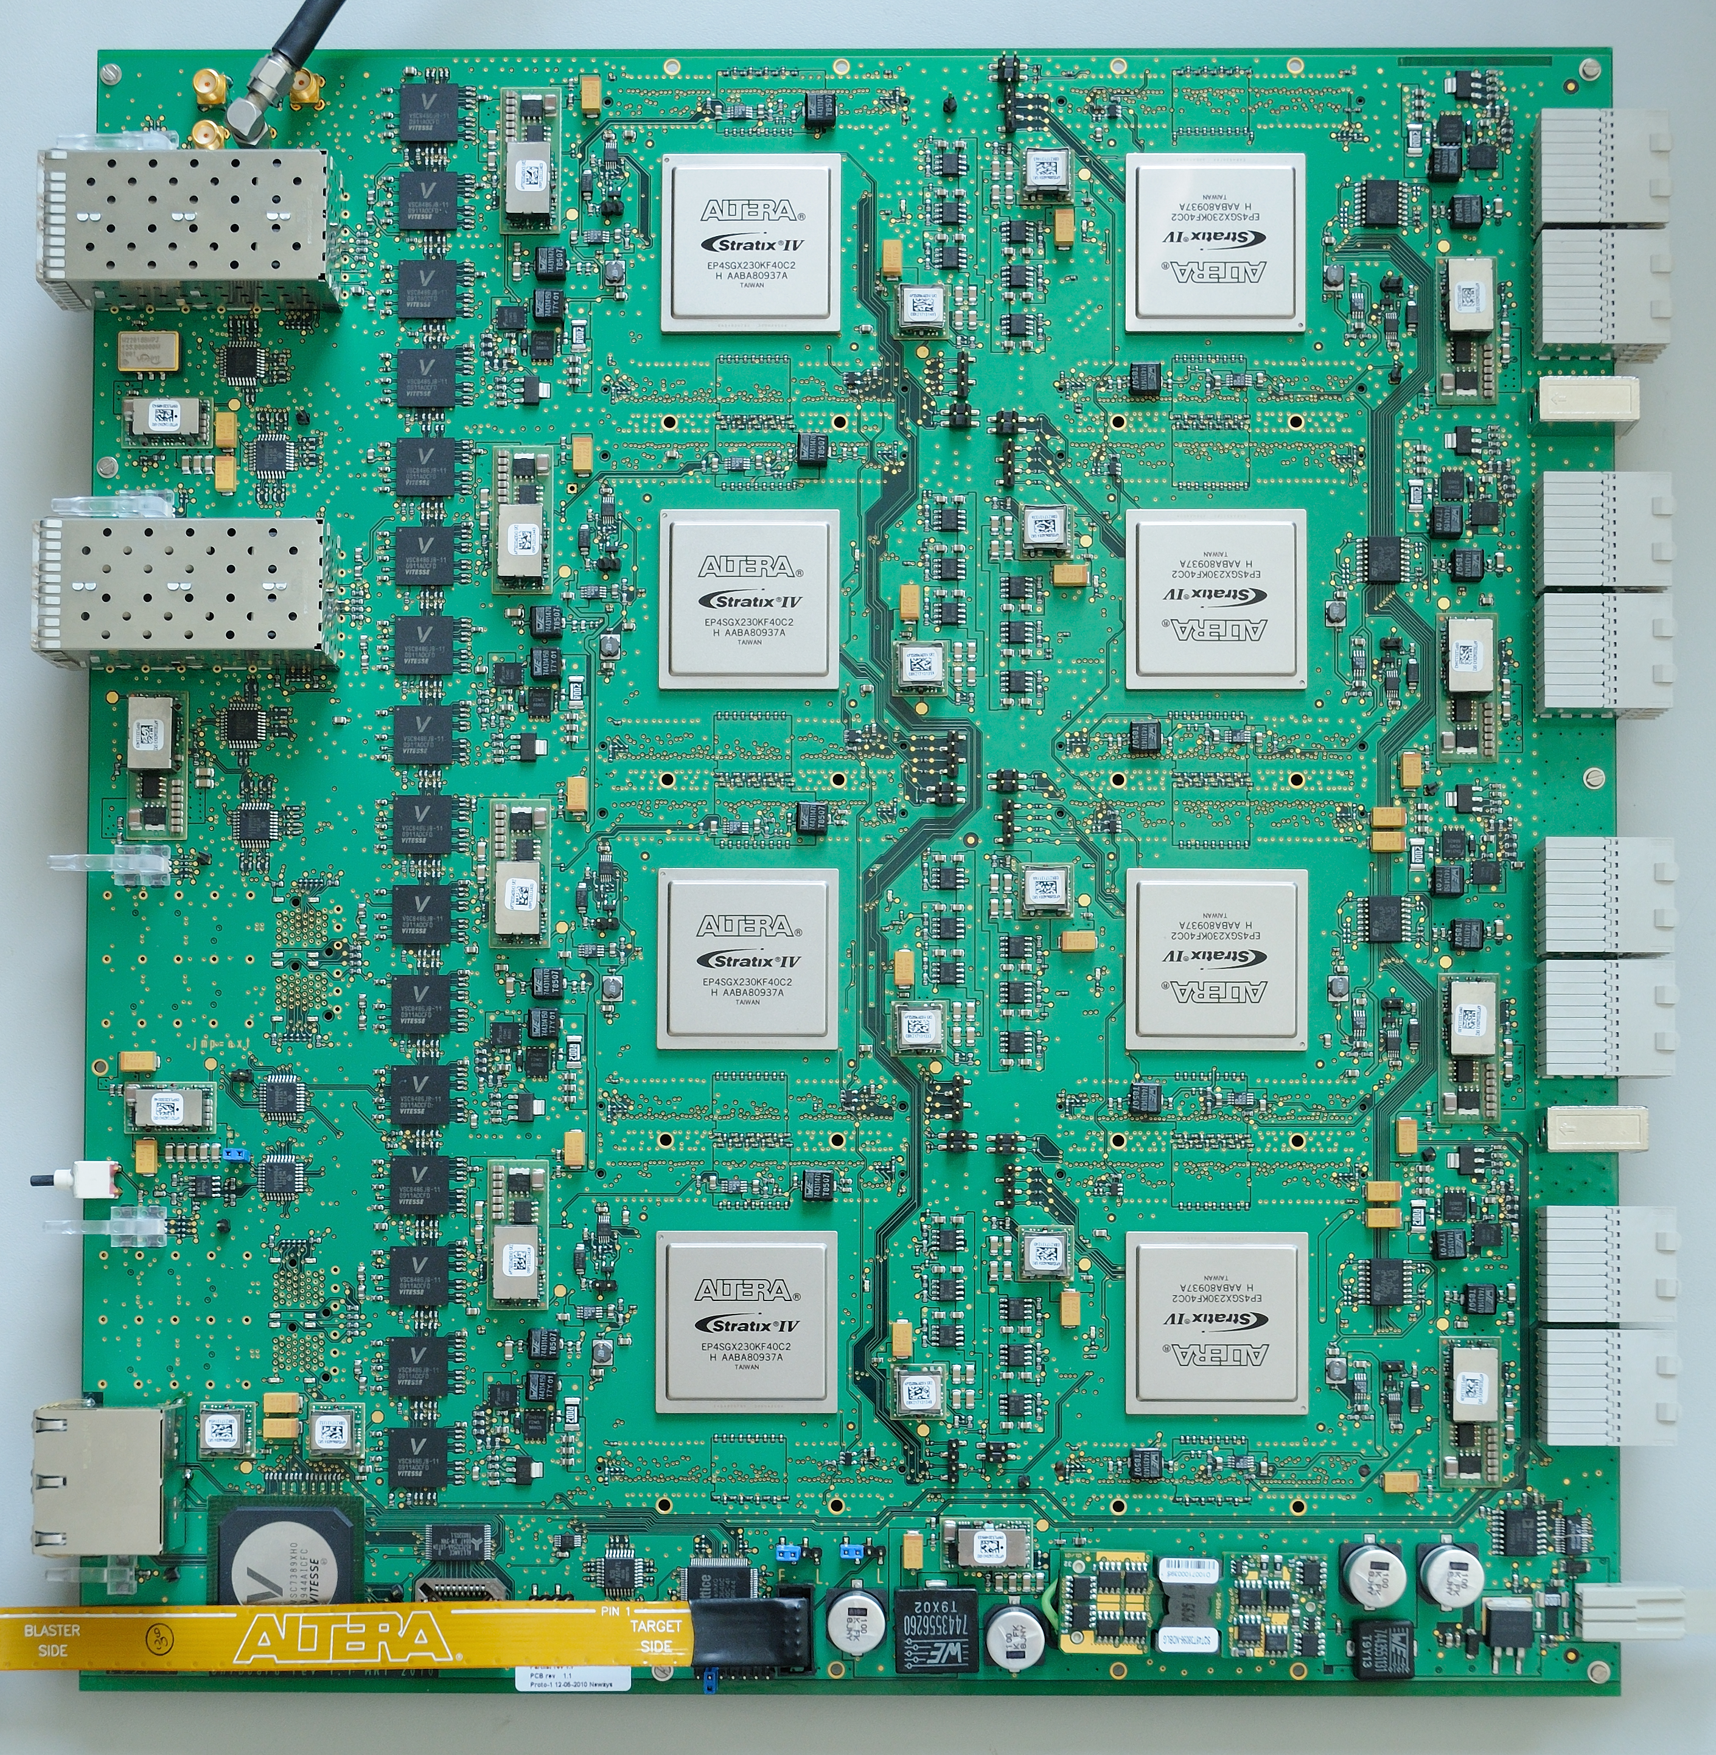
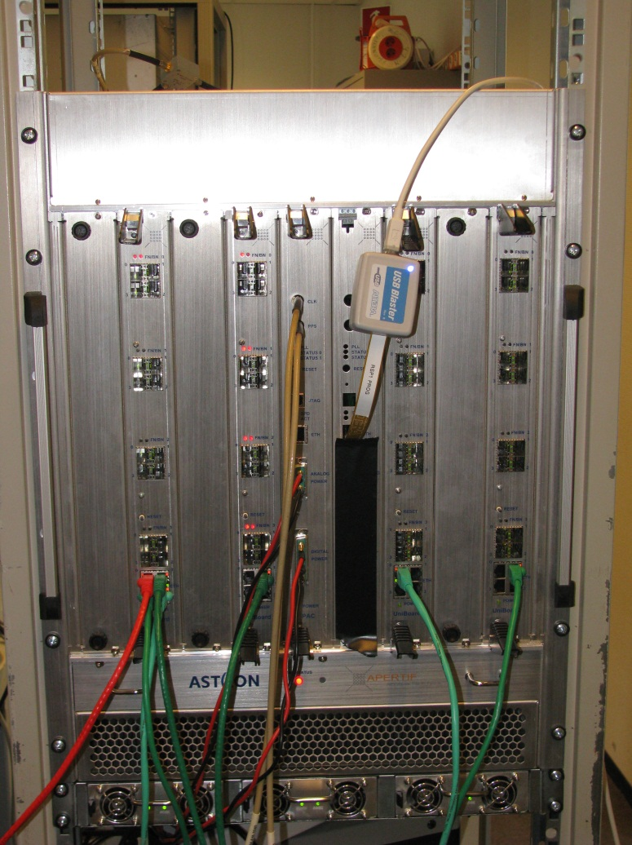
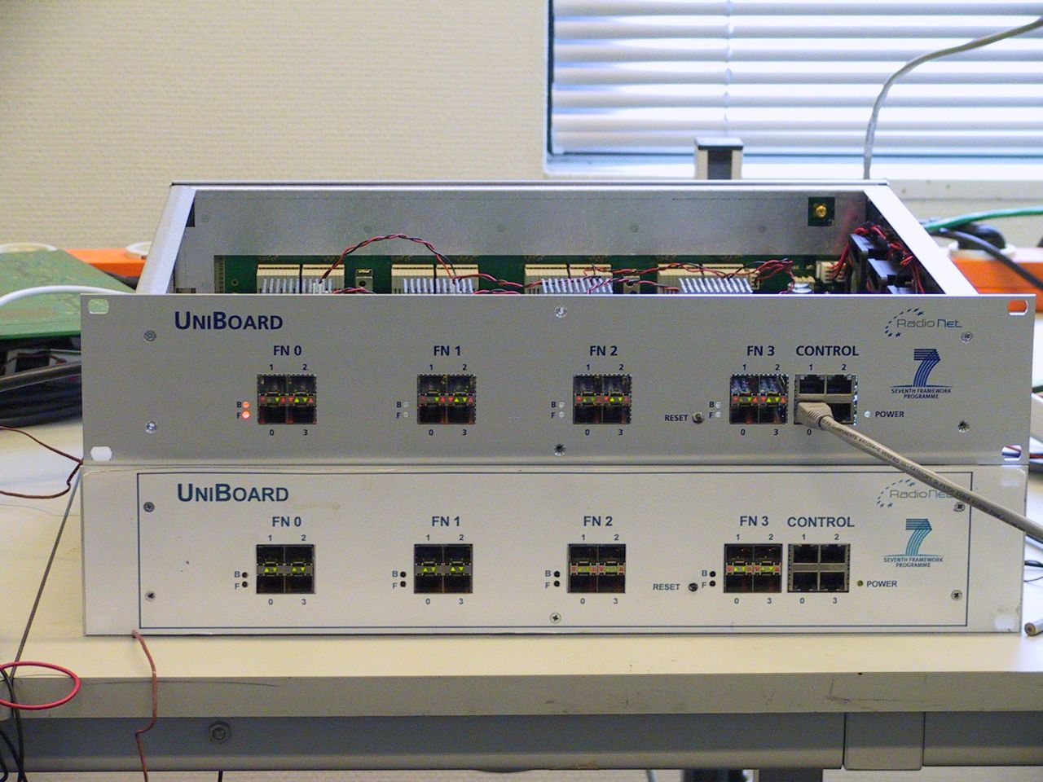
FPGA-based UniBoard Correlator
EC-funded, JIVE-led project
  Create generic, high performance computing platform for radio astronomy
One board roughly equivalent to MarkIV hardware correlator
  At 350 Watt power consumption…
UniBoard² considered in several SKA work packages
huib 08/06/10
/28

Slide 17
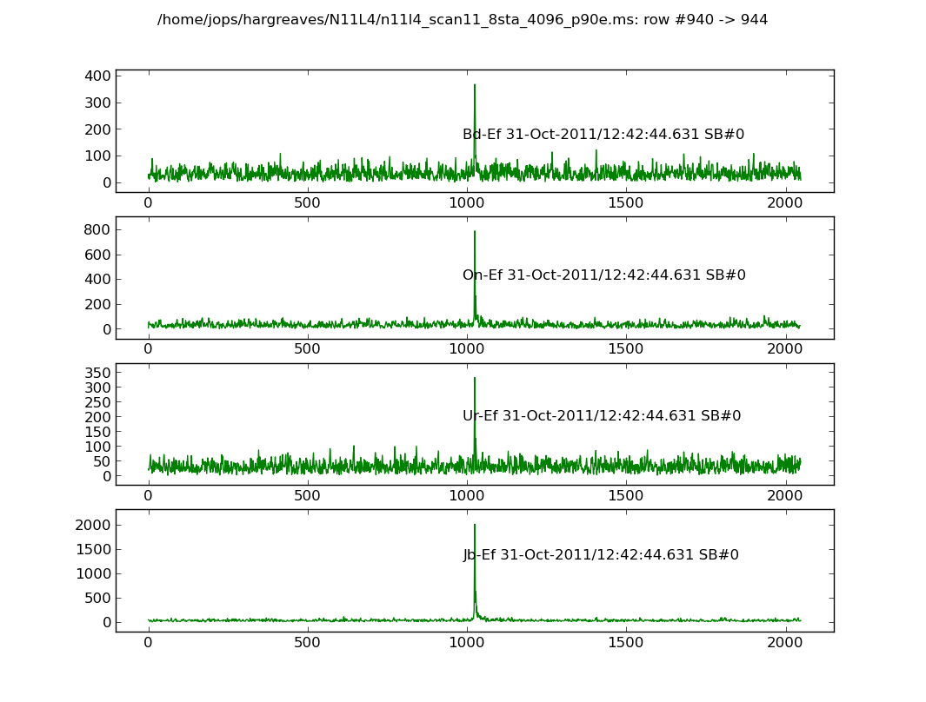
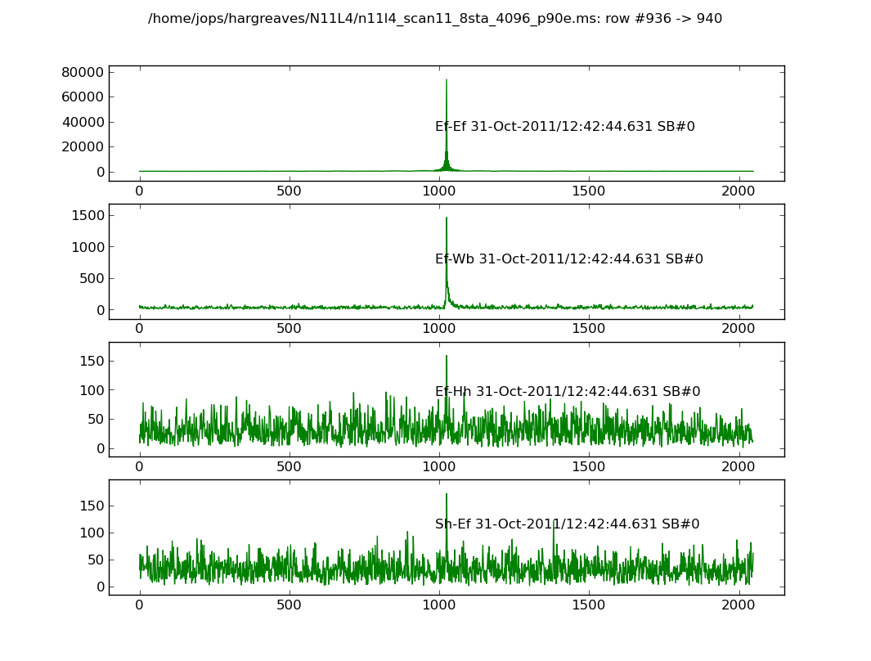
FPGA-based UniBoard Correlator
Real results
Close to commissioning
huib 08/06/10
/28

Slide 18
UniBoard²: picking up steam
Prototype on 20nm
Production on 14nm
Focus on AAlow beamforming
Mesh and memory and QSFP on break-out board
huib 08/06/10
/28

Slide 19
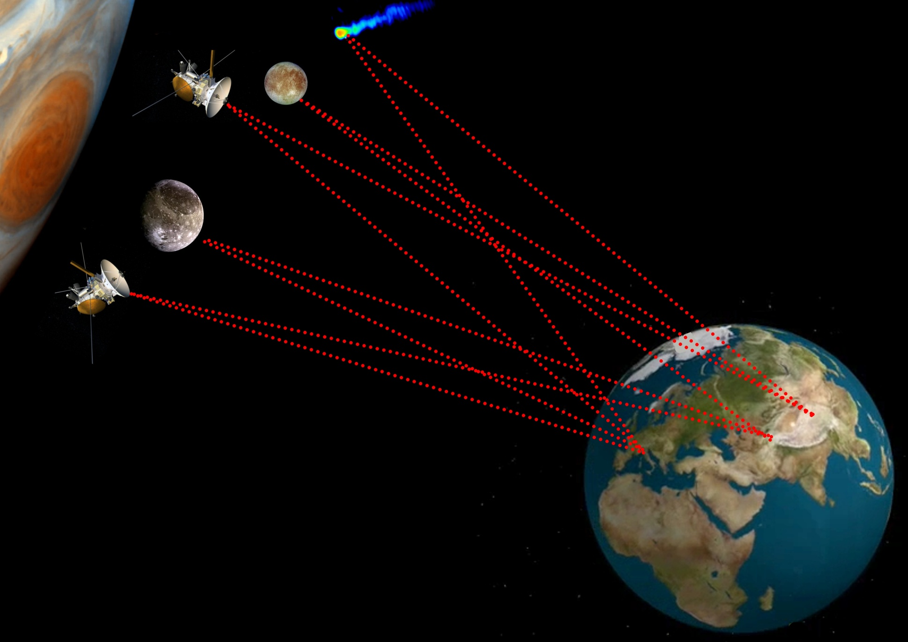

Space science VLBI: PRIDE
PRIDE: a multidisciplinary enhancement of the mission science return with minimum on-board instrumentation
Planetary
Radio
Interferometry &
Doppler
Experiment

Slide 20
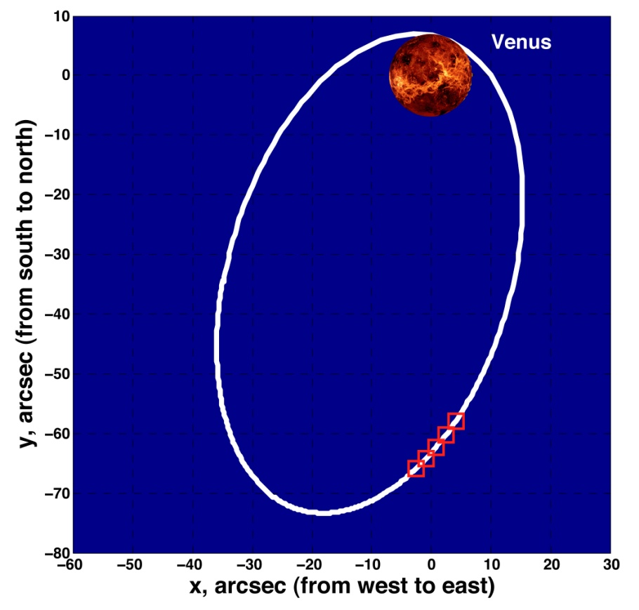
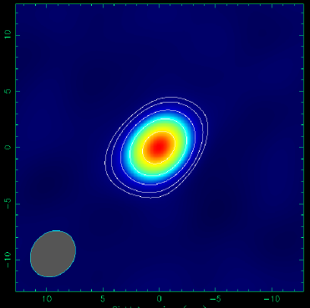
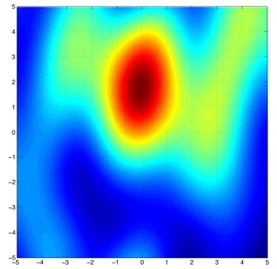
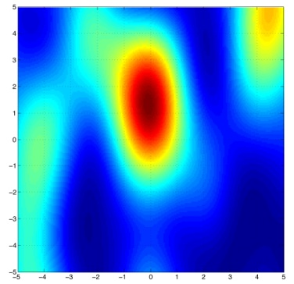
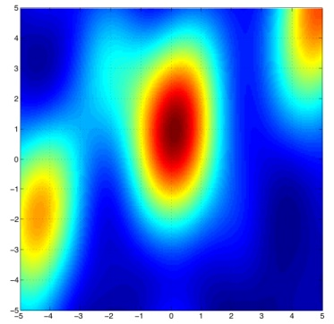
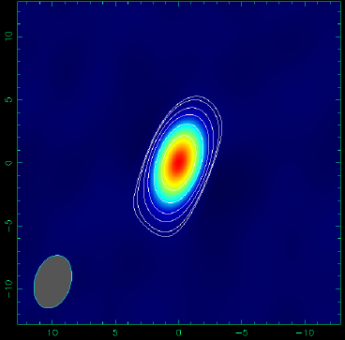
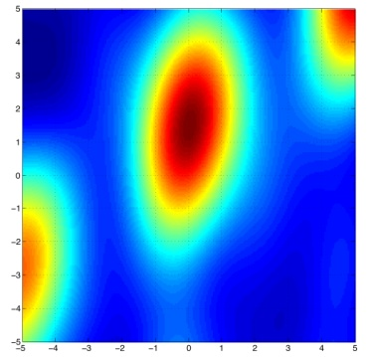
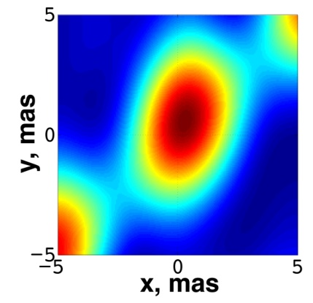
PRIDE in practice
8.4 GHz
2011.03.28
09^{h}05^{m} TDB
09^{h}30^{m} TDB
-10 dec, mas +10
09^{h}55^{m} TDB
10^{h}20^{m} TDB
10^{h}45^{m} TDB
-10 RA, mas +10
-10 RA, mas +10
EM081c: On, Wz, Mc, Ma, Ys, Mh, Sv, Zc

Slide 21

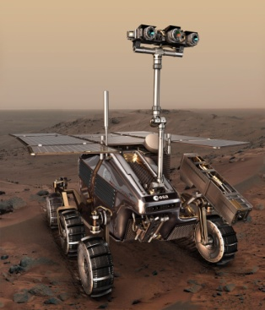
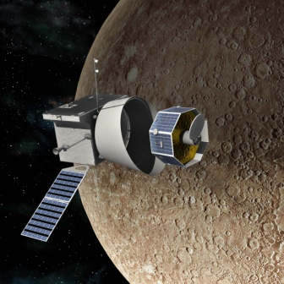
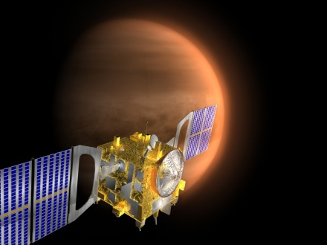
ESA planetary missions – VLBI “customers”
JUICE-Laplace
Selected by ESA
in Feb 2013
MarcoPolo-R
(asteroid sample return)
ExoMars
Subject of selection
in 2013
2025
BepiColombo
MMO
2020
Special consideration by
ESA, NASA, RFSA
2015
VenusExpress &
MarsExpress
Operational or firmly on track for launch
2010

Slide 22
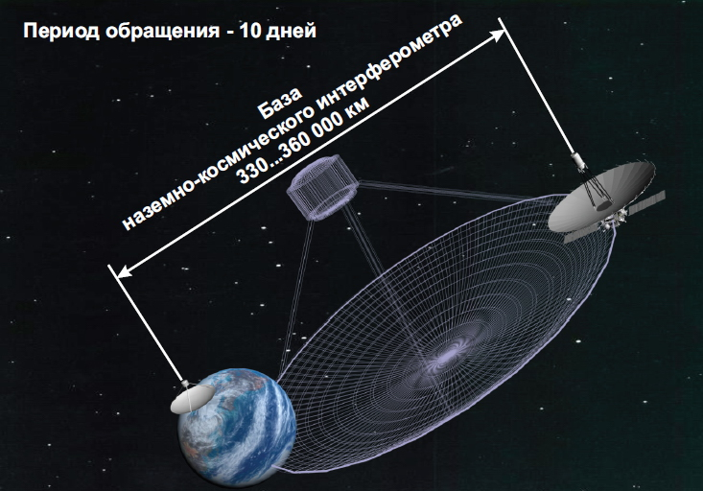
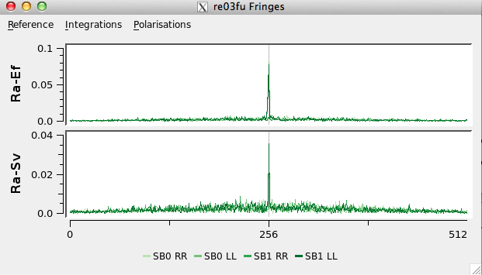
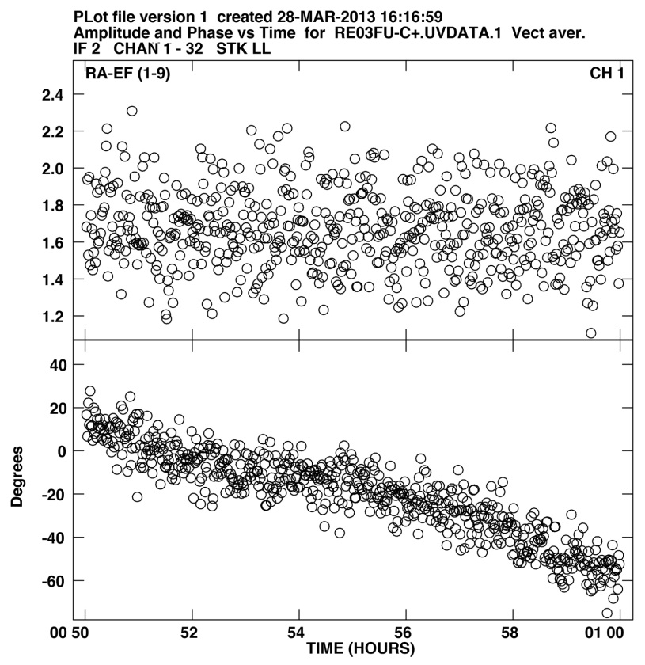
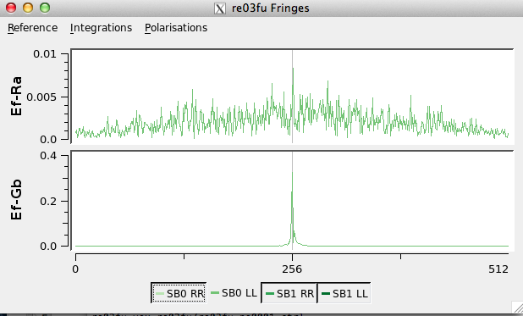
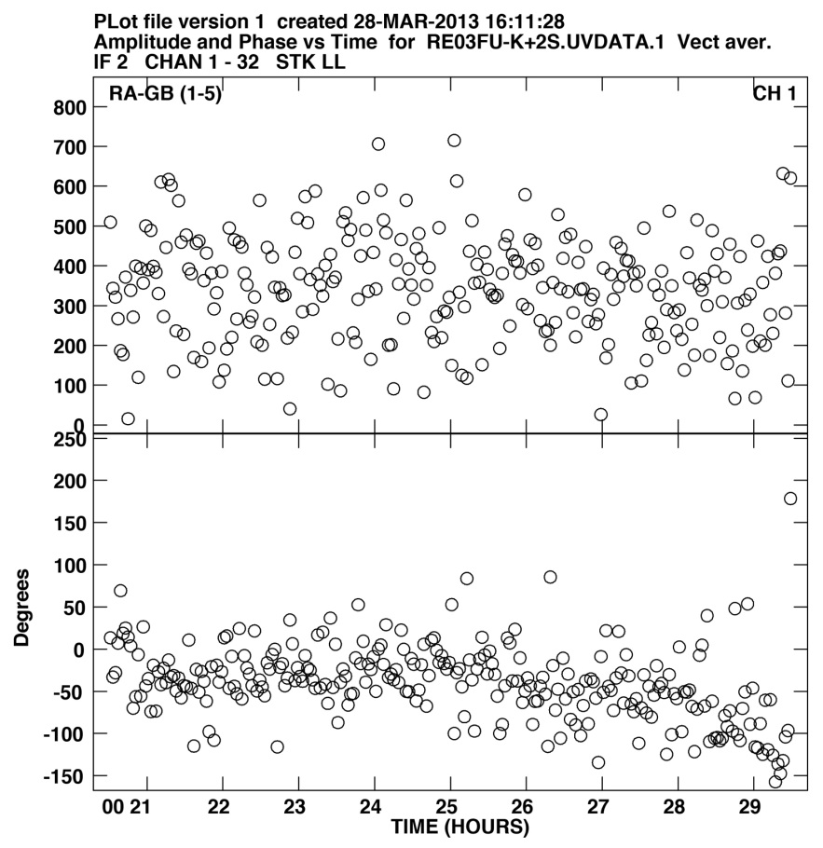
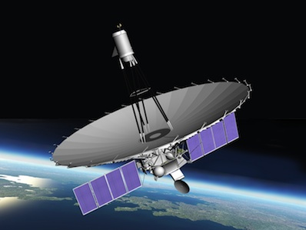
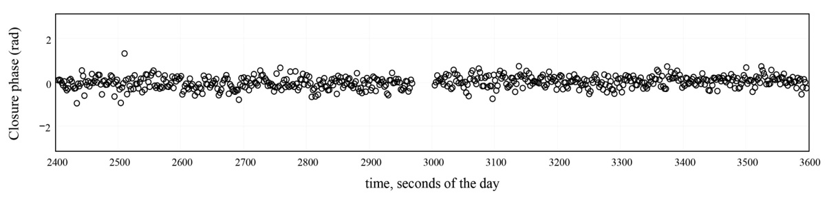
RadioAstron fringes on SFXC at JIVE
5 GHz
22 GHz
0716+714
B ≈ 2.5 D_{Earth}
huib 08/06/10
Closure phase
/28

Slide 23
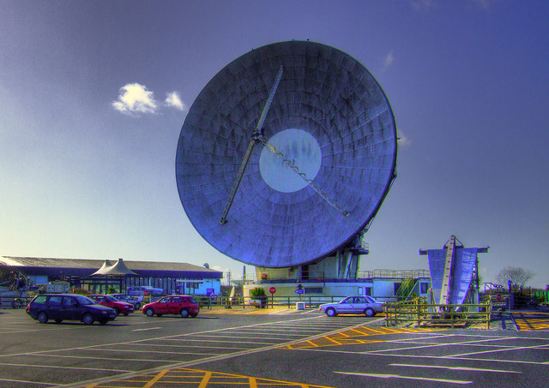
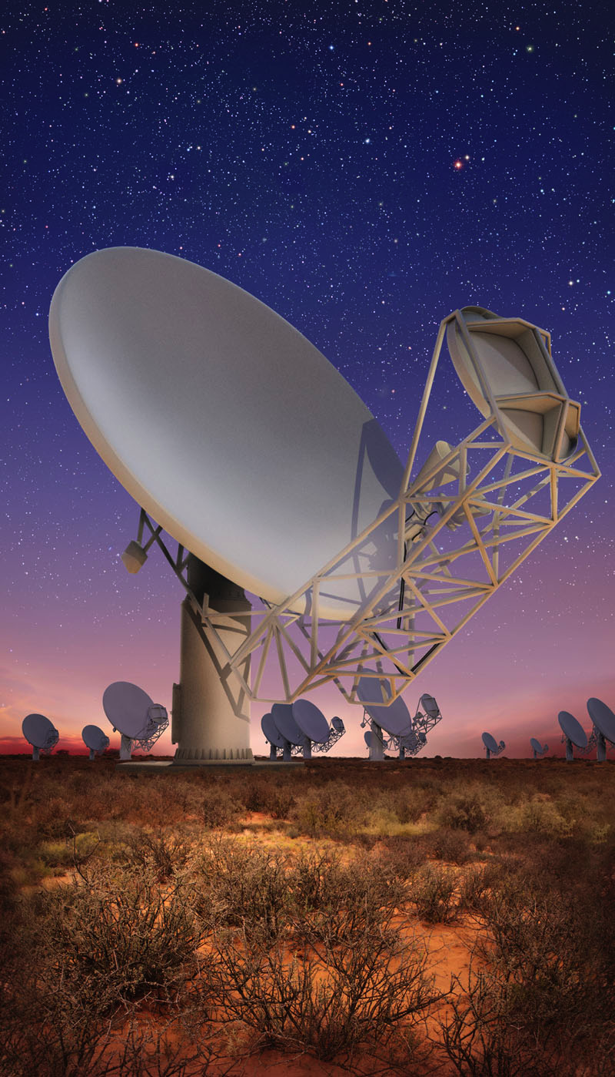
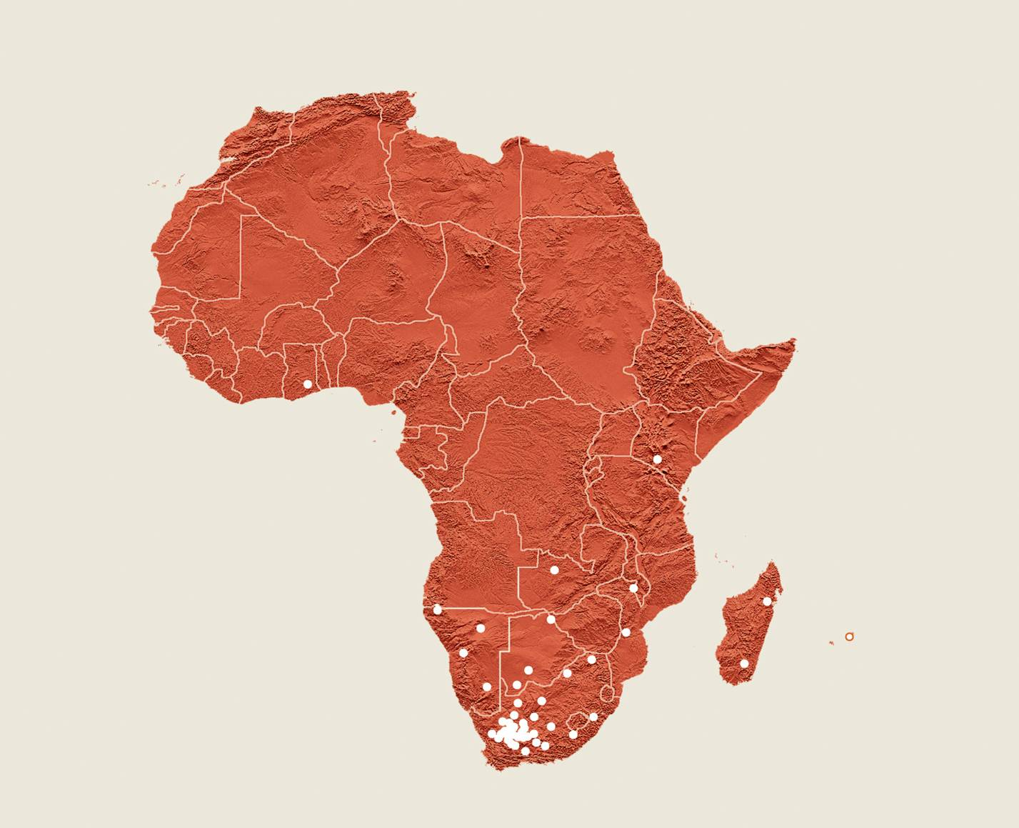
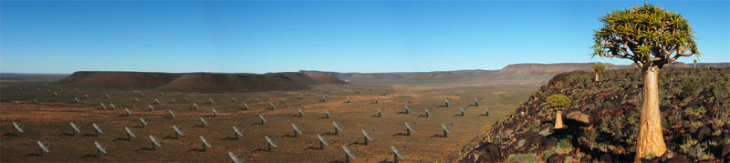
Re-cycling of telco dishes
Many 32 m telecom dishes are being scrapped
Some functional, well maintained
  But need major refurbishing
Interest in astronomical community: UK, New Zealand, South Africa
Up to 26 dishes spread across the African continent: immediate connection to European VLBI
May become part of EU – Africa collaborative project
Notes:
TODO: check connection path
TODO: picturs

Slide 24
The future….
Just about to happen…..
Digital Base Band Converters becoming operational in EVN
  Opening the way for 2Gbps, 4Gbps, …..
Automated triggered observations (EVN-light?)
BoD standard to be implemented by NRENs
100Gbps technology rolled out
KVN will become member of EVN
KVAZAR telescopes should get high-speed connectivity any moment
New Shanghai and Sardinia telescopes nearly operational
KAT7 participation in first (e)VLBI with EVN
e-Merlin getting ready to re-join the e-EVN
Disk-less operations in EVN (Mh, On, others?)
Notes:
TODO: check connection path
TODO: picturs

Slide 25
The future….
And further along
More telescopes, higher sensitivity
Clocks, frequency via public networks?
1 APERTIF beam of 12 WSRT dishes each added to EVN
VLBI with ALMA, MeerKAT, African VLBI Array, SKA,…
Notes:
TODO: check connection path
TODO: picturs

Slide 26
